Slide 1




МОЛЕКУЛЯРНЫЙ КИСЛОРОД И ЕГО ВЗАИМОДЕЙСТВИЕ С ТЕТРАПИРРОЛЬНЫМИ МАКРОЦИКЛАМИ И НАНОАНСАМБЛЯМИ НА ИХ ОСНОВЕ
Э.И. Зенькевич
Белорусский национальный технический университет, Минск, Беларусь
Institute of Physics, Technische Universität Chemnitz (Chemnitz, Germany)
Fraunhofer Institute for Electronic Nano Systems (Chemnitz, Germany)
Аккредитованный эксперт Российской корпорации РОСНАНО (Москва, Россия)
Minsk

Slide 2
Singlet Oxygen Generation (Energetic Scheme)
Quenching of T₁-state of the organic molecule (³M₁) may take place in the collision complex:

Slide 3
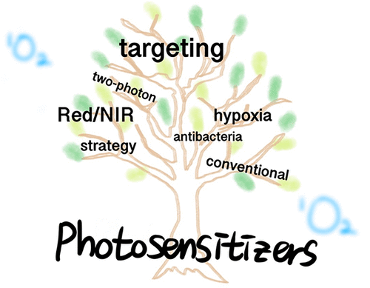
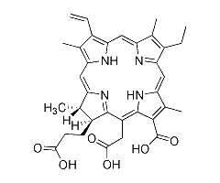
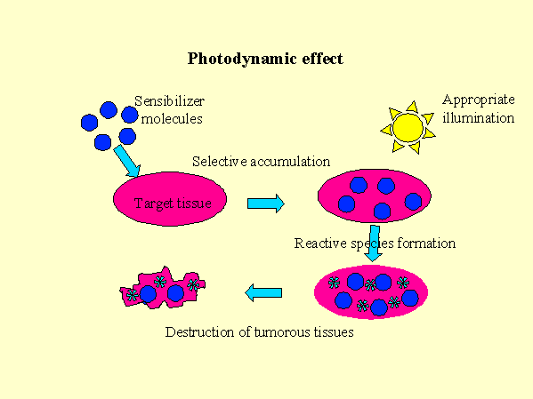
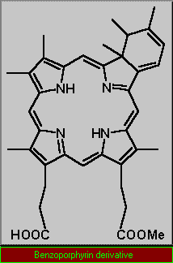
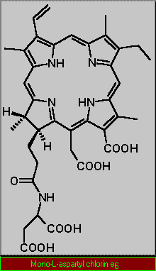
Международный проект INTAS № 93-2810 «Фотосенсибилизаторы для фотодинамической терапии на основе хлорофилла и бактериохлорофилла»
(Институт физики им. Б.И. Степанова НАН Беларуси, Минск, Беларусь; Колледж Королевы Марии, Лондон, Англия; Московская академия тонкой химической технологии
Москва, Россия) (1994-1997 г.г.)
E. Zenkevich, E. Sagun, V. Knyukshto, A. Shulga, A. Mironov, O. Efremova, R. Bonnett, S. Pinda Songca, M. Kassem. Photophysical and photochemical properties of potential porphyrin and chlorin photosensitizers for PDT. - J. Phochem. Photobiol. B: Biol. (1996) 33, p. 171-180 (April 2022 – Citation index 215).

Slide 4
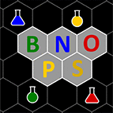
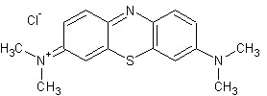
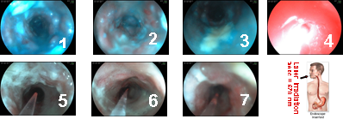
At the moment, methylene blue (MB) is a widely known histological dye that has been in use for many years. We have shown also that photophysical properties (especially efficiencies of singlet oxygen ¹Δ_{g} generation in water solutions) as well as diagnostics abilities of MB may be combined with its PDT efficiencies in precancerous lesions (stomach upper gastrointestinal tract) including even PDT treatment by simultaneously using of two PSs: Photolon (based on trisodium salt of chlorin e₆ and polyvinylpyrrolidone at the mass ratio 1:1) and MB

Slide 5
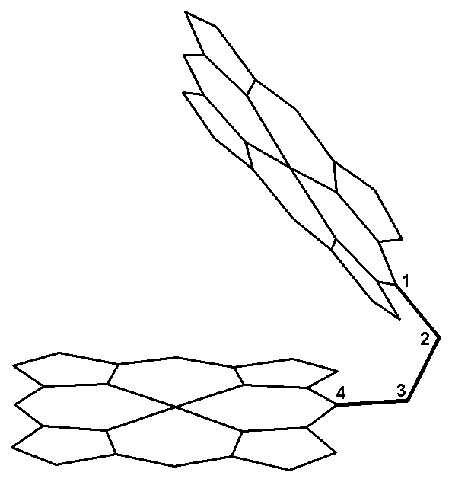
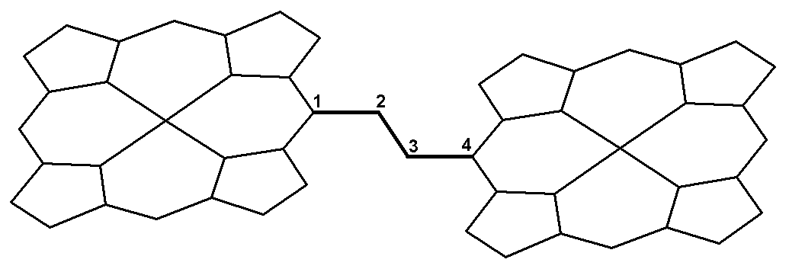

Химические димеры порфиринов и хлоринов
Schwarz, F. P., Gouterman, M., Muljiami, Z., and Dolphin, D. (1972) Energy transfer between covalently linked metal porphyrins, Bioinorg. Chem., 2 (2), 1-32.
Bogatskii A.V., Zhilina Z.I. . Sterically Hindered Porphyrins. Russian Chemical Reviews , 1982, 51, 592–604 (Data on the chemistry of sterically hindered porphyrins as well as dimeric and trimeric porphyrins are examined and described systematically.
Э.И.Зенькевич, А.М.Шульга, Е.И.Сагун, Г.П.Гуринович. Спектрально-люминесцентные свойства ковалентно-связанных молекул (димеров) порфиринов. - Материалы ХIХ Всесоюзн. съезда по спектр-пии, часть III “Спектроскопия сложных молекул” (1983) г.Томск, 102-104.
Г.П.Гуринович, Э.И.Зенькевич, Е.И.Сагун, А.М.Шульга. Спектрально-люминесцентные свойства и энергетика ковалентно-связанных димеров некоторых порфиринов. - Опт. и спектр. (1984) 56, No 6, 1037-1043
Ponomarev H.V., Shulga A.M. Chemistry of Heterocycl. Compounds (in Russian) 1986, No 2, 278— 279.
Shulga A.M., Ponomarev H.V. Chemistry of Heterocycl. Compounds (in Russian) 1988, No 3, 339— 344.
Ponomarev G.V., Borovkov V.V., Sugiura K., Sakata Y., Shulga A.M. Tetrahedron. 1993, 34, No 13, 2153 – 2156.
Zenkevich E.I., Shulga A.M., E.I. Sagun, Gurinovich G.P., Chernook A.V. Teubner-Texte fuhr Physik, Band 4. Leipzig. BSB B.G.Teubner Verlagsgesselschaft. 1985, 297-300.
Zenkevich E.I., Shulga А.М., Chernook A.V., Gurinovich G.P. Spectral peculiarities of NH-tautomerism in isocycle containing porphyrins and their covalently linked dimers. Chem. Phys. Lett. 1984, v. 109, No 3, p. 306-311.
Gurinovich G.P. Zenkevich E.I., Sagun E.I., Shulga А.М. Optics and Spectrosc. 1984, 56, No 6, 1037-1043.
Ме
Me
Fully staggered
Zn
Zn
Fully eclipsed
Этан-биспорфирины
Этан-бисхлорины
Zn
Zn
Zn
Zn
Ме
Ме
(ZnOEP)₂-Ph
Циклодимеры
Димеры с фенильным спейсером

Slide 6
ZnOEP-СН₃
Химические димеры и исходные мономерные аналоги (27 соединений)
Свободные основания, ZnP-H₂P
Zn-Zn, Zn-Cu, Cu-Cu
Структура, спектральная «чистота», коэффициенты экстинкции, конформационная динамика –ЯМР, HyperChem
CuP-H₂P, ZnP-CuP: Gouterman (1972) Govingjee (1978) - Our (1984 – low T) – Asano Someda (1988-2003)
Zn
Zn
Zn
Zn
ZnOEChl-СН₃
Zn
Zn
(ZnOEP)₂
(ZnOEChl)₂
Zn
Zn
Zn
Zn
ZnHTPP
ZnOEP-Ph
(ZnOEP)₂-Ph
Zn
Zn
Zn
Zn
Zn
Zn-3¹,5¹-Cyclodimer
(ZnHTPP)₂
ZnOEP-Cycle=СН₂

Slide 7
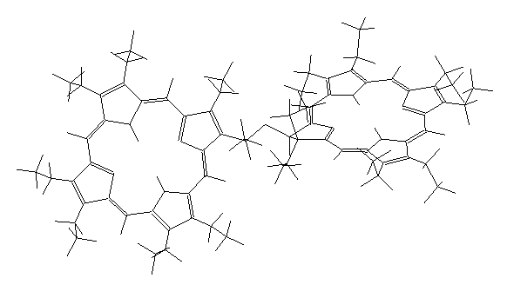
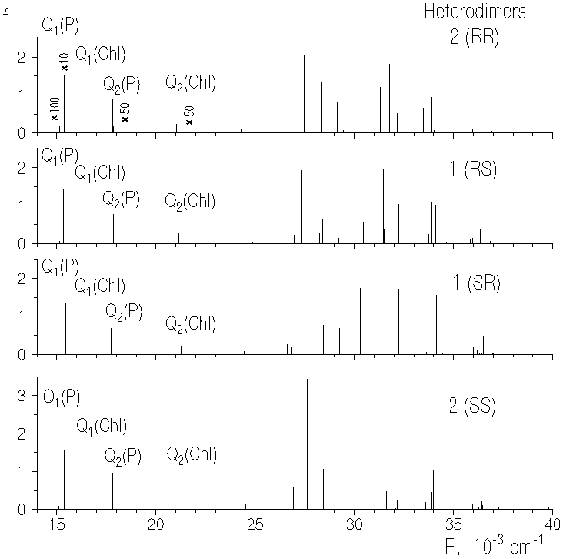
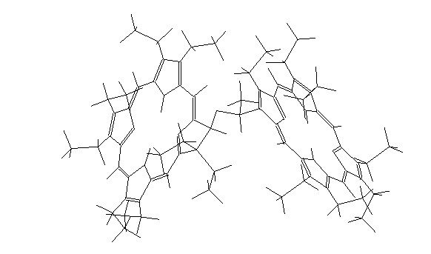
E.I. Zenkevich, V.N. Knyukshto, A.M. Shulga, V.A. Kuzmitzkii, V.I. Gael, E.G. Levinson and A.F. Mironov. Spectroscopy and photophysics of covalent ether-bonded porphyrin-chlorin heterodimers - J. of Luminescence (1997) v. 75, No 3. p. 229-244
Two possible alternative mechanisms may be account for the observed emission quenching the P subunit in the P-(CO)-Chl system: charge (electron) transfer (CT) or electronic excitation energy transfer (EET).
For the P-(CO)-Chl heterodimer 2 the dynamics of singlet-singlet nonradiative EET is appropriately described by the Forster-Galanin inductive-resonant mechanism without any additional assumptions. On the base of the preliminary analysis of the experimental and theoretical data for the heterodimer 1 we guess that this theory is still applicable to this system too, but the EET processes are faster in the comparison with the former case due to the closer proximity of interacting π macrocycles.

Slide 8
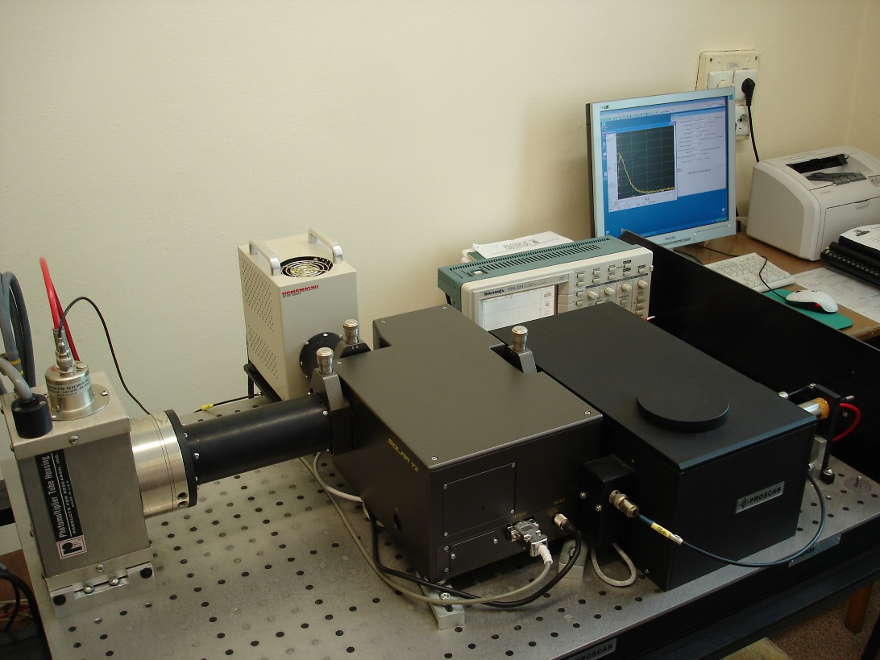
Singlet Oxygen Generation (Home-Made Registration Set-up)
A
FMA
О2
МВА
ОС
F
K
Monochromator
О
F1
1
FD
2
C
А
Laser
M
Highly sensitive laser NIR spectrometer (laser excitation at λexc =531 nm, registration range of 950÷1400 nm, detection system is based on PMT Hamamatsu Н10330-45, experimental response Δt_{1/2} = 1 ns, time correlated single photon counting mode.
Stasheuski, Galievsky, Sagun, Knyukshto, Zenkevich, von Borczyskowski. Singlet Oxygen Generation by Semiconductor Quantum Dots and Nanocomposites “Quantum Dots-Porphyrins” // Book of Abstracts of the XII International Conference on Laser Applications in Life Sciences (LALS-2010). Finland, Oulu, June 9-11, 2010.
Stasheuski, Galievsky, Sagun, Knyukshto, Zenkevich, von Borczyskowski. Singlet Oxygen Generation by Semiconductor Quantum Dots and Nanocomposites “Quantum Dots-Porphyrins” // Book of Abstracts of the XII International Conference on Laser Applications in Life Sciences (LALS-2010). Finland, Oulu, June 9-11, 2010.

Slide 9
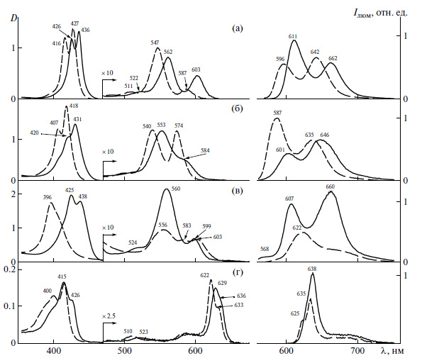
Проявление экстра-лигандирования в спектрах димеров порфиринов и хлоринов
(Zn-димеры и пиридинатные комплексы)
Поглощение
Флуоресценция
Zn
Zn
(ZnHTPP)₂
Zn
Zn
(ZnOEP)₂-Ph
Zn
Zn
(ZnOEP)₂
Zn
Zn
(ZnOEChl)₂

Slide 10
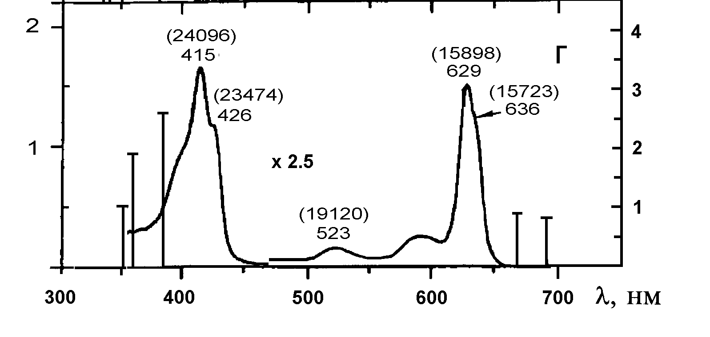
Характеристики симметричных химических димеров порфиринов
Экситонное расщепление
Excitonic splitting of Q-bands in ZnOEChl dimers
Е
λ
Полоса Соре, толуол, 295 К
Красный - мономер ZnOEP-мезоPh
Чёрный - димер ZnOEP-Ph-ZnOEP
Образование симметричных химических димеров порфиринов и хлоринов приводит к:
(а) батохромному смещению спектра поглощения (λ),
(б) сопровождается в ряде случае экситонным расщеплением (E) В- и Q-полос поглощения,
(в) межхромофорные взаимодействия практически не влияют на свойства и фотофизические характеристики (_{S,T}, B_{фл.}, _{T}, φ_{фосф.}) возбужденных S₁- и T₁-состояний хромофоров (отсутствует концентрационное тушение люминесценции).
.

Slide 11
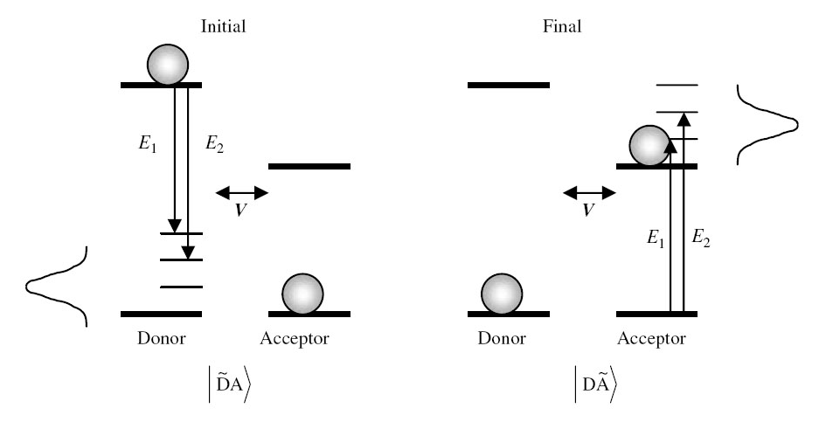
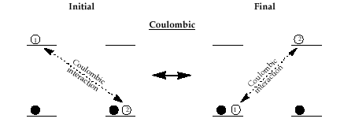
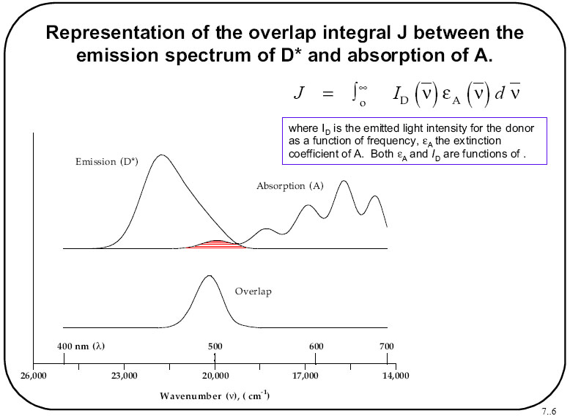
Индуктивно-резонансный перенос энергии электронного возбуждения
(Foerster Model)
D*A
DA*
R_{DA}
μ_{DA}
μ_{DA}
Orientation factor:
k²=[Cos(μ_{D}, μ_{A}) - 3 Cos(μ_{D}, R_{DA})⋅ Cos(μ_{A}, R_{DA})]²

Slide 12
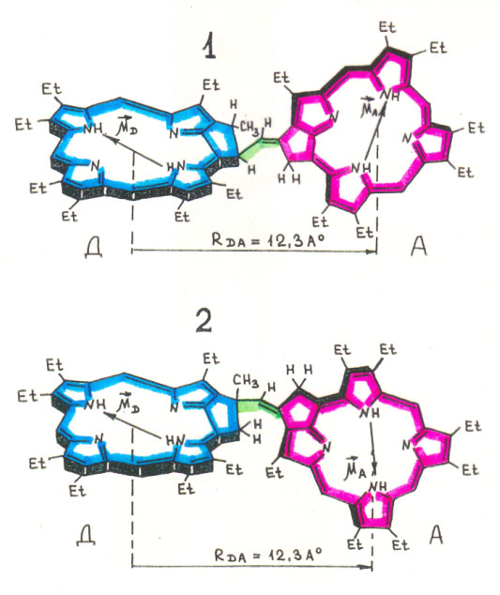
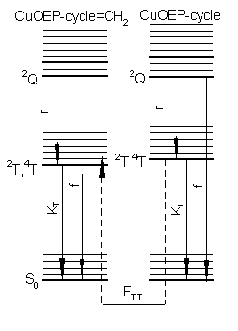
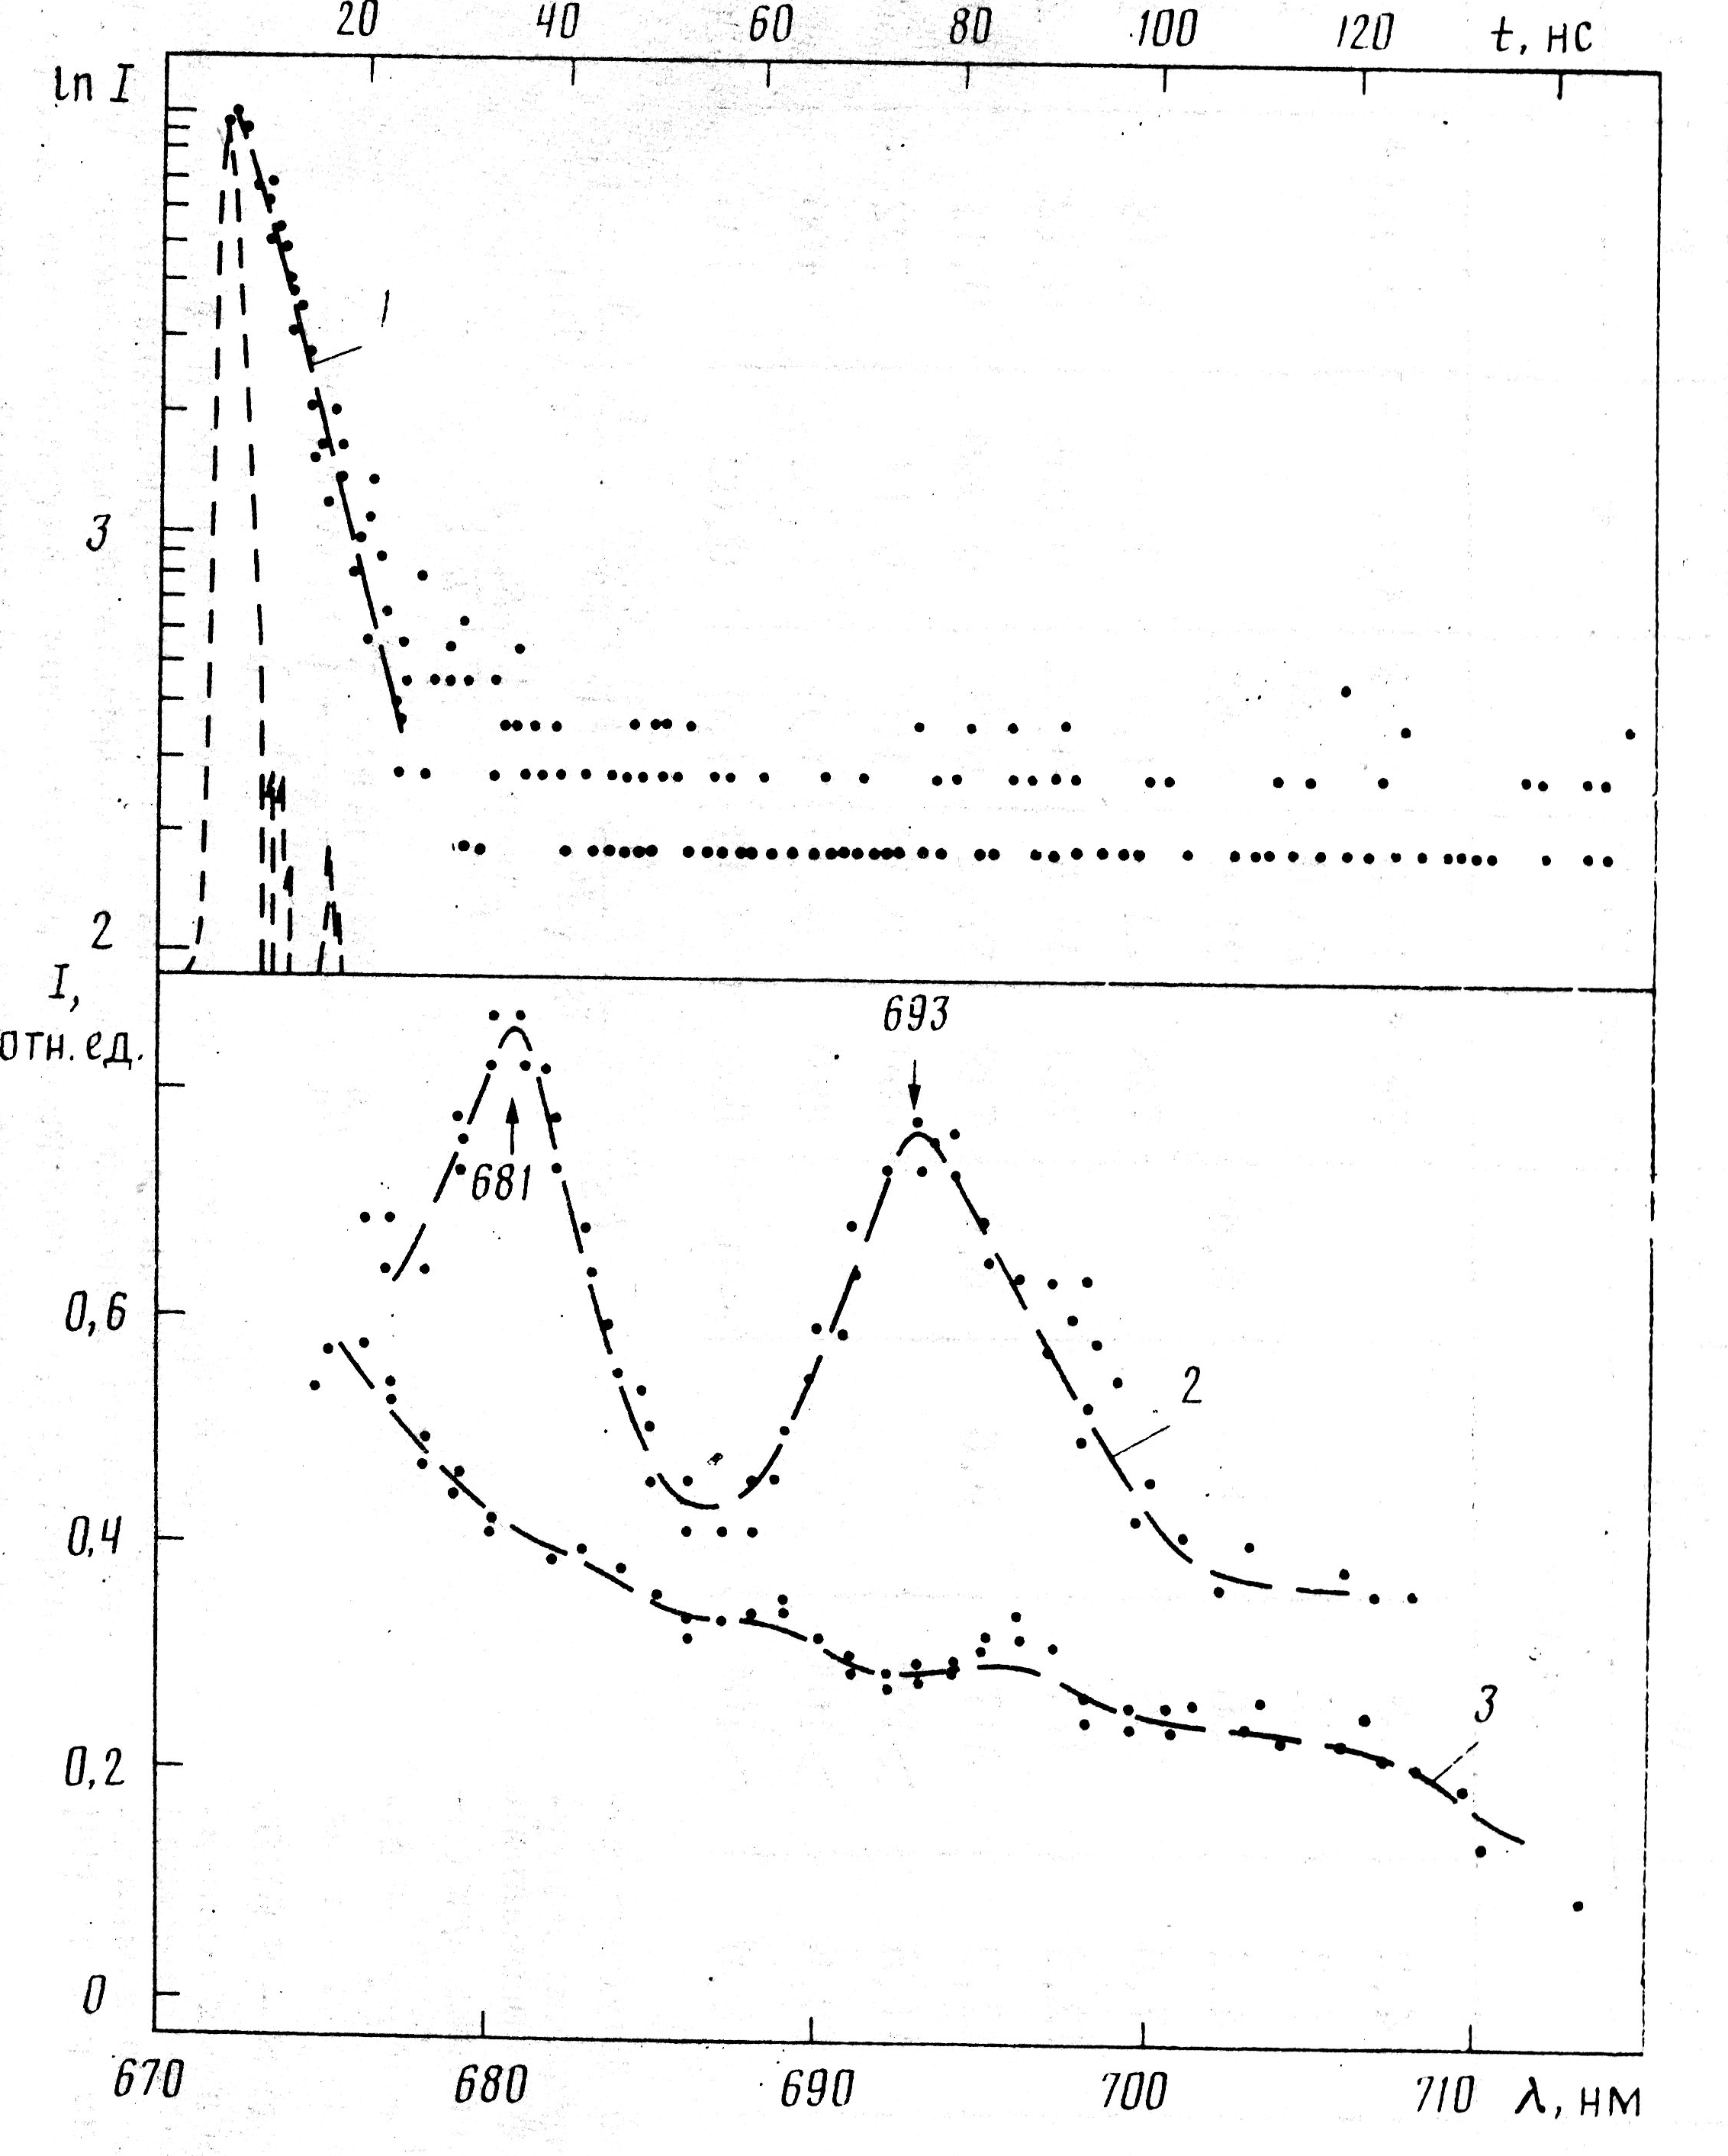
Перенос энергии возбуждения по триплетным уровням в химических димерах Сu-циклопентанпорфиринов при 77 К
N
Обменно-резонансный перенос энергии (Декстер)
(K_{ТТ-ЕT}) ∝exp(-2R/L)
N
Cu
Cu
N
N
D
A
Cu-3¹,5¹-Cyclodimer
77 К, ТГФ+Толуол Т
Тушение фосф. D в 70 раз τ_{D}⁰ = 0.18 мкс → τ_{D} = 5 нс
τ_{A} = 0.19 мкс
(K _{ТТ-ЕT})_{эксп} = 5×10⁶ с⁻¹
При временах задержки θ = 3.8 нс в «мгновенных» спектрах фосфоресценции димера полоса свечения D сравнима с полосой свечения А.

Slide 13
Непланарные деформации химических димеров ОЭП с фенильным спейсером в триплетном состоянии (20 соединений)
E
t
E
t
E
E
t
t
N
N
H
N
H
N
Zn
E
Zn
t
E
t
E
E
t
t
R
R
1
2
(ZnOEP)₂-Ph
N
N
r
1
d
d
Compound | τ _{S}, ns 295 К | ϕ _{F} 295 К | τ _{T}, ms 77 К | τ^{о}_{T}, μs 295 К | γ _{T} | γ _{Δ}
OEP | 12,4 | 0,09 | /21 | 1200 | 0,80 | 0,75
OEP-Ph | 11,2 | 0,05 | 14,5 | 4,0 | 0,78 | 0,54
(OEP)₂-Ph | 8,2 | 0,06 | -- | 2,45 | 0,95 | 0,26
ZnOEP-CH₃ | 1,6 | 0,03 | 31 | 1200 | 1,0 | 0,85
ZnOEP-Ph | 1,5 | 0,03 | 25 | 5,8 | 0.9 | 0.78
(ZnOEP)₂-Ph | 1,2 | 0,02 | 16,6 | 2,85 | ∼ 1.0 | 0.3
(ZnHTPP)₂ | 1,5 | 0,02 | 14,5 | 1160 | ∼1.0 | 0.95
ZnTPP | 1.5 | 0.02 | 14.8 | 1200 | 0.92 | 0.90
1
2
r
r
1
2
r
3
Zn
Zn
(ZnHTPP)₂-Ph

Slide 14
Transient Absorption Decays in Toluene and Dimethylformamide at 295 K
PHOTOINDUCED ELECTRON TRANSFER PARAMETERS
(Marcus Theory)
Rate constant for endergonic electron transfer
(the "normal" region)
Marcus Gibbs activation energy
Reorganization energy
λ = λ_{in} + λ_{solv}

Slide 15
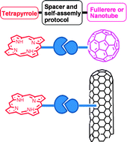
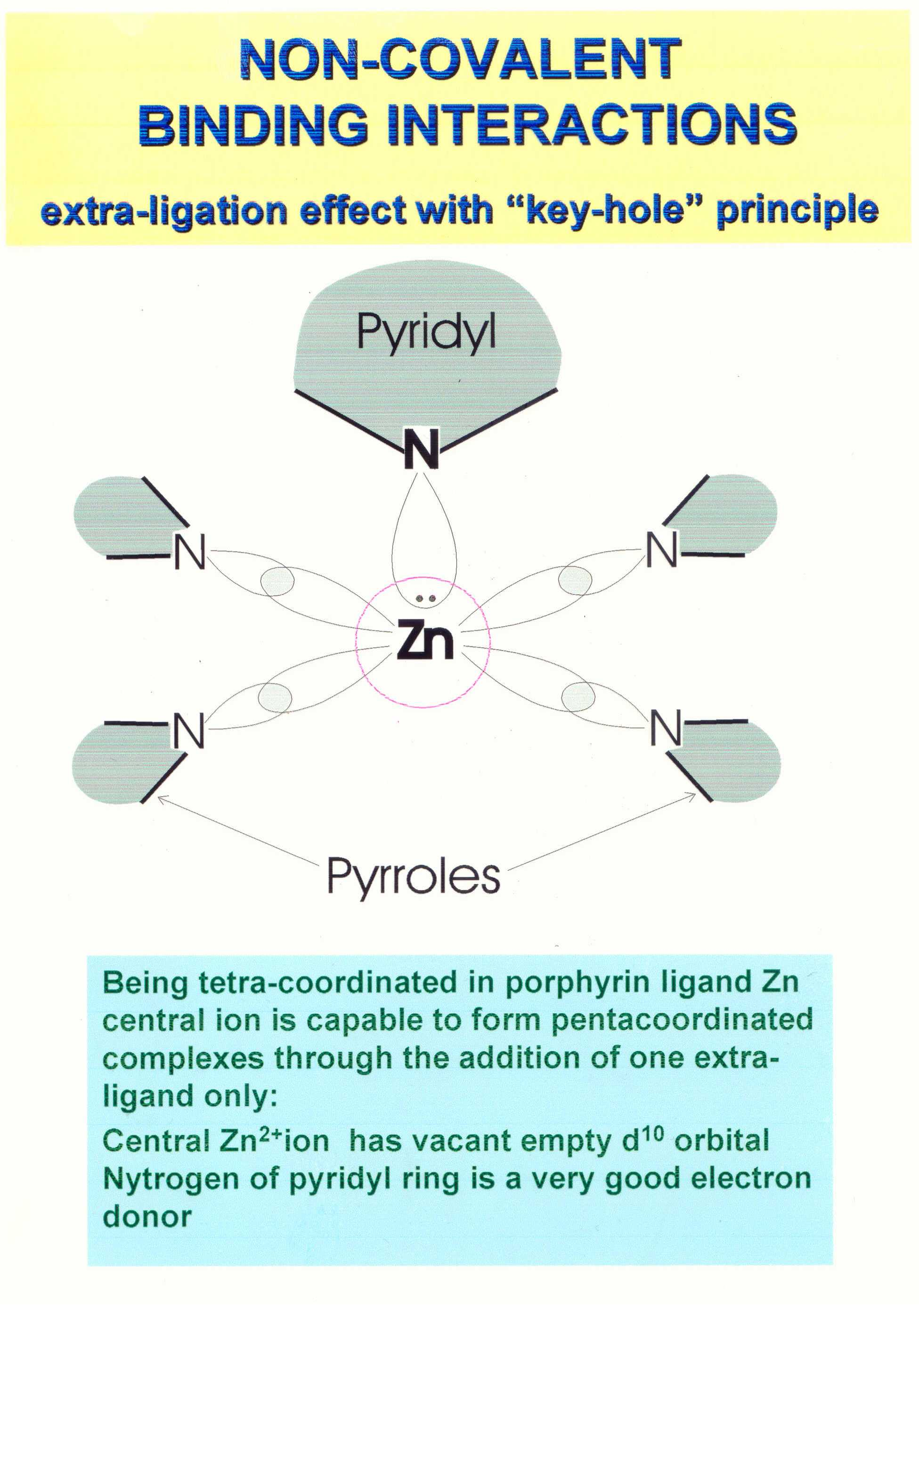
Формирование и свойства самособирающихся триад порфиринов (14 мономеров и 6 димеров)
Extra-Ligand Н₂Р-(m-Pyr)₂
Key-Hole Principle (Lego)
N
N
··
··
d_{Z2}
d_{Z2}
Zn
Zn
Complexation constant K_{C}∼10⁶÷10⁷ M⁻¹ increases strongly due to two-fold Zn-N interactions

Slide 16
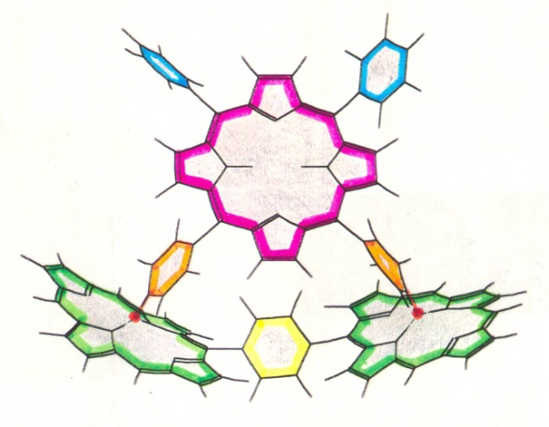
Структура самособирающихся триад порфиринов
Opposite meta-pyridyl rings: (m-Pyr)₂ l_{N-N} = 15.1 A⁰ (H₂P) l_{N-N} = 14.4 A⁰ (H₂Chl) d_{Zn-Zn} = 12.86 A⁰, r_{DA} = 8.2 A⁰ R_{Plane-Plane} = 5 A⁰ | Adjacent meta-pyridyl rings: (m^Pyr)₂ l_{N-N} = 10.0 A⁰ (H₂P) d_{Zn-Zn} = 12.23 A⁰, r_{DA} = 8.8 A⁰ R_{Plane-Plane} = 6.7 A⁰ | Adjacent para-pyridyl rings: (p^Pyr)₂ l_{N-N} = 12.2 A⁰ (H₂P) d_{Zn-Zn} = 12.45 A⁰, r_{DA} = 13.7 A⁰ R_{Center-Center} = 12.2 A⁰

Slide 17
Porphyrin Triads without Additional Electron Acceptors
Objective: Competition between energy transfer *Dimer→Extra-ligand and photoinduced charge transfer *Dimer→Extra-ligand governed by temperature and solvent polarity
Decay associated spectra
Global analysis of TCSPC
Picosecond transient absorption kinetics

Slide 18
Energy Levels and Relaxation Pathways
S₁
(¹Dimer*...Lig)
k₅
k₆
(Dimer...¹Lig*)
k₇
¹(Dimer⁺...Lig⁻)
³(Dimer⁺...Lig⁻)
S₁
CT
k₈
k₃₄
k₁
k₉
K₁₀
(Dimer...³Lig*)
T₁
Goes down
upon solvent
polarity increase
k₂
k₁₁
S₀
Rate K₅ : the energy transfer *Dimer →Extra-ligand
Rate K₆ : the photoinduced electron transfer *Dimer→Extra-ligand
Rate K₇ : the photoinduced hole transfer *Extra-ligand→Dimer

Slide 19
Values of bimolecular rate constants of the excited S₁-and T₁-states quenching by molecular oxygen were calculated using oxygen solubility in MCH and TOL at 293 K and the following expression
For typical large aromatic molecules with the ground and excited (π,π*) electronic states having a single accessible conformation, T₁∼>S₀ non-radiative intersystem crossing follows the well-known energy-gap low for radiationless decay

Slide 20
Singlet and Triplet Lifetimes and Bimolecular Rate Constants of Excited States Quenching by Molecular Oxygen for Monomers and Dimers in Toluene and Toluene+Pyridine at 293 К
Compound | Solvent | τ_{S}, ns | τ_{T}, ns | k_{T}, 10⁹M⁻¹s⁻¹ | k_{T}(lig)/ k_{T}^{a)}
ZnOEP-CH₃ | TOL TOL+PYR | 1.6 1.45 | 330 285 | 1.65 1.95 | 1.18
(ZnOEP)₂ | TOL TOL+PYR | 1.3 1.2 | 440 205 | 1.2 1.9 | 1.6
ZnOEP-Ph | TOL TOL+PYR | 1.5 1.4 | 335 370 | 1.6 1.5 | 0.94
(ZnOEP)₂Ph | TOL TOL+PYR | 1.2 1.1 | 495 490 | 1.1 1.1 | 1.0
ZnHTPP | TOL TOL+PYR | 1.6 1.5 | 570 530 | 1.0 1.05 | 1.05
(ZnHTPP)₂ | TOL TOL+PYR | 1.5 1.4 | 590 500 | 0.95 1.05 | 1.10
ZnOEChl | TOL TOL+PYR | 1.3 1.25 | 290 265 | 1.9 2.1 | 1.10
(ZnOEChl)₂ | TOL TOL+PYR | 1.2 1.2 | 350 285 | 1.6 2.0 | 1.25
ZnOEP-cycle-CH₂ | TOL TOL+PYR | 2.6 2.5 | 310 275 | 1.9 2.0 | 1.05
Zn-3¹,5¹-cyclo-dimer | TOL TOL+PYR | 2.5 2.5 | 355 295 | 1.6 1.9 | 1.2

Slide 21
Photophysical Parameters and Bimolecular Constants of Singlet and Triplet States Quenching by Molecular Oxygen for Pyridyl-Substituted Porphyrin Free Bases, Triads and Pentad at 293K
Compound | Solvent | τ_{S}, ns | τ_{S}⁰, ns | k_{S,} 10⁻⁹ M⁻¹s⁻¹ | ϕ_{F} | ϕ_{F}⁰ | τ_{T}, ns | k_{T,} 10⁻⁹ M⁻¹s⁻¹ | β=k_{T}/k_{S} | τ_{T} (77K), ms
TPP | mch | 9.9 | 12.9 | 9.1 | 0.071 | 0.115 | 285 | 1.35 | 0.15 | 5.8
H₂P-(m^Pyr)₂ | mch | 8.9 | 11.4 | 9.3 | 0.070 | 0.104 | 275 | 1.40 | 0.14 | 4.2
H₂P-(m-Pyr)₂ | mch | 8.7 | 11.0 | 9.4 | 0.073 | 0.109 | 275 | 1.40 | 0.15 | 4.0
H₂P-(p^Pyr)₂ | mch | 9.1 | 12.8 | 12.0 | 0.064 | 0.098 | 280 | 1.37 | 0.11 | 4.2
H₂P-(m-Pyr)₄ | mch | 8.4 | 10.5 | 9.3 | 0.071 | 0.098 | 260 | 1.45 | 0.15 | -
Н₂Р-(p-Pyr)₄ | mch | 8.7 | 11.5 | 11.2 | 0.076 | 0.114 | 305 | 1.30 | 0.12 | -
H₂P-dibuthyl- -(m-Руг)₂ | mch | 8.3 | 11.2 | 11.8 | - | - | 210 | 1.85 | 0.15 | 2.3
(ZnHTPP)₂ ⊗H₂P-(m-Pyr)₂ | mch | 8.3 | 10.0 | 7.8 | - | - | 380 | 1.0 | 0.14 | 2.8
(ZnHTPP)₂ ⊗H₂P-dibuthyl-(m-Руг)₂ | mch | 8.6 | 10.6 | 8.3 | - | - | 340 | 1.15 | 0.14 | 1.6
(ZnHTPP)₂ ⊗H₂P-(p^Pyr)₂ | mch | 8.0 | 10.4 | 11.3 | - | - | 340 | 1.15 | 0.10 | 4.1
(ZnHTPP)₂ ⊗H₂P-(m^Pyr)₂ | mch | 8.2 | 10.3 | 9.6 | - | - | 365 | 1.05 | 0.12 | 3.1
H₂P-(m^Pyr)₂ | tol | 9.5 | - | - | 0.075 | - | 380 | 1.45 | - | -
(ZnOEP)₂Ph ⊗H₂P-(m^Pyr)₂ | tol | 7.7 | - | - | 0.05 | - | 550 | 1.0 | - | -
2(ZnOEP)₂Ph ⊗ H₂P-(m-Pyr)₄ | tol | - | - | - | 0.04 | - | 680 | 0.80 | - | -

Slide 22
The photophysical properties of Zn-porphyrin and Zn-chlorin chemical dimers are sensitive to the extra-ligation by pyridine. One of these properties is enhanced non-radiative T₁∼∼>S₀ intersystem crossing (the most pronounced for dimers with higher lying T₁-states) relative to the uncomplexed dimers. The quenching is attributed to several reasons: accepting role of the extra-ligand vibrations, the enhanced spin-orbit coupling due to the singlet σ,π* states energy lowering and the out-of-plane distortion of porphyrin macrocycle. At 293 K for pyridinated dimers it was shown that their T₁-states quenching by molecular oxygen depends on the spacer flexibility and donor-acceptor interactions with pyridine.

Slide 23
Схематическое представление процесса генерации синглетного кислорода мультипорфириновым триадным комплексом
[ZnОЕР-Ph-ZnР(iso-PrPh)₃] ⊗H₂P(m-Pyr)₂(iso-PrPh)₂
Д А L
L
^{ПЭ}
^{ПЭ}
1,27 μ
N
N
●●
●●
Zn
Zn
^{hν}
Д
^{ПЭ}
А

Slide 24
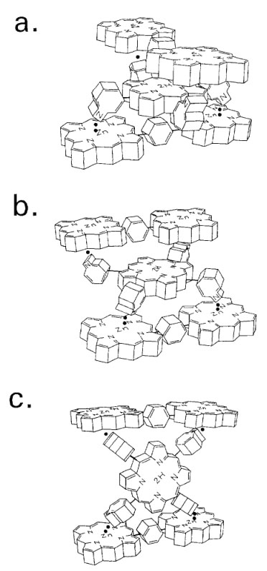
Zn
Zn
Zn
Zn
ПЭ
1,27 μ
hν

Slide 25
Using two-fold coordination of Zn-porphyrin dimers by di- and tetrapyridyl substituted porphyrin extra-ligands, triads and pentads have been prepared. The cooperative existence of energy and electron transfer processes in these systems results in the population of the final locally excited S₁- and T₁-states of porphyrin extra-ligands. The quenching of these states in triads and pentads by molecular oxygen is noticeably weakened with respect to that for individual pyridyl substituted porphyrins. This effect is explained by the screening action of a strongly quenched Zn-porphyrin dimer subunit in triads and pentads limiting the access of oxygen molecule to the excited extra-ligand. These facts have to be taken into account upon the analysis of natural dark and photoinduced reactions with participation of supramolecular systems with oxygen (oxygenation and deoxygenation in haemoglobin, singlet oxygen generation in tissues and photodynamic therapy of cancer).

Slide 26
ВРЕМЕНА ЖИЗНИ, КОНСТАНТЫ СКОРОСТИ ТУШЕНИЯ S1- (kS), Т1 -СОСТОЯНИЙ (kТ) И КВАНТОВЫЕ ВЫХОДЫ ГЕНЕРАЦИИ СИНГЛЕТНОГО КИСЛОРОДА (γΔ) МОЛЕКУЛАМИ ЭКСТРА-ЛИГАНДОВ И МУЛЬТИПОРФИРИНОВЫМИ КОМПЛЕКСАМИ В МЦГ ПРИ 295 К
Соединение | τS, нс | τS⁰, нс | kS×10⁹, M⁻¹с⁻¹ | τT, нс | kT×10⁹, M⁻¹с⁻¹ | γΔ
пиридил-замещенные свободные основания порфиринов (экстра-лиганды)
H2P(m-Pyr)2(Ph)2 | 8.7 | 11.3 | 10.1 | 270 | 1.4 | 0.65
H2P(m^Pyr)2(iso-PrPh)2 | 8.7 | 11.4 | 10.5 | 260 | 1.5 | 0.68
H2P(p^Pyr)2(Ph)2 | 8.7 | 11.2 | 10.0 | 290 | 1.3 | 0.66
H2P(m-Pyr)4 | 8.3 | 10.5 | 9.7 | 290 | 1.3 | 0.60
триадные комплексы
(ZnHTPP)2⊗H2P(m-Pyr)2(Ph)2 | 8.3 | 10.0 | 7.9 | 400 | 0.9 | 0.65
(ZnHTPP)2⊗H2P(m^Pyr)2(iso-PrPh)2 | 8.4 | 10.2 | 8.1 | 380 | 1.0 | 0.65
(ZnOEP)2Ph⊗H2P(m^Pyr)2(iso-PrPh)2 | 7.7 | 9.3 | 8.5 | 370 | 1.0 | 0.68
(ZnHTPP)2⊗H2P(p^Pyr)2(Ph)2 | 8.2 | 10.5 | 10.0 | 330 | 1.2 | 0.68
пентада
2(ZnOEP)2Ph⊗H2P(m-Pyr)4 | − | − | − | 680 | 0.5 | 0.64
*
*
*
*
*
*
*
*
1. Все мультипорфириновые комплексы обладают достаточно высокими значениями квантовых выходов γΔ.
2. Эффекты экранирования экстра-лигандов молекулами Zn-димеров в триадах и пентадах приводят к росту
длительности их Т1-состояний в жидких растворах при 295 К в присутствии молекулярного кислорода
3. Эффекты экранирования экстра-лигандов молекулами Zn-димеров, уменьшающие константы скорости kS и kТ, практически не влияют на γΔ.

Slide 27
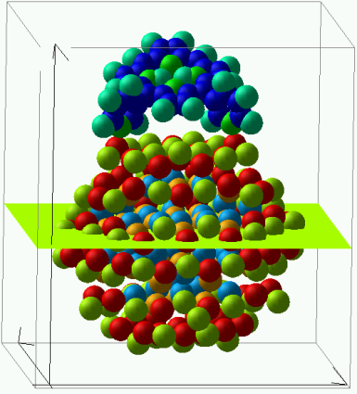
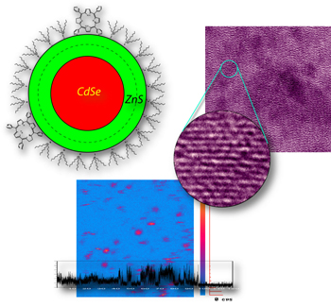
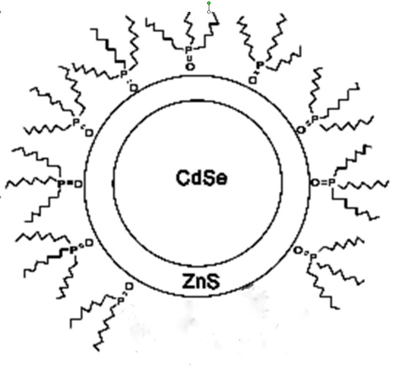
Cамосборка наноансамблей на основе полупроводниковых квантовых точек и порфиринов «QD CdSe/ZnS +Porphyrin»

Slide 28
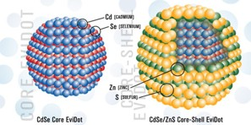
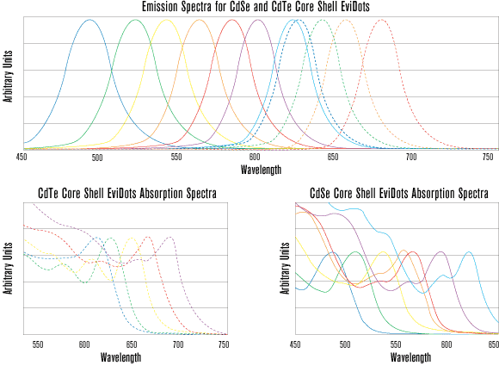
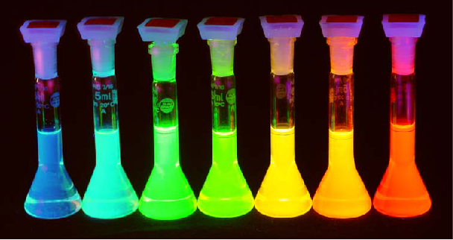
Полупроводниковые нанокристаллы или квантовые точки (КТ)
Размерные эффекты
CdSe
ZnS
ЗП
Поглощение
E_{1s1s}
Длина волны
ВЗ
λ_{em} = 495 nm / d = 1.9 nm
λ_{em} = 560 nm / d = 2.7 nm
λ_{em} = 620 nm / d = 5.1 nm
Изменение цвета

Slide 29
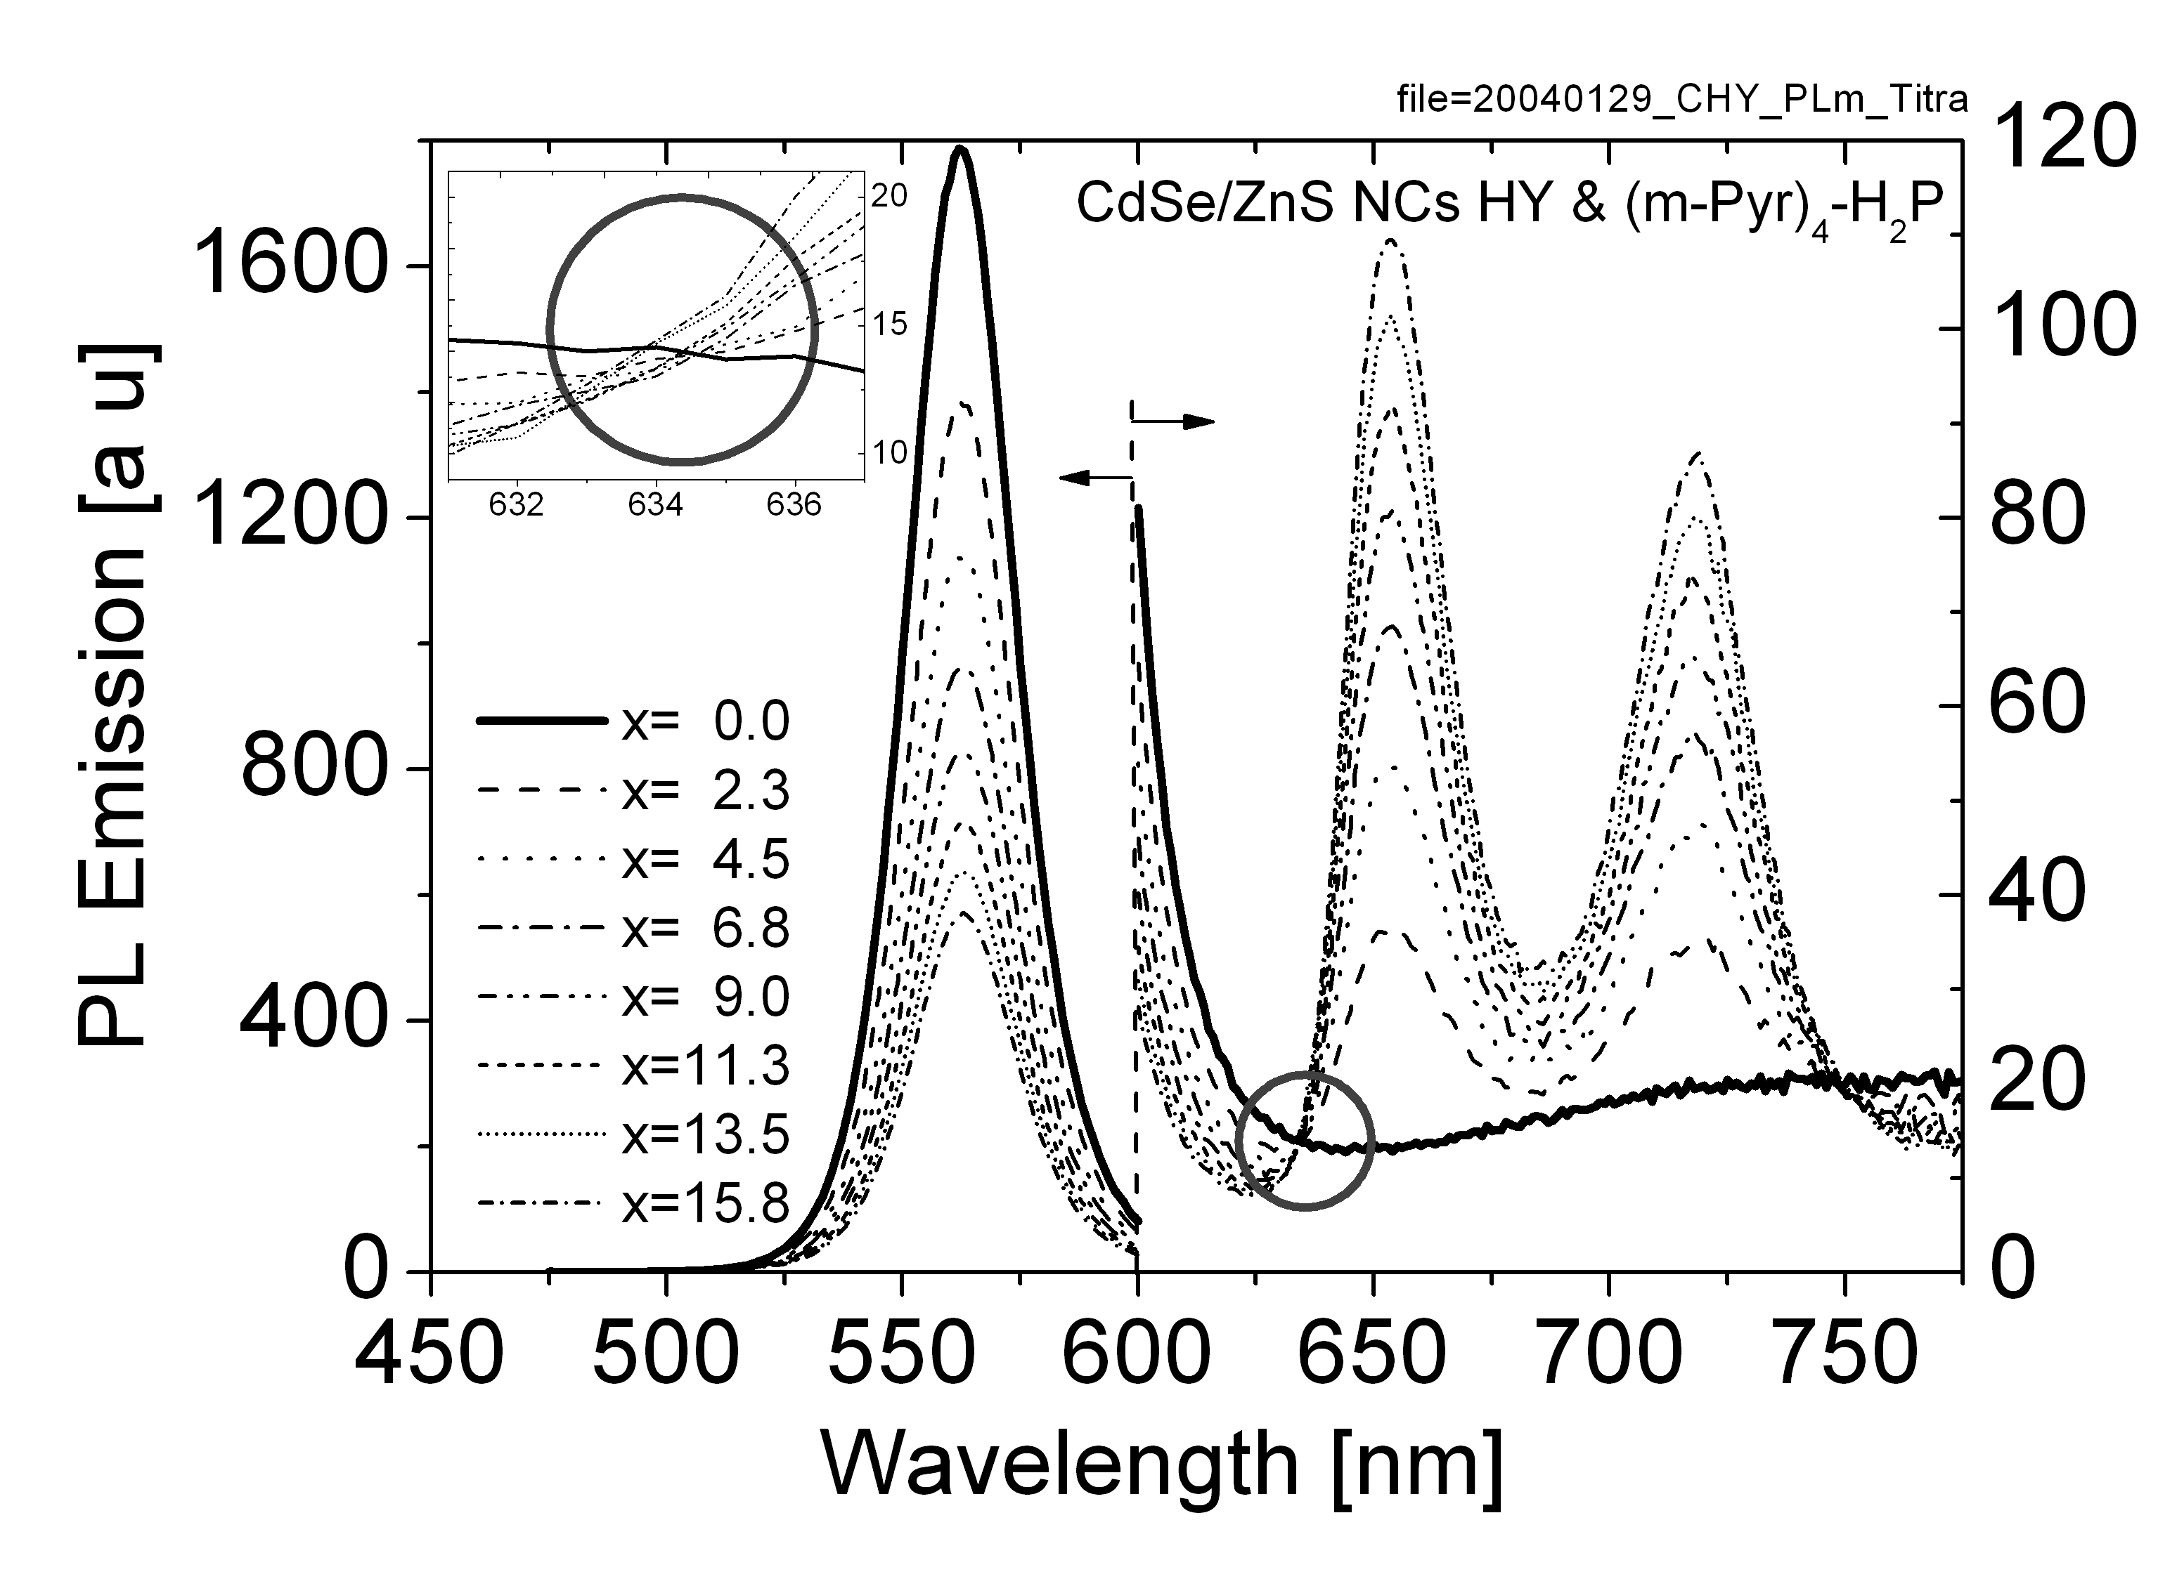

Полупроводниковые КТ CdSe/ZnS и порфирины
Photoluminescence decay:
Steady-state Photoluminescence:
Molar Ratio:
x=[C_{H2P}]/[C_{NC}]

Slide 30
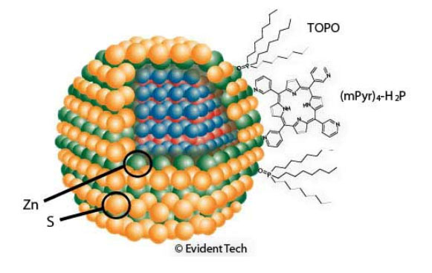
Причины тушения фотолюминесценции КТ в наноансамблях «КТ-порфирин»
ТОPO
H₂P
Energy Transfer?
CdSe/ZnS
H₂P
Quenching
Sensibilization
E_{FRET} = [ε_{A} / ε_{D}] x [F_{AD} /F _{FA}]
PL Excitation Spectra

Slide 31
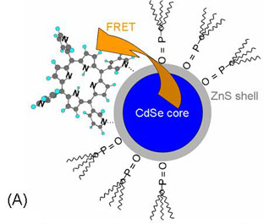
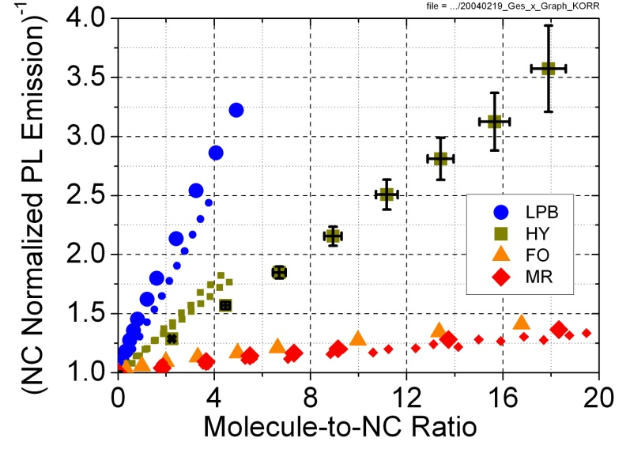
Динамика релаксационных процессов в наноансамблях «КТ-порфирин»
1- FRET
2 – Electron Tunneling in the Conditions of Quantum Confinement

Slide 32
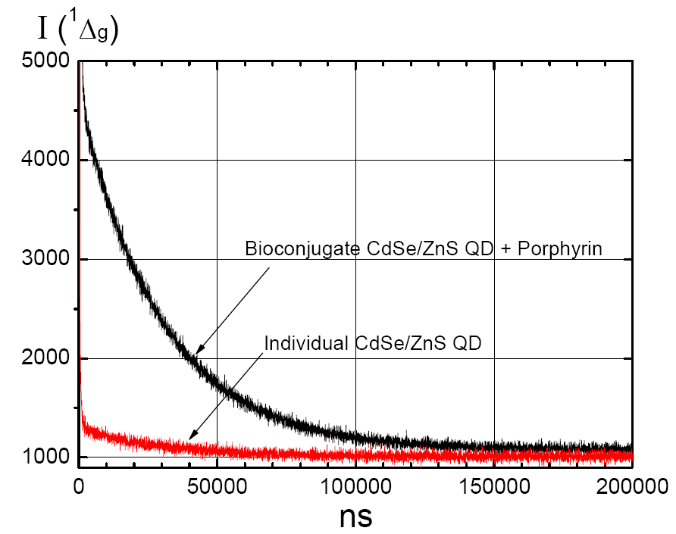
Singlet Oxygen Generation by Quantum Dots and Nanoassemblies
Oxygen 1 atm
Air 1 atm
A
A
τ, ns

Slide 33
Singlet Oxygen Generation by Quantum Dots and Nanoassemblies
(Innetraband Auger Effect)
FRET
S₁* (PS)
Powerful laser excitation
Dependencies of the emission normalized intensities on the energy of laser excitation for individual QDs (A) and QDs in bioconjugate composition (B) as well as for alone porphyrins (C) and porphyrin molecules attached to QDs (D).

Slide 34
Experimental Correlations for Nanoassembly
QD CdSe/ZnS + H₂P(m-Pyr)₄ (х = 4.0):
Quantum Efficiences of Energy Transfer QD→Porphyrin
Quantum Efficiences of Singlet Oxygen Generation by Nanoassemblies
Table. FRET QD→H₂P, PL Sensibilisation and Quenching Parameters
Transfer Parameters | ϕ_{D}⁰ | J(ν), сm³M⁻¹ | R₀^{theor}, Å | R_{DA}, Å | k_{DA}^{theor}, с⁻¹ | k_{DA}^{experim}, с⁻¹ | Φ_{DA}^{experim} | k_{q}^{experim}, с⁻¹
HY+Porphyrin | 0.63 | 4.0×10⁻¹⁴ | 31.0 | 27.8 | 8.0×10⁸ | 7.0×10⁵ | 0.14±0.02 | 7.0×10⁶
Ф^{Δ}_{DA} = 0.12±0.03
Quantum Efficiency of Energy Transfer Evaluated on the Basis of Data on Sensitized Generation of Singlet Oxygen by Bioconjugate
Standard is Pd-meso-porphyrin, γ_{Δ} = 1.0
E. Zenkevich, E. Sagun, V. Knyukshto, A. Stasheuski, V. Galievsky, A.Stupak, T. Blaudeck, C. von Borczyskowski, J. Phys. Chem. C (2011).

Slide 35
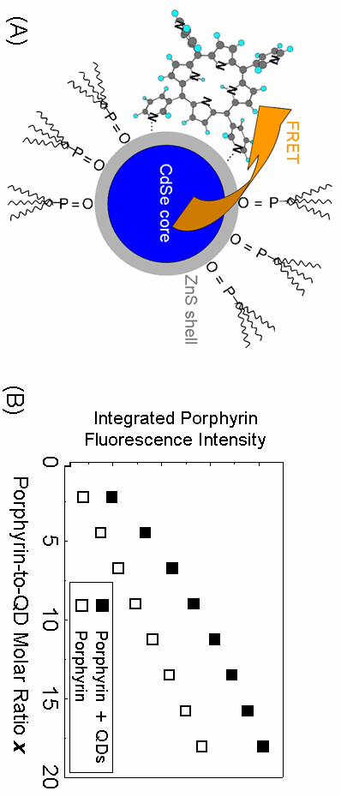
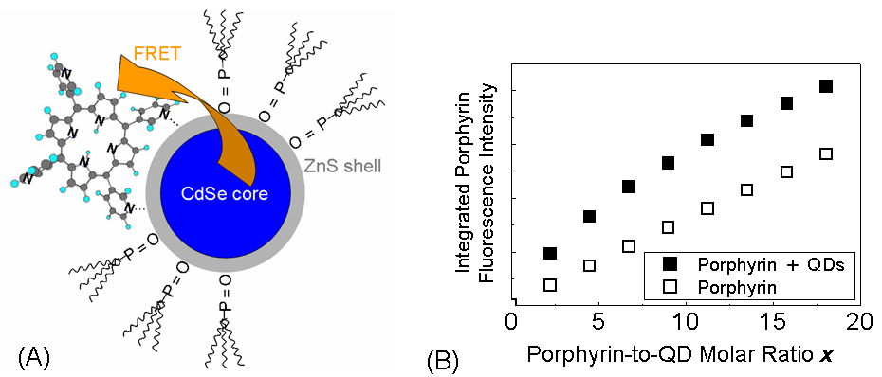


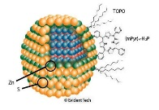
Sensitized Generation of Singlet Oxygen by Bioconjugate
«QD CdSe/ZnS +Porphyrin»
Photodynamic Therapy Applications
ZnS
FRET
Т-Т ET
CdSe
N
TUMOR
NH
N
HN
N
N
h
ν
1
Energy Transfer

Slide 36
Sensitized Generation of Singlet Oxygen by Nanoassembly
«QD CdSe/ZnS +Porphyrin Triad»
ZnS
FRET
CdSe
h
ν
h
ν
FRET
2
1
Zenkevich, von Borczyskowski. Macroheterocycles (2009) V.2, № 3-4, P. 206-220
Сагун, Зенькевич, Кнюкшто, Шульга, Ивашин. Оптика и спектроскопия (2009) T. 107, № 6, С. 1011-1025
Сагун, Зенькевич, Кнюкшто, Шульга, В. Ивашин. Оптика и спектроскопия. (2010). T. 108, № 4, С. 590-607

Slide 37
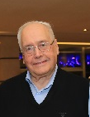
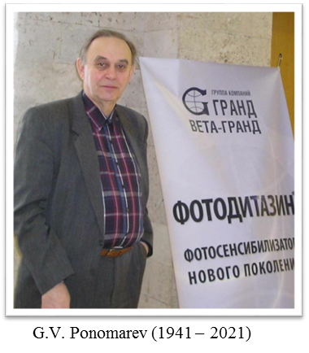
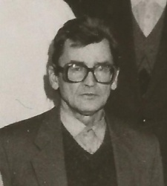

A.F. Mironov (1935 – 2021)
A.M. Shulga (1941 – 2014)
О милых спутниках, которые наш свет
Своим сопутствием для нас животворили,
Не говори с тоской: их нет,
Но с благодарностию: были…
В.А. Жуковский «Воспоминание» (1827)

