Slide 1
АБСОРБЦИОННЫЕ СВОЙСТВА И ФОТОСЕНСИБИЛИЗИРУЮЩЕЕ ДЕЙСТВИЕ МОЛЕКУЛЯРНОГО КИСЛОРОДА. СРАВНЕНИЕ С ПОРФИРИНАМИ
A.A. Красновский*, А.С. Бендиткис, С.Е. Гончаров,
А.С. Козлов
ФИЦ биотехнологии РАН
*phoal@mail.ru

Slide 2
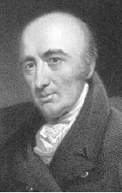
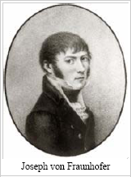
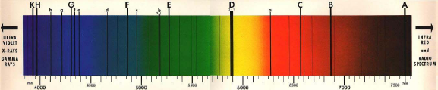
William Hyde Wollaston, 1766-1828
Joseph von Fraunhofer, 1787-1826
In 1801, Wollaston and in 1814, Fraunhofer discovered black lines (Fraunhofer lines) in the solar spectrum.

Slide 3
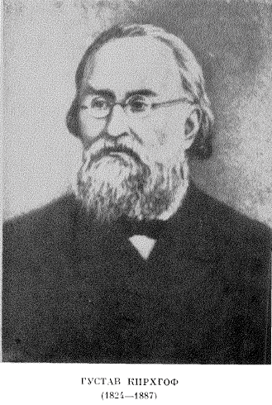
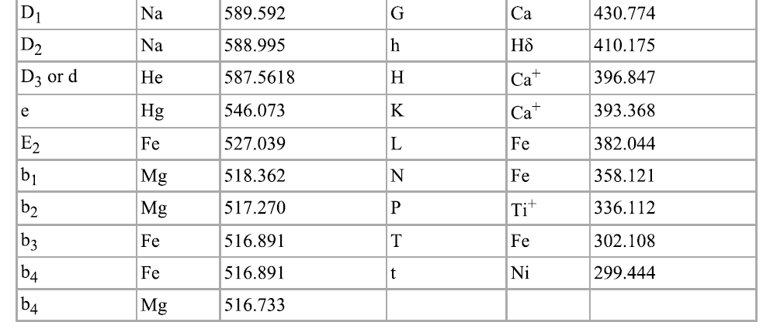
Gustav Kirchhoff,
1825-1887
Robert Bunsen,
1811-1899
In 1859-1860, Kirchhoff and Bunsen showed that Fraunhofer’s lines corresponded to the absorption spectrum of different atoms in the solar
atmosphere. This discovery was a starting point of the method of optical
spectroscopy.

Slide 4
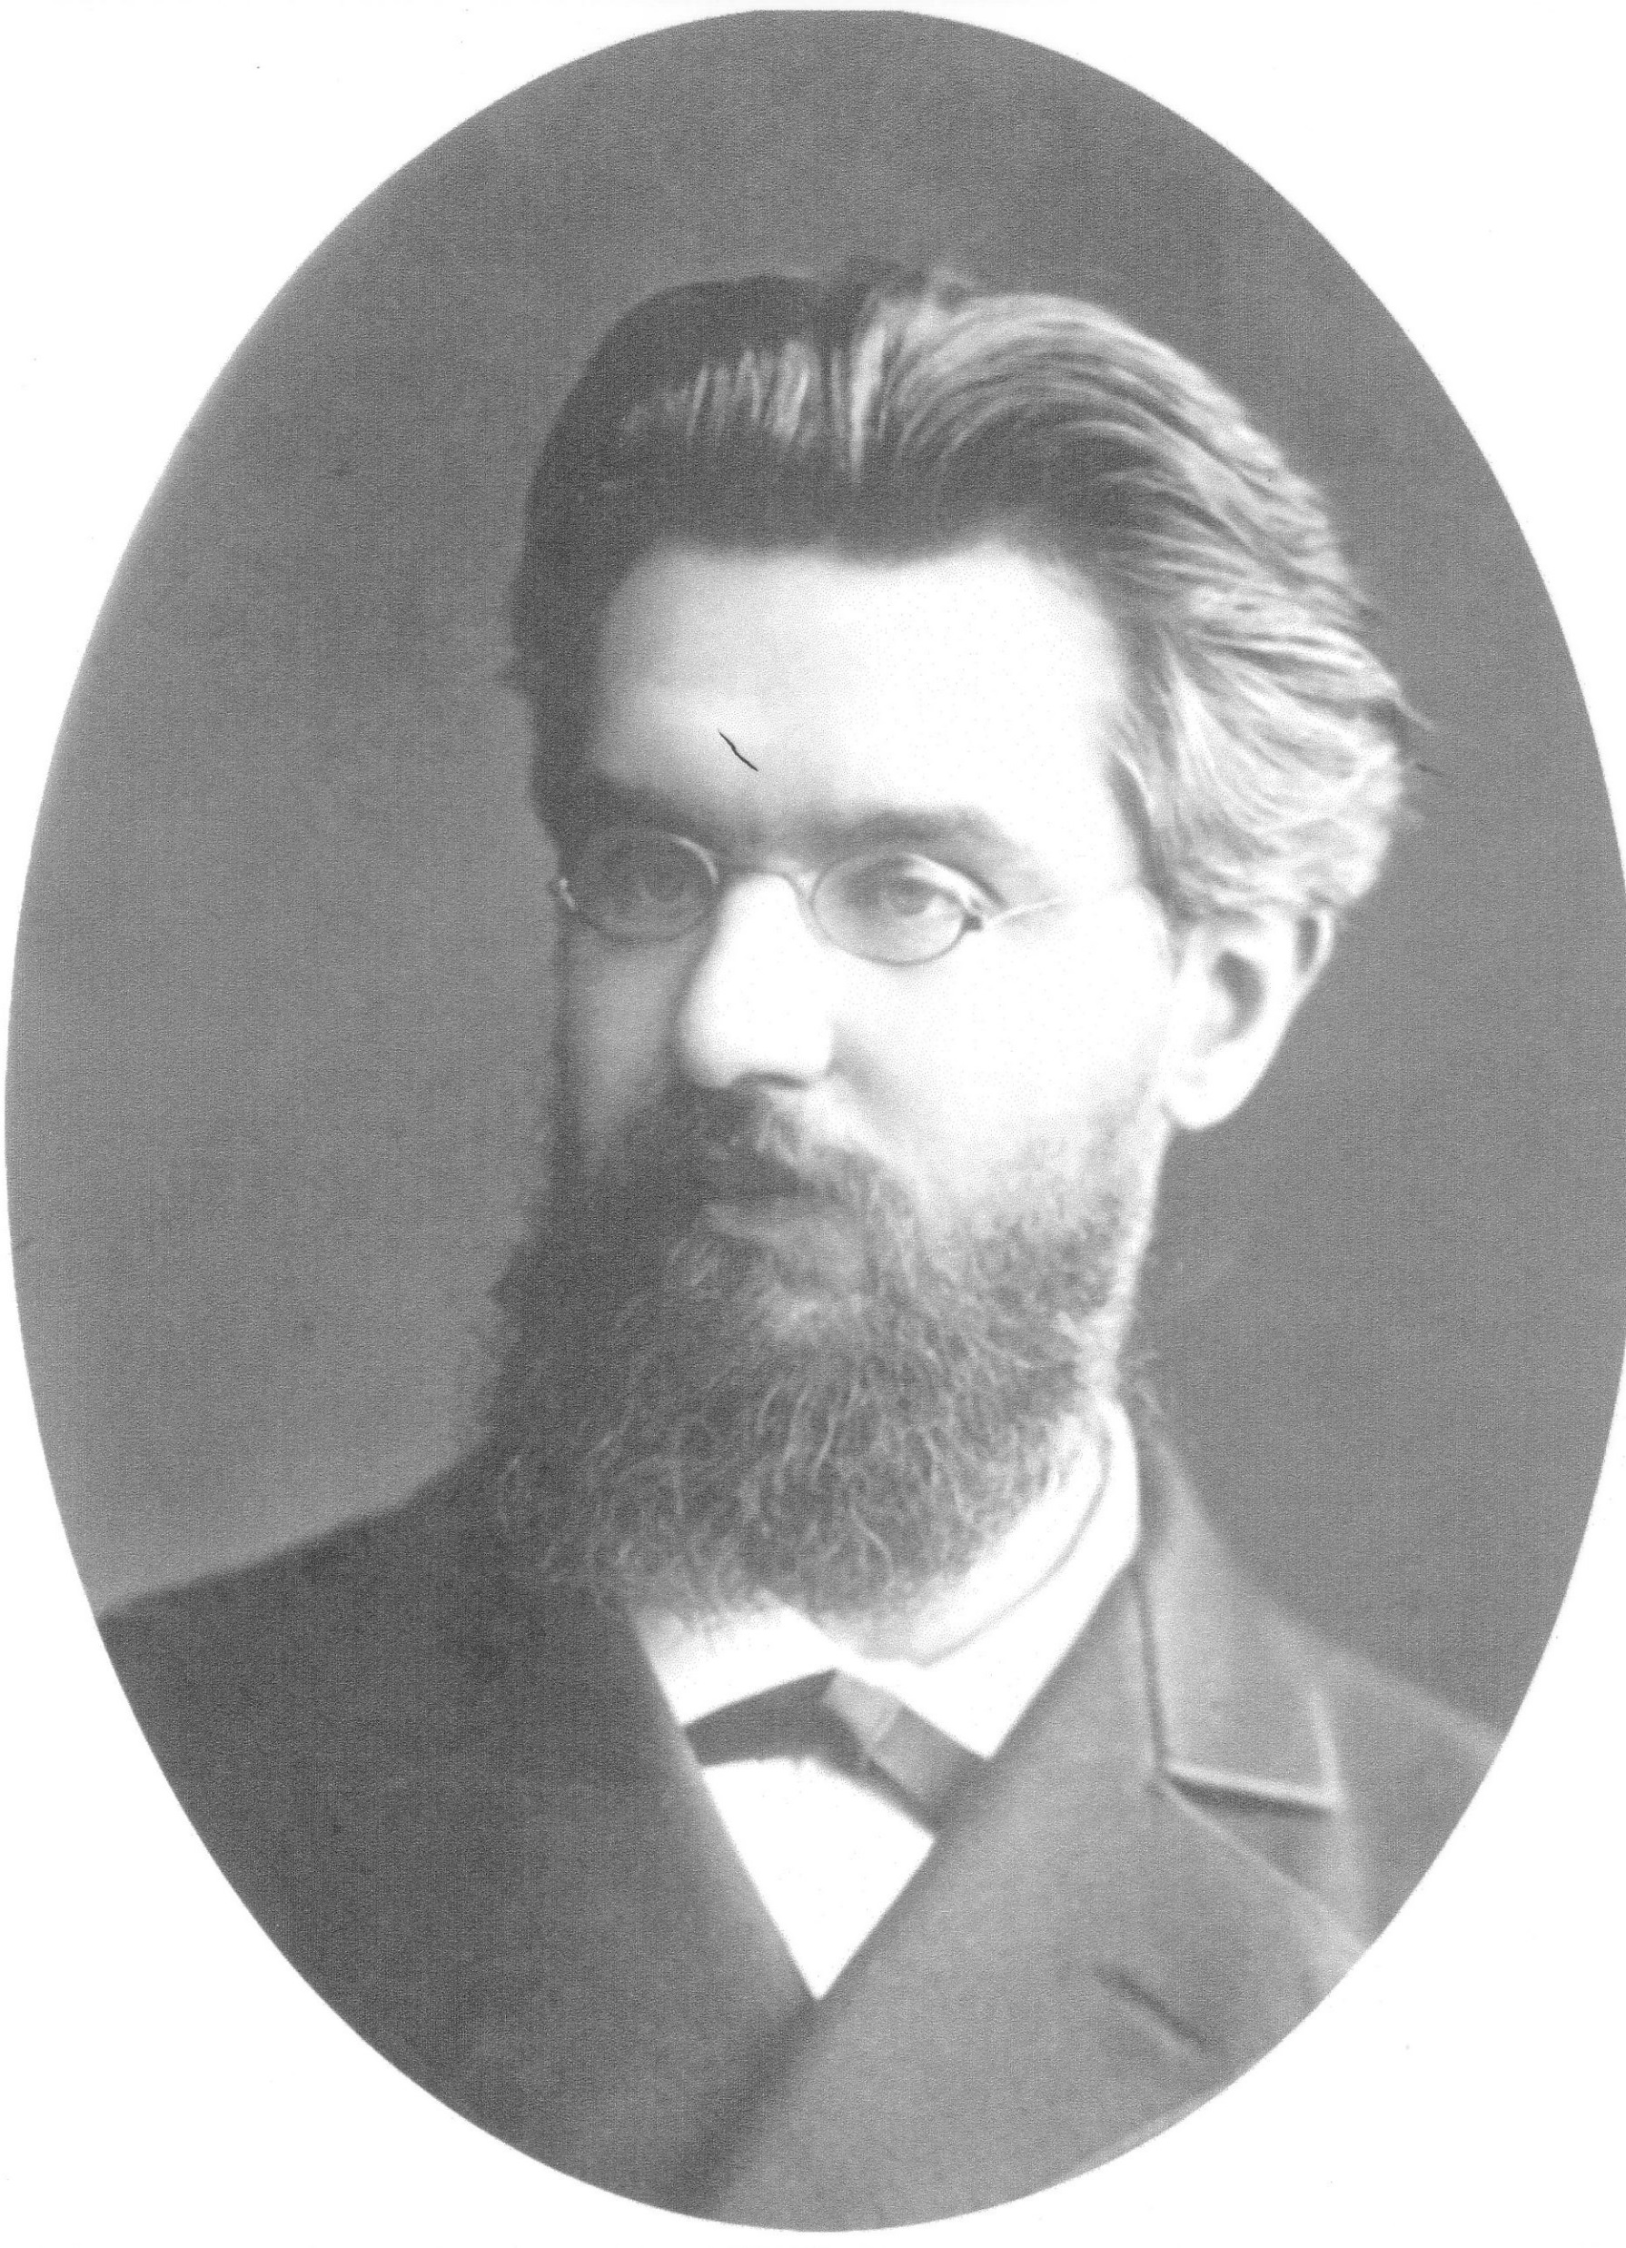
1885 г.
“Н.Г. Егоров сообщает о результатах своих наблюдений над спектром поглощения атмосферного слоя толщиной в 3 км между Университетской астрофизической башней и Физическим кабинетом Медицинской академии в С. Петербурге. Этот слой оказался достаточным, чтобы дать в спектре электрического света волны группы A и B “.
Журн. Русс. Физико-химич. О-ва, 17, 8A, 138, 1885
In 1881-1885, Nikolai Egoroff (1849-1919) (Docent of the St. Petersburg University and Professor at the St. Petersburg Military Academy), using a strong projector and telescope found Fraunhofer’s lines A and B (762 and 688 nm) in the absorption spectrum of the 3-10 km layer of air. Then, he observed these bands and also three additional bands at 626, 574 and 476 nm using a 60-m tube filled with oxygen pressured to 6 atm.
Egorov, Compt. Rend. Acad. Sci., 101, 1143, 1885
Egorov
Nikolai Grigorievich
(1849-1919)

Slide 5
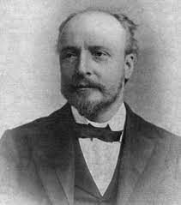
Egoroff’s papers were confirmed and supported in series of papers of 1886-1890
Sir J. Dewar
1886-1888 1887-1990 1988-1889

Slide 6

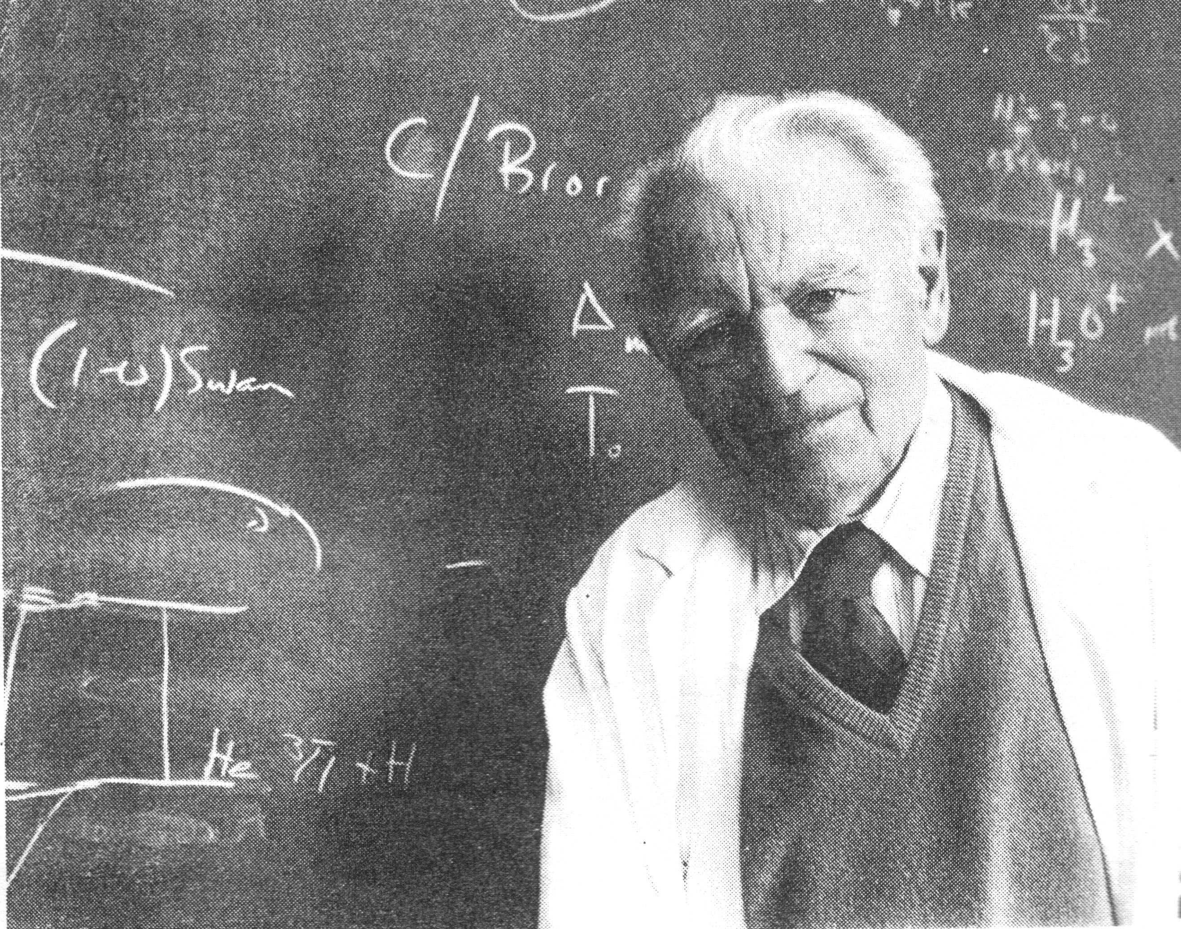
In 1928, Mulliken applied to oxygen the molecular orbit theory and concluded that oxygen molecules have the triplet ground state and two excited singlet states of relatively low energy
(↓↑)
Gerhard Hertzberg
German and Canadian physicist
1904-1999
Robert Sanderson Mulliken
1896-1986
(↓↓)
G. Herzberg. Photography of infrared solar spectrum to wavelength 12,900 A. Nature (London), 133, 759, 1934.
Mulliken. R.S. Nature, 122, № 3075, 505, 1928
Mulliken. R.S. Phys. Rev. 32, № 6, 880-887, 1928

Slide 7
ε = 8×10⁻⁴ M⁻¹cm⁻¹
Fraunhofer-Egoroff lines
Absorbance, rel. units
A
Mulliken-Herzberg lines
Fraunhofer-Egoroff lines
Mulliken-Herzberg lines
B
Vibronic transitions corresponding to the main atmospheric oxygen absorption bands
Relative intensities of the atmospheric absorption peaks of atmospheric oxygen

Slide 8
ε_{max} × 10², M⁻¹cm⁻¹
1
0.5
Mulliken-Herzberg lines
0
Relative intensities of the atmospheric absorption peaks of gaseous oxygen
Absorption spectrum of compressed oxygen at 150 atm. in the 5 cm optical path
Monomols O₂
Dimols (O₂)₂

Slide 9
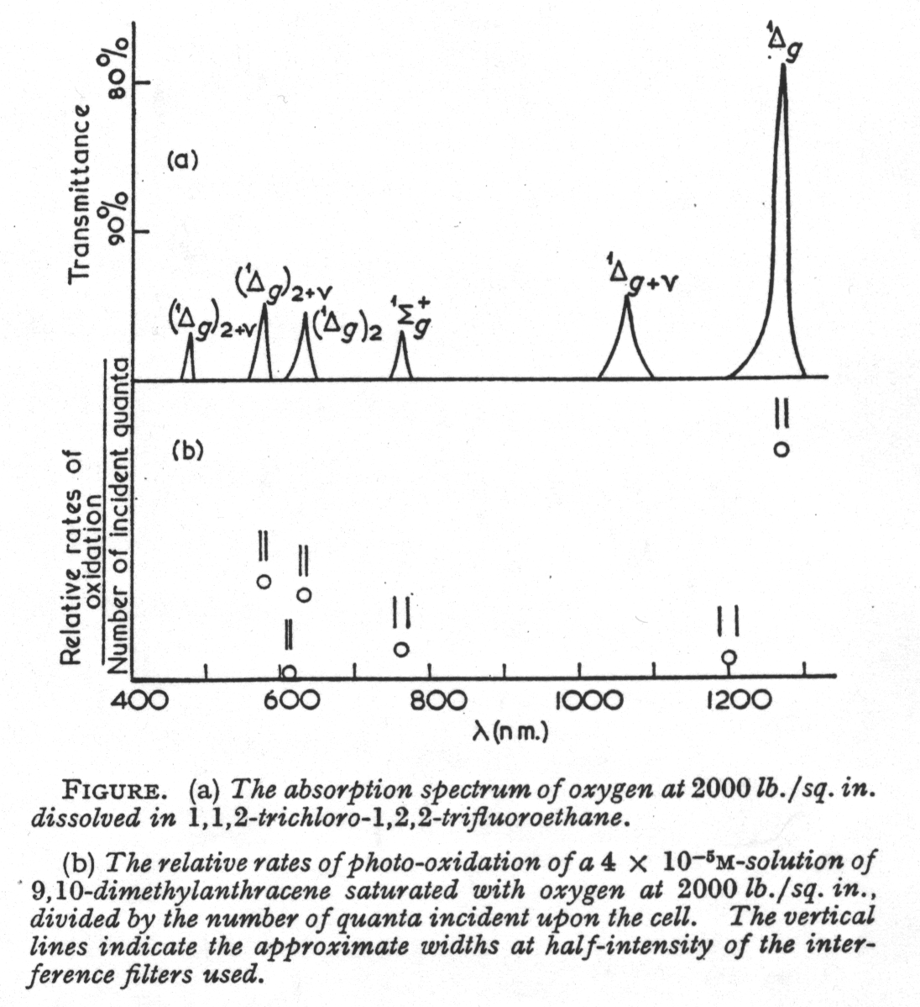
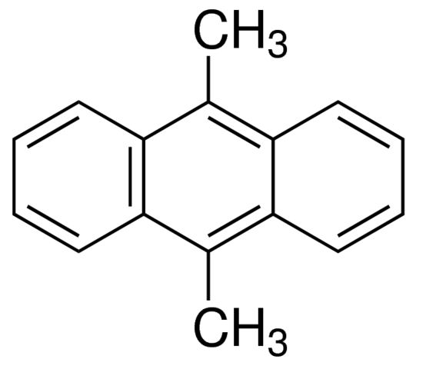
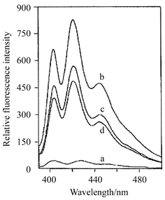
Absorption spectrum of oxygen dissolved at high pressure (130 atm, 3.5 M) in freon 113
hv
Action spectrum of DMA oxygenation
D.F. Evans. Chem. Com. 367-368, 1969

Slide 10
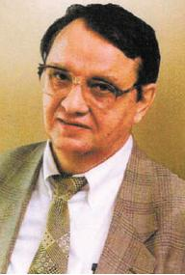
N.F. Gamaleya
V.S. Letokhov
T.I. Karu
They started from helium-neon and ruby lasers which were built first in 1960
Presently low level laser therapy (LLLT) uses lasers with the emission wavelengths 370-1700 nm

Slide 11
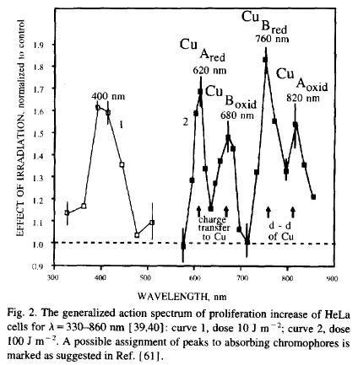
Karu, 1982-1990
Oxygen absorption at 150 bar pressure, 5 cm pathlength
1:10
Dianov-Klokov, 1964, Long, Kearns 1973; Gurinovich, 1991

Slide 12
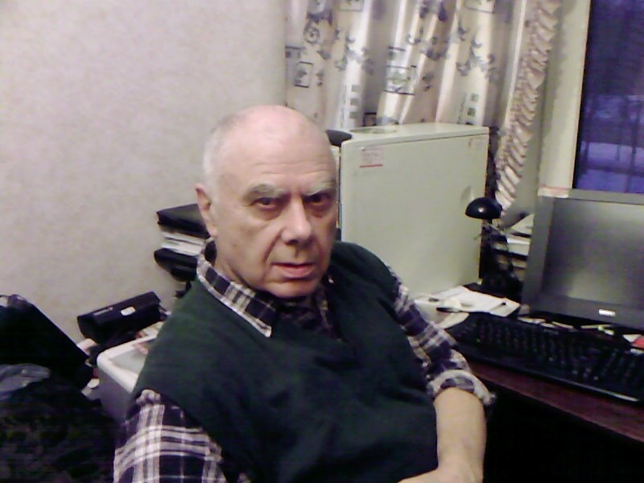
IR-VIS laser
Светокислородный эффект
Light oxygen effect
Ambartzumian R.V. PROC. SPIE, V. 701, p. 341-343, 1986

Slide 13
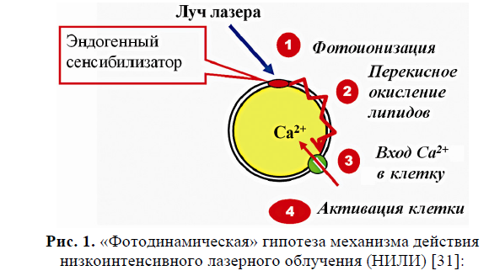
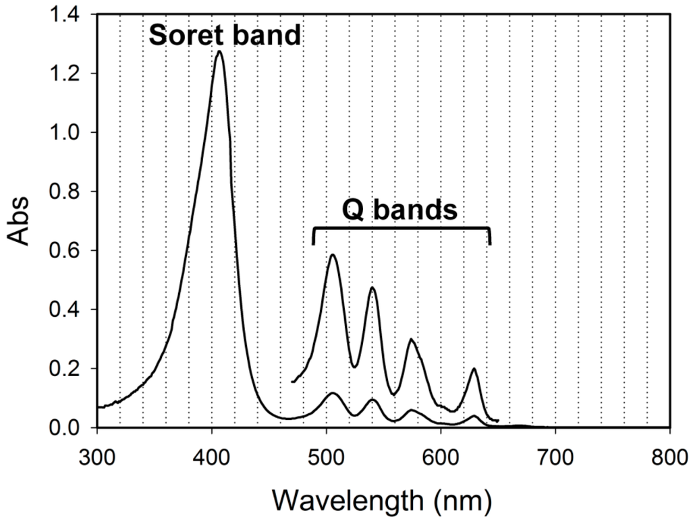
Laser beam
Photogeneration of
singlet oxygen
Endogenic proto-porphyrin IX, 10 nM
Lipid peroxi-dation
Ca⁺ enters the cell
Cell activation
Photodynamic hypothesis of laser action
Vladimirov, Klebanov, Osipov, 1985-2010

Slide 14
Hela cells
760
620
820
680
Action spectrum of DNA biosynthesis
Absorption spectrum of air-dried HeLa cells
Fe-NO ?
Letokhov, Karu et al. 1982-2010

Slide 15
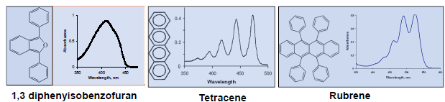
Laser light
³O₂
¹O₂
+ Trap
Trap oxygenation
Probing beam
1270 nm
Krasnovsky, Drozdova, Ivanov, Ambartzumian. Biochemistry Moscow, Vol. 68, 963, 2003

Slide 16
765 nm
1273 nm
Fraunhofer-Egoroff
Band A
1
Mulliken-Herzberg band
2
Wavelength, nm
Аction spectra of oxygenation of the singlet oxygen traps under direct excitation of oxygen molecules by IR laser radiation obtained using tunable titan-sapphirer (1) and forsterite laser (2) in aerated solutions
Krasnovsky, Abartzumian Chem. Phys. Lett., 2004, 400, 511
Krasnovsky, Kozlov, Biofizika, 2014, 59, 199
Krasnovsky, Kozlov, J. Photochem. Photobiol. A:, 2016, 329, 167

Slide 17
1270
V_{r}/n,
V_{r}/n,
1070
1270
CCl₄
1070
ethanol
0,00075
1000 1050 1100 1150
1200 1250 1300
Wavelength, nm
The action spectrum of DPIBF photooxygenation in air-saturated organic solvents upon irradiation by tunable GTWave optical fiber laser
Kozlov, Egorova et al. Optics lett. 2021, 46, 556-558

Slide 18
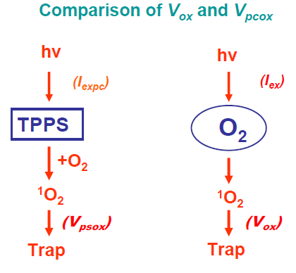
Diode laser
Oxygen excitation spectrum
Krasnovsky, Kozlov, Rоumbal. Photochem. Photobiol. Sci., 11, 988-997, 2012
Krasnovsky, Kozlov. Biofizika, 59,199–205, 2014
Krasnovsky, Kozlov. J. Photochem. Photobiol. A., 329, 167-174, 2016
Krasnovsky, Kozlov. J. Biomed. Photonics & Engineering, 3(1) 1-10, 2017

Slide 19
Optical density in 1 cm (A), molar absorption coefficient (ε) and cross section of light absorption (σ) for molecular oxygen as obtained photochemically in air saturated CCl₄ under ambient conditions
CCl₄
CCl₄, C₆F₆, СF₂СlCFCl₂
Maximum, nm | A×10⁵ | ε ×10³ M⁻¹cm⁻¹ | σ ×10²³, сm²
1273 | 1.33 | 5.1 | 2.0
1073 | 0.013 | 0.051 | 0.02
765 | 0.25 | 0.96 | 0.38
765 in atmosphere - 0,8 -
1268 in atmosphere - 0,026 -
Krasnovsky, Kozlov, Rоumbal. Photochem. Photobiol. Sci., 11, 988-997, 2012
Krasnovsky, Kozlov. Biofizika, 59,199–205, 2014
Krasnovsky, Kozlov. J. Photochem. Photobiol. A., 329, 167-174, 2016
Kozlov, Egorova et al. Optics lett. 2021, 46, 556-558
Krasnovsky, Kozlov, Benditkis, Rus. Phys. Journal, 2022, 64, 2035-2045

Slide 20
765
1273
Molar absorption coefficients of molecular oxygen dissolved under normal conditions in different solvents
Krasnovsky, Kozlov, J. Biomed. Photonics, 2017, 3(1) 1-10
Krasnovsky, Benditkis, Kozlov. Macroheterocycles 2019, 12(2), 71-80
Krasnovsky, Kozlov, Benditkis, Rus. Phys. Jour. 2022, 64, 2035-2045

Slide 21
DPIBF
CCl₄
Tetracene
Solvent -CCl₄
Trap is DPIBF
¹(⁺Trap..Solvent..O₂⁻)_{o} + hv → ³(⁺Trap..Solvent..O₂⁻) + O₂ → ¹О₂

Slide 22
LED (laser) spectrometers for measurement of photosensitized singlet oxygen phosphorescence at 1274 nm in air-saturated solvents
Steady-state
Time-resolved
Krasnovsky, Benditkis, Kozlov, Biochemistry (Moscow) Biochemistry (Moscow), 2019, Vol. 84, No. 2, pp. 153-163

Slide 23
1-iodo-perfluoro-hexane
CCl₄
C₆F₆
Excitation spectra of ¹O₂ phosphorescence in aerated CCl₄, hexafluorobenzene and 1-iodoperfluorohexane using a set of cw lasers with fixed wavelengths.
Benditkis, Kozlov, Goncharov, Krasnovsky. J. Opt. Soc. Of America: B 38, 3410-3416 (2021); doi.org/10.1364/JOSAB.432684

Slide 24
Aerated 1-iodoperfluorohexane
Kinetic traces of singlet oxygen phosphorescence upon excitation of dissolved oxygen by millisecond laser pulses. A: 690 nm laser pulses of 6.5 ms duration, 45 Hz repetition rate and 900 mW average power; B: 770 nm laser pulses of 1.2 ms duration, 45 Hz repetition rate and 70 mW average power. Accumulation time was 30 min. Insets are semilogarithmic plots of the phosphorescence decays.
Benditkis, Kozlov, Goncharov, Krasnovsky. J. Opt. Soc. Of America: B 38, 3410-3416 (2021); doi.org/10.1364/JOSAB.432684

Slide 25
Excitation spectrum of singlet oxygen phosphorescence in aerated carbon tetrachloride in the short wavelength region

Slide 26
Krasnovsky, Kozlov, J. Biomed. Photonics, 2017, 3(1) 1-10;
Krasnovsky, Benditkis, Kozlov. Macroheterocycles 2019, 12(2), 171-180
Krasnovsky, Physics of wave phenomena, 2020, 28, 116
Benditkis, Kozlov, Goncharov, Krasnovsky. J. Opt. Soc. Of America: B 38, 3410-3416 (2021)

Slide 27
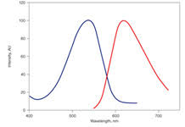
Propidium iodide
(хорошо флуоресцирует только при связывании с нуклеиновыми кислотами)
A
F

Slide 28
Сравнение уровня гибели клеток Y. lipolytica под действием облучения в отсутствии фотосенсибилизаторов. Сеанс облучения (или инкубации) составлял 30 мин. В данном представлении из величин эффектов при облучении вычтен темновой эффект, а разности приведены к одному значению мощности источников излучения.

Slide 29
Сравнение уровня гибели клеток Y. lipolytica под действием LED облучения (660 нм) в отсутствии фотосенсибилизаторов и с фотосенсибилизатором (производное пирофеофорбида (б/м-PrPhb) в концентрации 10 мкг/мл). Сеанс облучения (или инкубации) составлял 30 мин. В представленных данных полностью учтен темновой эффект и сделана поправка на мощность источников излучения.

Slide 30
Благодарю за внимание

