Slide 1
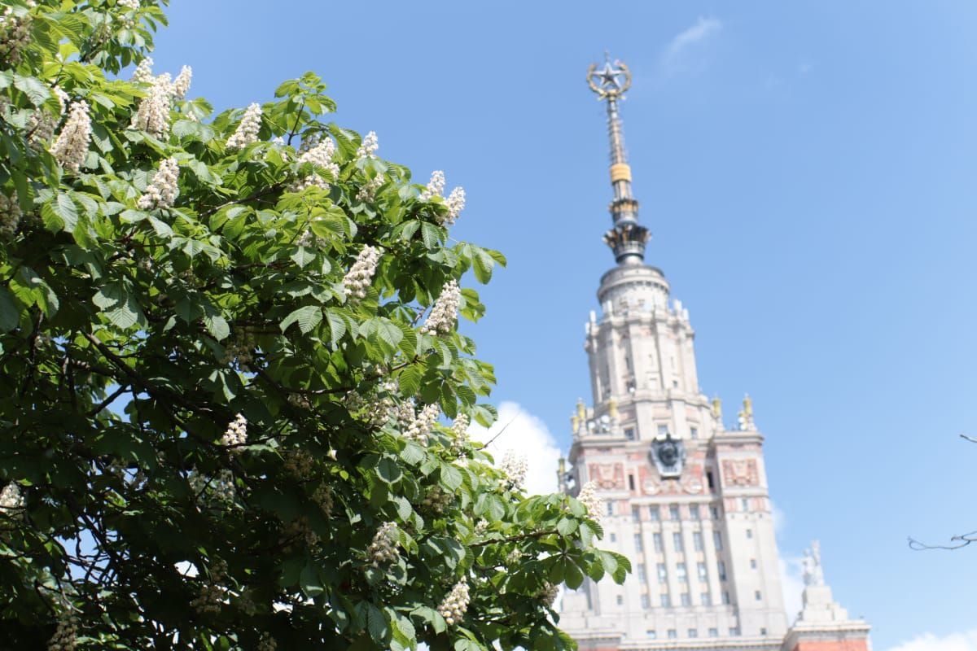

Lomonosov Moscow State University, Department of chemistry
Mono and binuclear porphyrazines with annelated
carbazole units:
synthesis and optical properties
Tatiana Dubinina
XIV International conference "Synthesis and application of porphyrins and their analogues"

Slide 2
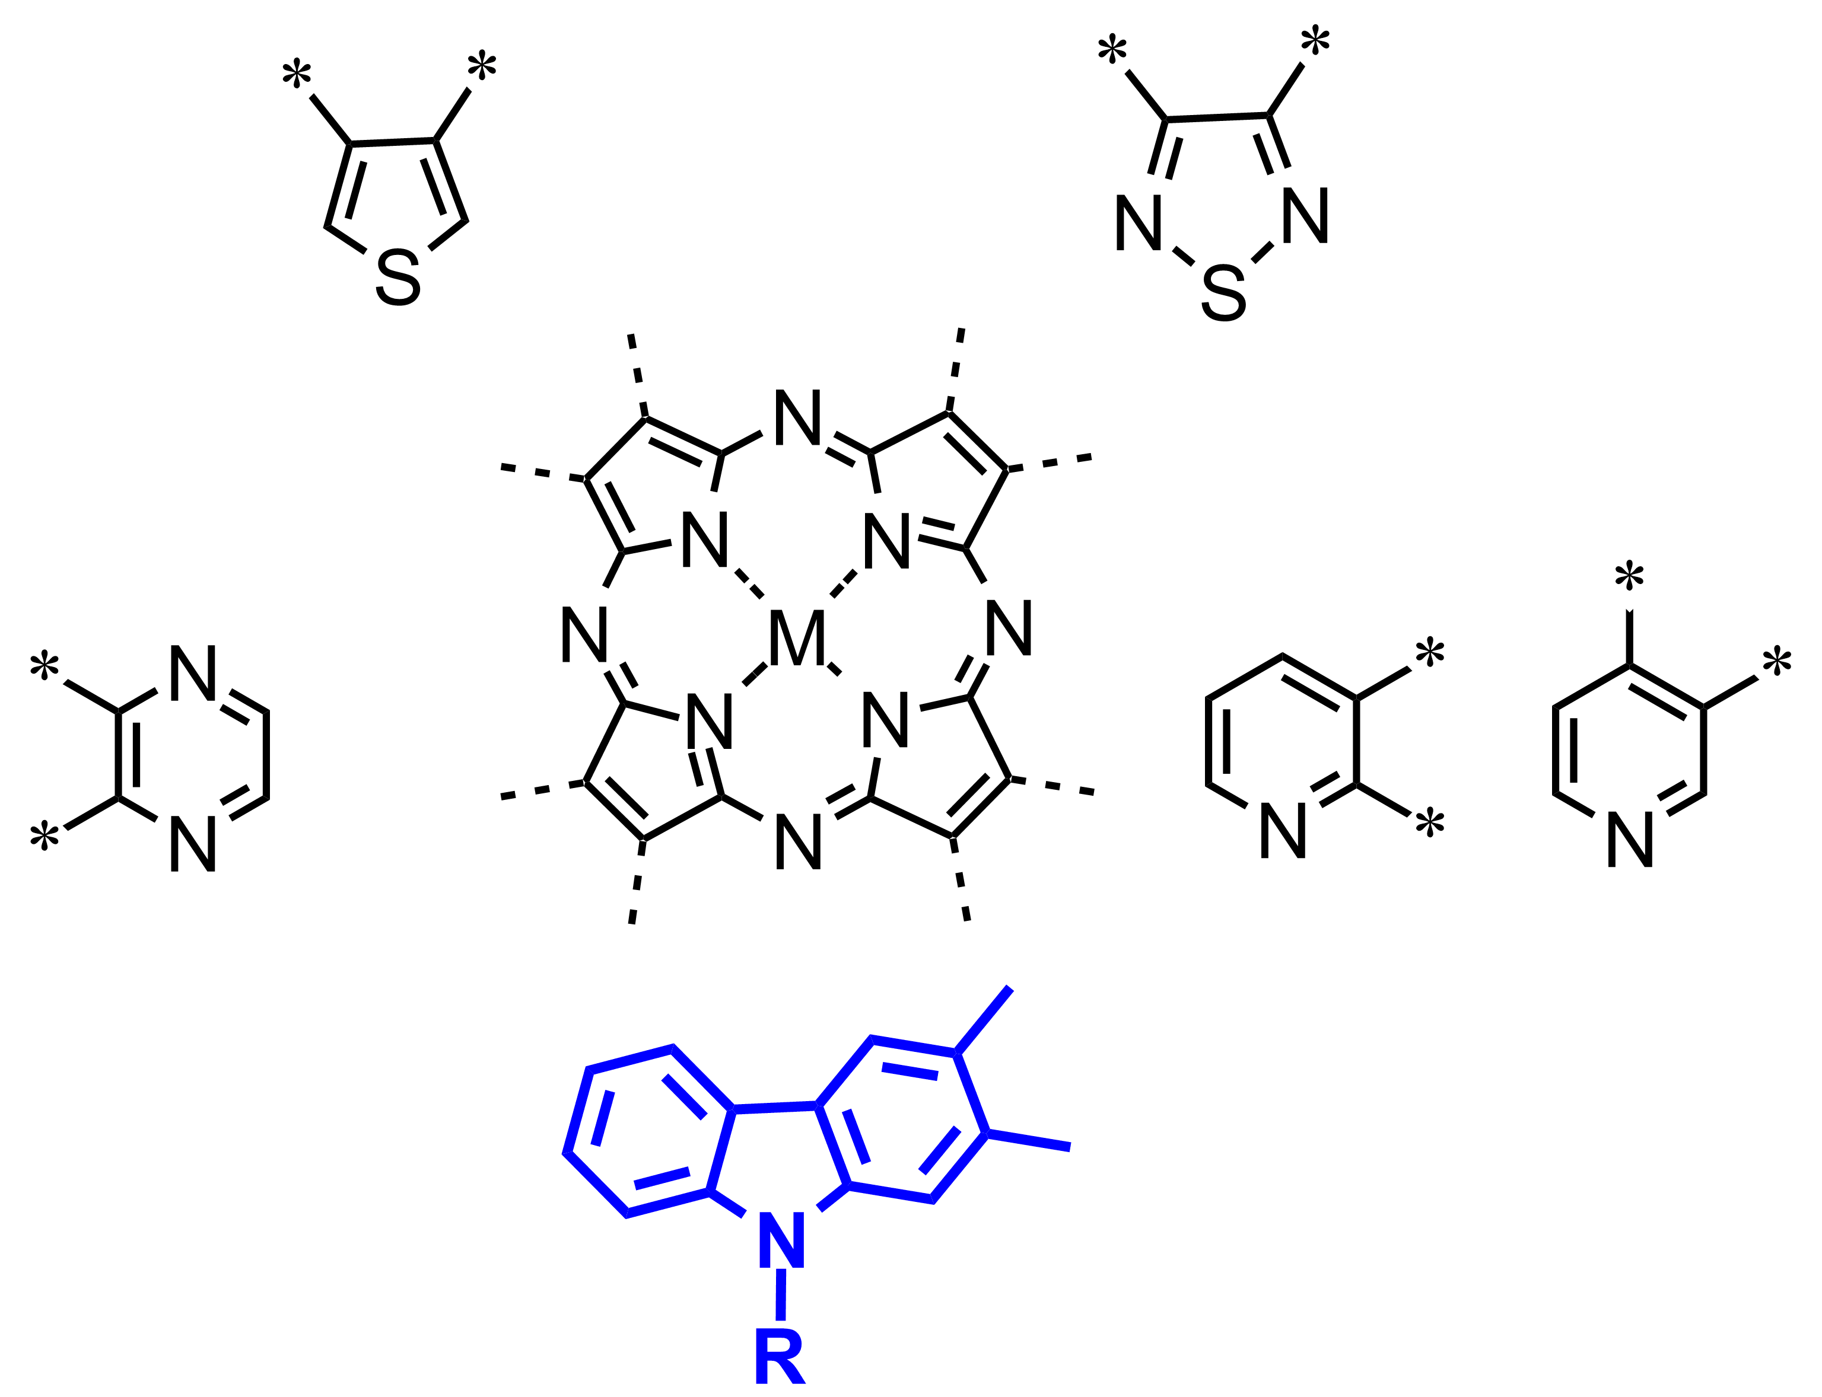
Heteroannelated porphyrazines
Kimura M, Suzuki H, Tohata Y, Ikeuchi T, Yamamoto S, Kobayashi N. Asian Journal of Organic Chemistry 2017; 6: 544-50

Slide 3
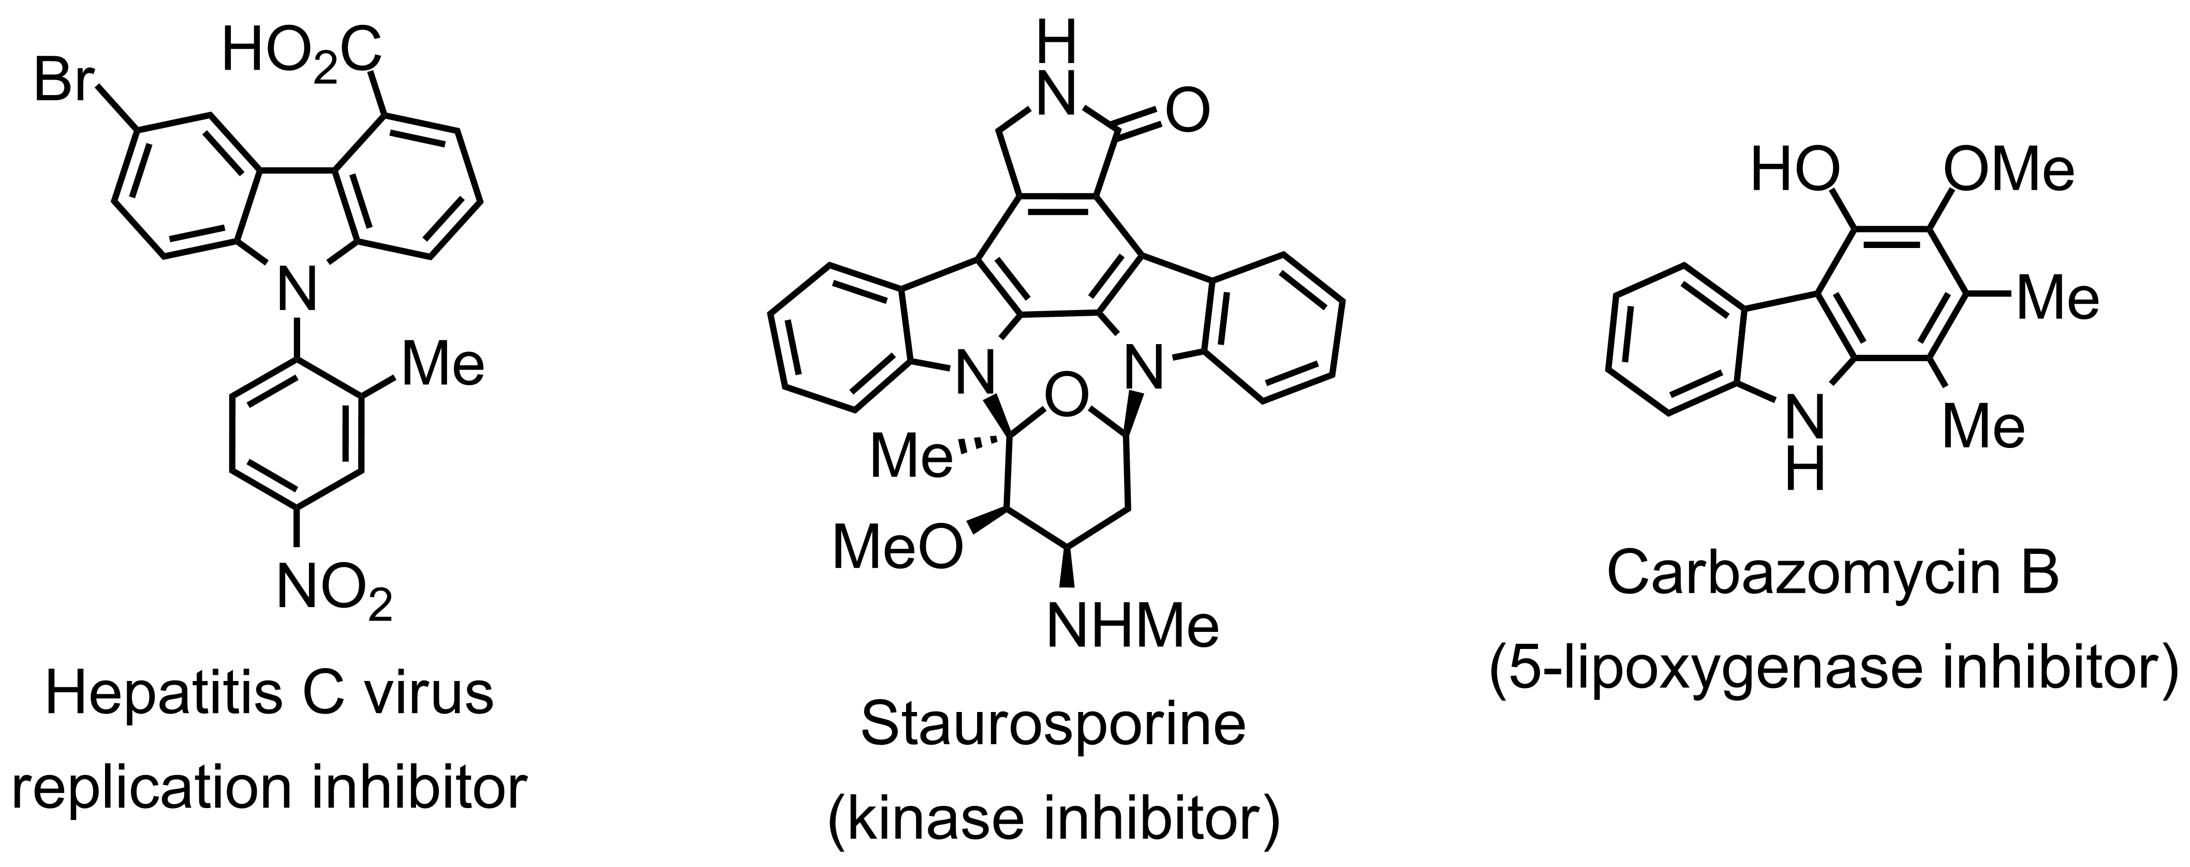
Drugs containing carbazoles
antibiotics
Synthetic materials for LEDs
containing the carbazole moiety
Advances in Heterocyclic Chemistry, eds. E. F. V. Scriven and C. A. Ramsden, Academic Press, 2019, vol. 129, pp. 1-88

Slide 4
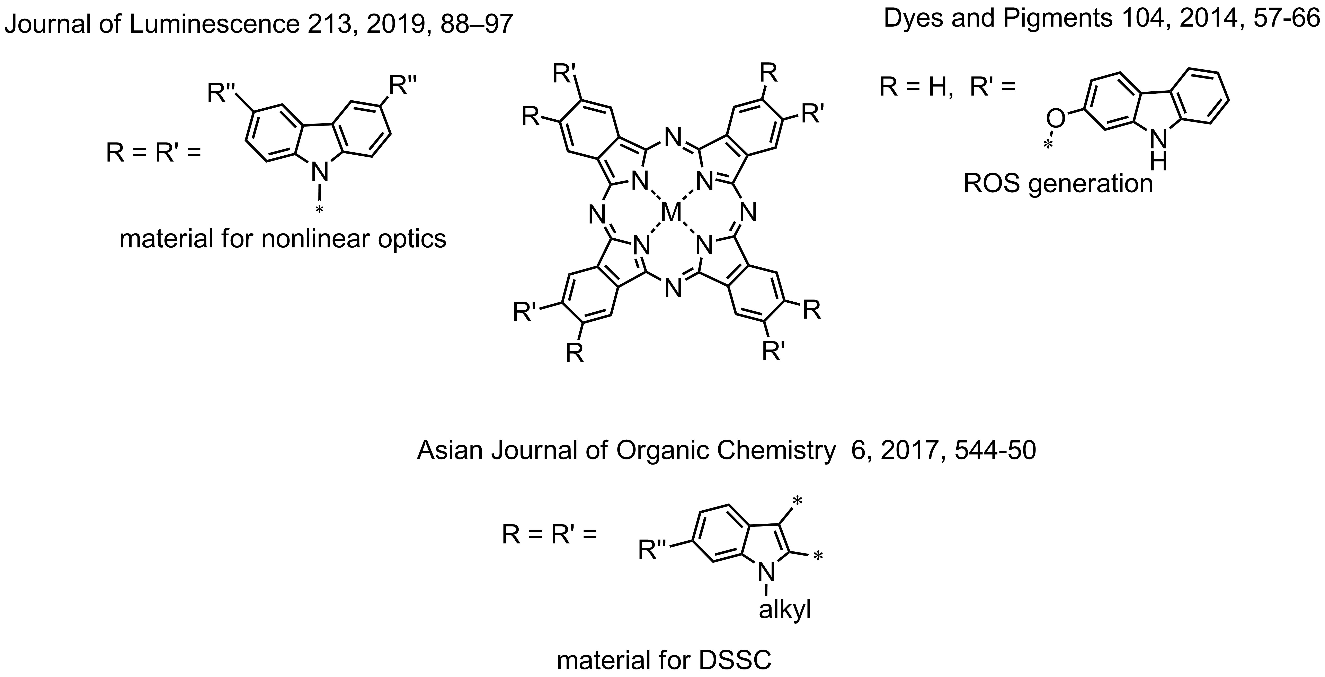
Carbazole unit as a functional group in phthalocyanines

Slide 5
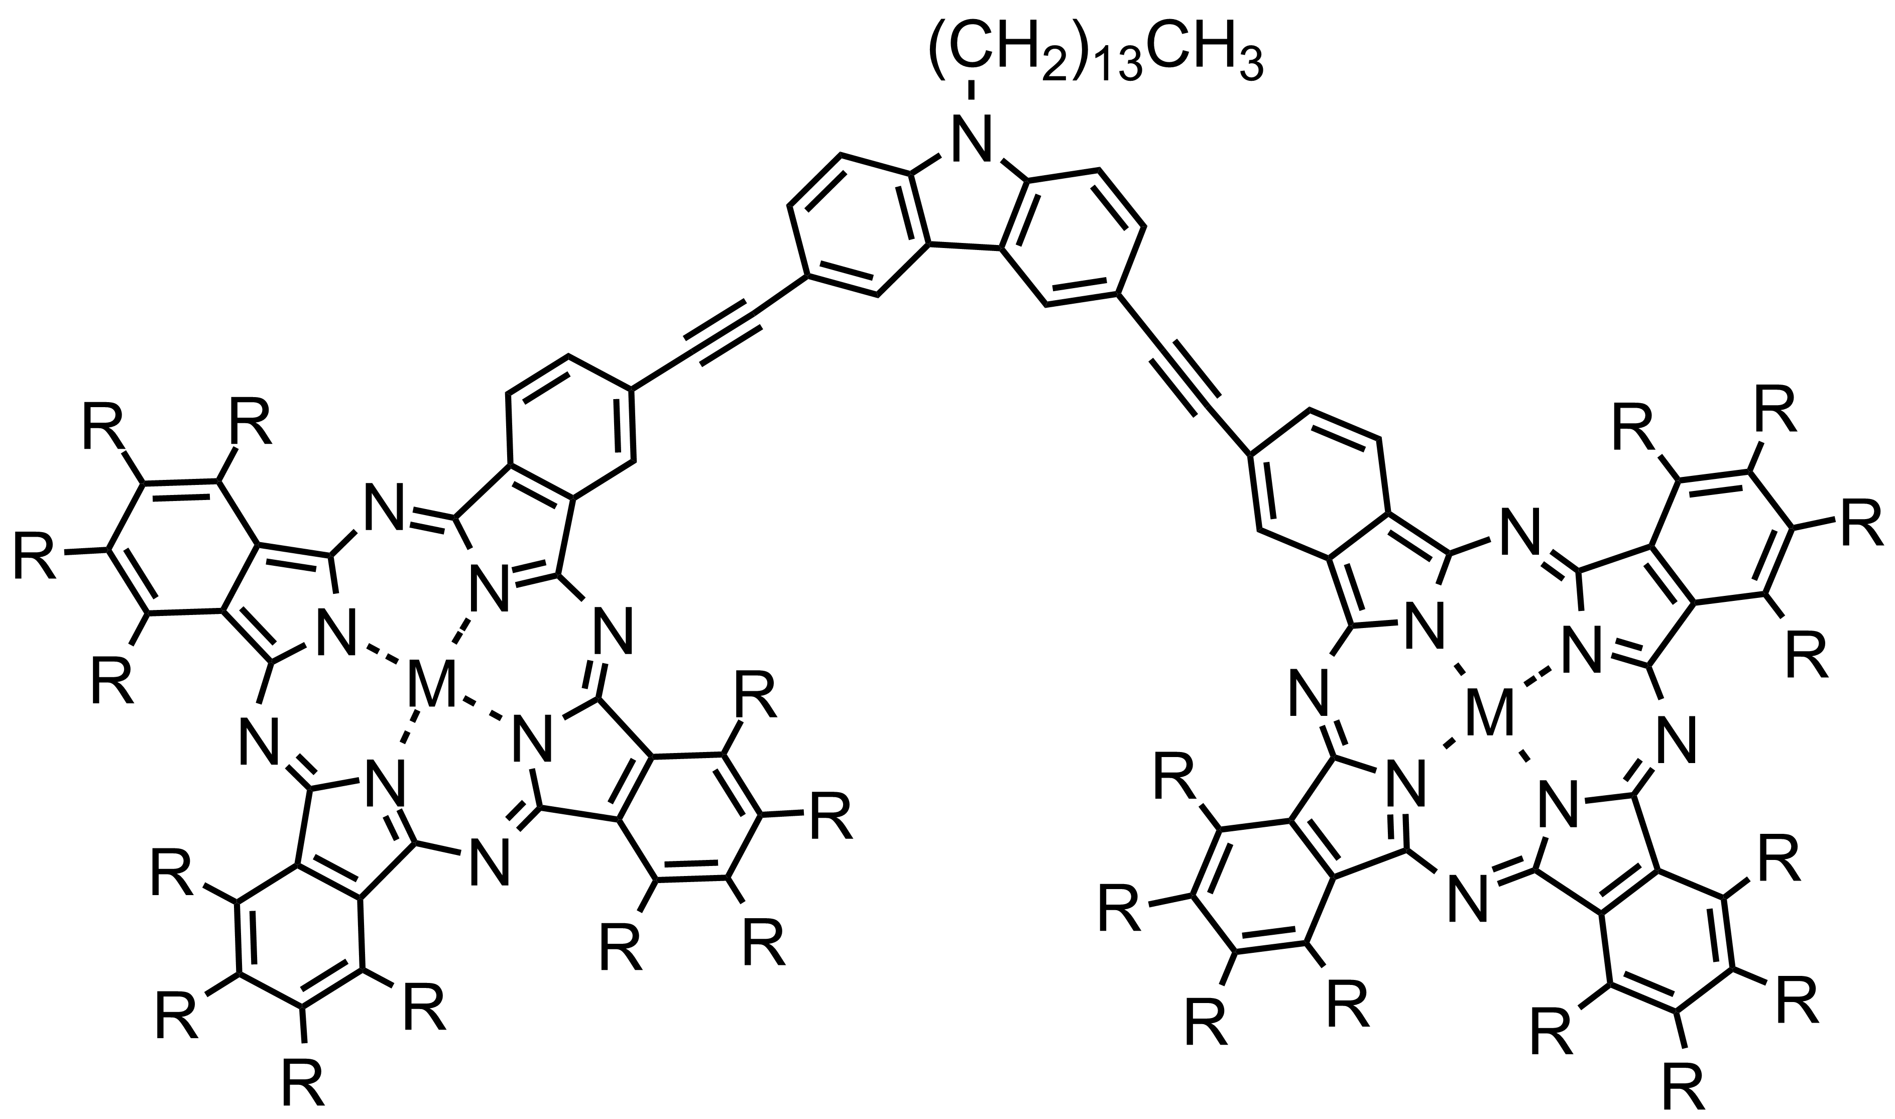
Example of binuclear phthalocyanine with carbazole linker
Dyes and Pigments 2003, 58, 135–143

Slide 6
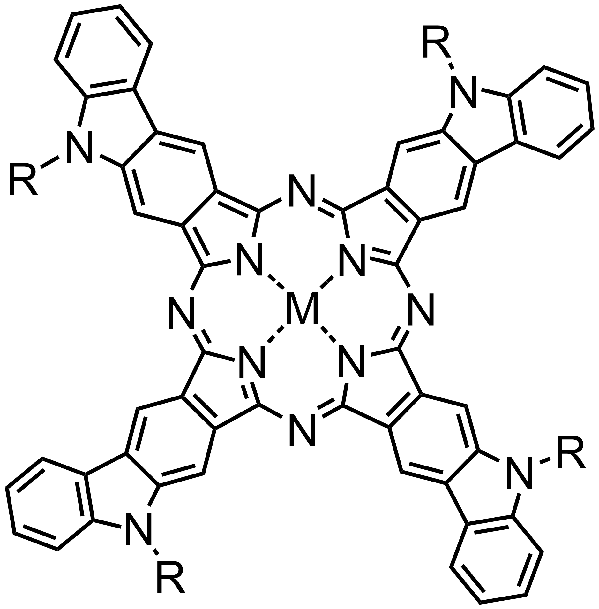
The main objects of study
mononuclear carbazole-fused porphyrazines
Binuclear porphyrazines with carbazole linker

Slide 7
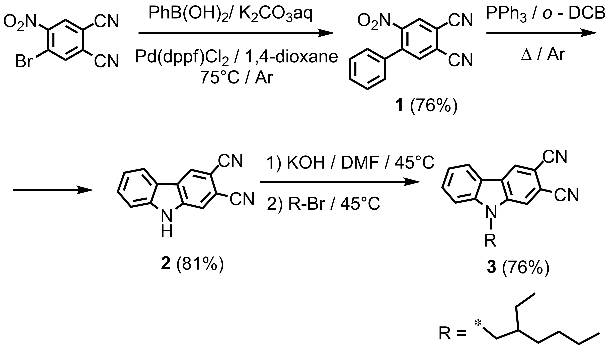
Synthesis of mononuclear carbazole-fused porphyrazines
Conditions of cross-coupling stage | Result
[Pd(PPh₃)₂]Cl₂, 1,4-dioxane, K₂CO₃(sat.), Δ | low conversion
Pd(PPh₃)₄, 1,4-dioxane, K₂CO₃(sat.), Δ | low conversion
Pd(PPh₃)₄, toluene, EtOH, K₂CO₃(sat.), 2M, Δ | low conversion, phthalocyanine admixture
Pd(dppf)Cl₂, toluene, EtOH, K₂CO₃(sat.), 2M, Δ | phthalocyanine admixture
Pd(dppf)Cl₂, 1,4-dioxane, K₂CO₃(sat.), Δ | complete conversion

Slide 8
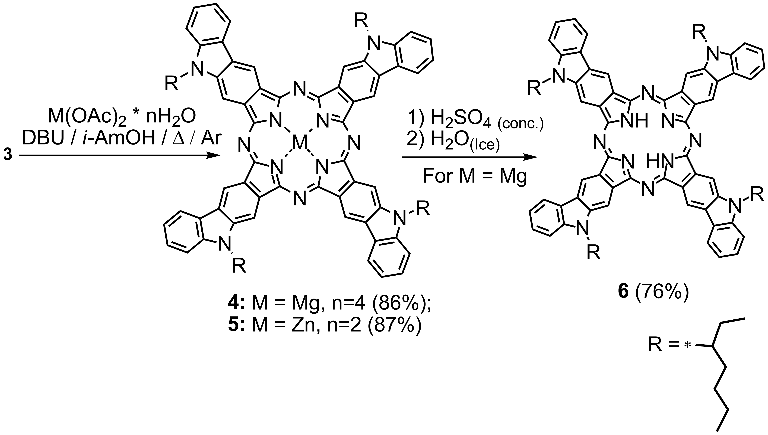
Synthesis of mononuclear carbazole-fused porphyrazines
Only one of potential isomers is shown

Slide 9
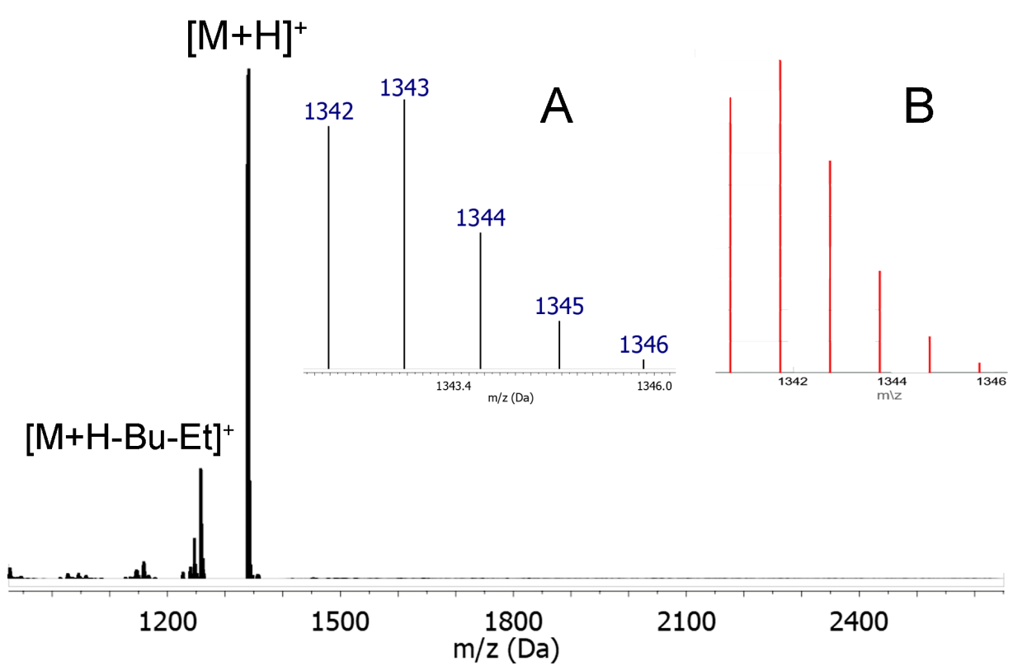
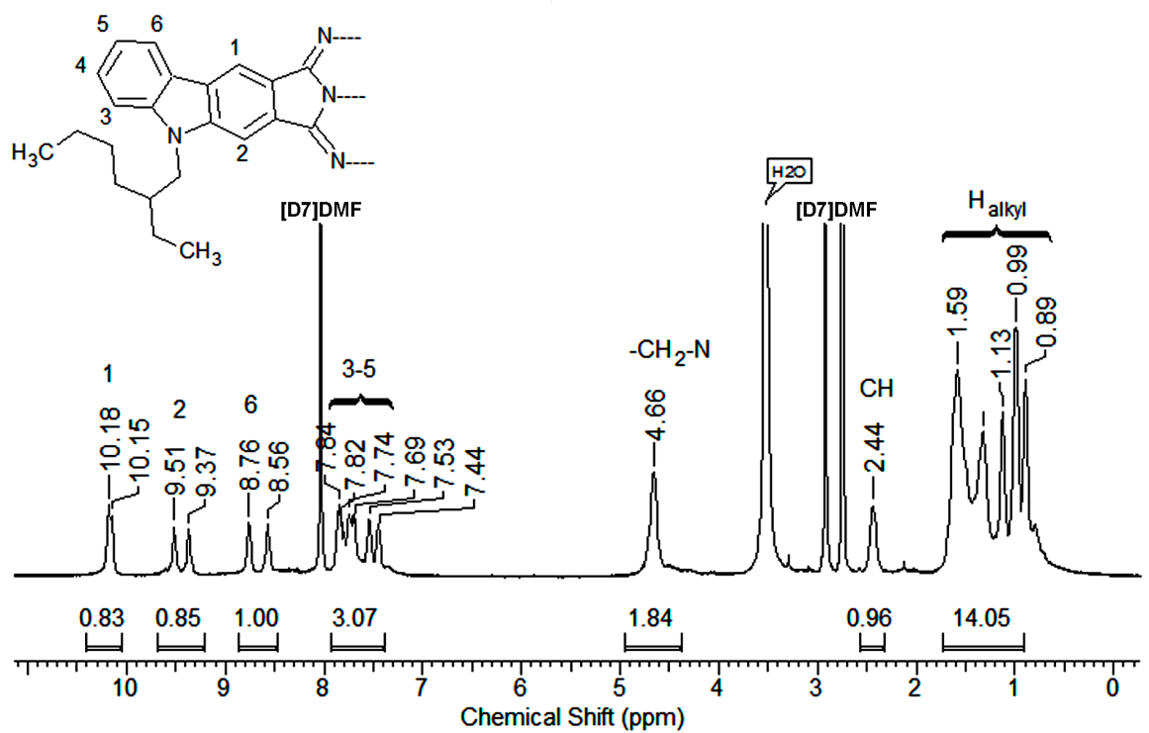
Identification of carbazole-fused porphyrazines
MALDI TOF (positive ion mode) of Mg complex 4, isotopic pattern (inset A) and simulated MS pattern (inset B)
¹H NMR spectrum of Mg complex 4 measured in [D7]DMF

Slide 10
UV-Vis spectroscopy of carbazole-fused porphyrazines
UV-Vis spectra of zinc carbazolocyanine and unsubstituted zinc phthalocyanine in DMF
UV-Vis spectra of magnesium carbazolocyanine (4) and corresponding ligand (6) in DMF

Slide 11
Binuclear porphyrazines with carbazole linker

Slide 12
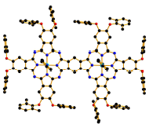
Extension of π-system
Inorg. Chem. Front., 2017, 4, 110
Dyes and Pigments, 2012, 93, 1471
Chem. Commun., 2012, 48, 4365
Dyes and Pigments, 2014, 9, 163

Slide 13
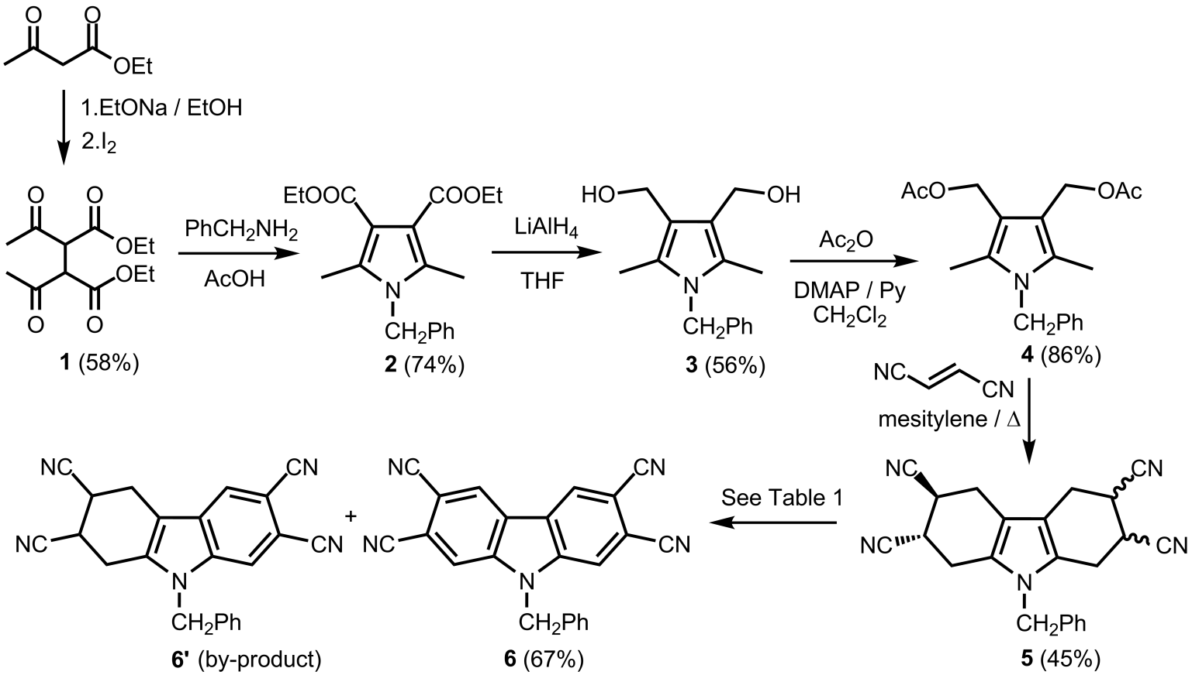
Synthesis of binuclear porphyrazines with carbazole linker: preparation of carbazole linker

Slide 14
The most challenging step - oxidative aromatization
Oxidizing agent | Conditions | Products
Chloranil | Mesitylene / Δ | + | + | +
DDQ | 1,4-dioxane / Δ | - | + | +
DDQ | о-DCB / 100°C | - | + | +
DDQ | о-DCB / Δ | - | - | +

Slide 15
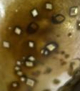
Molecular structure of tetracyano-carbazole

Slide 16

Synthesis of binuclear porphyrazines with carbazole linker: mixed (statistical) cyclization
A₄
A₃B
A₃B
A₄
Binuclear compound

Slide 17
Synthesis of binuclear porphyrazines with carbazole linker:
direct cyclization

Slide 18
UV-Vis-NIR and MCD data for tert-butyl-substituted complexes
We thank professor N.Kobayashi for MCD measurements

Slide 19
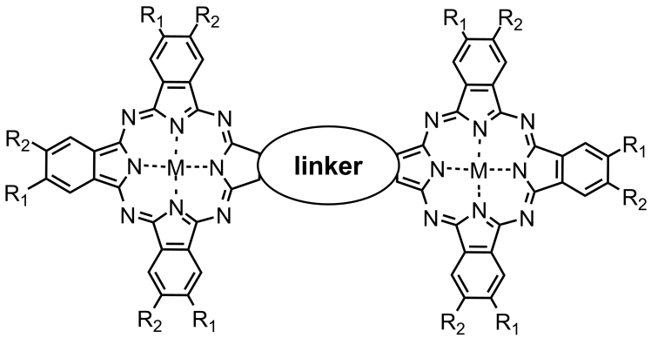
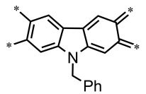



Q band’s positions for planar binuclear complexes
835nm
712nm
Russian Chemical Bulletin 2006; 55: 1155-58
789nm
784nm
Inorganica Chimica Acta 2010; 363: 1869-78
Chemical Communications 2012; 48: 4365-67

Slide 20
Synthesis of binuclear porphyrazines with carbazole linker
UV-Vis-NIR spectra in DMF

Slide 21
Singlet oxygen quantum yields
Compound | Φ_{Δ} (DMF)
tBu binuclear | 0,15
Ph binuclear | 0,08
PhO binuclear | 0,09
Photosens® | 0,19
λ_{max} = 675 nm

Slide 22
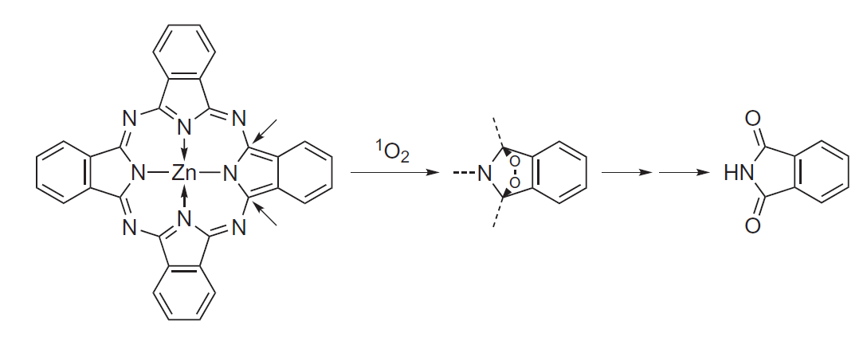
Photodegradation of binuclear porphyrazines
with carbazole linker
degradation
Degradation rate in different solvents:
ν(DMF) > ν(C₆H₆) > ν(THF)

Slide 24
Conclusions
Effective synthetic approaches to carbazolocyanines and initial dinitrile were developed
Novel type of planar binuclear porphyrazines sharing a common aromatic bridge were obtained
Photochemical properties, including photodegradation process, were investigated for binuclear complexes

Slide 25
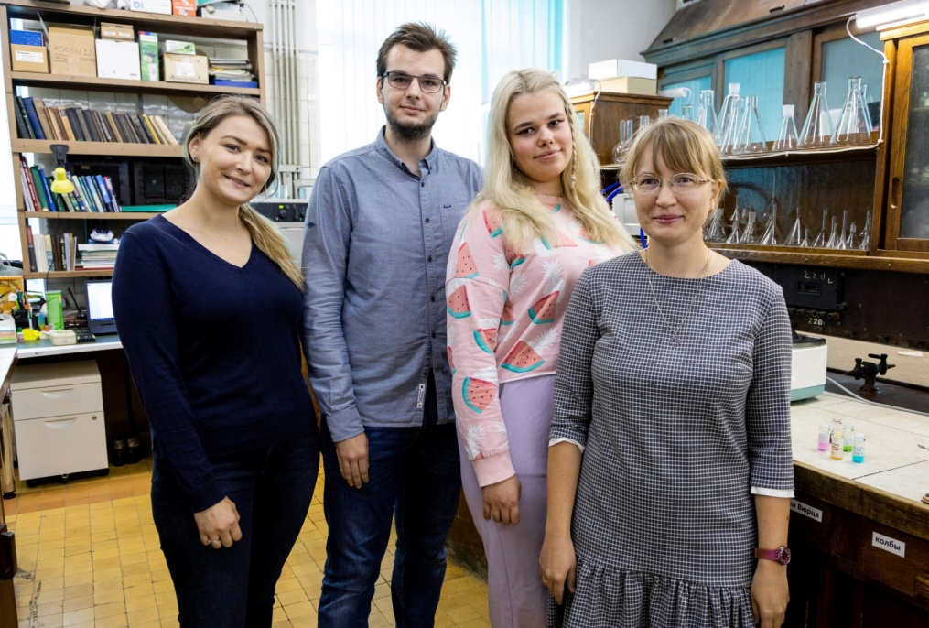


PhD M.A. Gradova (Semenov Institute of
Chemical Physics),
Prof. N. Kobayashi (Shinshu University)
Group of phthalocyanines and their analogs (MSU):
PhD A.D. Kosov and E.A. Gorbunova
M.Sc. E.O.Moiseeva
students M.S.Belousov, A.S. Agranat, N.E. Kononenko and A.A. Petukhova
Thank you for your attention!
financial support from
Russian Science Foundation Grant № 21-73-00162

Slide 26
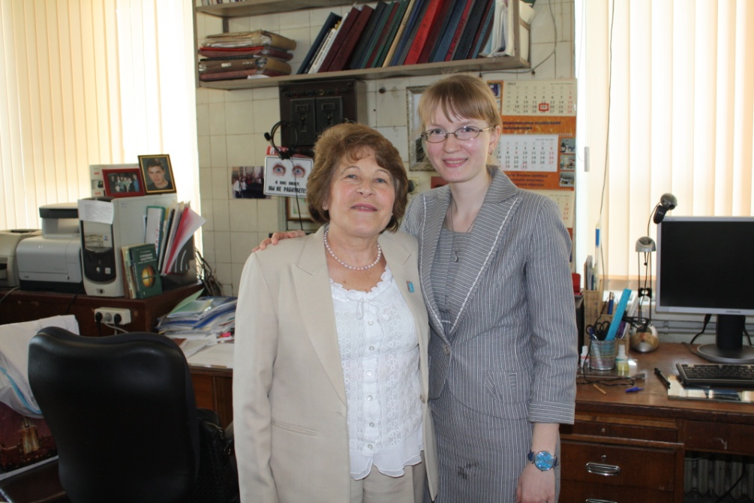
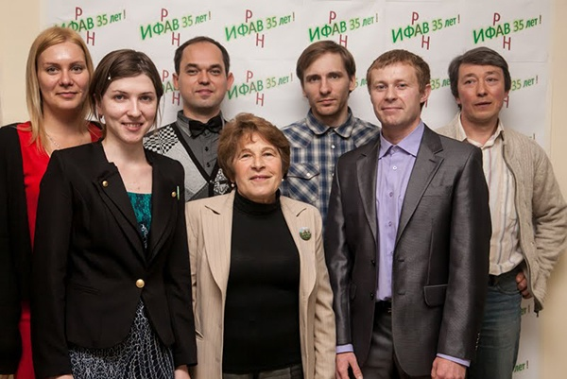
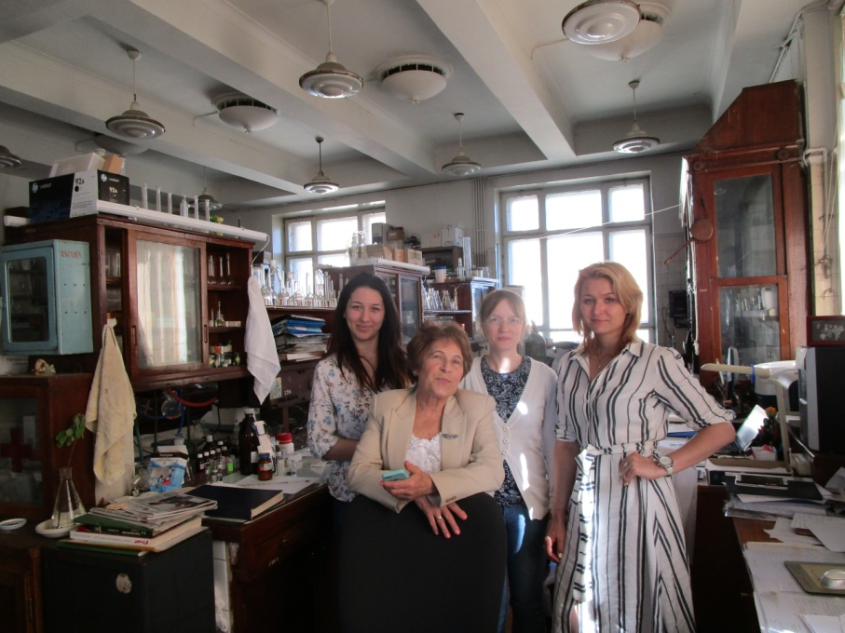
to the memory of Professor Larisa Tomilova (11/04/1947 - 04/01/2021)

