Slide 1
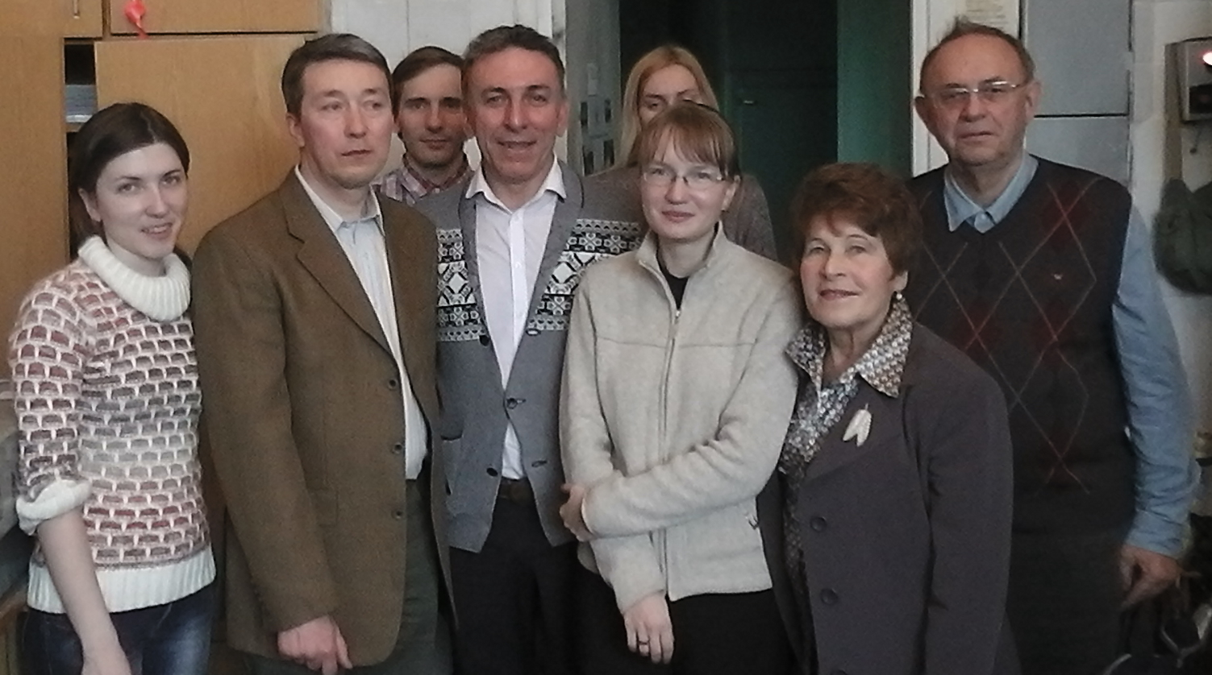

Slide 2
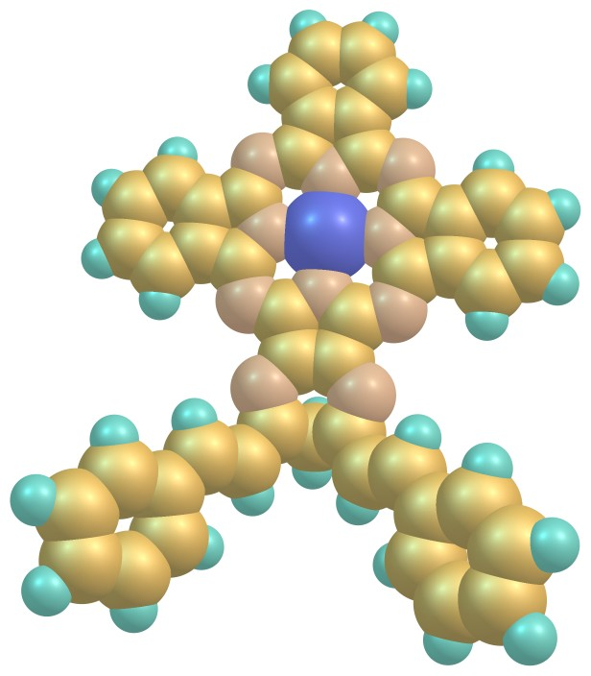
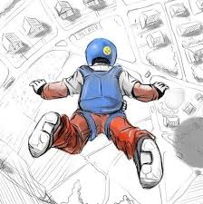
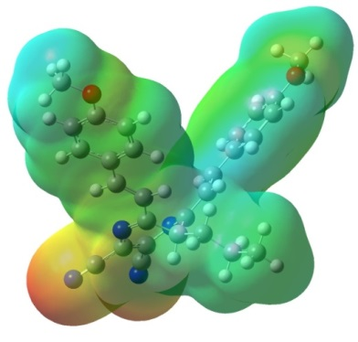
TRIBENZO-1,4-DIAZEPINOPORPHYRAZINES AS PERSPECTIVE PHOTOSENSITIZERS WITH BREAKDOWN OF THE KASHA-VAVILOV’S RULE
P.A. Tarakanov,^{1,2} A.O. Simakov, M.E. Neganova,¹ D.V. Mischenko,^{2,3} S.D. Bondarenko,^{2,4} P.A. Mikhina,^{2,4} I.A. Sergeeva,⁴ K.V. Fedorova,⁴ A.R. Krot,⁴ N.S. Goryachev,^{2,4} M.S. Kukharsky,¹ S.A. Pukhov,¹ V.E. Pushkarev¹
¹Institute of Physiologically Active Compounds RAS, 142432 Chernogolovka, Russia
²Institute of Problems of Chemical Physics RAS, 142432 Chernogolovka, Russia
³ Research and Education Center of Moscow State Regional University in Chernogolovka, Mytishchi, Russia
⁴ M.V. Lomonosov Moscow State University, 119991 Moscow, Russia

Slide 3
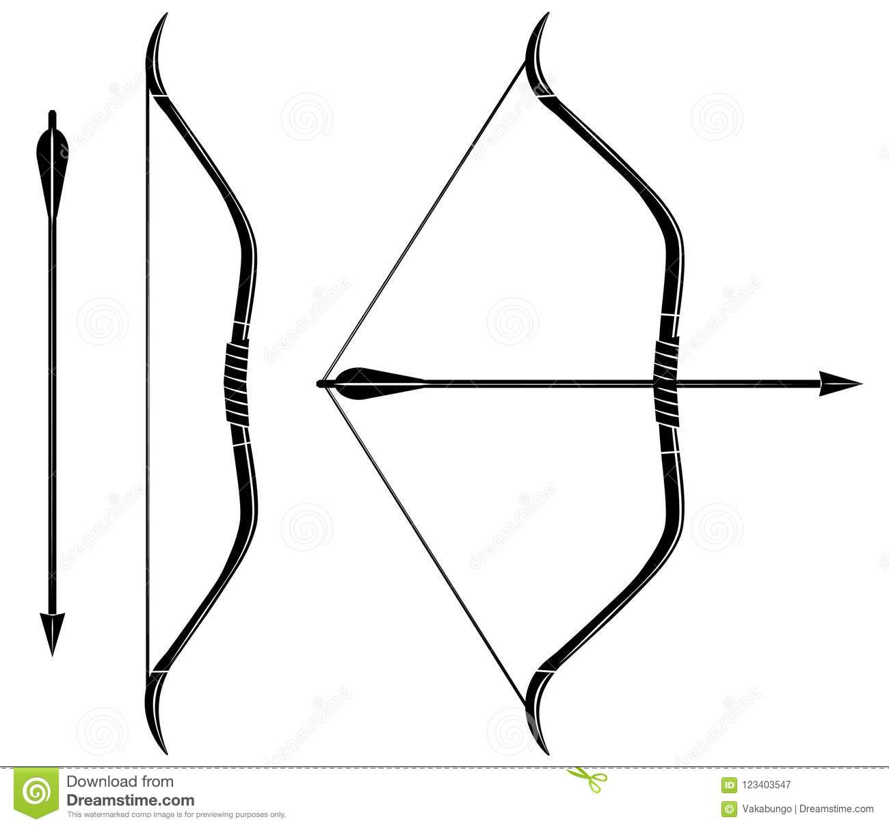
Path to preclinical studies
Animal model
Interaction with blood serum
Photophysical properties
Molecular
structure
Nano-construction of
PSs in water solutions
Study in cell
cultures
Photochemical properties
Interaction with tissue homogenate

Slide 4
Synthesis
Macroheterocycles 2018 11(3) 312-315

Slide 5
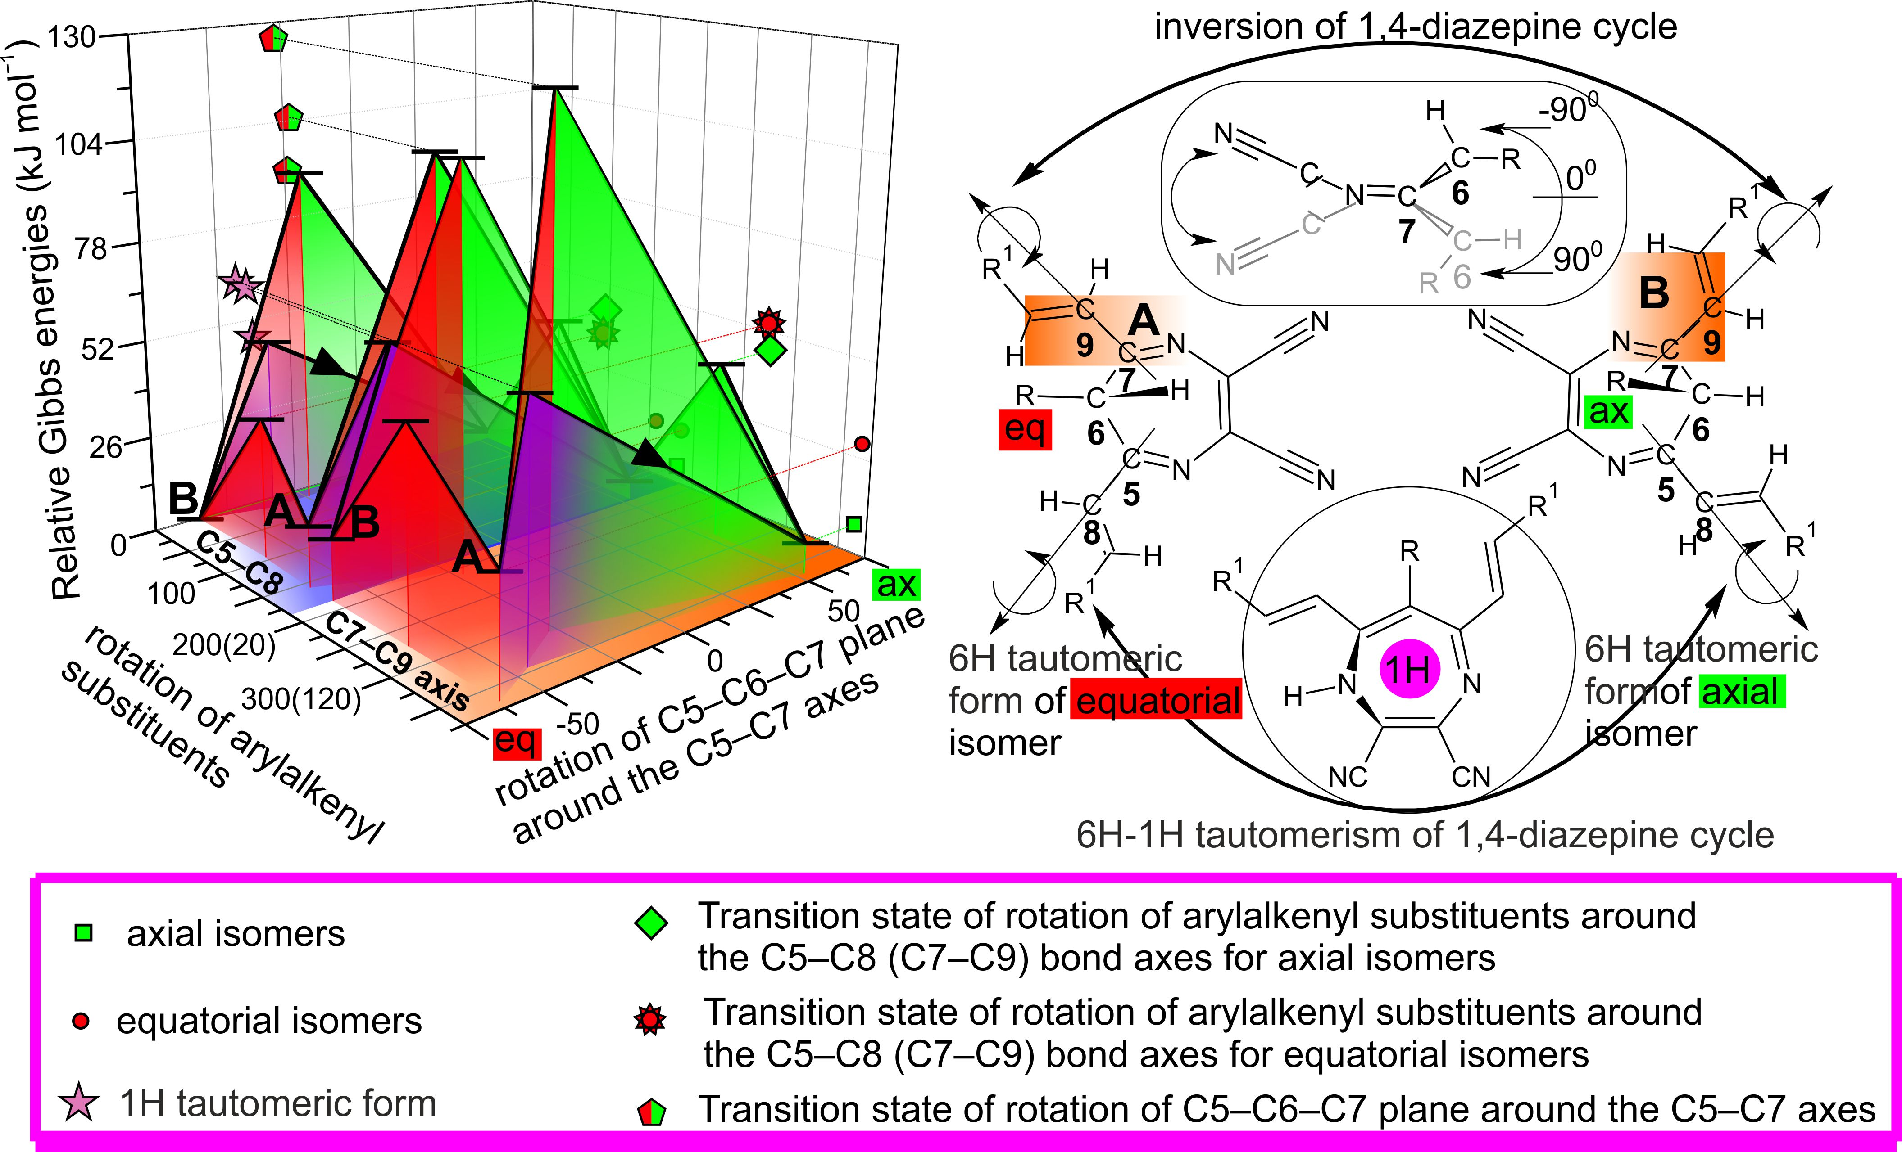
Particular structural features of 6-substituted 5,7-bis(2’-arylethenyl)-6H-1,4- diazepine-2,3-dicarbonitrile
Org. Biomol. Chem., 2016, 14, 1138-1146; Macroheterocycles 2018 11(3) 312-315

Slide 6
Strong intermolecular hydrogen bonding interactions in 1,4-diazepineporphyrazines
Ellipsoid style presentation: A, B – top and front view, respectively (hydrogen atoms are omitted for clarity).
Capped sticks style presentation with color by symmetry equivalence, hydrogen bonding and short contacts options were applied: C – top view.
Dalton Trans., 2018, 47, 14169-14173

Slide 7
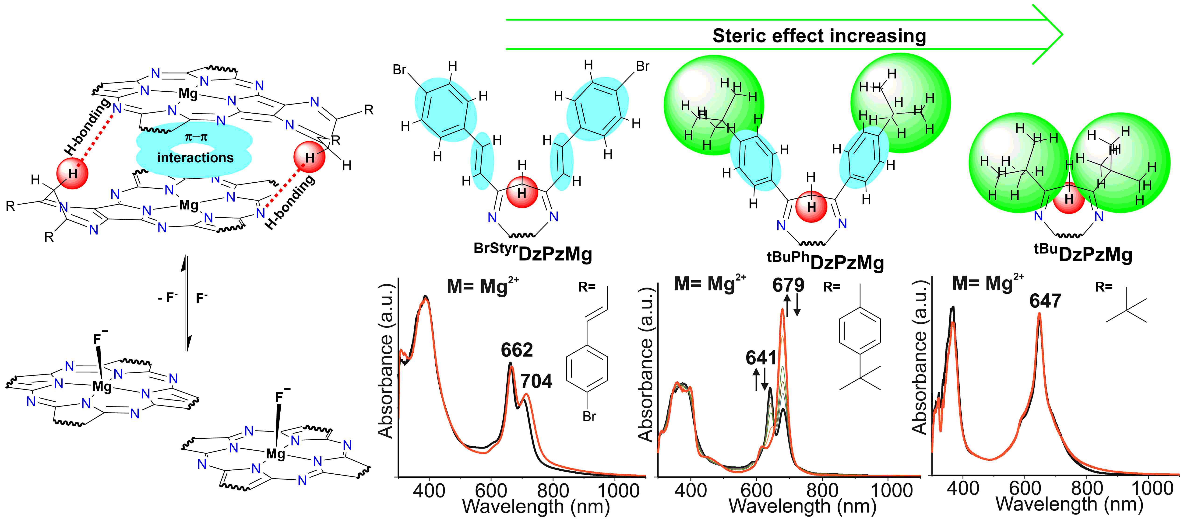
The extent of dimerization could be modulated by the specific choice of peripheral diazepine substituents
The spectral changes resulting from changes in the peripheral substituents and solvent conditions. Py = pyridine. C_{M} = 2–5 μM. C_{M}(TBAF) = 500 μM.
Dalton Trans., 2018, 47, 14169-14173; J. Porphyrins Phthalocyanines 2021, 25, 1204-1211

Slide 8
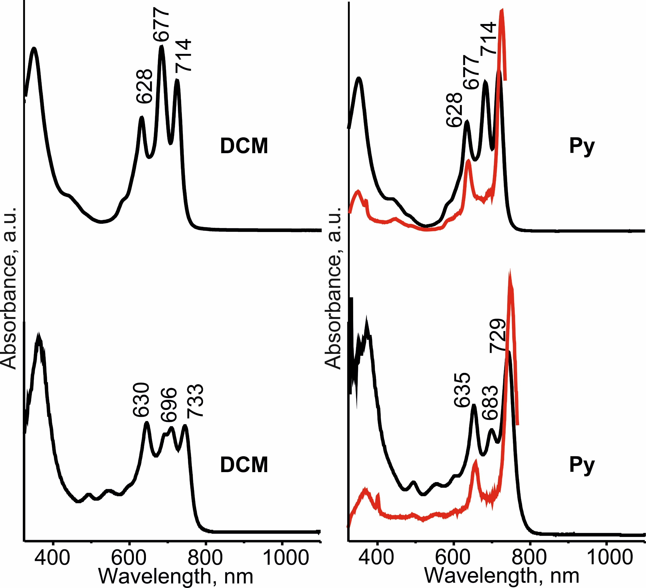
The extent of aggregation could be modulated by the specific choice of peripheral diazepine substituents
Spectrochimica Acta Part A: Molecular and Biomolecular Spectroscopy 139 (2015), 464–470

Slide 9
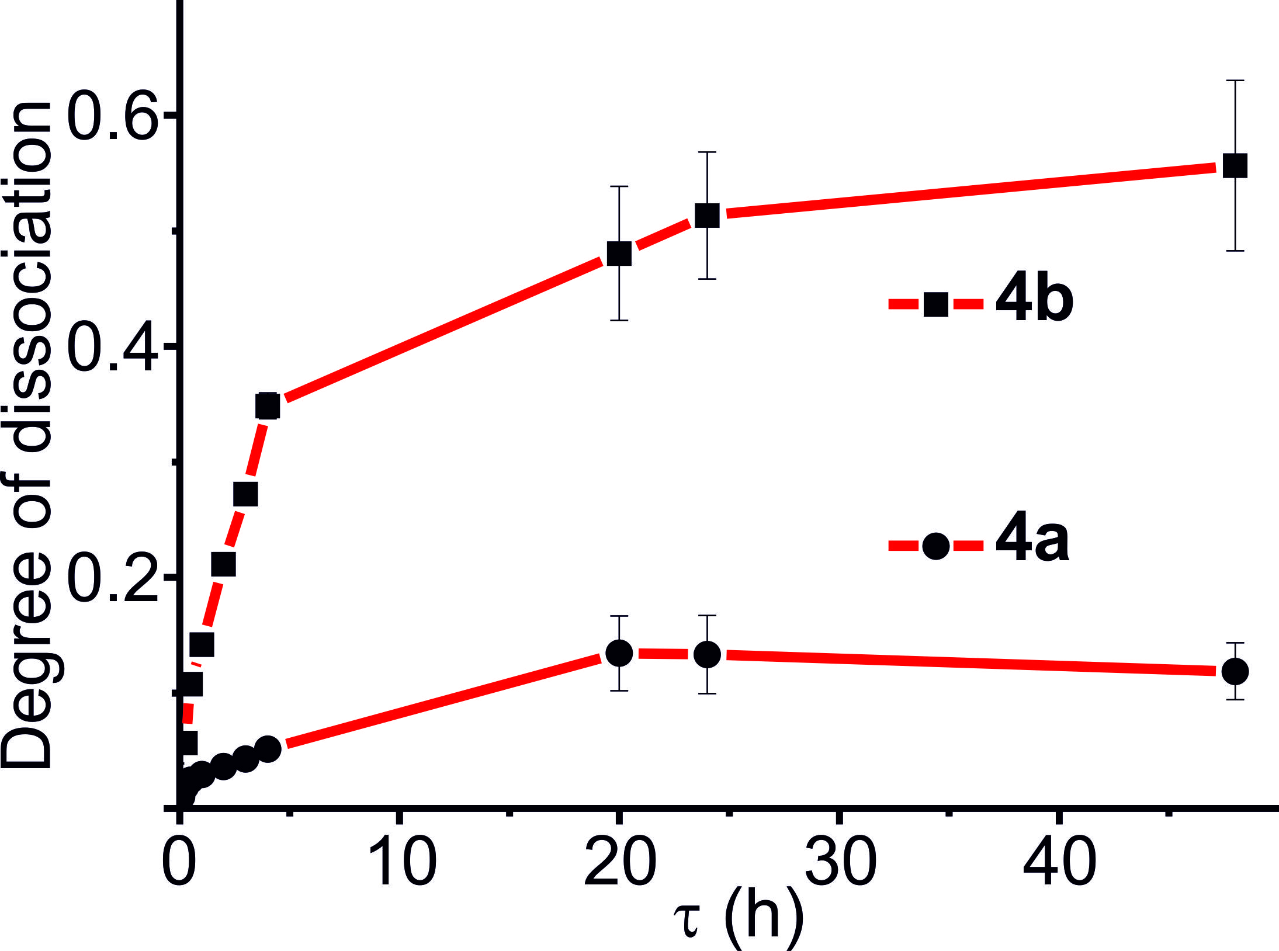
The extent of aggregation of PSs in MCF-7 cells and rat brain homogenates
The fluorescence quantum yields of 4a,b
complexes | Φ_{F}
 | λ_{excited} = 620 nm
4a | 0.35 ±0.04
4b | 0.05 ±0.005
4a
4b
Time dependence of degree of dissociation of 4a,b in rat brain homogenate (RBH) obtained by fluorescence measurements (C= 10 μM)
4a/DAPI
4b/DAPI
Fluorescence image of MCF-7 cells with micellar forms of 4a,b 10 μM

Slide 10
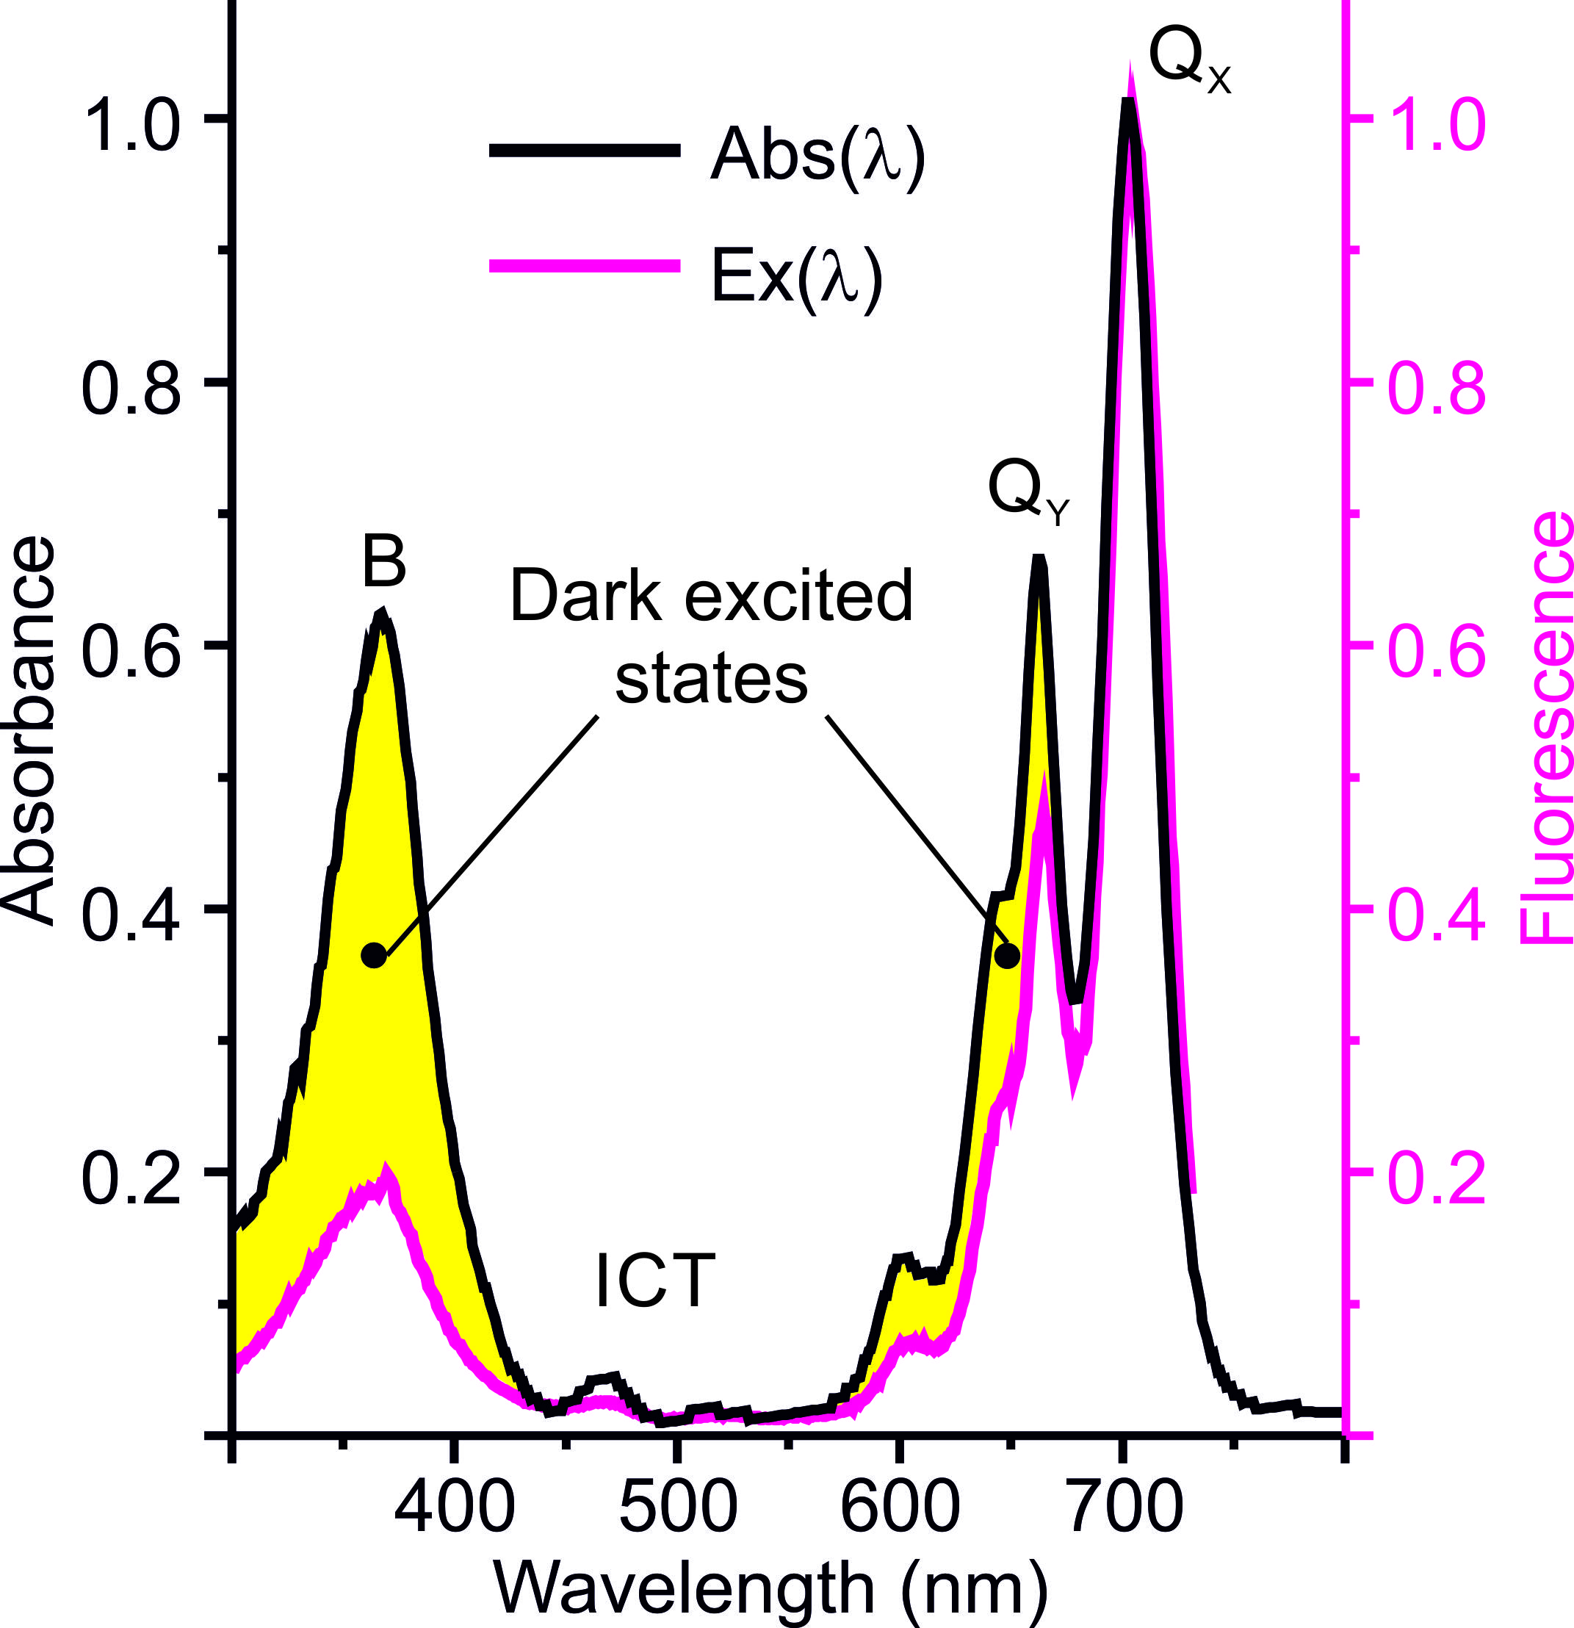
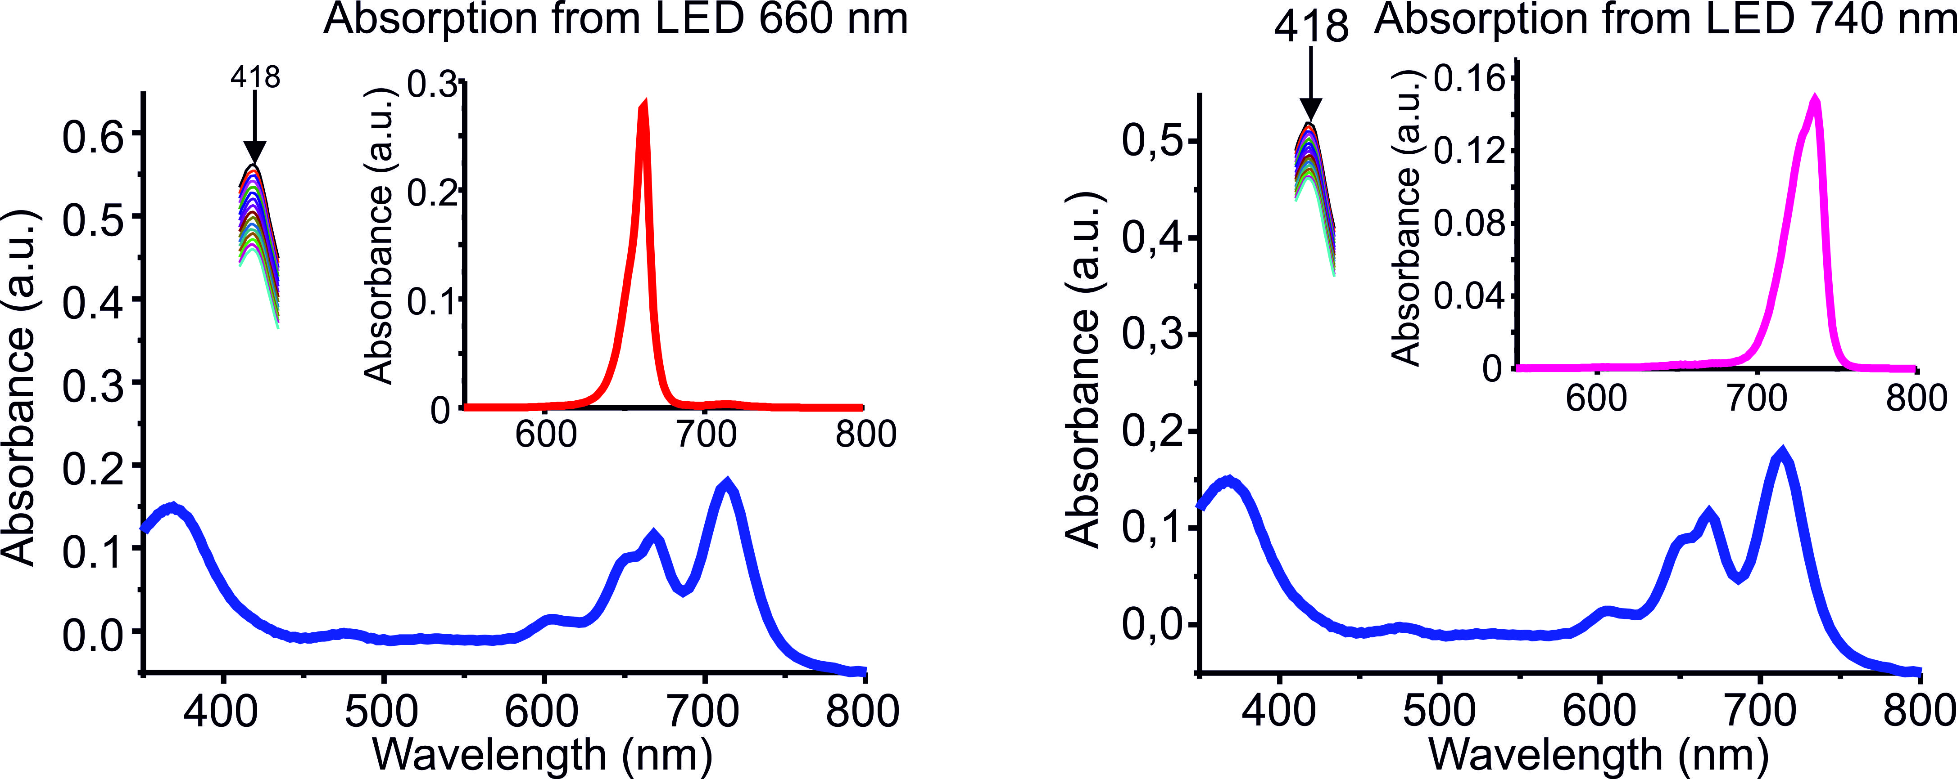
Photophysical and Photochemical properties
Table 1. The fluorescence and singlet oxigen quantum yields of 4a depend on the excitation wavelength
complexes | Φ_{F} |  | Ф_{Δ}
 | Excited |  | Excited
 | Qx | Qy | Qx | Qy
4a | 0.5 ±0.05 | 0.35 ±0.04 | 0.34 ±0.03 | 0.62 ±0.06
Normalized absorbance and fluorescence spectra of 4a

Slide 11
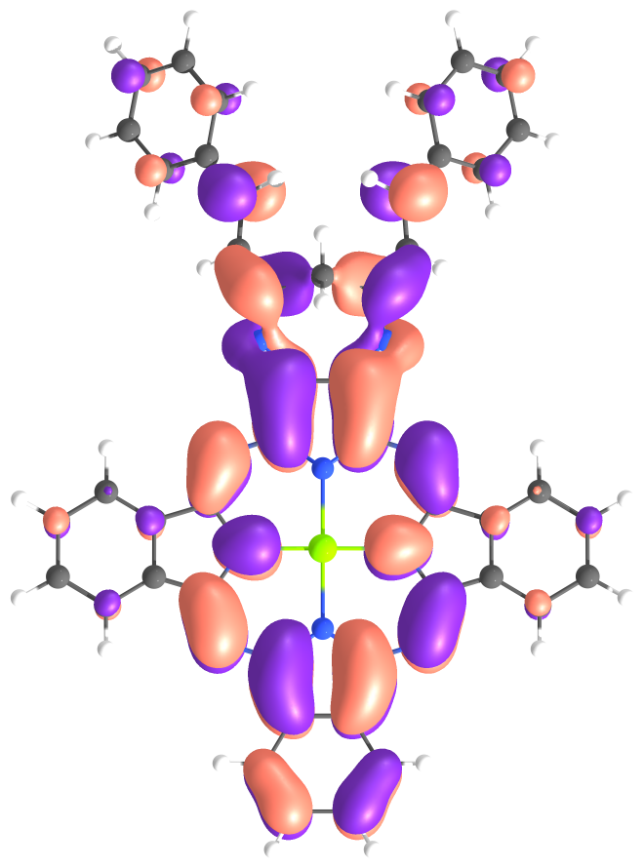
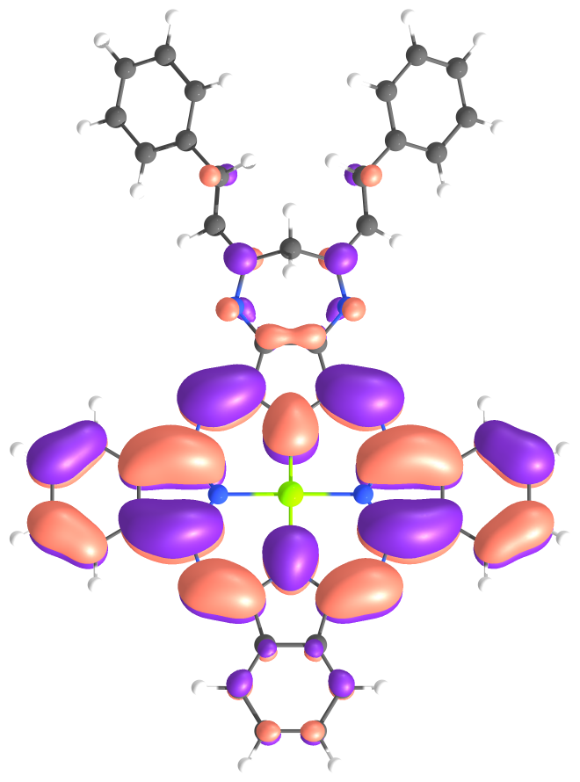
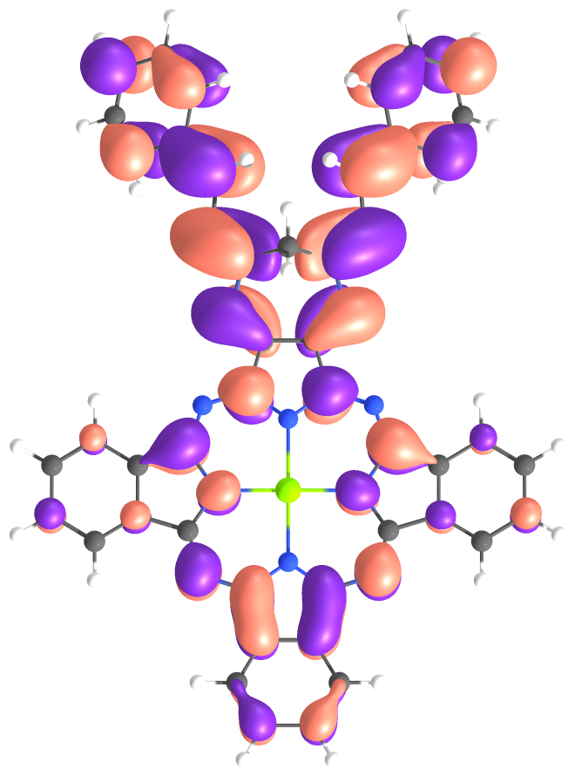
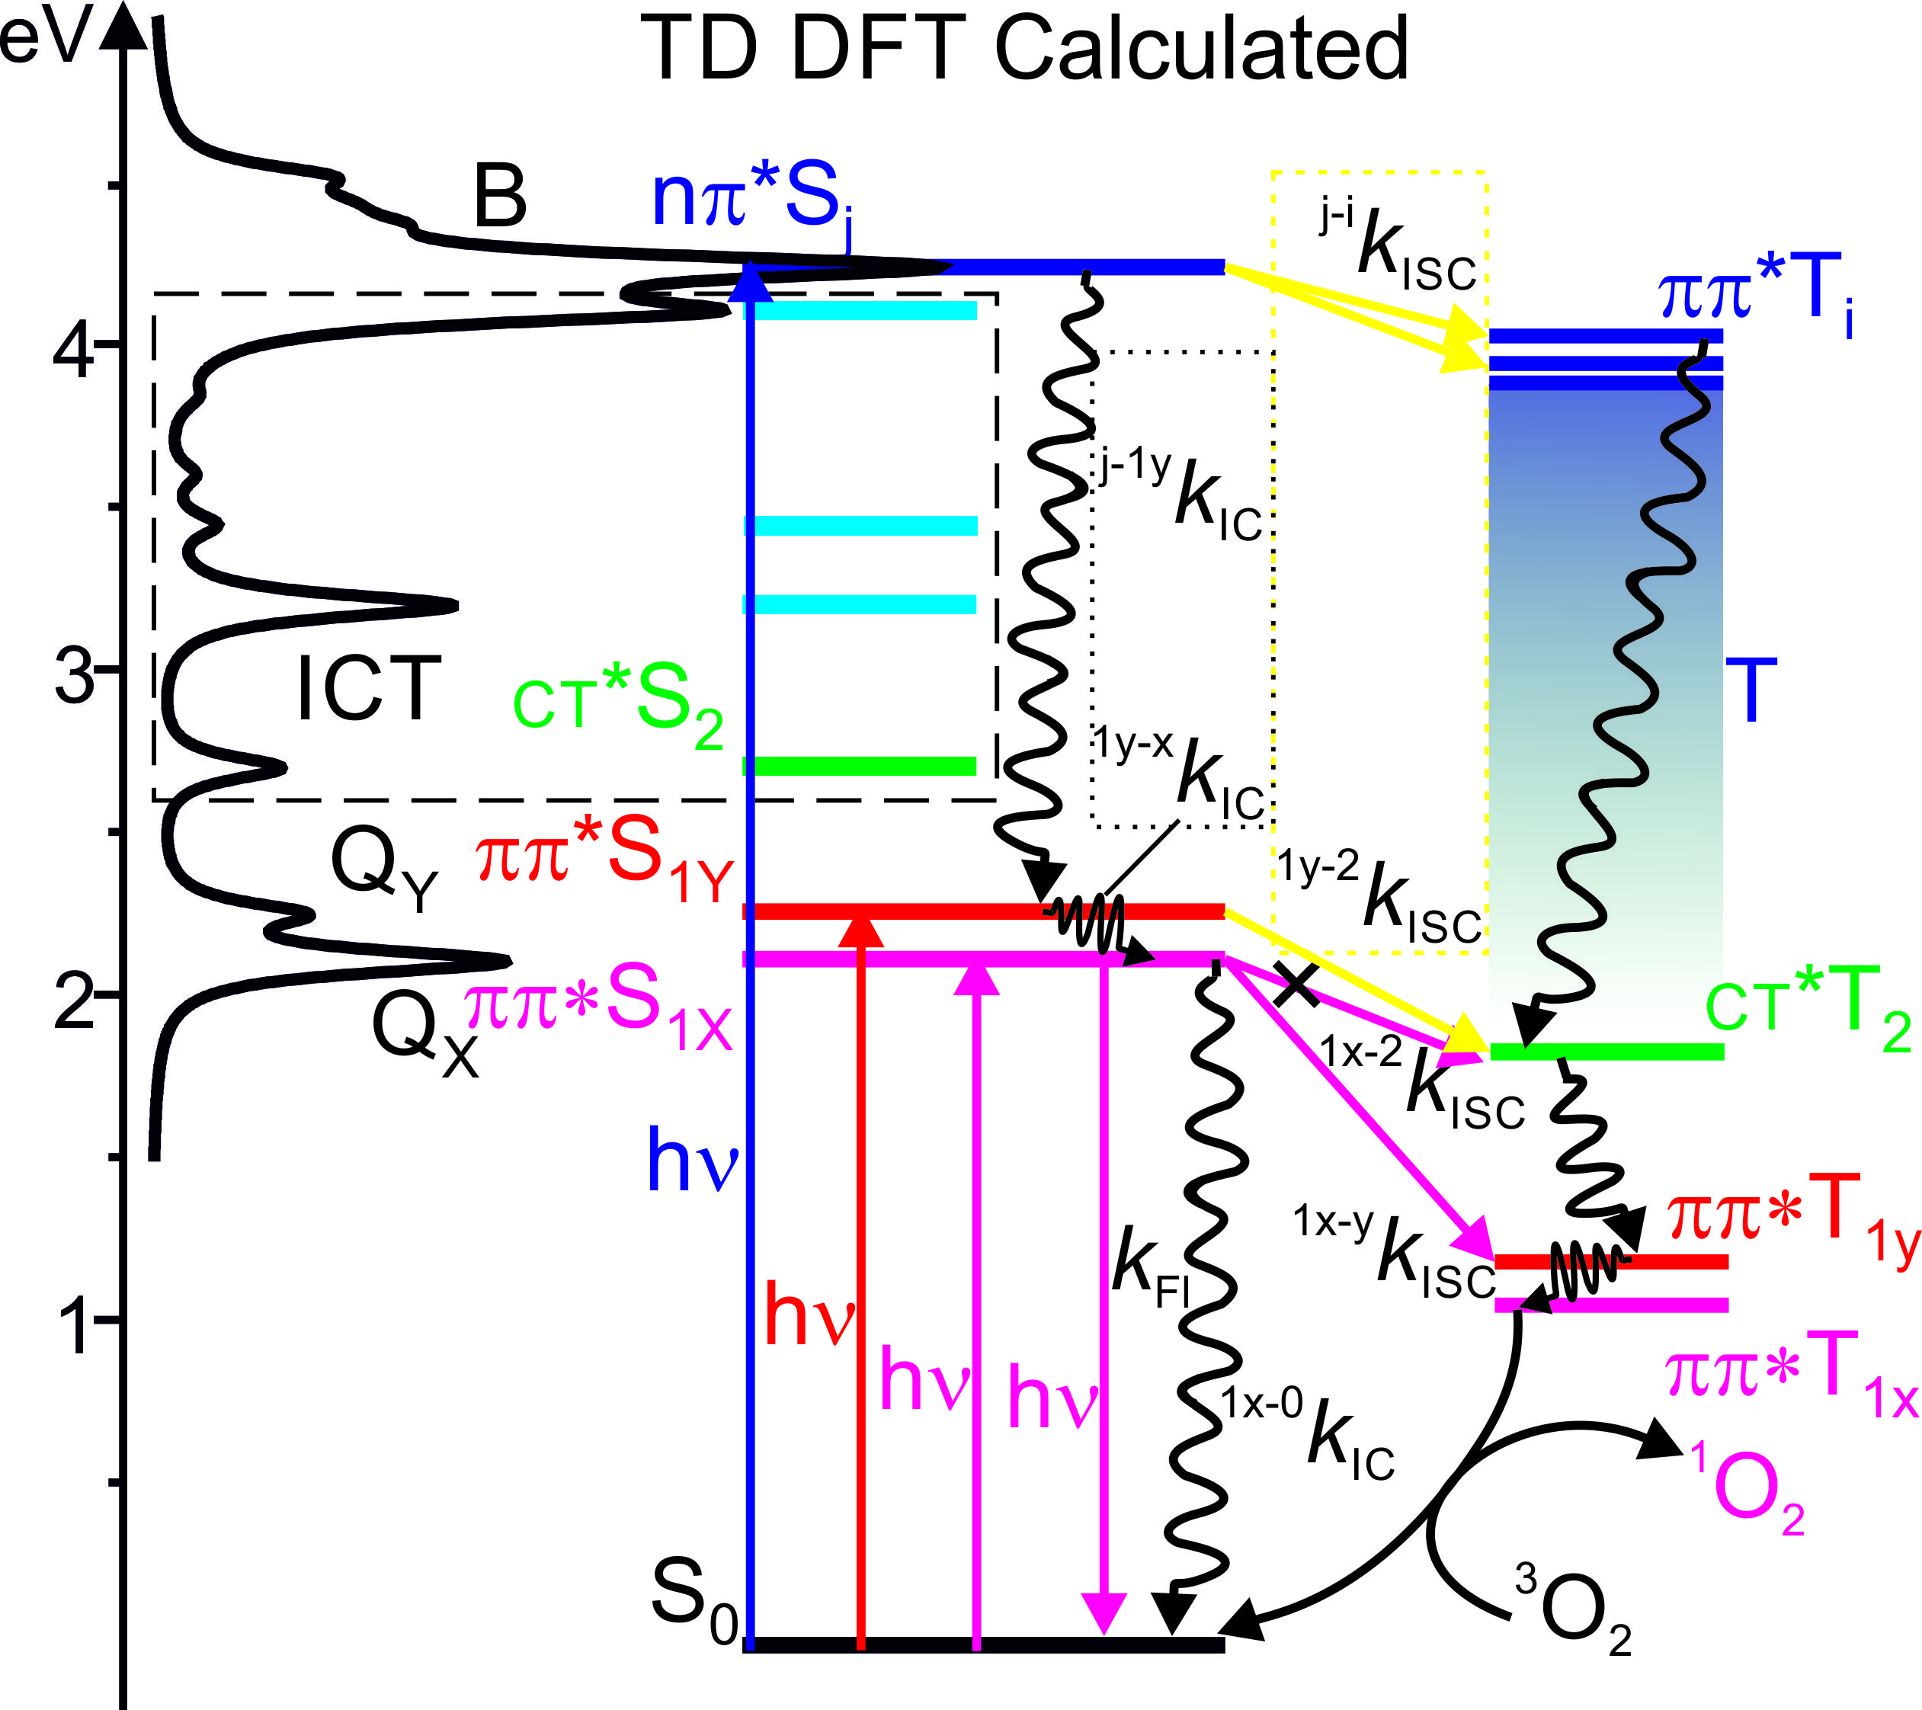
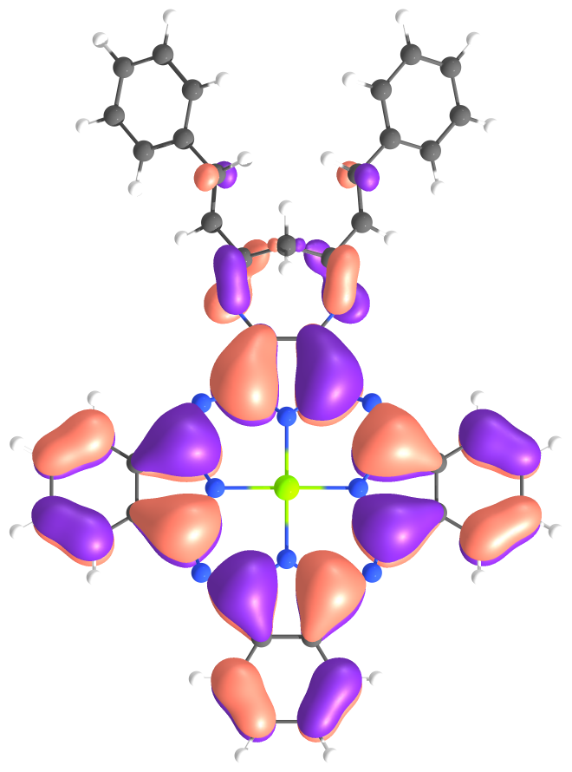
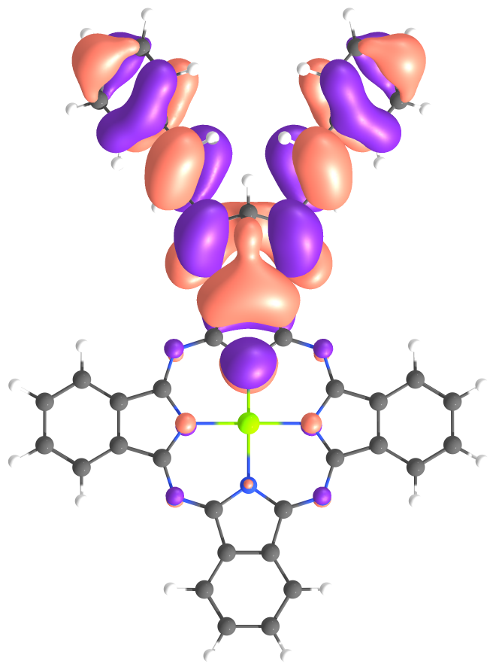
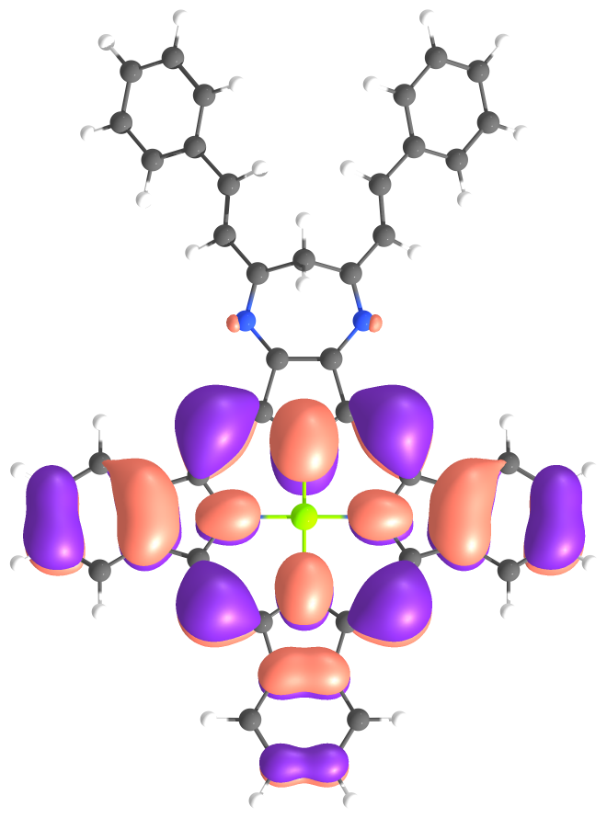
TD DFT calculations and natural transition orbital analysis
S₂: E=2.702 eV
H₋₁ -> L (0.80)
H₋₁ -> L₊₂ (0.04)
The mechanism responsible for triplet generation in these system (S (ππ*) → T (CT*)) is similar to the ISC involving S (ππ*) → T (nπ*) transitions and hence greatly enhancing the ISC (El-Sayed’s rule). ^{1y-2}k_{ISC} > ^{1y-x}k_{IC} that lead to anti-Kasha effect.
Fermi golden rule: $k_{ISC}∝\frac{{\left\langle T_{i} | H_{SO} | S_{j}\right\rangle }^{2}}{{\left({∆E}_{S_{j}−T_{j}}\right)}^{2}}$
ΔE: (S_{1x}-T₂) = 0.29 eV; (S_{1y}-T₂) = 0.43 eV; (S_{1x}-T_{1y}) = 0.93 eV
S_{1y}: E=2.255 eV
H₋₃ -> L (0.10)
H₋₁ -> L (0.05)
H -> L₊₁ (0.79)
Charge transfer SOC
S_{1x}: E=2.110 eV
H₋₃ -> L₊₁ (0.08)
H -> L (0.85)
LUMO
LUMO₊₁
LUMO₊₂
T₂: E=1.825 eV
H₋₁ -> L (0.60)
H₋₁ -> L₊₂ (0.24)
HOMO
HOMO₋₁
HOMO₋₃
T_{1y}: E=1.178 eV
H -> L₊₁ (0.95)
T_{1x}: E=1.044 eV
H -> L (0.91)
H -> L₊₂ (0.05)

Slide 12
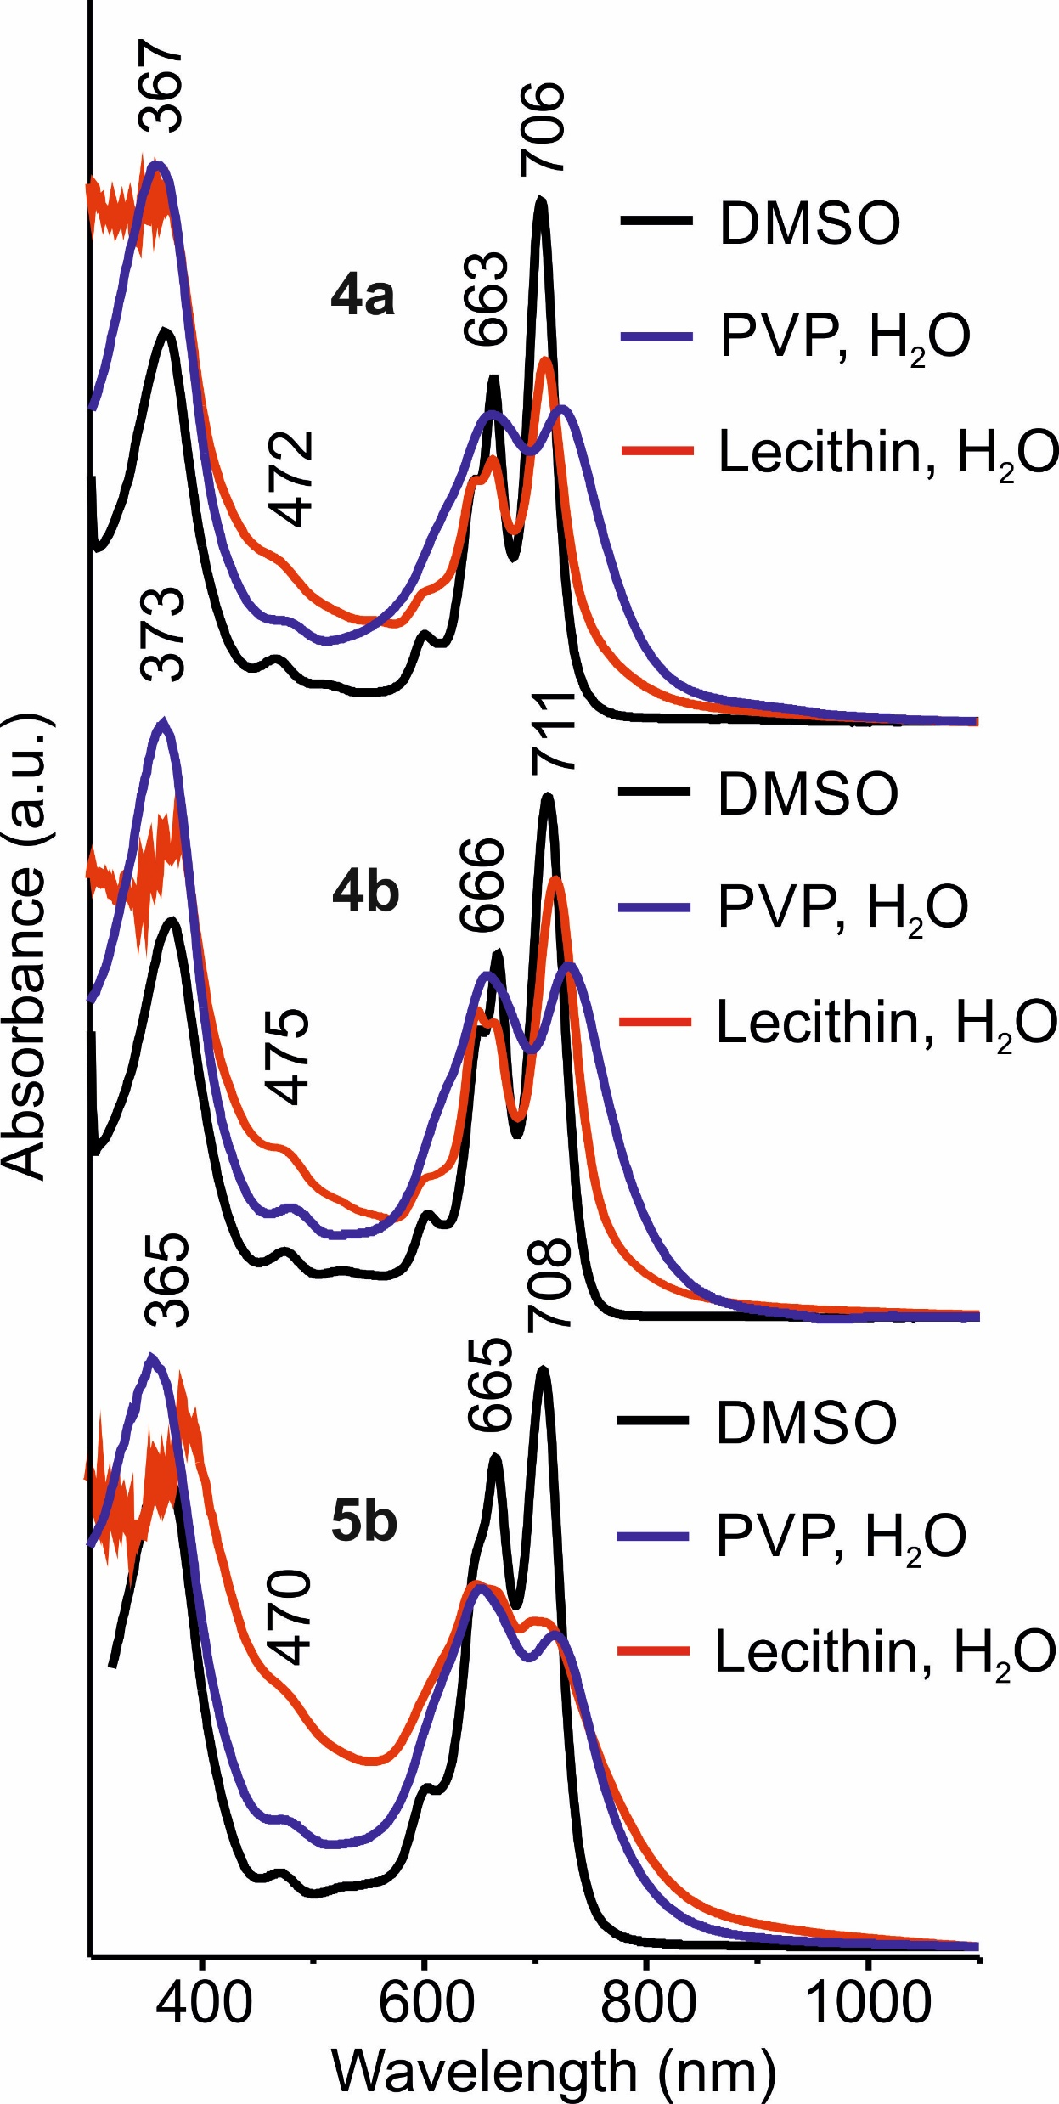
Nano-construction of PSs in water solutions
4a
The liposomal forms of PSs based on lecithin from egg yolk contain 1% of complexes.
4b
The micellar forms of PSs based on polyvinylpyrrolidone (PVP) contain 3-4% of complexes.
5b

Slide 13
Dynamic light scattering of nano-construction of PSs in water solutions
Table 2. Hydrodynamic radius of nanoparticles in micellar forms of complexes
Sample | Average hydrodynamic radius of the component, nm | Average contribution of component intensity*, %
4a-PVP | 56 ± 12 | 25
4b-PVP | 50 — 450 | —
5b-PVP | 46 ± 9; 2.5 ± 0.8 | 42; 18
70
80
4b
4a-PVP
5b-PVP
50
60
R_{h}, nm
30
40
R_{h}, nm
20
10
1
100
1e+4
1e+6
1e+8
0
0.4
0.8
1.2
1.6
2
0
0.4
0.8
1.2
1.6
2
Intensity Distrib (nm)
С, μM
С, μM
Comparison of the micellar solutions samples of 4b-PVP size distributions obtained by processing correlation functions in the DynaLS program.
Dependence of the hydrodynamic radius R_{h} 4a-PVP, 5b-PVP on the concentration of complexes in an aqueous solution.

Slide 14
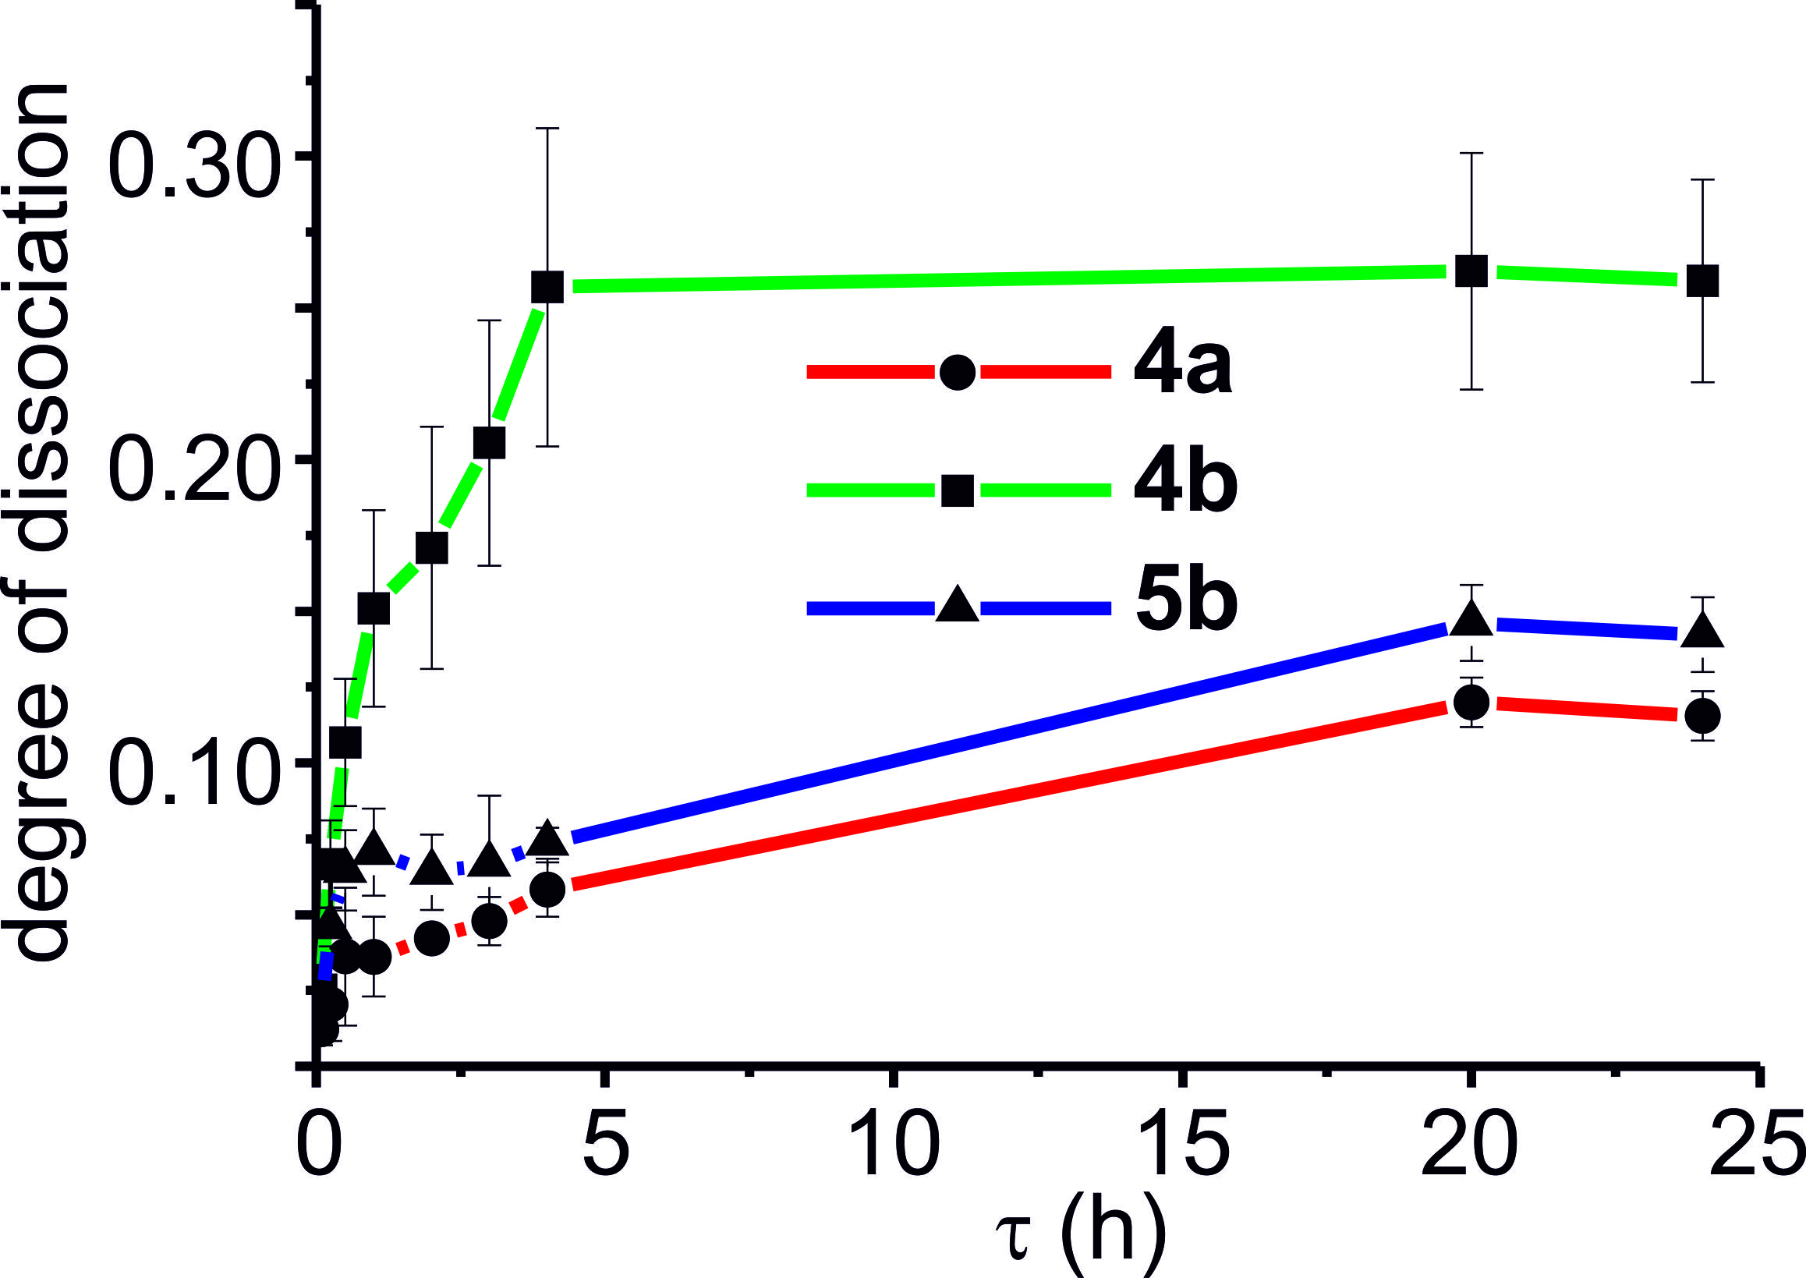
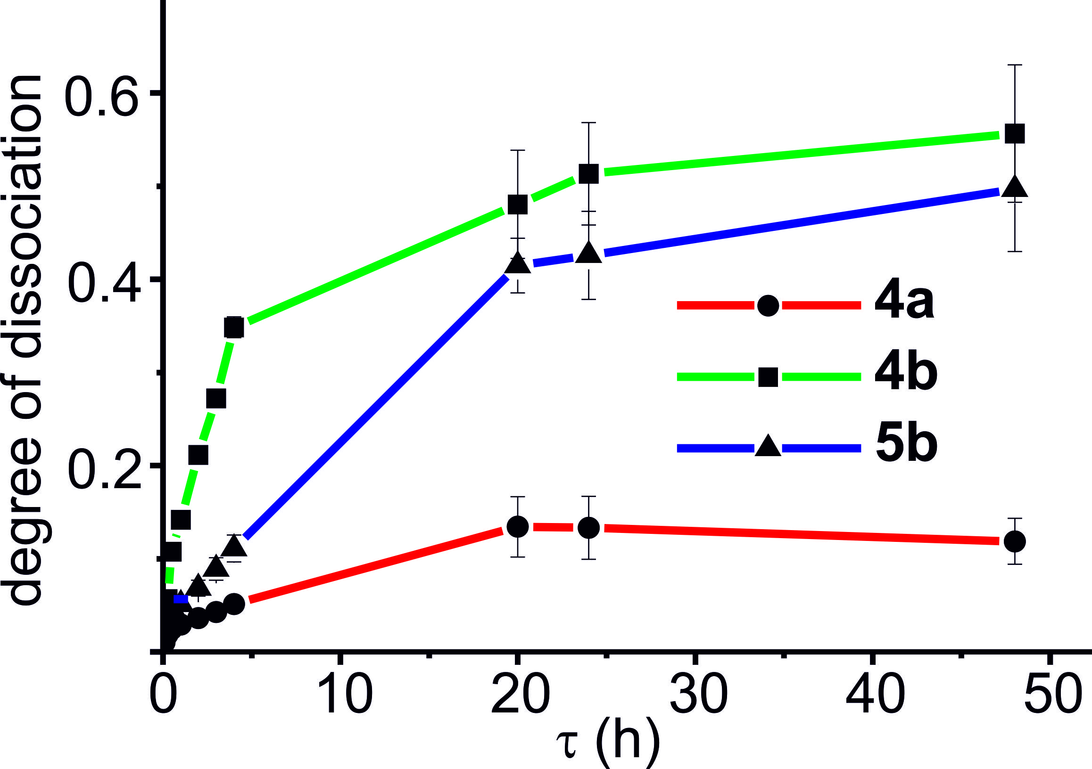
Interaction with blood serum and with tissue homogenate
Membranes
Proteins
Time dependence of degree of dissociation of the complexes in fetal bovine serum (FBS) obtained by fluorescence measurements (C= 10 mM)
Time dependence of degree of dissociation of complexes in rat brain homogenate (RBH) obtained by fluorescence measurements (C= 10 μM)

Slide 15
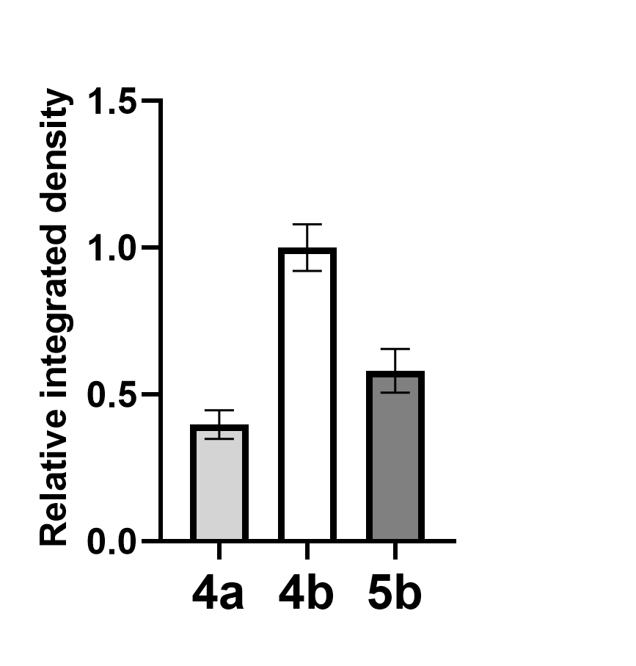
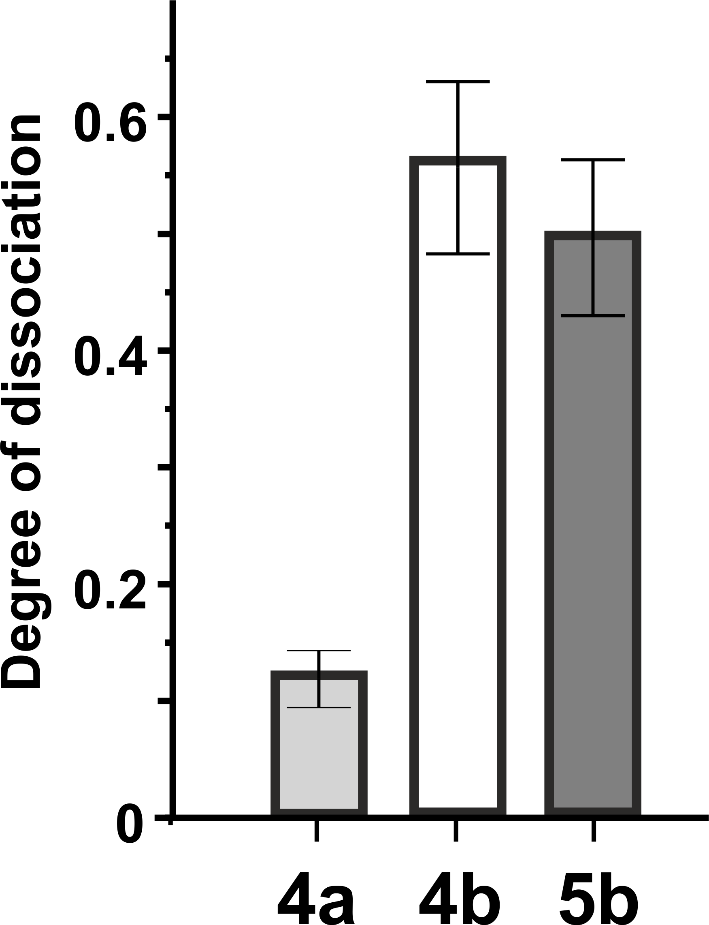
The extent of aggregation of PSs in MCF-7 cells
The fluorescence quantum yields and average hydrodynamic radius (R_{h}) of the complexes
complexes | Ф_{F} (Qy) | R_{h}, nm
4a | 0.35 ±0.04 | 56 ± 12
4b | 0.05 ±0.005 | 50 — 450
5b | 0.03 ±0.003 | 46 ± 9; 2.5 ± 0.8
Relative integrated density of fluorescence intensity of complexes in cells
Degree of dissociation of complexes in rat brain homogenate (RBH)
Fluorescence image of MCF-7 cells with micellar forms of complexes10 μM (A- 4a, B- 4b, C- 5b)

Slide 16
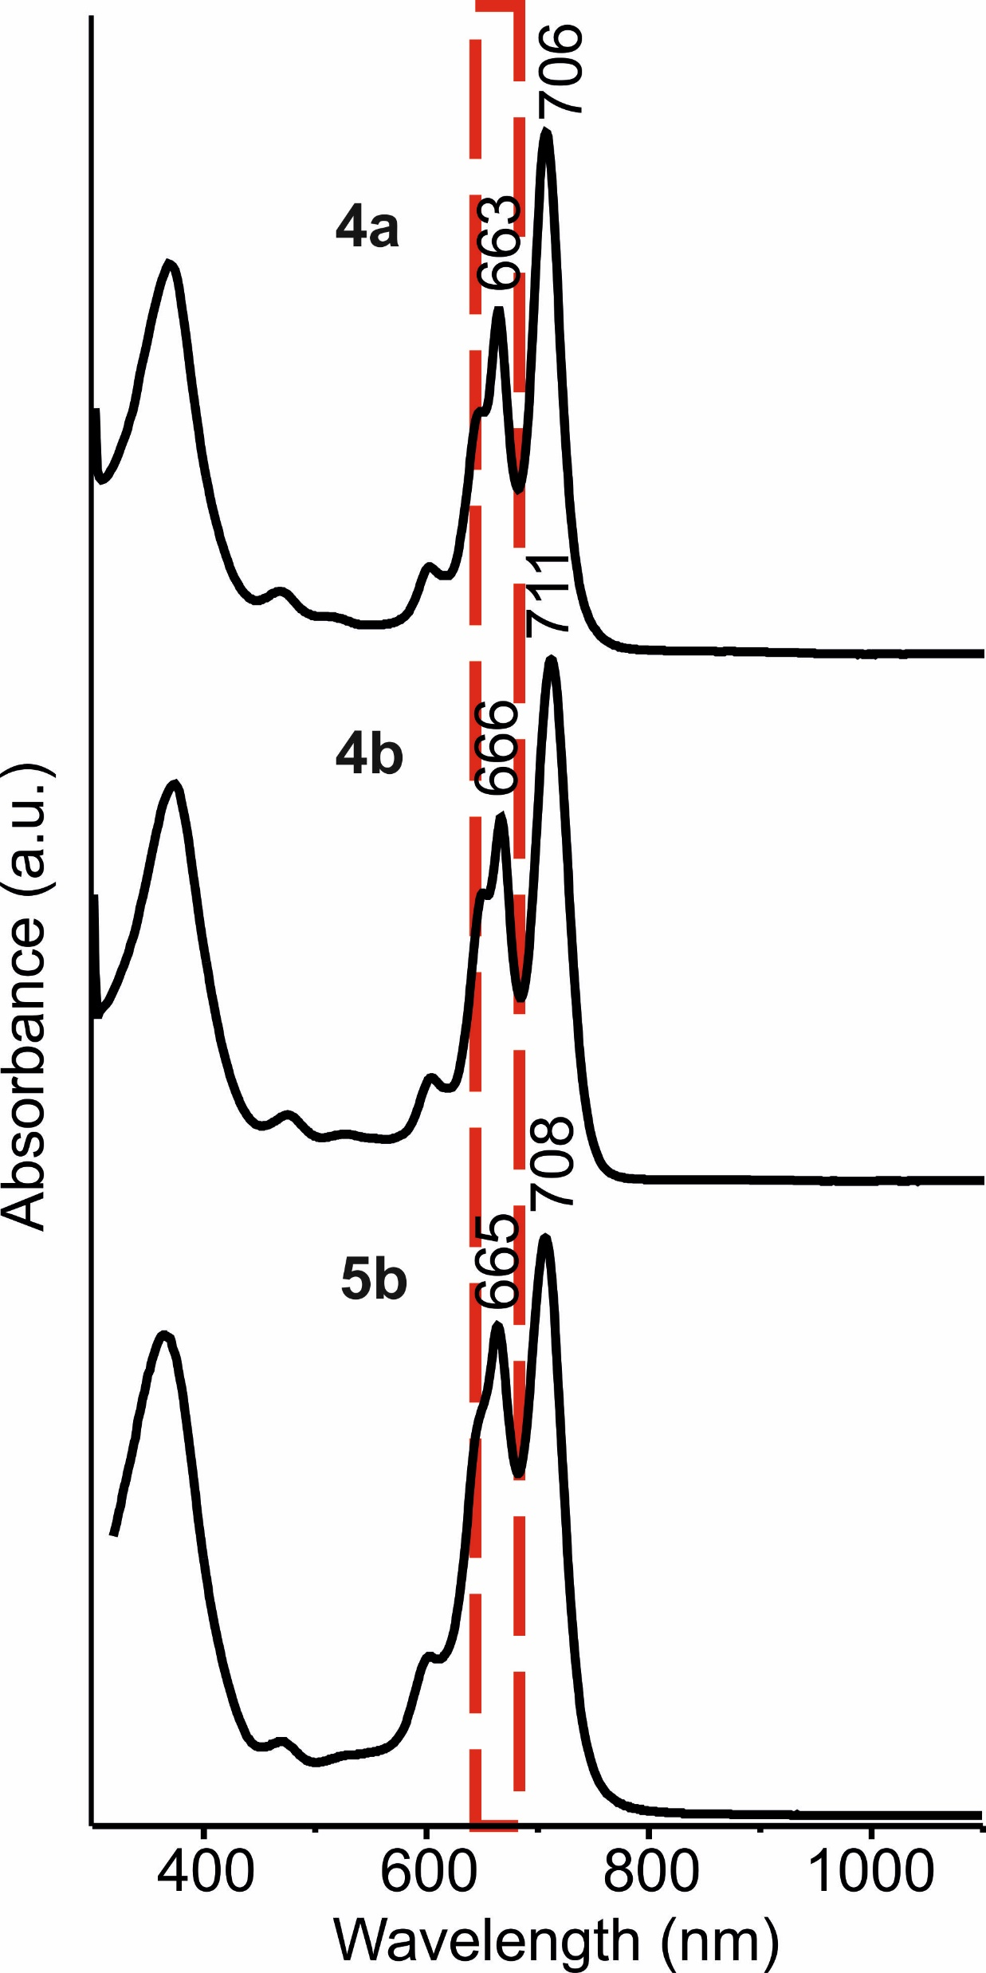
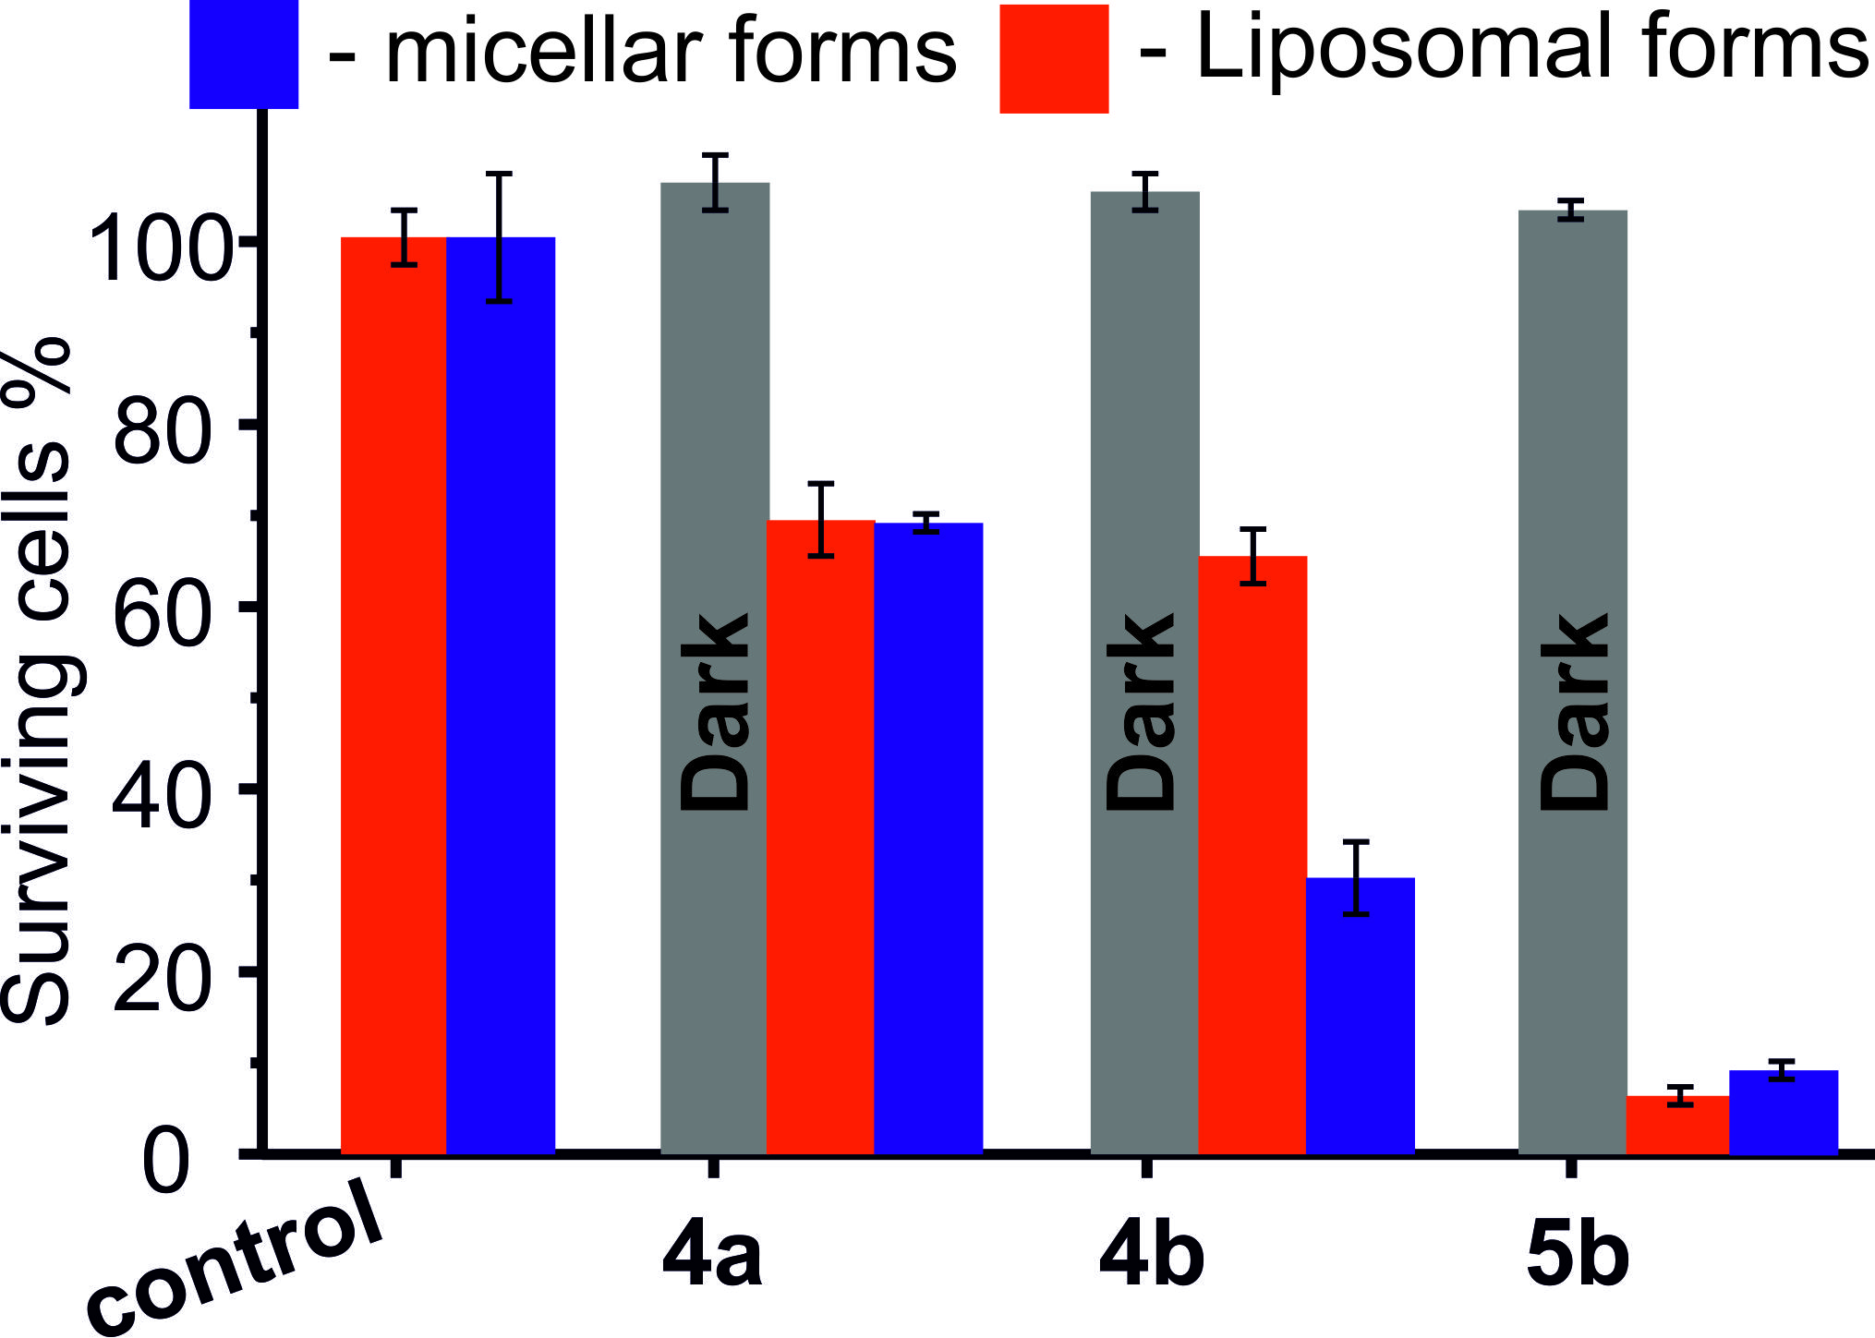
In vitro analysis of photodynamic activity using MCF-7 cells and rat brain homogenates
Table 3. The singlet oxigen quantum yields and average hydrodynamic radius (R_{h}) of the complexes
complexes | Ф_{Δ} (Qy) | Ф_{F} (Qy) | R_{h}, nm
4a | 0.62 ±0.06 | 0.35 ±0.04 | 56 ± 12
4b | 0.35 ±0.04 | 0.05 ±0.005 | 50 — 450
5b | 0.35 ±0.04 | 0.03 ±0.003 | 46 ± 9; 2.5 ± 0.8
Degree of dissociation of complexes in rat brain homogenate (RBH)
Relative integrated density of fluorescence intensity of complexes in cells
Photoinduced cytotoxicity of complexes (1 μM) toward MCF-7 cells using 4 J/cm² dose light (670 nm, LED).

Slide 17
Conclusions
1
The simultaneous presence of substituents at the C5, C6, and C7 positions of the 1,4- diazepine heterocycle results in effective intramolecular steric interactions, which, in turn, significantly affect the temperature dependent stability of the conformational state of the molecule. It can provide ways of controlling the selective synthesis of low-symmetry A₃B-type 5,7-arylethenyl substituted-6H-1,4-tribenzodiazepinoporphyrazines based on temperature dependent steric effect in 5,6,7-substituted-1,4-diazepine-2,3-dicarbonitrile during cross-condensation under Linstead macrocyclization conditions.
The presence of conformation lability and ability of 1,4-diazepine moiety to form intermolecular hydrogen bonding provides control of the tendency of 5,7-arylethenyl substituted-6H-1,4-tribenzodiazepinoporphyrazines to aggregate in different mediums.
1,4-Diazepine moiety in tribenzodiazepinoporphyrazines has strong effect on the decay paths of the excited state based on spin–orbit charge-transfer ISC (SOCT-ISC), which results in anti-Kasha effect.
In vitro study showed possibility to create nanoscale heavy-atom-free photosensitizers with drug release effect based on low-symmetry A₃B-type 5,7-arylethenyl substituted-6H-1,4-tribenzodiazepinoporphyrazines in PVP polymer matrix.
2
3
4

Slide 18
Тетрапиррольные макроциклы как перспективная основа для создания тераностиков
Лаборатория фталоцианинов и их аналогов ИФАВ РАН, Черноголовка, Россия
Лаборатория биохимии патологических процессов ИФАВ РАН, Черноголовка, Россия
Группа экспериментальной химиотерапии опухолей ИПХФ РАН, Черноголовка, Россия
Лаборатория молекулярной биологии ИПХФ РАН, Черноголовка, Россия
Лаборатория химической физики ферментов ИПХФ РАН, Черноголовка, Россия
Лаборатория генетического моделирования нейродегенеративных процессов ИФАВ РАН, Черноголовка, Россия
Лаборатория природных соединений ИФАВ РАН, Черноголовка, Россия
МГУ имени М.В. Ломоносова, физический факультет, отделение экспериментальной и теоретической физики, кафедра молекулярных процессов и экстремальных состояний вещества, Москва, Россия
Группа синтеза порфиразинов НИИ макрогетероциклов (ИГХТУ), Иваново, Россия
Спасибо за внимание
Acknowledgements. The work was financially supported by the RSF (Grant 17-73-10413).

