Slide 1


Antibacterial activity of water-soluble porphyrin and silver nanoparticles hybrid materials
¹VNU University of Engineering and Technology (VNU-UET), Hanoi, Vietnam
²Ivanovo State University of Chemistry and Technology, Ivanovo, Russian Federation
Vu Thi Thao, Phan Tan Khanh¹, Bui Thi Thu Thuy¹, Nguyen Xuan Loc¹, Ha Thi Quyen¹, Nguyen Duc Cuong¹, D.B. Berezin²
Russian, 7/2022

Slide 2
Content
01
02
03
04
Introduction
Synthesis
Antibacterial application
Conclusions
2

Slide 3
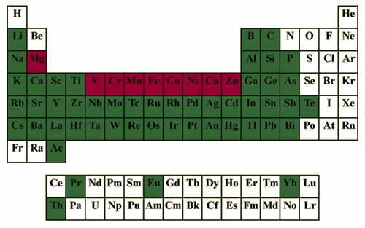
1. Introduction
Fig. 1. Elements known to form complexes with porphyrins (green). Metals found in Nature are shown in red
Fig. 2. Ascendant trend of publications on the topic of porphyrins , as indexed by sciencedirect.com
https://llg.chem.uni.wroc.pl/?Molecules%3BPorphyrins___Porphyrin_Primer___Properties
https://sci-hub.se/10.5772/22730
3

Slide 4
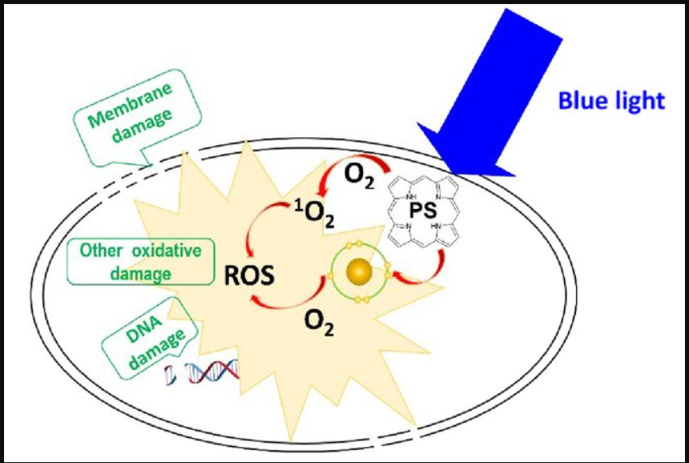
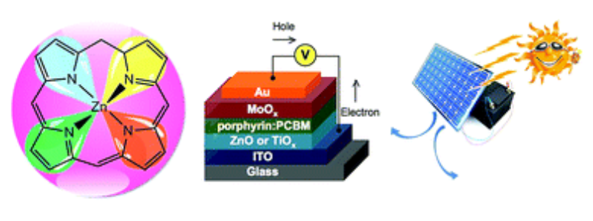
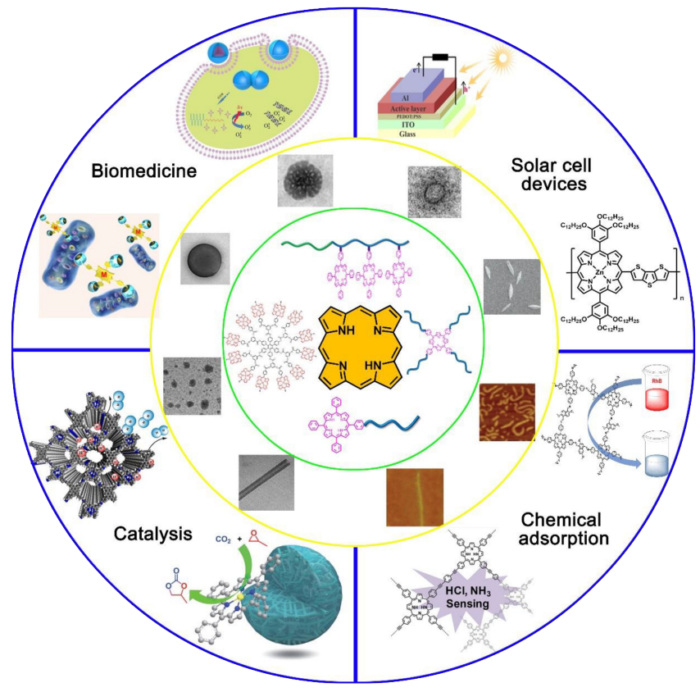
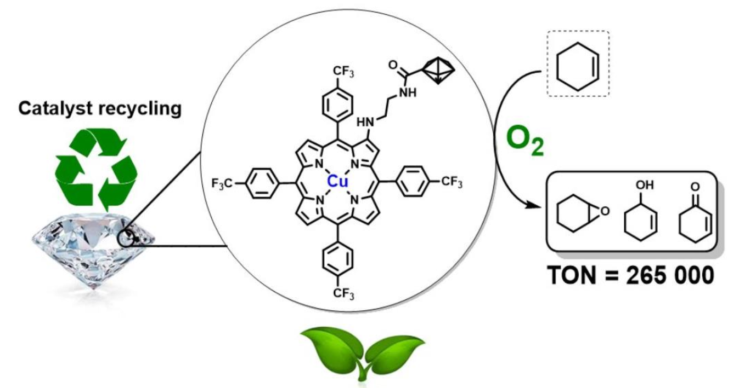
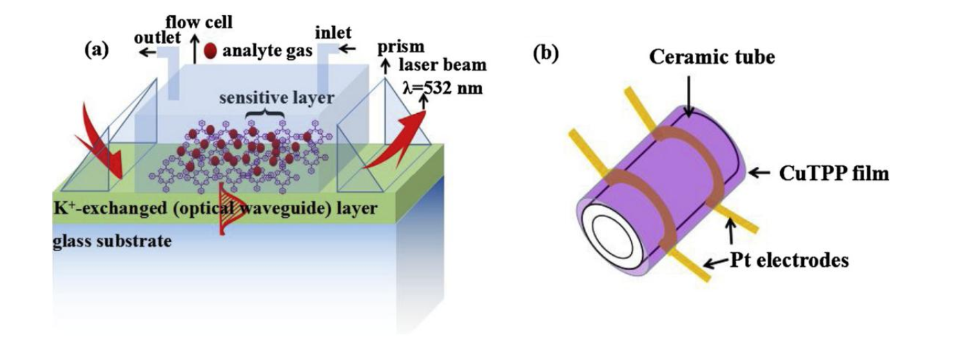
1. Introduction
Fig. 3. Application of porphyrins
https://www.sciencedirect.com/science/article/pii/S0079670018303319#fig0280
4

Slide 5
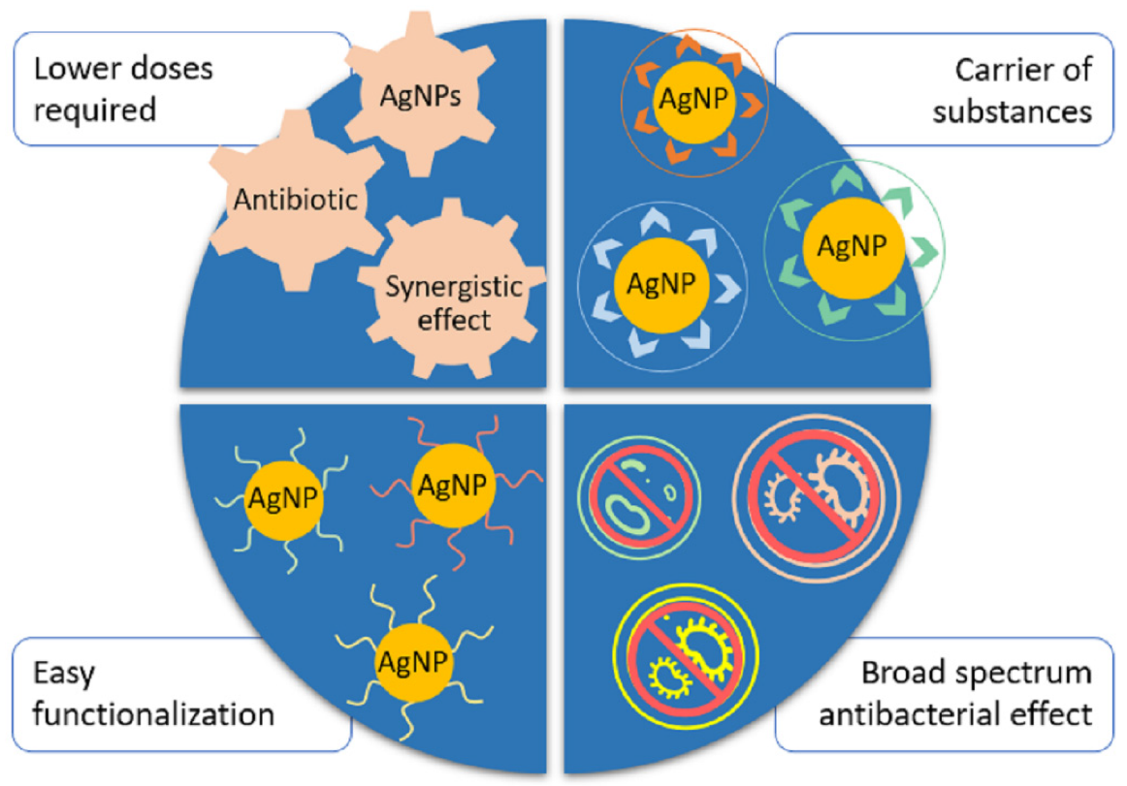
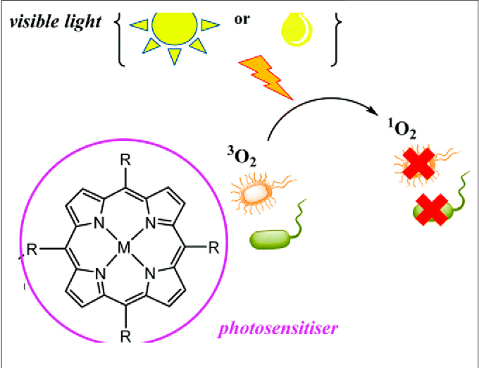
1. Introduction
Fig. 4. Advantages of using AgNPs in combination or as an alternative to antibiotics.
Fig. 5. Production of ROS by porphyrins and application in PACT. The illustration shows a generation of singlet oxygen upon irradiation by light which leads to microorganism destruction
https://www.mdpi.com/1422-0067/22/13/7202/htm
5

Slide 6
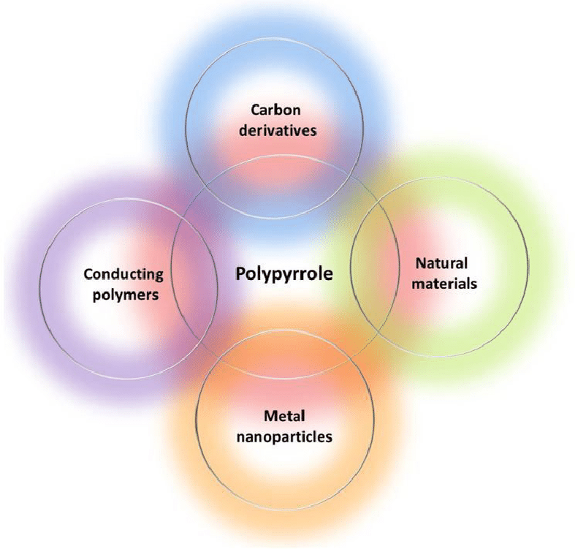
1. Introduction
Hybrid materials of AgNPs, Porphyrin (TASP), PPy for antibacterial application?
Fig. 6. Interaction of polypyrrole and chemical compounds for the development of effective antibacterial nanocomposites
https://www.researchgate.net/publication/349320329_Antibacterial_activity_of_polypyrrole-based_nanocomposites_A_mini-review
6

Slide 7
2. Synthesis
Synthesis of H2TPP-> TASP
Biosynthesis of AgNPs by leaf extracts of Guava (Psidium guajava L.)
Synthesis of polypyrrole (PPy)
Synthesis of hybrid nanomaterial (TASP+AgNPs, TASP+AgNPs+PPy , AgNPs+PPy)
7

Slide 8
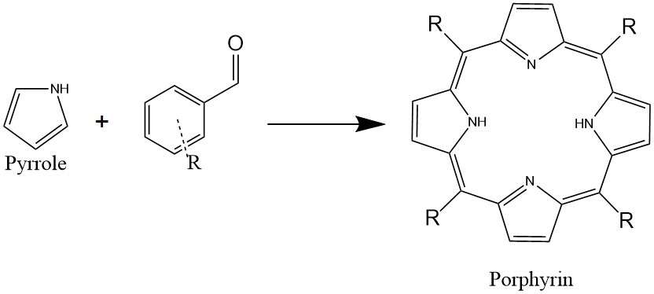
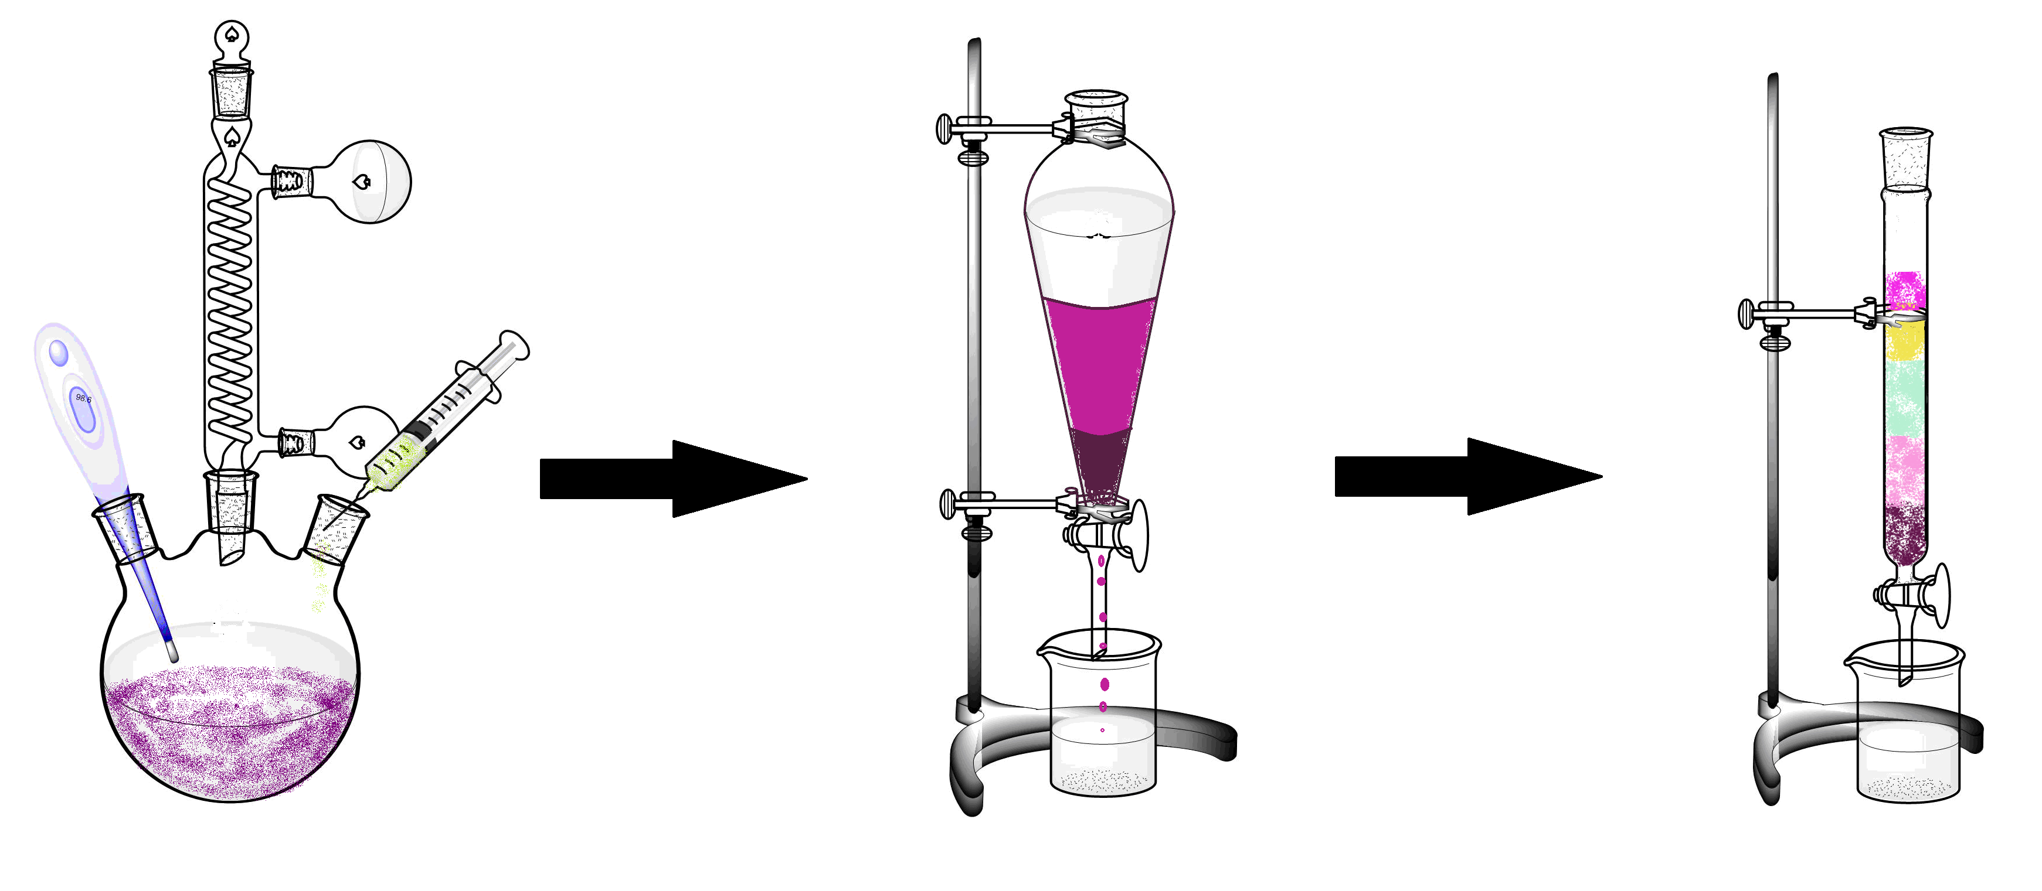
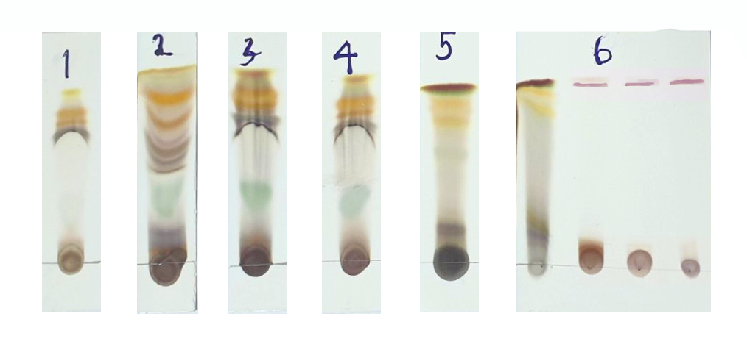
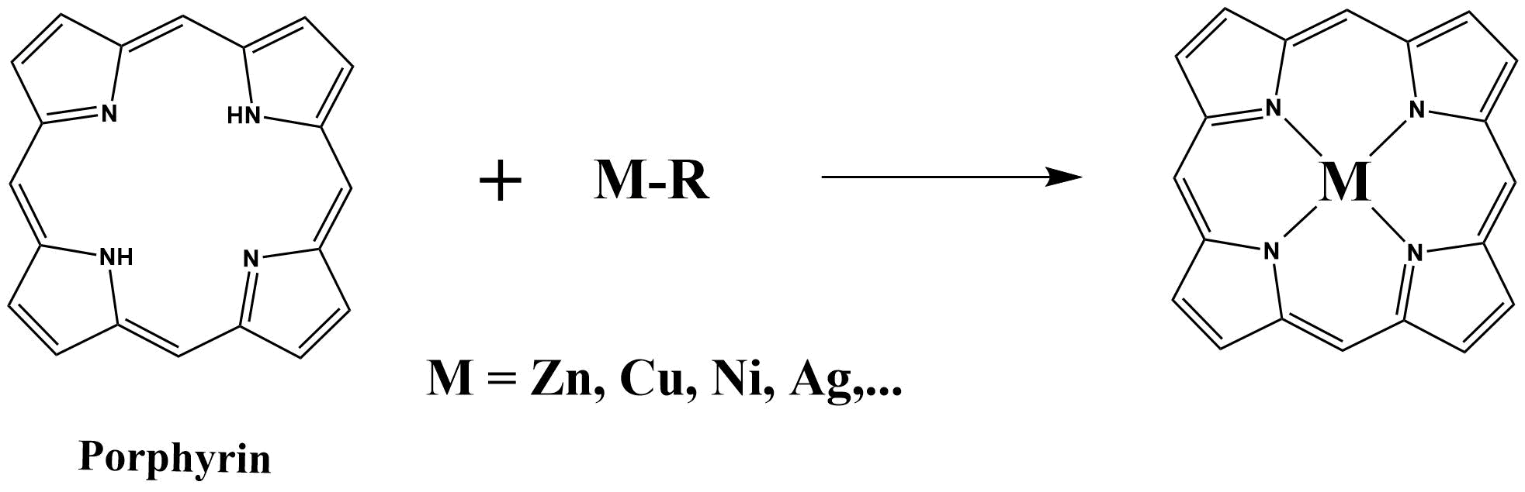
2. Synthesis of H₂TPP and MTPP
Fig. 7. Schema of synthesis of porphyrin
Fig. 8. Schema of synthesis of metal porphyrins
Fig. 9. Schema of synthesis, extraction and thin-layer chromatography of porphyrin products
8

Slide 9
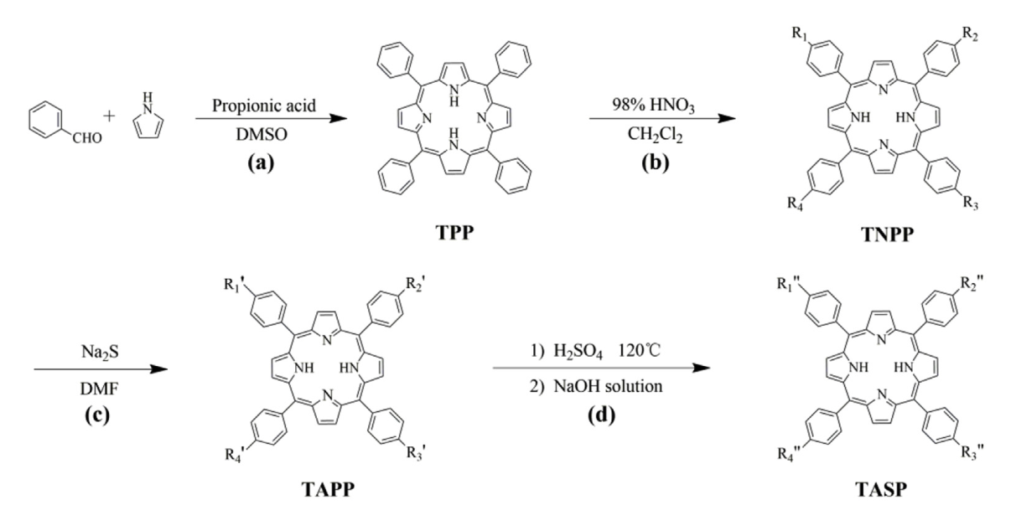
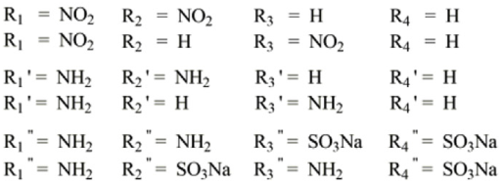
2. Synthesis of TASP
Fig. 10. Schema of synthesis of TASP
9

Slide 10
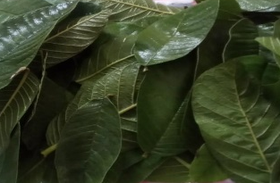
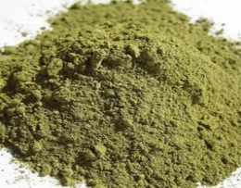
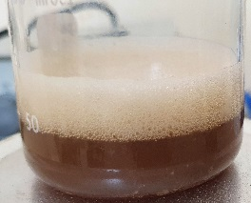
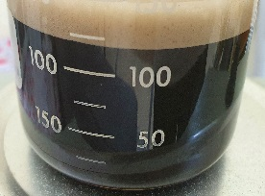




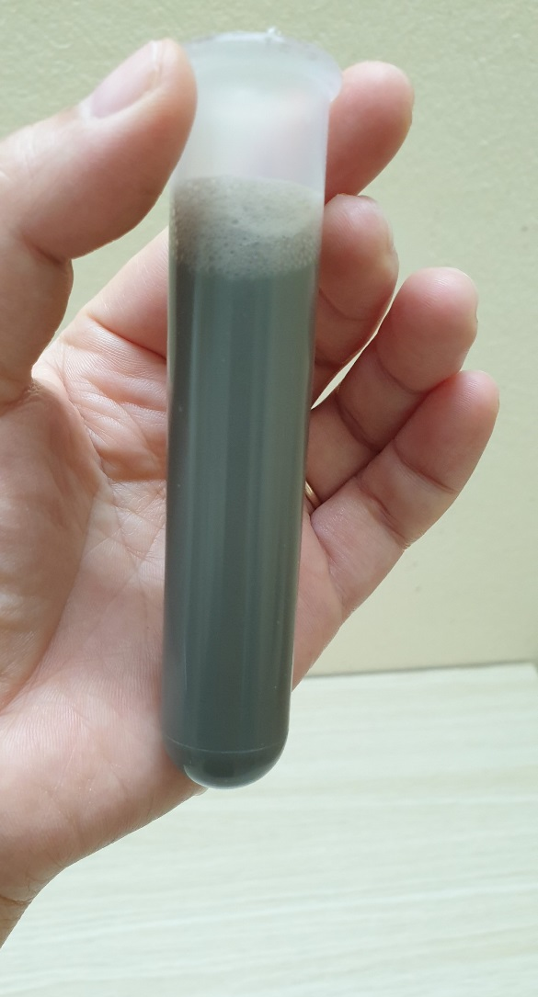
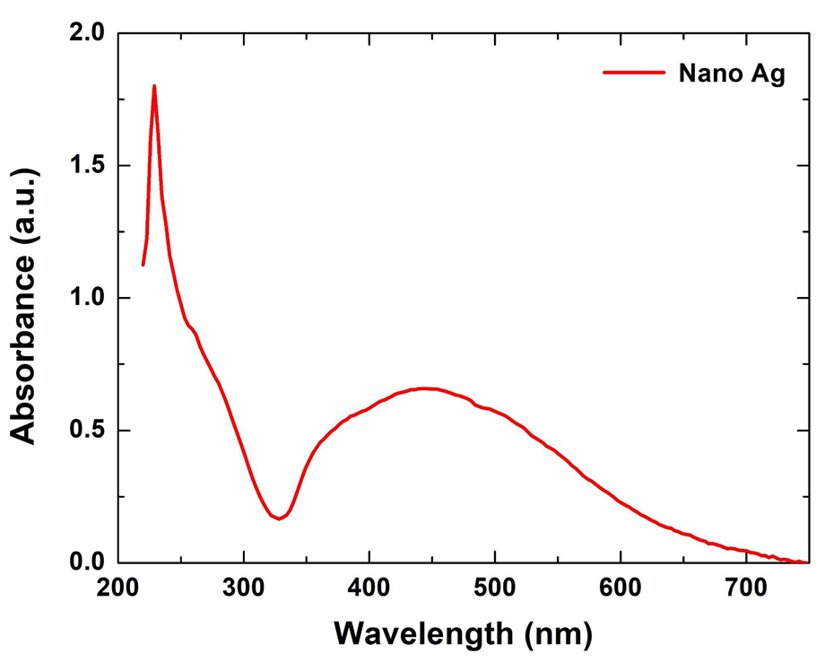
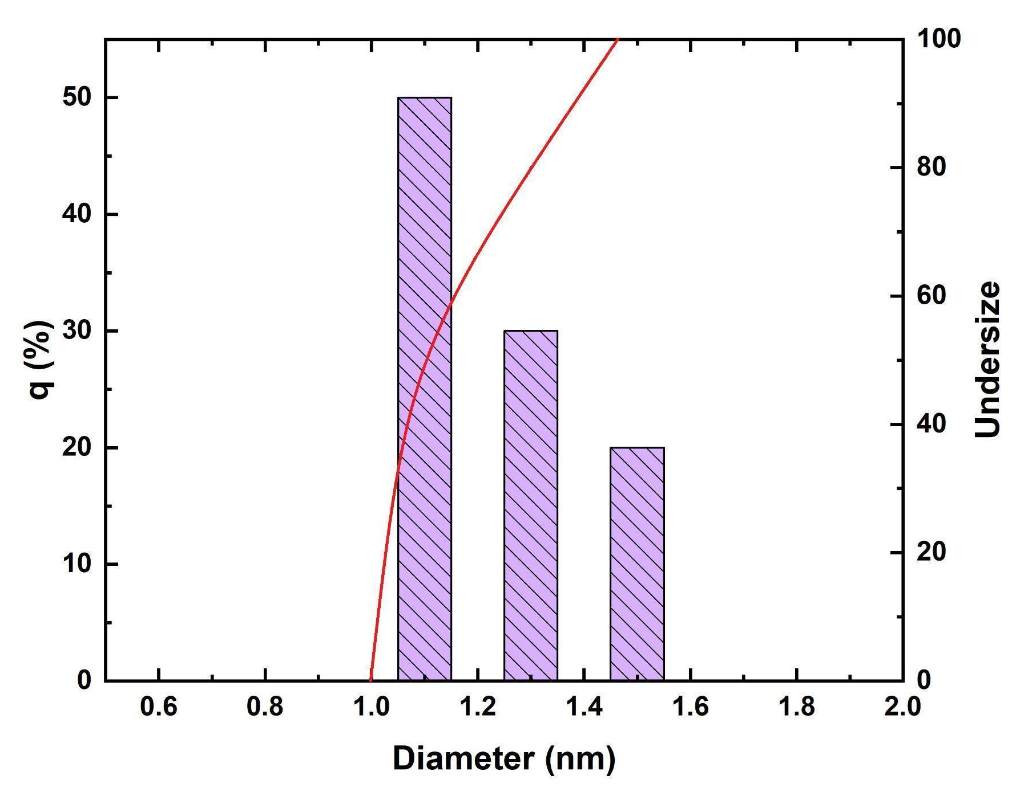
2. Synthesis of AgNPs
leaf extracts of Guava
Factors affecting the quality of Ag nanoparticles (AgNPs)
Temprature
Magnetic stirring speed
C_{AgNO3}
Leaf extracts of Guava
Ratio of extract and salt solution
Time reation
And others
AgNPs
Fig. 11. UV-Vis and particle size distribution (DLS) of silver nanoparticles synthesized from guava leaf extract
10

Slide 11
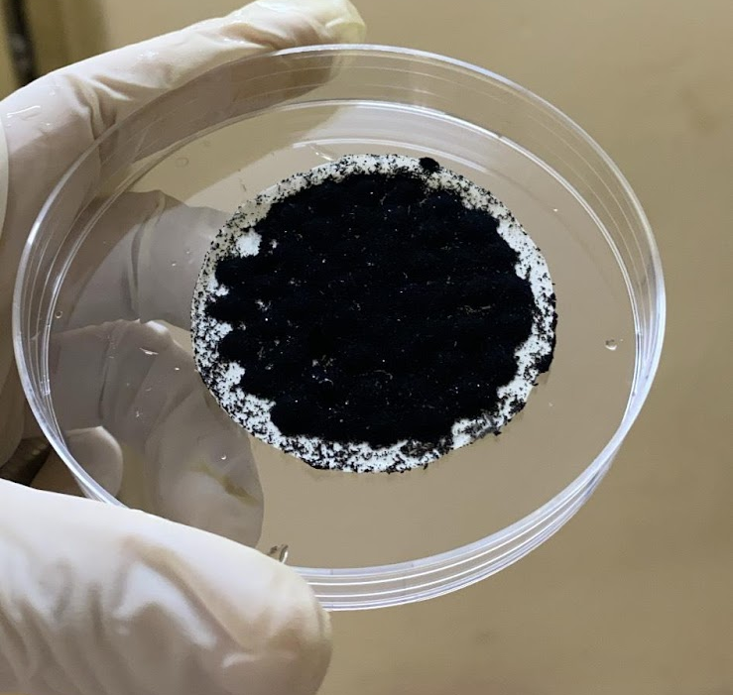
2. Synthesis of polypyrrole (PPy)
filtration and vacuum drying
Pyrrole + Fe(III) solution
Fig. 12. Schema of synthesis of PPy
11

Slide 12
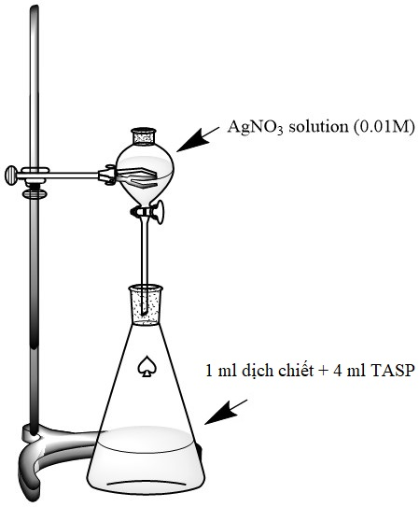
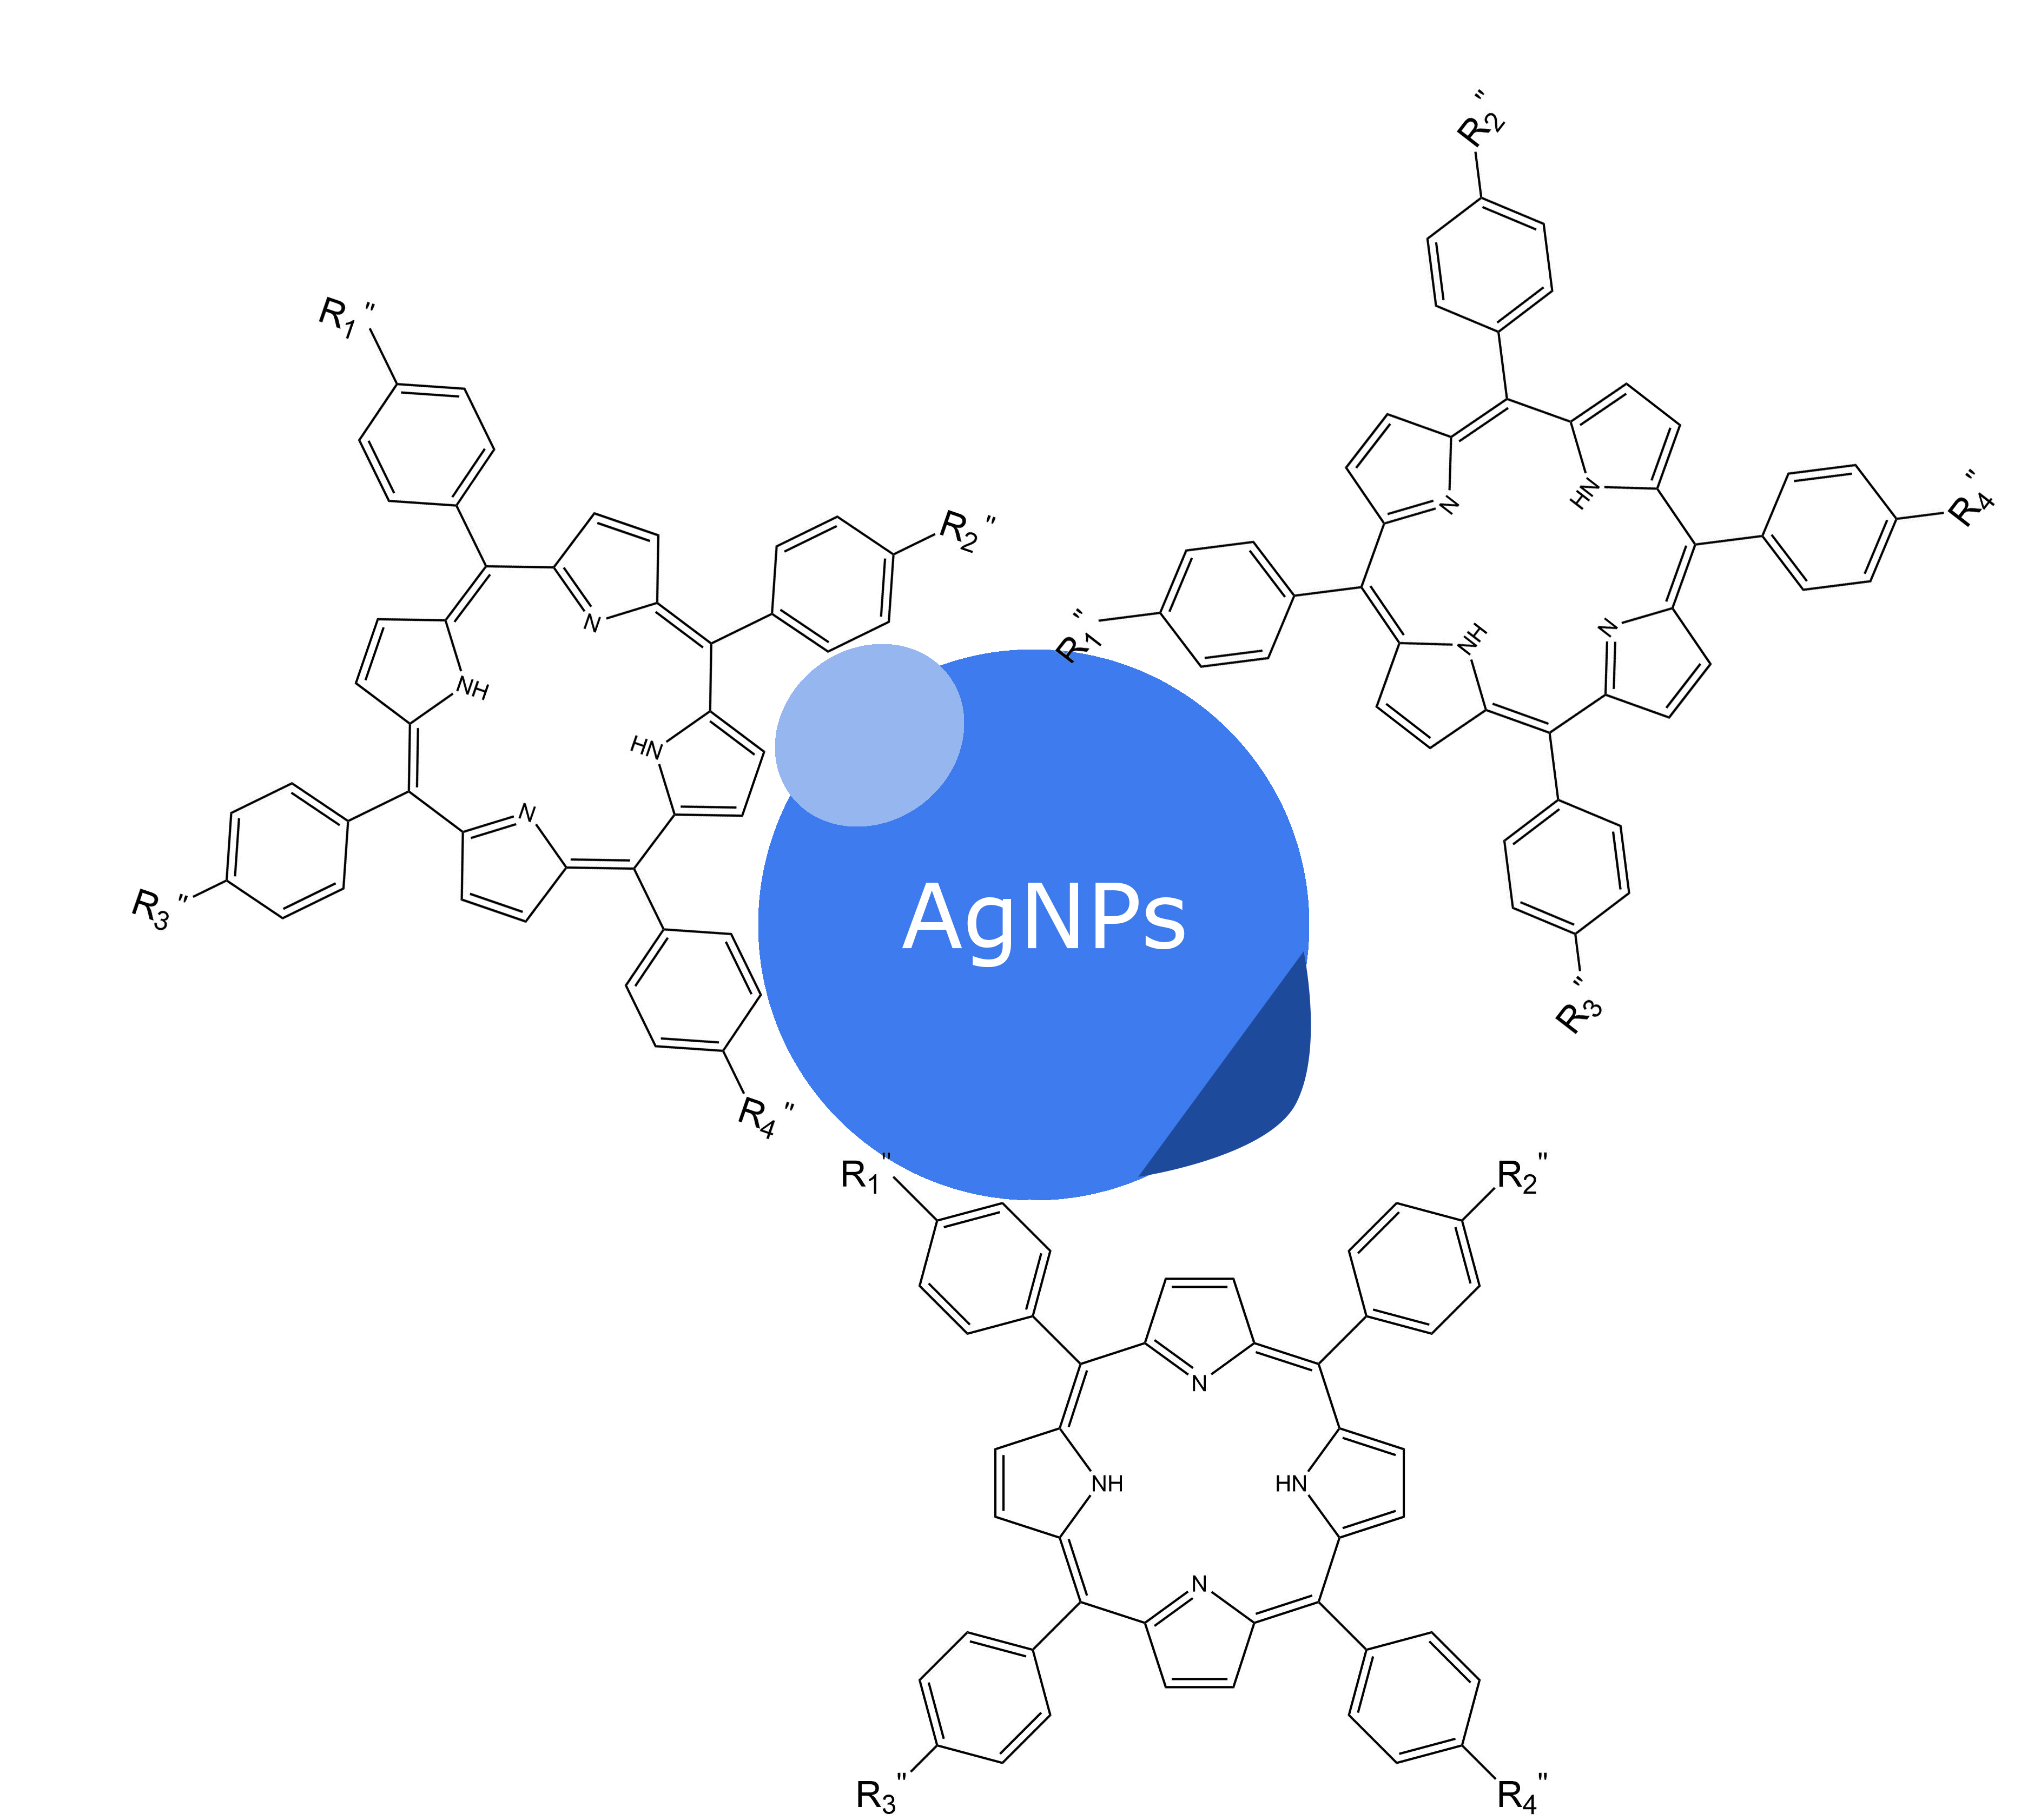
2. Synthesis of hybrid material TASP+AgNPs
AgNO3 solution (0.01M)
1 ml of leaf extracts of Guava (Psidium guajava L.) + 4 ml TASP
Fig. 13. Schema of synthesis of TASP and AgNPs/TASP
12

Slide 13
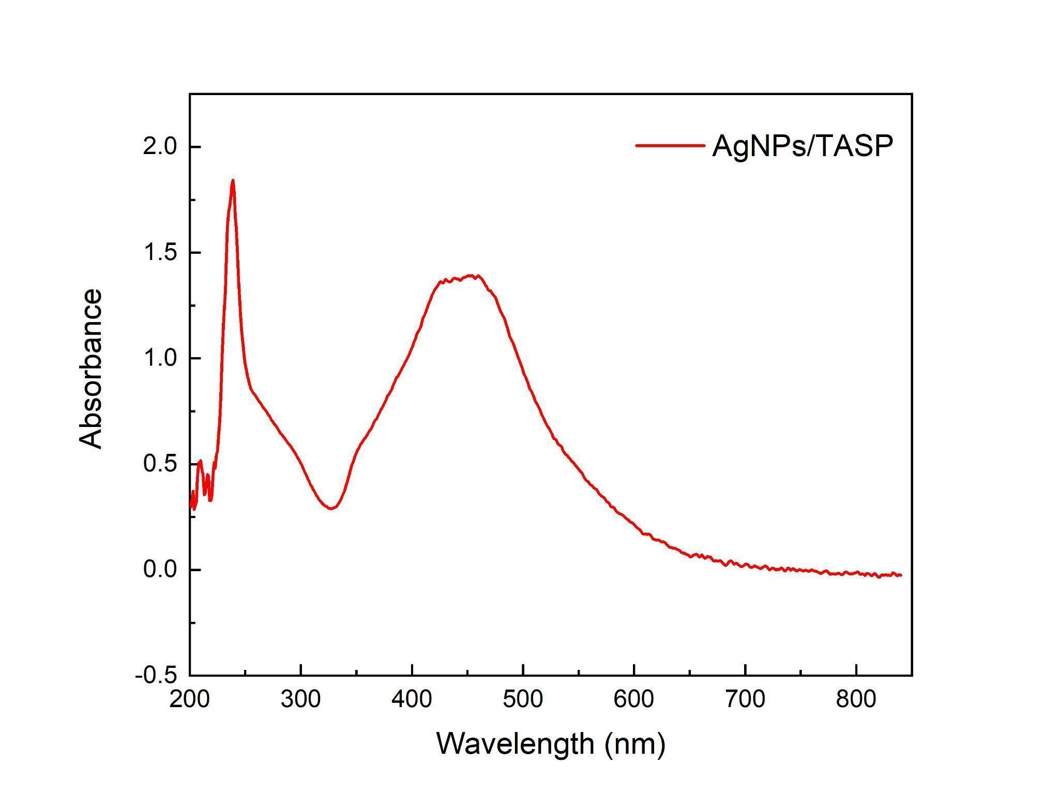
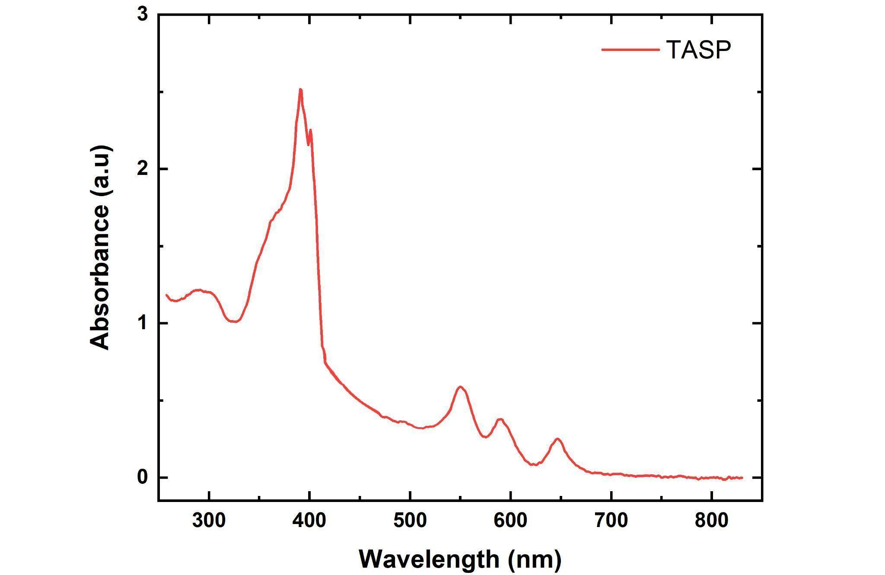
2. Synthesis of hybrid material TASP+AgNPs
Fig. 14. UV-Vis of TASP (left) and AgNPs/TASP (right)
13

Slide 14
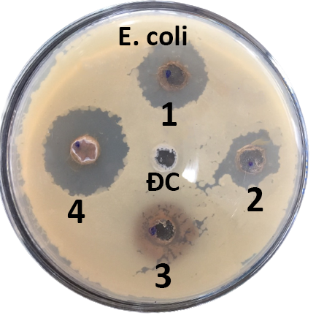
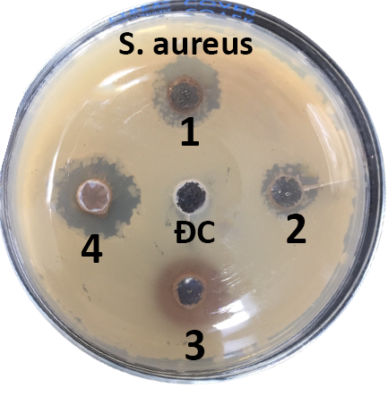
3. Antibacterial application
Fig. 15. Antibacterial activity against test organisms S. aureus and E. coli
14

Slide 15
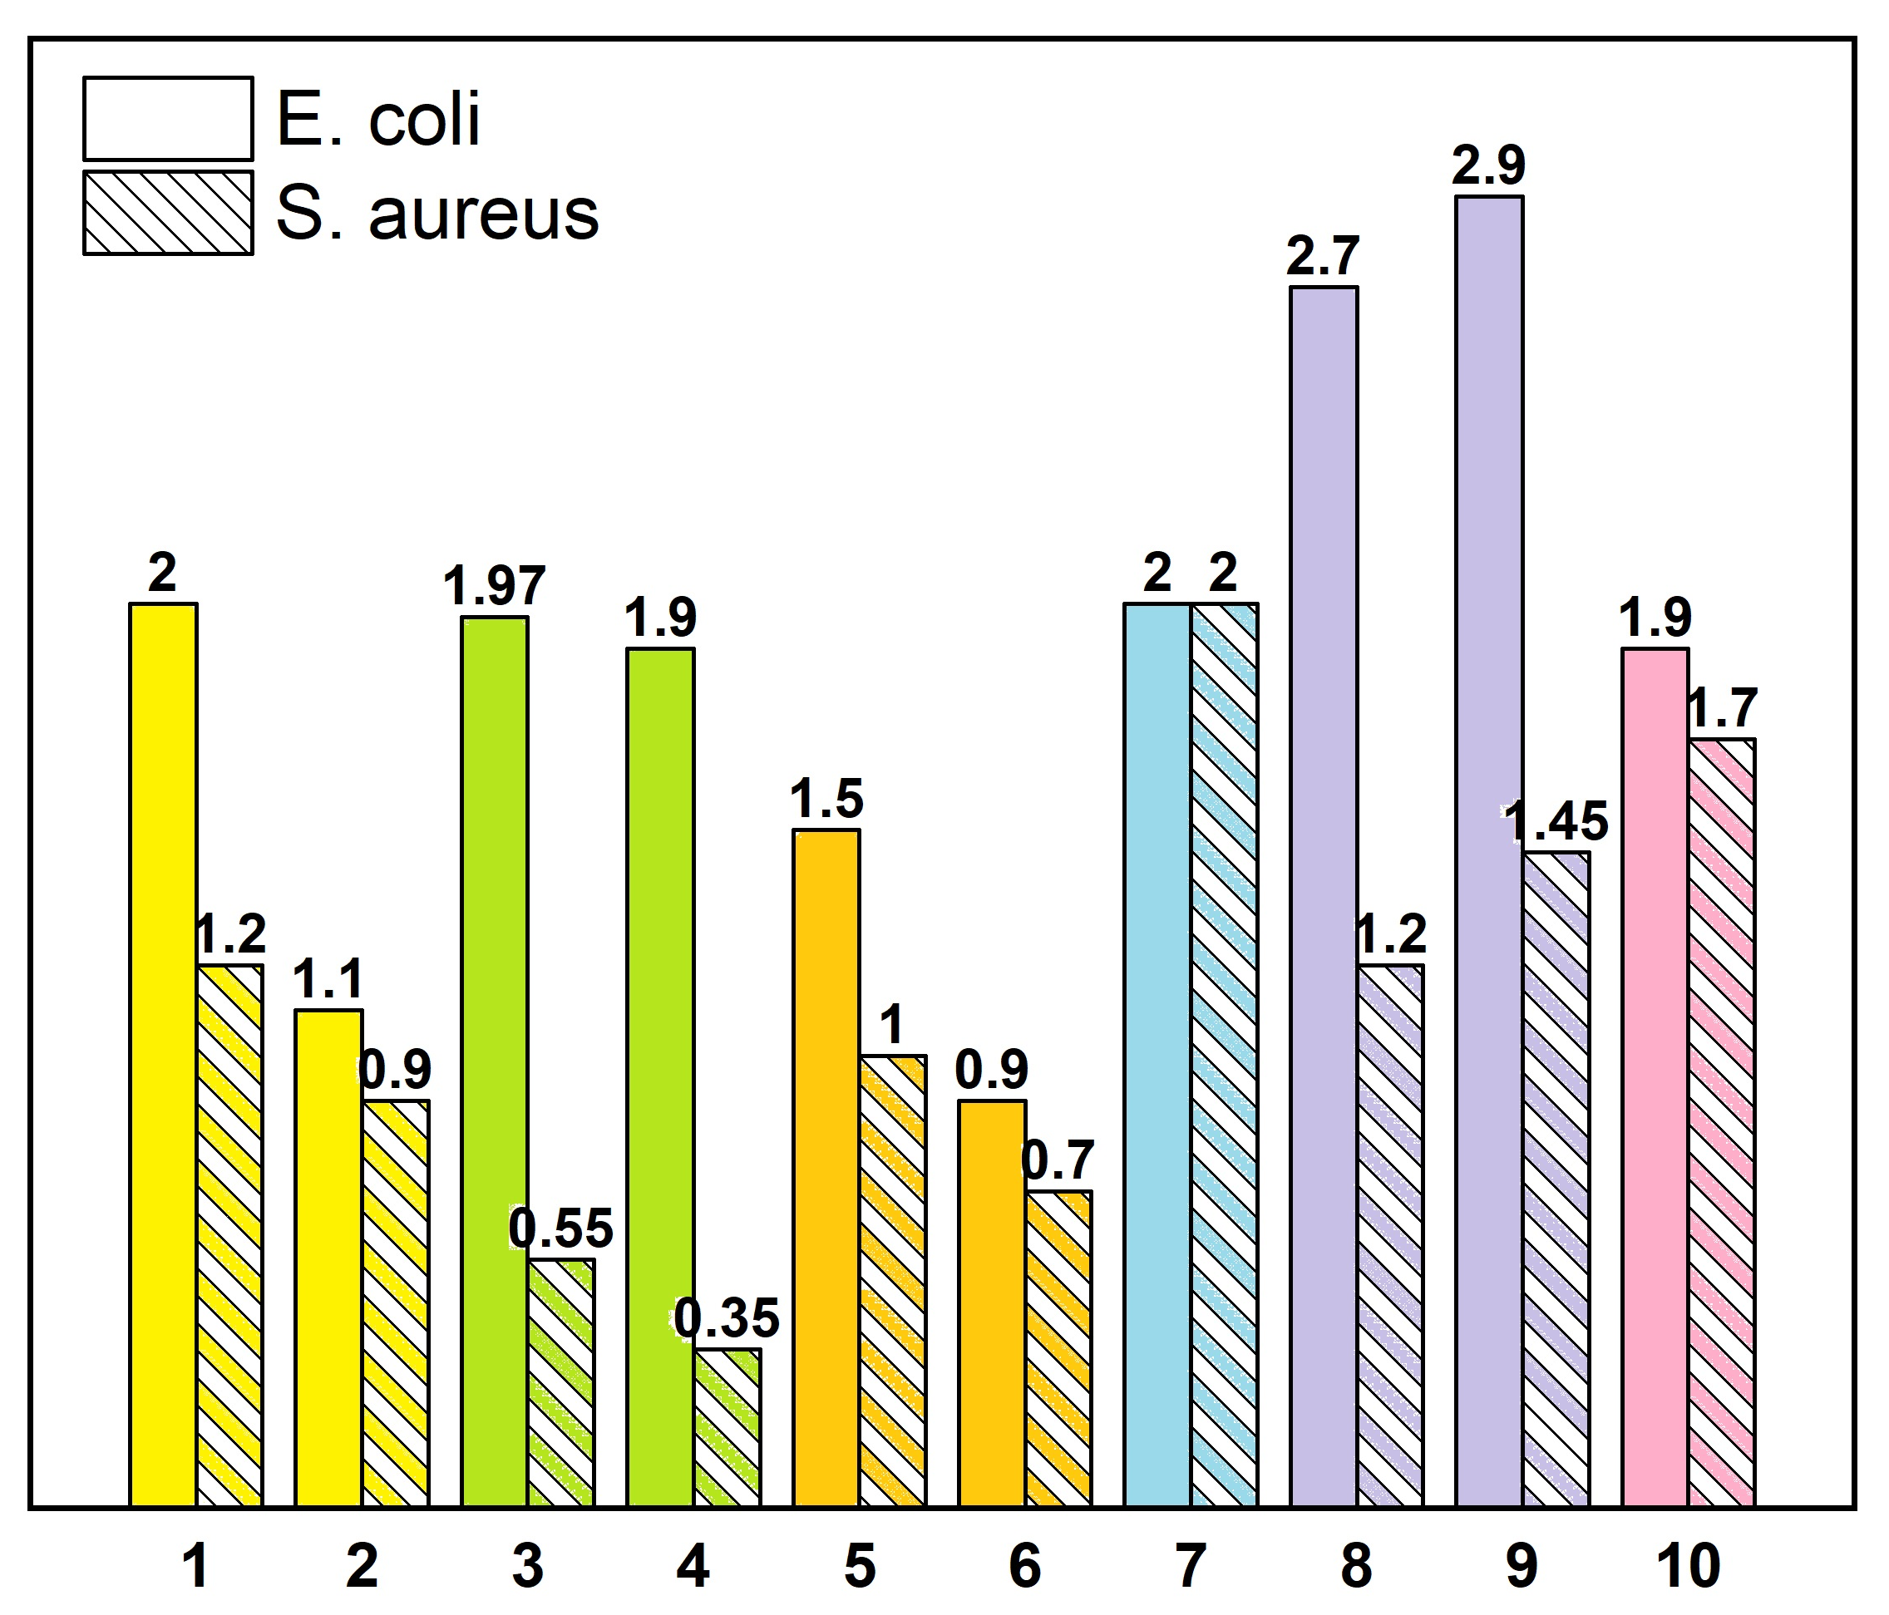
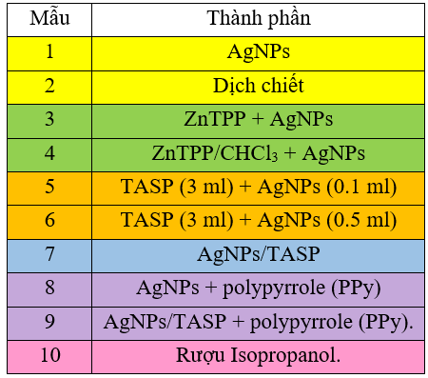
3. Antibacterial application
Samples
Composition
leaf extracts of Guava
Antibacterial ring diameter (cm)
Fig. 16. Diameter of antibacterial ring of the research materials with two strains of bacteria E.coli and S. aureus.
15
Notes:
Các mẫu chất đã tổng hợp được thử nghiệm kháng khuẩn với 2 chủng e.coli và s.aureus
Mẫu số 1 là nano bạc cho thấy khả năng kháng khuẩn tốt với e.coli nhưng lại tương đối kém với S. a
Mẫu số 3 và 4 là các mẫu vật liệu lai với porphyrin không tan trong nước ở lần thử nghiệm trước đó, kết quả cho thấy cả hai mẫu đều có hoạt tính kém hơn so với nano bạc
Mẫu 5,6 là vật liệu lai chế tạo bằng cách khuấy trộn thông thường vẫn cho kết quả kém hơn so với nano bạc do việc khuấy trộn đã vô tình làm loãng dd nano bạc ban đầu, khiến chúng bị kết tủa thành các hạt lớn hơn.
Mẫu số 7 là vật liệu lai bằng pp tổng hợp xanh từ dịch chiết lá ổi cho kết quả kháng khuẩn tốt hơn nano bạc và hoạt tính đồng đều ở cả 2 chủng e.coli và s.a
Mẫu số 8 và 9 có sự xuất hiện của PPy thì đều cho kết quả kháng khuẩn vượt trội hơn nano bạc thông thường. Trong đó vật liệu lai khi kết hợp với PPy là mẫu số 9 vẫn kháng khuẩn mạnh hơn so với nano bạc kết hợp PPy (mẫu số 8).

Slide 16
4. Conclusions
Silver nanoparticles from green synthesis, water-soluble porphyrins (TASP), polypyrrole and AgNPs/TASP hybrid materials have been successfully synthesized by us. In which TASP shows two characteristic absorption spectral bands soret (400-450 nm) and Q-band (500-700 nm), nanosilver gives a broad absorption spectrum of 300-600 nm which is typical for the surface plasmon effect of metalnanomaterials.
Materials combining TASP (a water-soluble porphyrin derivative) with silver nanoparticles (AgNPs) increased resistance to E. coli and S. aureus compared to AgNPs.
However, when adding polypyrrole (a polymer capable of promoting the release of Ag ions) to the AgNPs/TASP hybrid material, the antibacterial ability of this hybrid material was the highest among the investigated material samples. This will open the direction of research, fabrication and application of polymer thin films containing AgNPs/TASP hybrid materials to increase antibacterial ability compared to conventional silver nanoparticle.
The research was carried out with the support of the science and technology project of the University of Technology - Hanoi National University, № CN20.12
16

Slide 17
References
Lingyan Gao, Haojie Wang, Bo Zheng, Feihe Huang, Combating antibiotic resistance: Current strategies for the discovery of novel antibacterial materials based on macrocycle supramolecular chemistry, Giant, Volume 7, 2021,100066, ISSN 2666-5425
R Elashnikov, M Radocha, I Panov, S Rimpelova, P Ulbrich, A Michalcova, V Svorcik, O Lyutakov (2019), “Porphyrin‑silver nanoparticles hybrids: Synthesis, characterization and antibacterial activity”, Mater Sci Eng C Mater Biol Appl, 102, pp.192-199.
Stojiljkovic, I., Evavold, B. D., & Kumar, V. (2001). Antimicrobial properties of porphyrins. In Expert Opinion on Investigational Drugs (Vol. 10, Issue 2, pp. 309–320).
Agnes Antoinette Ntoumba, Francois Eya’ane MevaBiogenic..., Synthesis of Silver Nanoparticles Using Guava (Psidium guajava) Leaf Extract and Its Larvicidal Action against Anopheles gambiae, Journal of Biomaterials and Nanobiotechnology, 2020, 11, 49-66.
17

Slide 18


