Slide 1

А.В. Нючев
В.Ф. Отвагин, Н.С. Кузьмина, П. Янкович, Е.А. Федотова, А.Ю. Федоров
Разработка водорастворимых конъюгатов
для комбинированной фотодинамической и таргетной терапии
  XIV Международная конференция
  «Синтез и применение порфиринов и их аналогов»
  2 июля 2022

Slide 2
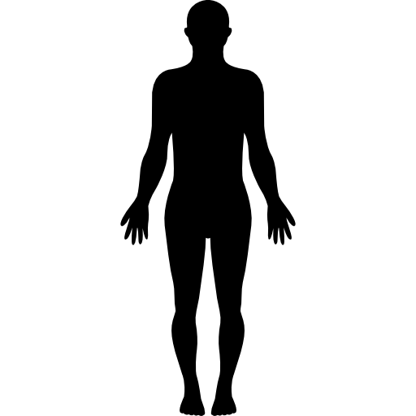

Photodynamic therapy: medicinal bases
Photosensitizer
Light
irradiation
Tumor
tissue
Distribution in body
Localization of PS
in target tissue/organ
Generation of high-energy species,
followed by cell death
Chem. Rev. 2010, 110, 2795.
2

Slide 3
Physical and chemical principles of PDT
PS
*
S1
T1
Fluorescence
Radiationless transition
Phosphorescence
hν
PS
S0
3

Slide 4
Physical and chemical principles of PDT
³O₂
-
PS
OH
NADPH, guanine,
tyrosine, etc.
+
Hydroxy radical
+
R
R
PS
Type I
*
S1
PS
*
T1
Fluorescence
Radiationless transition
Phosphorescence
hν
PS
S0
3

Slide 5
Physical and chemical principles of PDT
³O₂
-
PS
OH
NADPH, guanine,
tyrosine, etc.
+
Hydroxy radical
+
R
R
PS
Type I
*
S1
PS
*
T1
³O₂
Fluorescence
Radiationless transition
Phosphorescence
hν
Type II
PS
S0
¹O₂
Singlet oxygen
3

Slide 6

Physical and chemical principles of PDT
¹O₂
¹O₂
¹O₂
¹O₂
Activation of apoptosis or necroptosis
Important biomolecules
(peptides, DNA, RNA)
Death of tumor cells
4

Slide 7
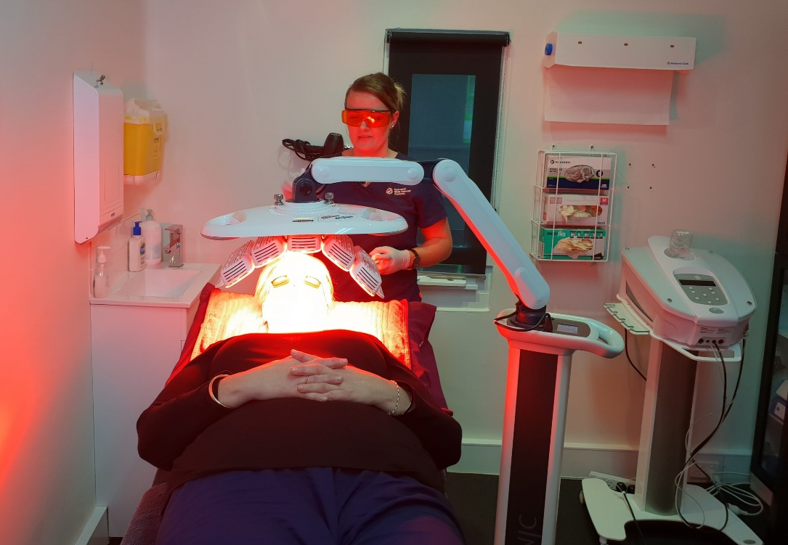
Photodynamic therapy: medicinal bases
Photodynamic therapy
of skin
5

Slide 8
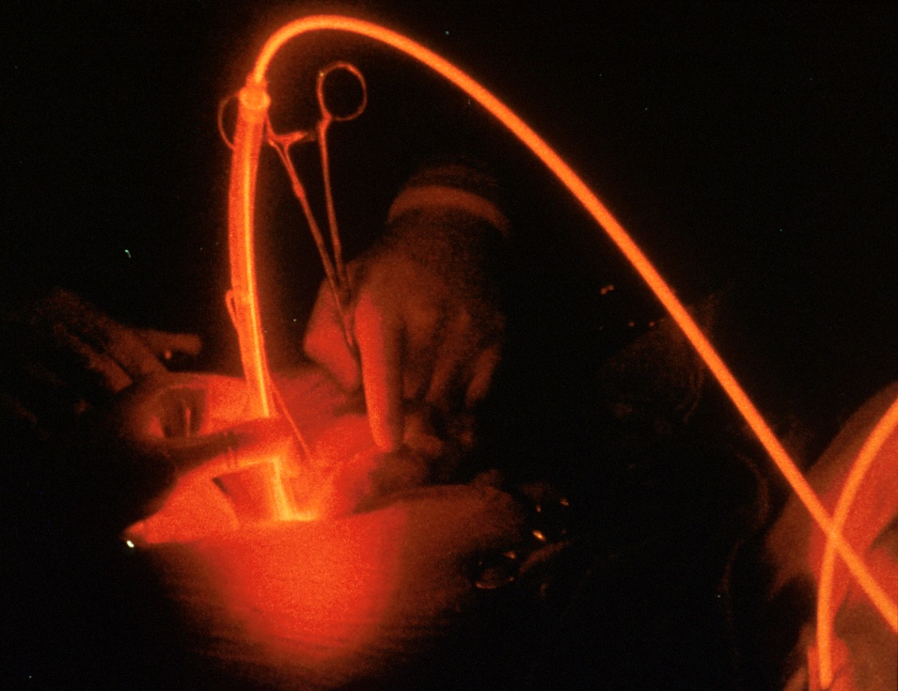
Photodynamic therapy: medicinal bases
Photodynamic therapy
of skin
Photodynamic therapy
of internal organs/tissues
5

Slide 9
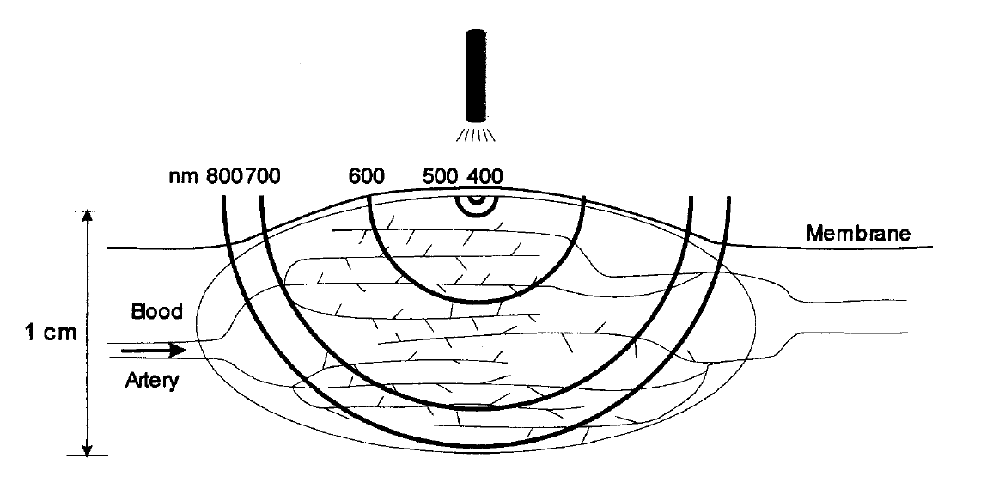
The dependence of the depth of penetration of light on the wavelength
The dependence of the depth of penetration of light on the wavelength
Tetrahedron 1998, 54, 4151.
6

Slide 10
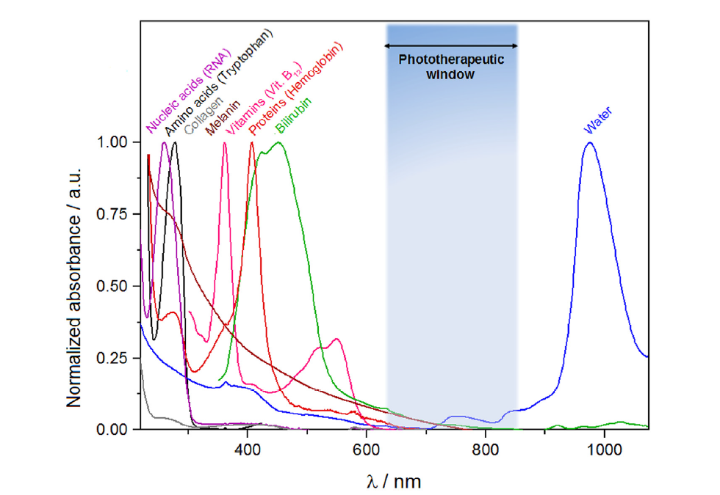
Phototherapeutic window
Coord. Chem. Rev. 2016, 325, 67.
7

Slide 11
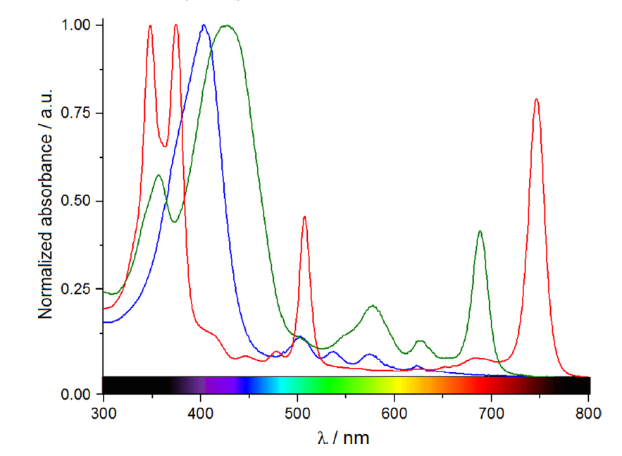
Absorbance spectra of different PSs
The size of the π system affects
photophysical properties
Chlorin
Bacteriochlorin
Porphyrin
Coord. Chem. Rev. 2016, 325, 67.
8

Slide 12
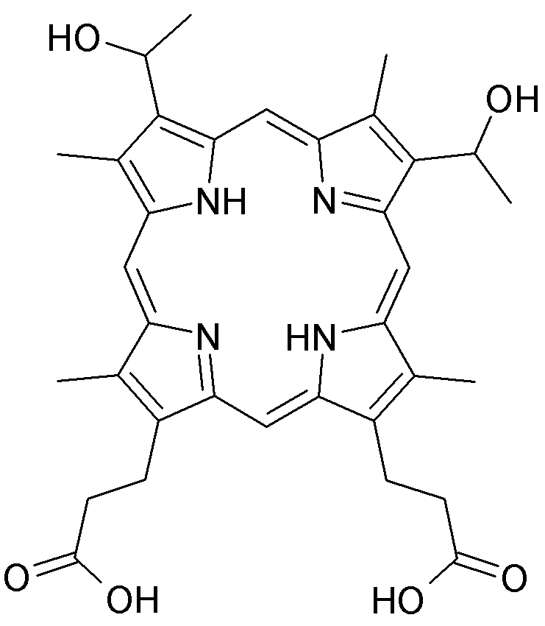
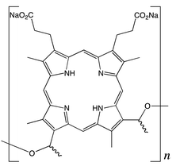
Photosensitizers
Photosensitizers for PDT
Chemical purity
Accumulation selectivity
Presence/absence of
dark toxicity
Photophysical properties
Photosensitivity
I Generation
Hematoporphyrin
(HpD)
Photofrin
(the mixture of porphyrins)
λ_{max} = 630 nm
ɛ ̴ 10³ M⁻¹cm⁻¹
Approved for clinical use
- Long photosensitivity
- Low extinction coefficients
!
!
9

Slide 13
Photosensitizers
Photosensitizers for PDT
Chemical purity
Accumulation selectivity
Presence/absence of
dark toxicity
Photophysical properties
Photosensitivity
I Generation
Hematoporphyrin
(HpD)
Photofrin
(the mixture of porphyrins)
λ_{max} = 630 nm
ɛ ̴ 10³ M⁻¹cm⁻¹
Approved for clinical use
- Long photosensitivity
- Low extinction coefficients
9

Slide 14
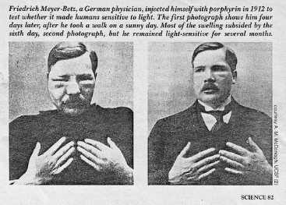
Photosensitizers
Photosensitizers for PDT
Chemical purity
Accumulation selectivity
Presence/absence of
dark toxicity
Photophysical properties
Photosensitivity
I Generation
Hematoporphyrin
(HpD)
Photofrin
1912.
Dr. Friedrich Meyer Betz first
applied HpD on himself
(the mixture of porphyrins)
λ_{max} = 630 nm
ɛ ̴ 10³ M⁻¹cm⁻¹
Approved for clinical use
- Long photosensitivity
- Low extinction coefficients
9

Slide 15
Photosensitizers
Photosensitizers for PDT
Chlorins
Pheophorbides
II Generation
Natural porphyrins
Chlorophyll
Tookad
NPe6
λ_{max} = 763 nm
λ_{max} = 664 nm
ɛ ̴10⁴ M⁻¹cm⁻¹
ɛ ̴10⁴ M⁻¹cm⁻¹
Low
photosensitivity
Purlytins
No photosensitivity
Approved for the treatment
of prostate cancer
Approved for the treatment
of lung cancer
Purlytin
λ_{max} = 630 nm
ɛ ̴10⁴ M⁻¹cm⁻¹
2nd stage of clinical trials
Low water solubility
10

Slide 16
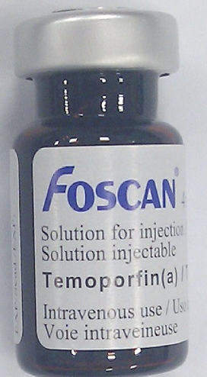
Photosensitizers
Photosensitizers for PDT
Synthetic chlorins
Phthalocyanines
II Generation
Synthetic
porphyrins
Foscan
λ_{max} = 670-770 nm
λ_{max} = 652 nm
ɛ = 10⁵ M⁻¹cm⁻¹
ɛ = 10⁴ M⁻¹cm⁻¹
High photochemical
activity
High photochemical
activity
Long excretion
Long excretion
Treatment of skin and
breast cancers
Treatment of head and neck
cancers
11

Slide 17
Photosensitizers
Ways for the improvement of PSs
Low selectivity of accumulation
in tumor tissues
I & II Generations
12

Slide 18
Photosensitizers
Ways for the improvement of PSs
Low selectivity of accumulation
in tumor tissues
Conjugate
Solution
I & II Generations
Delivery of the molecule
to the tumor cells
III Generation
12

Slide 19
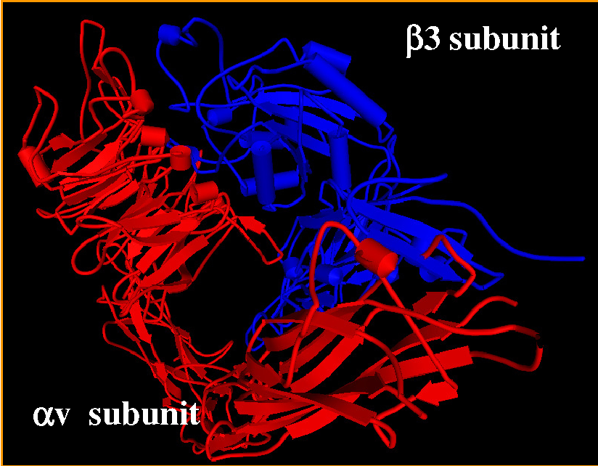
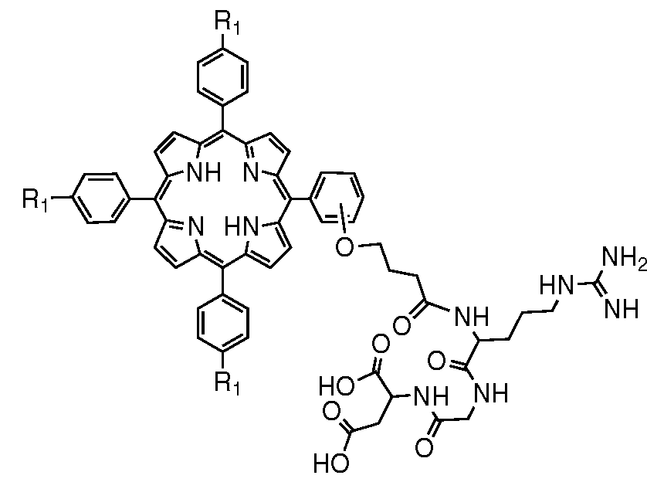
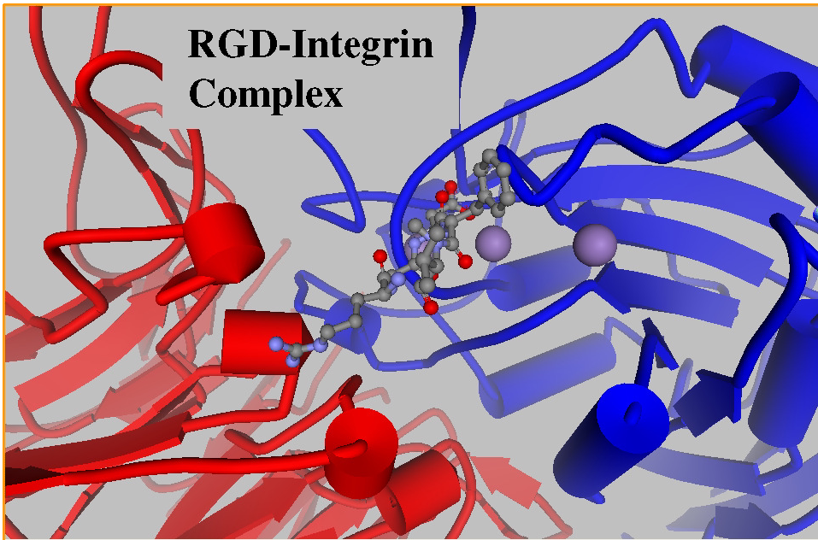
Peptide Conjugates
Αvβ3 Integrin (target)
RGD peptide
Org. Biomol. Chem., 2016,14, 2985;
Eur. J. Org. Chem. 2003, 1486.
Complex "Integrin-RGD peptide"
13

Slide 20
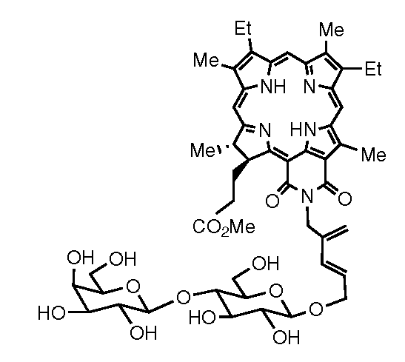
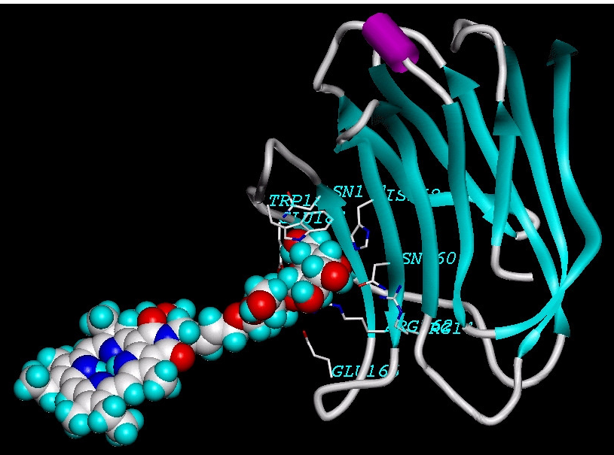
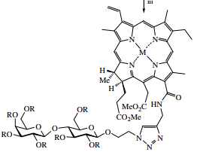
Carbohydrate Conjugates
Photoactive
part
λ_{max} = 700 nm
Carbohydrate
RSC Adv. 2015, 5, 33496;
J. Med. Chem. 2009, 52, 445.
Galectin-3 (target)
Mendeleev Commun. 2008, 18, 135.
14

Slide 21
Conjugates with cytostatics
Paclitaxel
Hydrolysis
Hydrolysis
Increase activity
Tumor cell growth inhibition
Doxorubicin
Bioorg. Med. Chem. 2011, 19, 5383
15

Slide 22
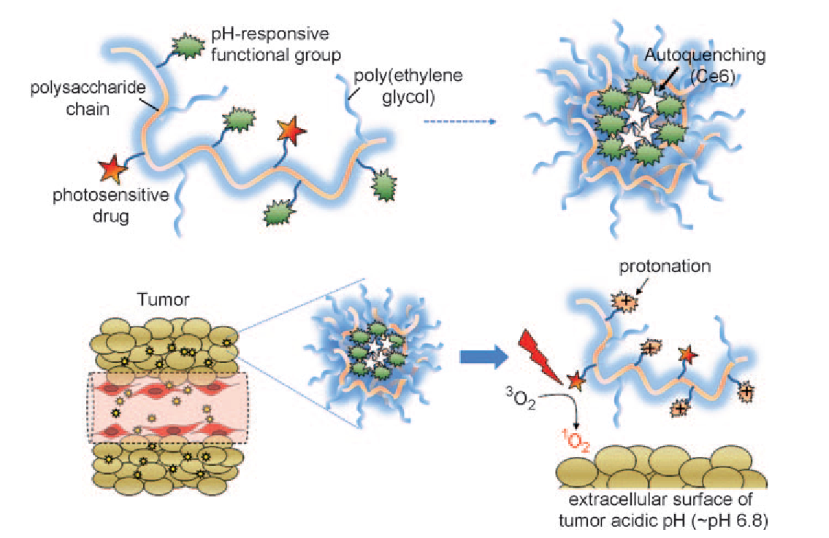
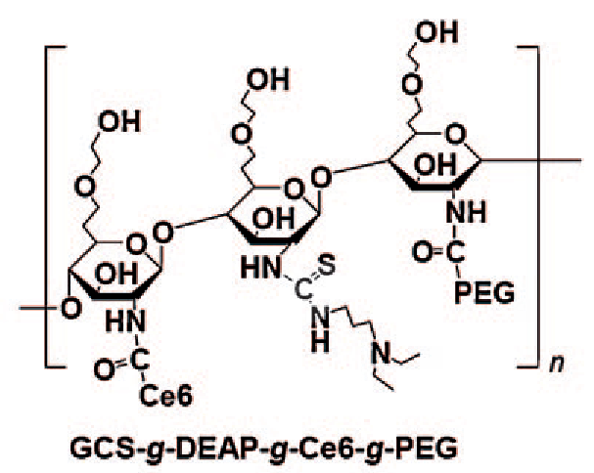
pH Dependent Conjugates
Neutral / Alkaline pH –
PDT self-quenching
=
Acidic pH - death of the
tumor due to PDT
Се6
Angew. Chem. Int. Ed. 2011, 50, 1644.
16

Slide 23
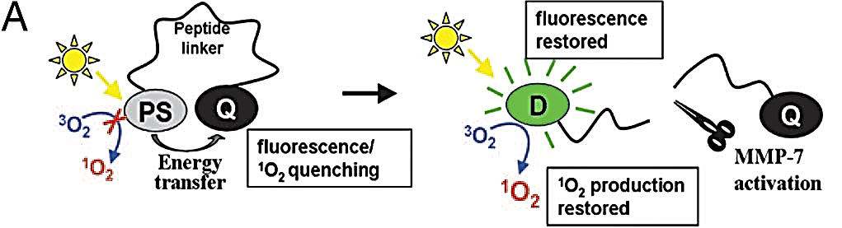
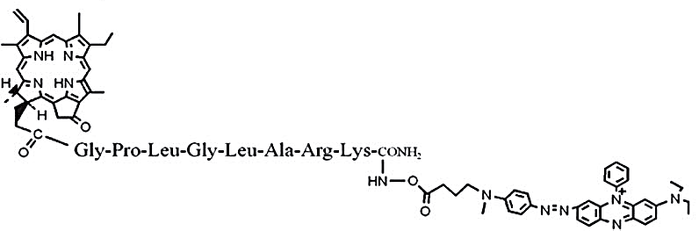
Molecular Beacons
Photoactive fragment
MMP-7 - Matrix metalloproteinase
is abundant in tumor cells
MMP-7 specific peptide
Quencher
PNAS, 2007, 104, 8989.
Molecular Beacon
BHQ3
17

Slide 24
Combination of Therapy Agents
Combined treatment of tumors: photodynamic (PDT) and tyrosine kinase inhibition
Target delivery
the possibility of in vivo studies of agent distribution in organs and tissues using imaging techniques
18

Slide 25
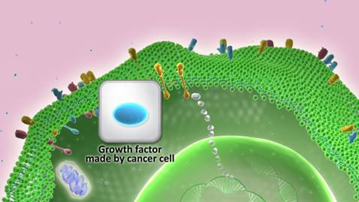
Target ligand of conjugate
VEGFR/EGFR
Ligand
Accumulation in tumor tissues
Ligand (inhibitor) of epidermal growth factor and vascular endothelial growth factor receptors
It is a tyrosine kinase inhibitor
FDA approved for clinical use in 2011
J. Med. Chem. 1999, 42, 5369-5389; J. Med. Chem. 2002, 45, 1300-1312;
J. Med. Chem. 2002, 45, 3772-3793; J. Med. Chem. 2003, 46, 4910-4925.
19

Slide 26
Synthesis of VEGFR/EGFR ligand
Patent WO 2010/028254 A2
20

Slide 27
Synthesis of VEGFR/EGFR ligand
A.V. Nyuchev, O.I. Koifman, D.V. Belykh, A.Yu. Fedorov et al., Synthesis, 2015, 47, 3717.
21

Slide 28
Synthesis of VEGFR/EGFR ligand
A.V. Nyuchev, O.I. Koifman, D.V. Belykh, A.Yu. Fedorov et al., Synthesis, 2015, 47, 3717.
22

Slide 29
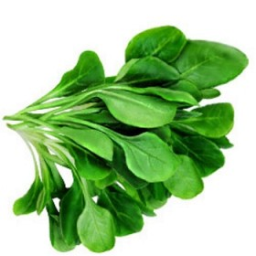
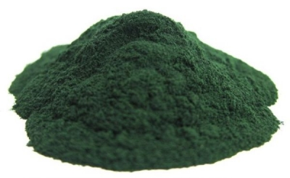
Preparation of methylpheophorbide-a
Spinach
or Spirulina
23

Slide 30
Synthesis of chlorin and 4-arylaminoquinazoline conjugates
A.V. Nyuchev, O.I. Koifman, D.V. Belykh, A.Yu. Fedorov et al., Synthesis, 2015, 47, 3717.
24

Slide 31
Synthesis of chlorin and 4-arylaminoquinazoline conjugates
A.V. Nyuchev, O.I. Koifman, D.V. Belykh, A.Yu. Fedorov et al., Synthesis, 2015, 47, 3717.
24

Slide 32
Synthesis of chlorin and 4-arylaminoquinazoline conjugates
A.V. Nyuchev, O.I. Koifman, D.V. Belykh, A.Yu. Fedorov et al., Synthesis, 2015, 47, 3717.
24

Slide 33
Synthesis of chlorin and 4-arylaminoquinazoline conjugates
A.V. Nyuchev, O.I. Koifman, D.V. Belykh, A.Yu. Fedorov et al., Synthesis, 2015, 47, 3717.
25

Slide 34
Synthesis of chlorin and 4-arylaminoquinazoline conjugates
A.V. Nyuchev, O.I. Koifman, D.V. Belykh, A.Yu. Fedorov et al., Synthesis, 2015, 47, 3717.
26

Slide 35
Synthesis of chlorin and 4-arylaminoquinazoline conjugates
Low water solubility
A.V. Nyuchev, O.I. Koifman, D.V. Belykh, A.Yu. Fedorov et al., Synthesis, 2015, 47, 3717.
26

Slide 36
Combination of Therapy Agents
Combined treatment of tumors: photodynamic (PDT) and tyrosine kinase inhibition
Target delivery
the possibility of in vivo studies of agent distribution in organs and tissues using imaging techniques
27

Slide 37
Synthesis of water-soluble chlorin conjugates with 4-arylaminoquinazolines
V.F. Otvagin, A.V. Nyuchev, O.I. Koifman, A.Yu. Fedorov et al., Eur. J. Med. Chem. 2018, 144, 740.
28

Slide 38
Synthesis of water-soluble chlorin conjugates with 4-arylaminoquinazolines
V.F. Otvagin, A.V. Nyuchev, O.I. Koifman, A.Yu. Fedorov et al., Eur. J. Med. Chem. 2018, 144, 740.
28

Slide 39
Synthesis of water-soluble chlorin conjugates with 4-arylaminoquinazolines
V.F. Otvagin, A.V. Nyuchev, O.I. Koifman, A.Yu. Fedorov et al., Eur. J. Med. Chem. 2018, 144, 740.
28

Slide 40
Synthesis of water-soluble chlorin conjugates with 4-arylaminoquinazolines
V.F. Otvagin, A.V. Nyuchev, O.I. Koifman, A.Yu. Fedorov et al., Eur. J. Med. Chem. 2018, 144, 740.
29

Slide 41
Synthesis of water-soluble chlorin conjugates with 4-arylaminoquinazolines
V.F. Otvagin, A.V. Nyuchev, O.I. Koifman, A.Yu. Fedorov et al., Eur. J. Med. Chem. 2018, 144, 740.
29

Slide 42
Synthesis of water-soluble chlorin conjugates with 4-arylaminoquinazolines
V.F. Otvagin, A.V. Nyuchev, O.I. Koifman, A.Yu. Fedorov et al., Eur. J. Med. Chem. 2018, 144, 740.
29

Slide 43
Synthesis of water-soluble chlorin conjugates with 4-arylaminoquinazolines
V.F. Otvagin, A.V. Nyuchev, O.I. Koifman, A.Yu. Fedorov et al., Eur. J. Med. Chem. 2018, 144, 740.
29

Slide 44
Synthesis of water-soluble chlorin conjugates with 4-arylaminoquinazolines
VEGFR/EGFR
Ligand
V.F. Otvagin, A.V. Nyuchev, O.I. Koifman, A.Yu. Fedorov et al., Eur. J. Med. Chem. 2018, 144, 740.
30

Slide 45
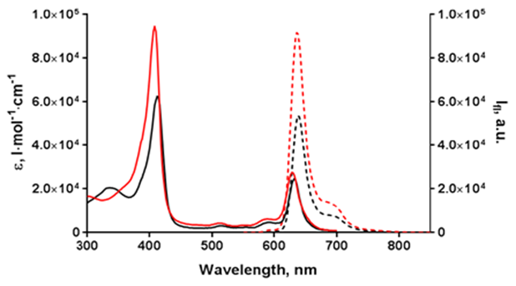
Photophysical properties of conjugates
Compound | λ_{abs}(nm) (log ε) | λ_{em}(nm)ª | Φ_{F}^{b}(%)
Conjugate | 412 (4.80) 632 (4.39) | 638 | 7.3
Free PS | 408 (4.96) 628 (4.44) | 636 | 9.5
ªExited at 410 nm. ^{b}Relative to Rhodamine B in water.
Conjugate
Free PS
V.F. Otvagin, A.V. Nyuchev, O.I. Koifman, A.Yu. Fedorov et al., Eur. J. Med. Chem. 2018, 144, 740.
31

Slide 46
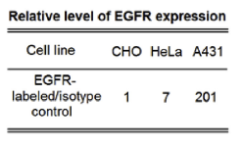
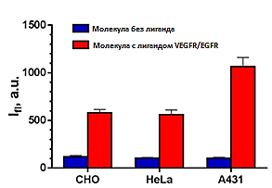
Biological evaluation, in vitro tests
Cellular uptake
Free PS
Conjugate
V.F. Otvagin, A.V. Nyuchev, O.I. Koifman, A.Yu. Fedorov et al., Eur. J. Med. Chem. 2018, 144, 740.
32

Slide 47
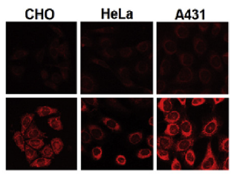
Biological evaluation, in vitro tests
Cellular uptake
Free PS
Conjugate
V.F. Otvagin, A.V. Nyuchev, O.I. Koifman, A.Yu. Fedorov et al., Eur. J. Med. Chem. 2018, 144, 740.
32

Slide 48
Biological evaluation, in vitro tests
Cellular uptake
Free PS
Conjugate
V.F. Otvagin, A.V. Nyuchev, O.I. Koifman, A.Yu. Fedorov et al., Eur. J. Med. Chem. 2018, 144, 740.
32

Slide 49
Biological evaluation, in vitro tests
Dark toxicity and PDT
Conjugate
Cellular uptake
Free PS
Conjugate
Free PS
V.F. Otvagin, A.V. Nyuchev, O.I. Koifman, A.Yu. Fedorov et al., Eur. J. Med. Chem. 2018, 144, 740.
32

Slide 50
Biological evaluation, in vitro tests
Dark toxicity and PDT
 | IC₅₀ PDT, μM | IC₅₀ Dark toxicity, μM | IC₅₀dark/ IC₅₀light
CHO | 2.7 | 32 | 12
HeLa | 2.2 | 25 | 11
A431 | 2.6 | 48 | 18
Cellular uptake
Free PS
Conjugate
Irradiation:
Wavelength 615-635 nm
Dose 20 J/сm²⁵
Power 20 mWatt/сm²
V.F. Otvagin, A.V. Nyuchev, O.I. Koifman, A.Yu. Fedorov et al., Eur. J. Med. Chem. 2018, 144, 740.
32

Slide 51
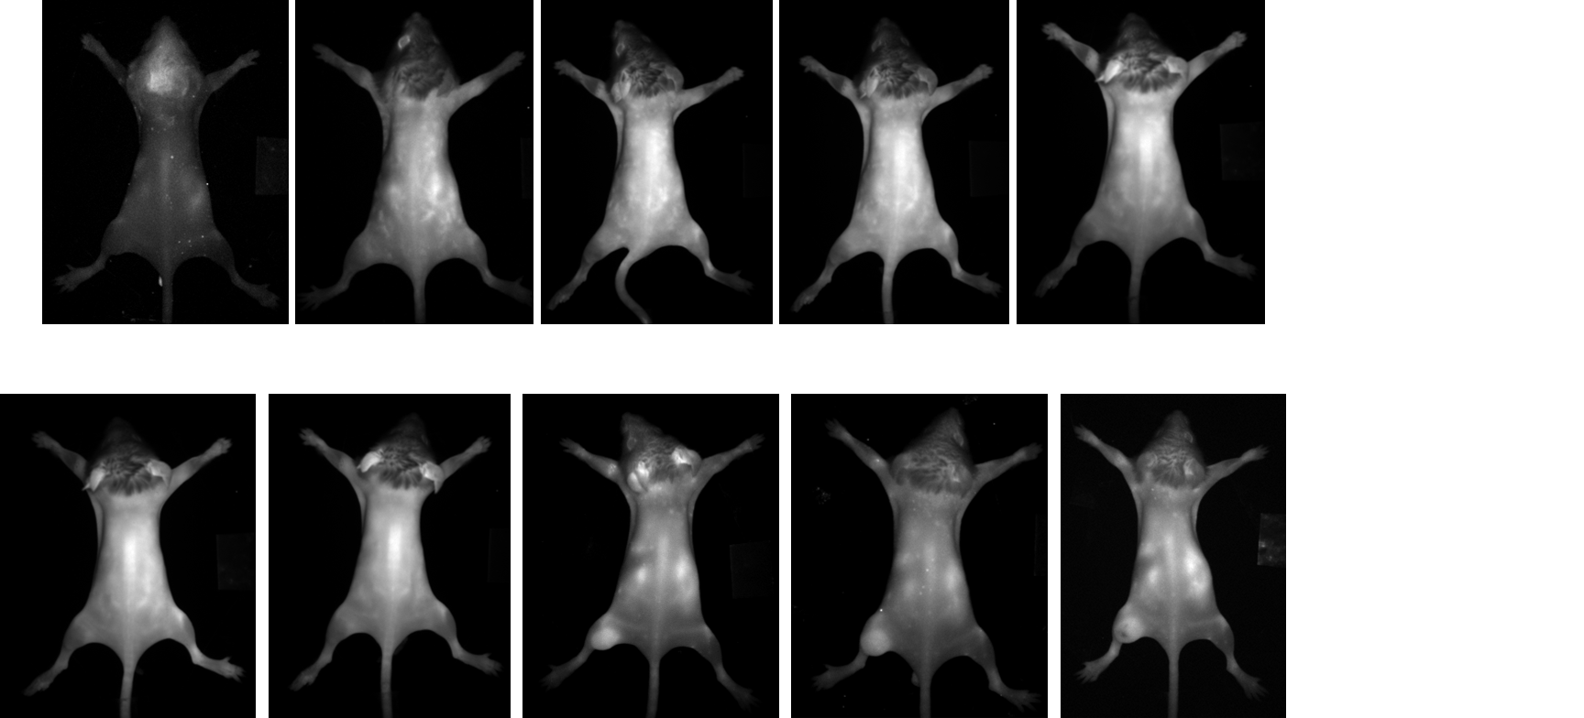
Biological evaluation, in vivo tests
In vivo studies (dose 25 mg/kg), Balb/c mice
Control
5 min
4 h
24 h
Subcutaneous injection of CT-26 cells
V.F. Otvagin, A.V. Nyuchev, O.I. Koifman, A.Yu. Fedorov et al., Eur. J. Med. Chem. 2018, 144, 740.
33

Slide 52
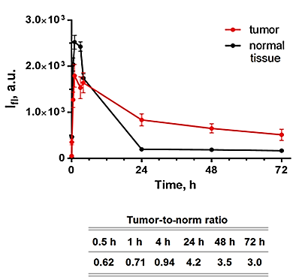
Biological evaluation, in vivo tests
In vivo studies (dose 25 mg/kg), Balb/c mice
Control
5 min
4 h
24 h
Subcutaneous injection of CT-26 cells
V.F. Otvagin, A.V. Nyuchev, O.I. Koifman, A.Yu. Fedorov et al., Eur. J. Med. Chem. 2018, 144, 740.
33

Slide 53
Synthesis of water soluble conjugates of chlorins with carbohydrates
34

Slide 54
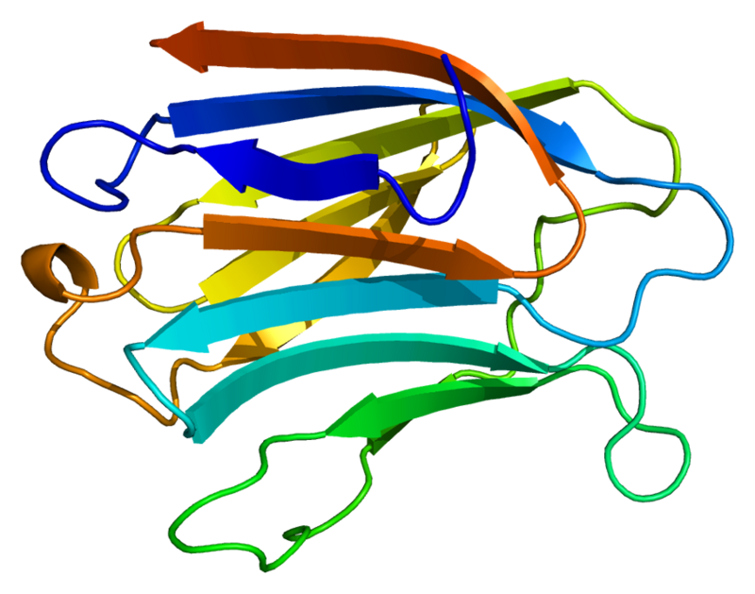
Synthesis of water soluble conjugates of chlorins with carbohydrates
Binding to galectins
in tumor cells
Hydrophilicity
Org. Biomol. Chem., 2016,14, 2985
Galectin-3
35

Slide 55
Synthesis of water soluble conjugates of chlorins with carbohydrates
N.S. Kuzmina, V.F. Otvagin, A.V. Nyuchev, O.I.Koifman, A.Yu. Fedorov et al., Mendeleev. Commun. 2020, 30, 159.
36

Slide 56
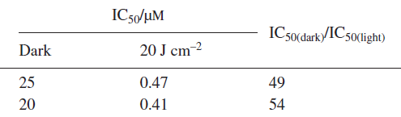
Synthesis of water soluble conjugates of chlorins with carbohydrates
β-D-galactosyl
β-D-glucosyl
N.S. Kuzmina, V.F. Otvagin, A.V. Nyuchev, O.I.Koifman, A.Yu. Fedorov et al., Mendeleev. Commun. 2020, 30, 159.
37

Slide 57
Synthesis of water soluble conjugates of chlorins with carbohydrates
N.S. Kuzmina, V.F. Otvagin, A.V. Nyuchev, O.I.Koifman, A.Yu. Fedorov et al., Mendeleev. Commun. 2020, 30, 159.
38

Slide 58
Water soluble chlorin / carbohydrate / 4-arylaminoquinazoline conjugate
V.F. Otvagin, A.V. Nyuchev, Y.G. Gorbunova, O.I. Koifman, A.Yu. Fedorov et al., J. Med. Chem. 2019, 62, 11182.
39

Slide 59
Water soluble chlorin / carbohydrate / 4-arylaminoquinazoline conjugate
V.F. Otvagin, A.V. Nyuchev, Y.G. Gorbunova, O.I. Koifman, A.Yu. Fedorov et al., J. Med. Chem. 2019, 62, 11182.
39

Slide 60
Water soluble chlorin / carbohydrate / 4-arylaminoquinazoline conjugate
V.F. Otvagin, A.V. Nyuchev, Y.G. Gorbunova, O.I. Koifman, A.Yu. Fedorov et al., J. Med. Chem. 2019, 62, 11182.
39

Slide 61
Water soluble chlorin / carbohydrate / 4-arylaminoquinazoline conjugate
V.F. Otvagin, A.V. Nyuchev, Y.G. Gorbunova, O.I. Koifman, A.Yu. Fedorov et al., J. Med. Chem. 2019, 62, 11182.
40

Slide 62
Water soluble chlorin / carbohydrate / 4-arylaminoquinazoline conjugate
V.F. Otvagin, A.V. Nyuchev, Y.G. Gorbunova, O.I. Koifman, A.Yu. Fedorov et al., J. Med. Chem. 2019, 62, 11182.
40

Slide 63
Water soluble chlorin / carbohydrate / 4-arylaminoquinazoline conjugate
V.F. Otvagin, A.V. Nyuchev, Y.G. Gorbunova, O.I. Koifman, A.Yu. Fedorov et al., J. Med. Chem. 2019, 62, 11182.
40

Slide 64
Water soluble chlorin / carbohydrate / 4-arylaminoquinazoline conjugate
Conjugate
Free PS
V.F. Otvagin, A.V. Nyuchev, Y.G. Gorbunova, O.I. Koifman, A.Yu. Fedorov et al., J. Med. Chem. 2019, 62, 11182.
41

Slide 65
Water soluble chlorin / carbohydrate / 4-arylaminoquinazoline conjugate
Conjugate
Free PS
Conjugate
Free PS
V.F. Otvagin, A.V. Nyuchev, Y.G. Gorbunova, O.I. Koifman, A.Yu. Fedorov et al., J. Med. Chem. 2019, 62, 11182.
41

Slide 66
Water soluble chlorin / carbohydrate / 4-arylaminoquinazoline conjugate
Conjugate
Free PS
Conjugate
Free PS
V.F. Otvagin, A.V. Nyuchev, Y.G. Gorbunova, O.I. Koifman, A.Yu. Fedorov et al., J. Med. Chem. 2019, 62, 11182.
41

Slide 67
Water soluble chlorin / carbohydrate / 4-arylaminoquinazoline conjugate
Conjugate
Free PS
V.F. Otvagin, A.V. Nyuchev, Y.G. Gorbunova, O.I. Koifman, A.Yu. Fedorov et al., J. Med. Chem. 2019, 62, 11182.
41

Slide 68
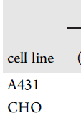
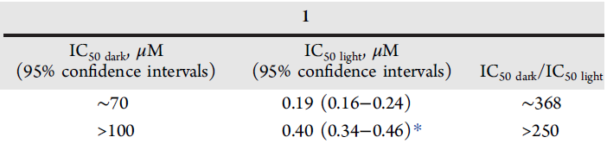

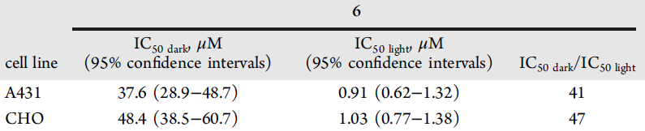
Water soluble chlorin / carbohydrate / 4-arylaminoquinazoline conjugate
Conjugate
Free PS
V.F. Otvagin, A.V. Nyuchev, Y.G. Gorbunova, O.I. Koifman, A.Yu. Fedorov et al., J. Med. Chem. 2019, 62, 11182.
41

Slide 69
Water soluble chlorin / carbohydrate / 4-arylaminoquinazoline conjugate
Conjugate
Free PS
V.F. Otvagin, A.V. Nyuchev, Y.G. Gorbunova, O.I. Koifman, A.Yu. Fedorov et al., J. Med. Chem. 2019, 62, 11182.
41

Slide 70
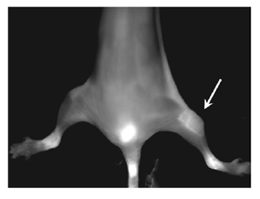
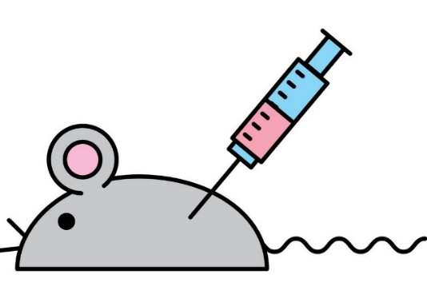
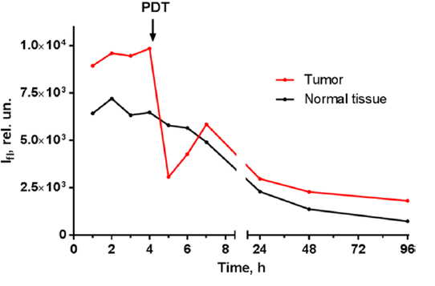
Water soluble chlorin / carbohydrate / 4-arylaminoquinazoline conjugate
V.F. Otvagin, A.V. Nyuchev, Y.G. Gorbunova, O.I. Koifman, A.Yu. Fedorov et al., J. Med. Chem. 2019, 62, 11182.
41

Slide 71
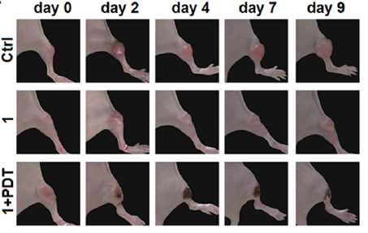
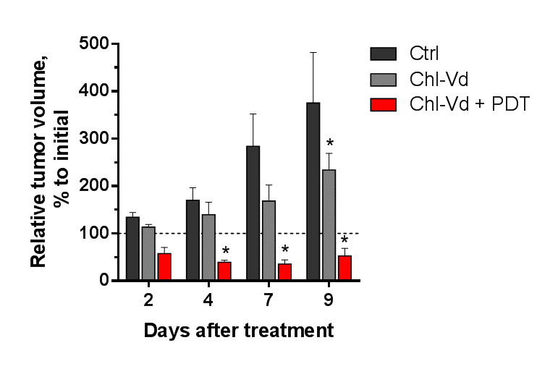
Water soluble chlorin / carbohydrate / 4-arylaminoquinazoline conjugate
Control
Conjugate
Conjugate + PDT
Control
Conjugate
Conjugate + PDT
Intravenous administration, dose 15 mg/kg.
Irradiation 50 J/cm² at 635 nm
V.F. Otvagin, A.V. Nyuchev, Y.G. Gorbunova, O.I. Koifman, A.Yu. Fedorov et al., J. Med. Chem. 2019, 62, 11182.
41

Slide 72
Conjugates with self-immolative linkers
Water-soluble photoactive chlorin conjugate for dual therapy of cancer
Self-immolative linker
Chemotherapeutic drug
Water-soluble part
Photosensitizer
Antitumor therapy
(¹O₂, ROS or radicals)
Fluorescent
imaging
Antitumor therapy
(inhibition of proteins)
Selective delivery
of whole conjugate
Two differently-acting types of drugs in ONE molecule!
42

Slide 73
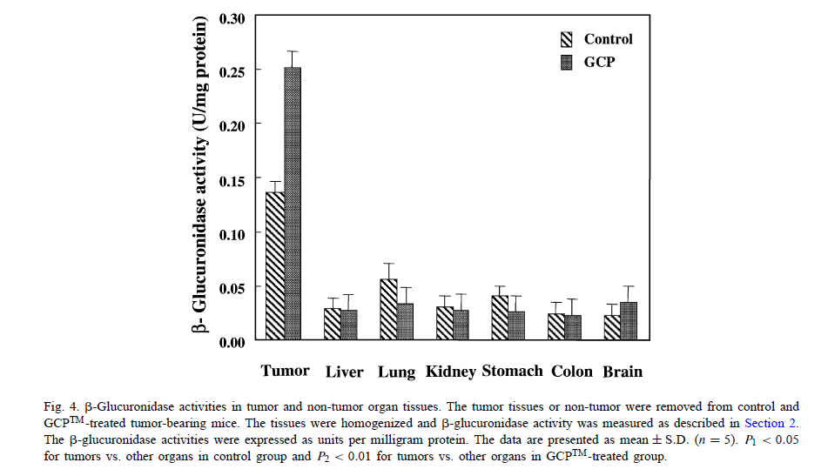
Conjugates with self-immolative linker
ß-glucuronidase is produced by tumor tissues
43

Slide 74
Conjugates with self-immolative linker
ß-glucuronidase is produced by tumor tissues
ß-glucuronide based
self-immolative linker
43

Slide 75
Conjugates with self-immolative linker
ß-glucuronidase is produced by tumor tissues
ß-glucuronide based
self-immolative linker
43

Slide 76
Chemotherapeutic part of conjugate
Approved by FDA in 2016.
Treatment of advanced renal cell carcinoma and thyroid cancer
Cabozantinib
Suppresses:
- Metastasis
- Angiogenesis
- Tumor Growth
It is a small molecule inhibitor of the tyrosine kinases c-Met and VEGFR2
Inhibitor with IC₅₀ of picoM concentration range
44

Slide 77
Conjugate with self-immolative linker
45

Slide 78
Conjugate with self-immolative linker
45

Slide 79
Conjugate with self-immolative linker
45

Slide 80
Conjugate with self-immolative linker
45

Slide 81
Conjugate with self-immolative linker
45

Slide 82
Conjugate with self-immolative linker
45

Slide 83
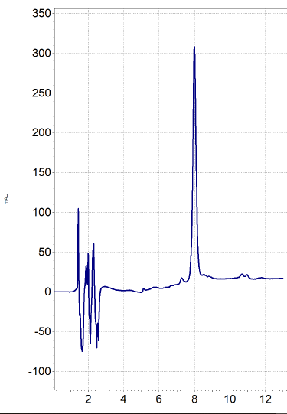
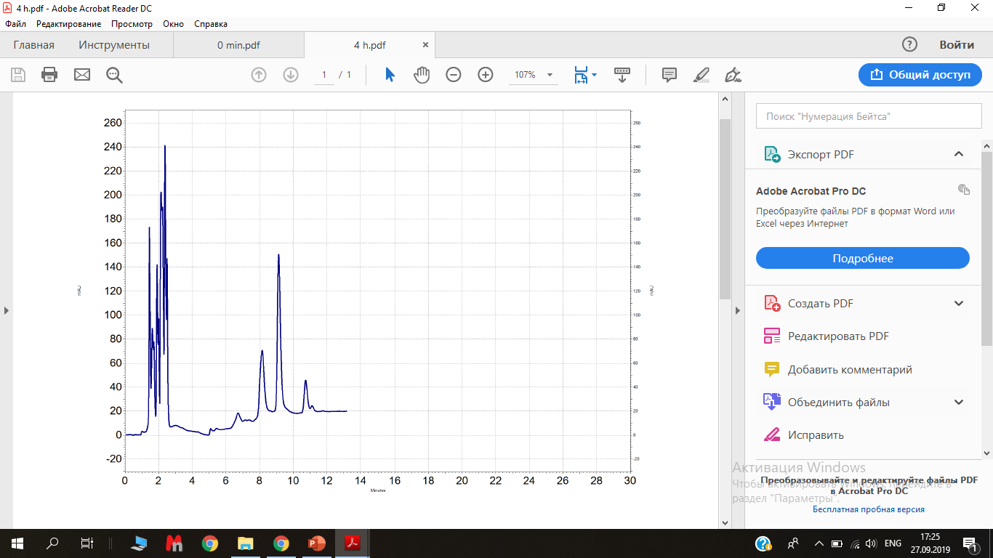
HPLC analysis of Conjugate with self-immolative linker
HPLC
0 min
+ β-glucuronidase
240 min
ß-glucuronide based
Self-immolative linker
PEG
PEG
Conjugate
Drug
46

Slide 84
Summary
V.F. Otvagin, A.V. Nyuchev et al., Eur. J. Med. Chem. 2018, 144, 740.
V.F. Otvagin, A.V. Nyuchev et al., J. Med. Chem. 2019, 62, 11182.
47

Slide 85
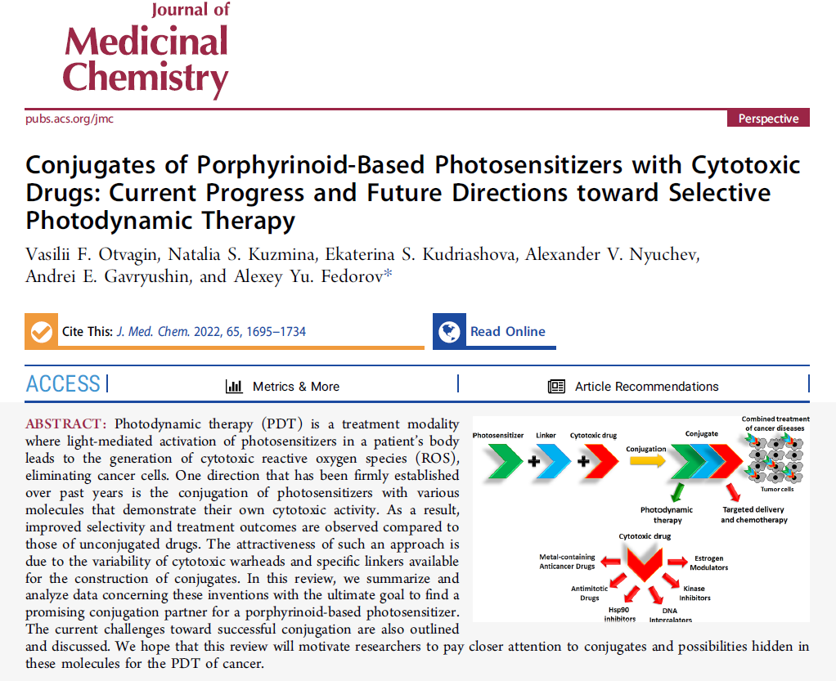
Summary
48

Slide 86
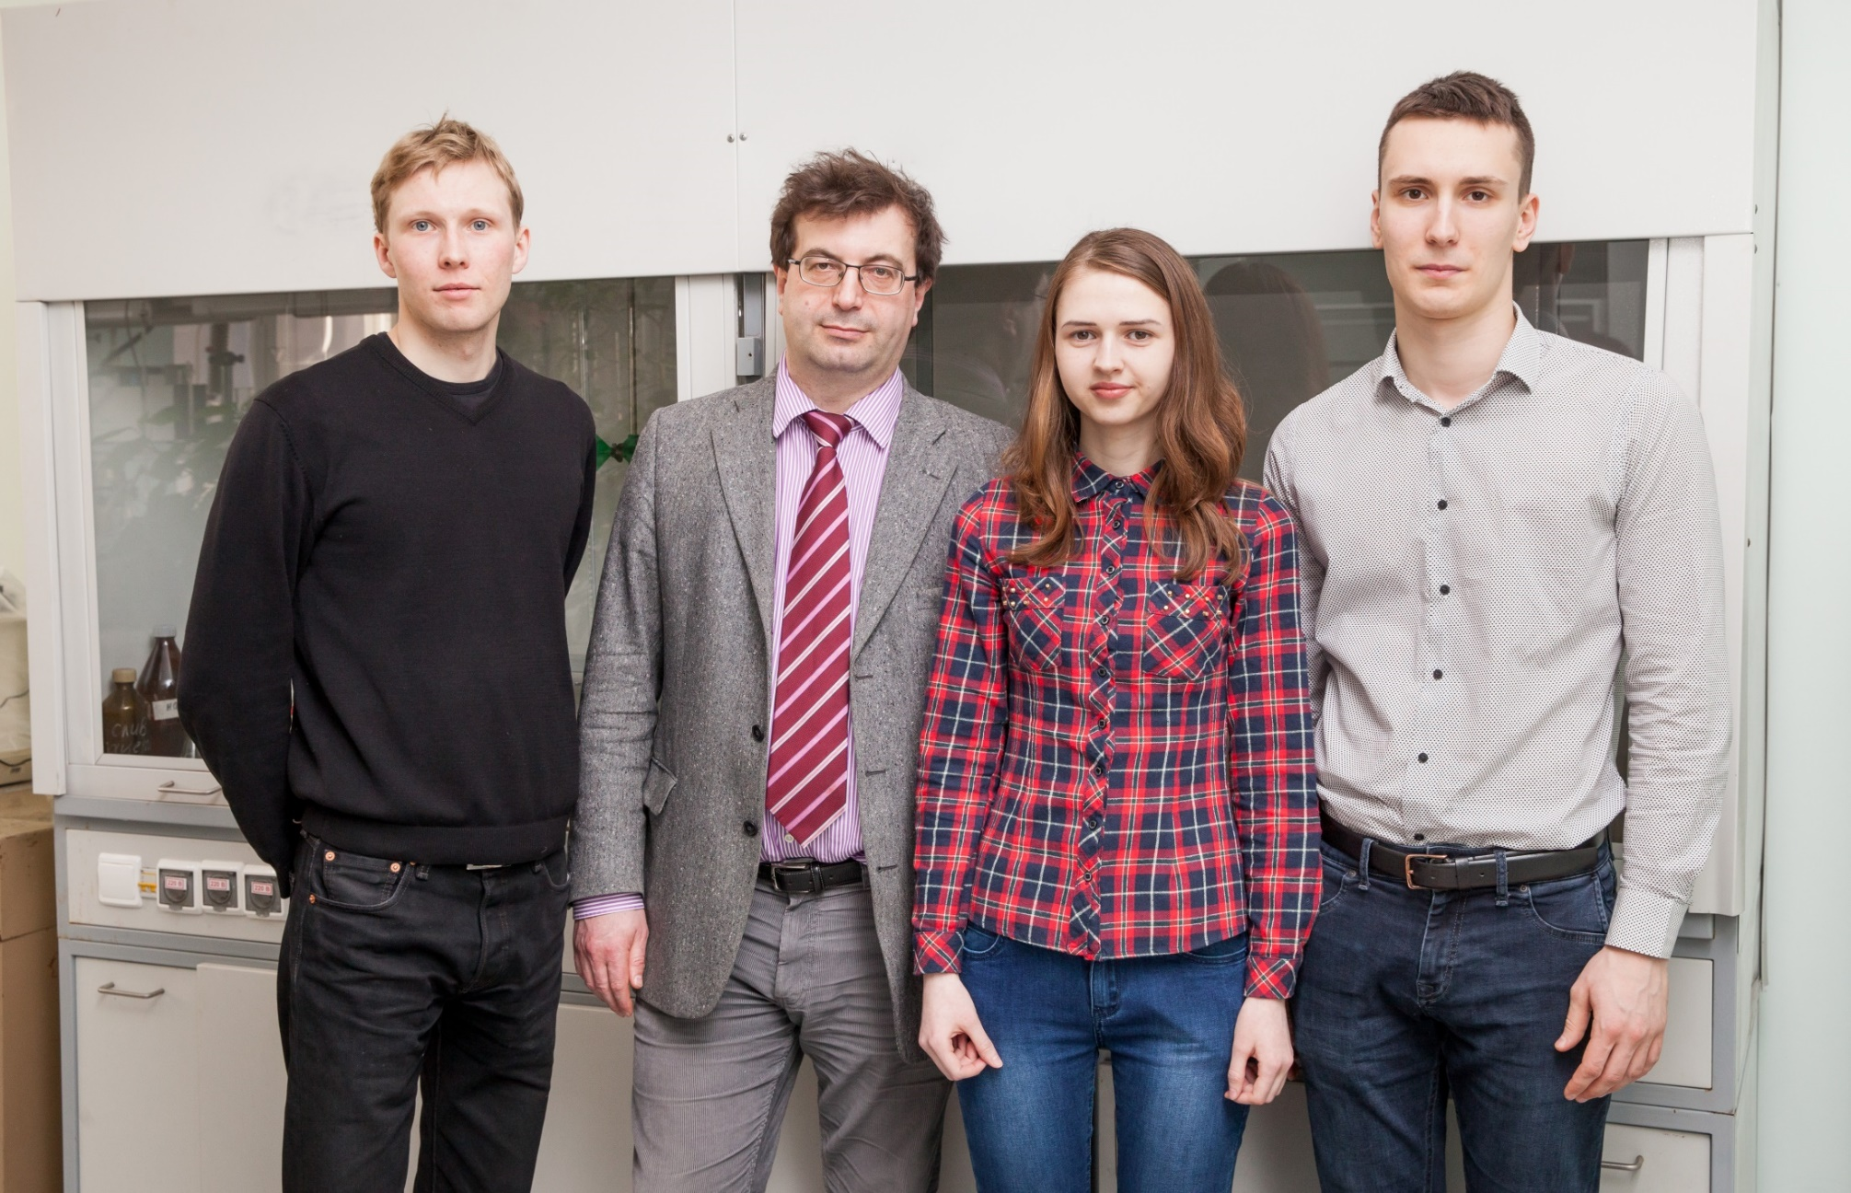
“Photoactive” group

Slide 87



Acknowledgements
Academician I.P. Beletskaya, Lomonosov Moscow state University
Academician O.I. Koifman, Ivanovo Technological University
Academician Yu.G. Gorbunova, Frumkin Institute of Physical Chemistry and Electrochemistry RAS
Dr. I. Balalaeva, N. Peskova, L. Krylova — Lobachevsky University
Prof. D. Belykh, Komi Scientific Center, Syktyvkar
Pros. H.-G. Schmalz, Cologne University, Germany
РНФ №21-73-10230

Slide 88
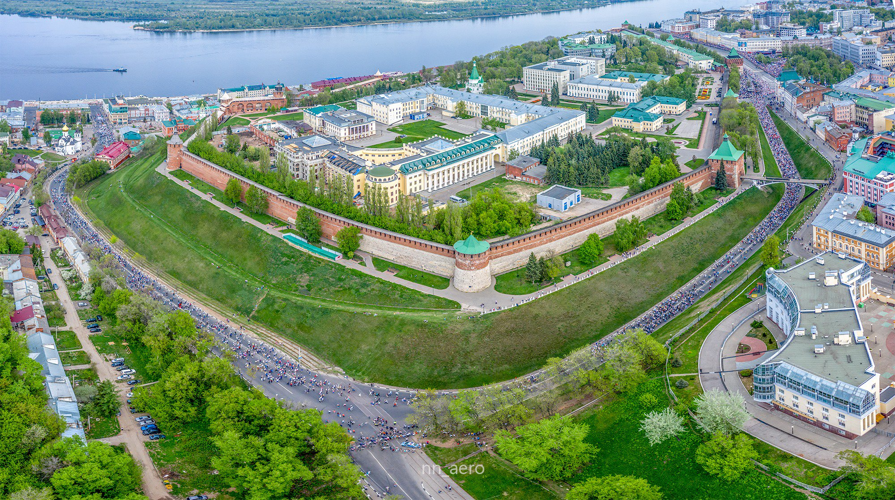

Slide 89
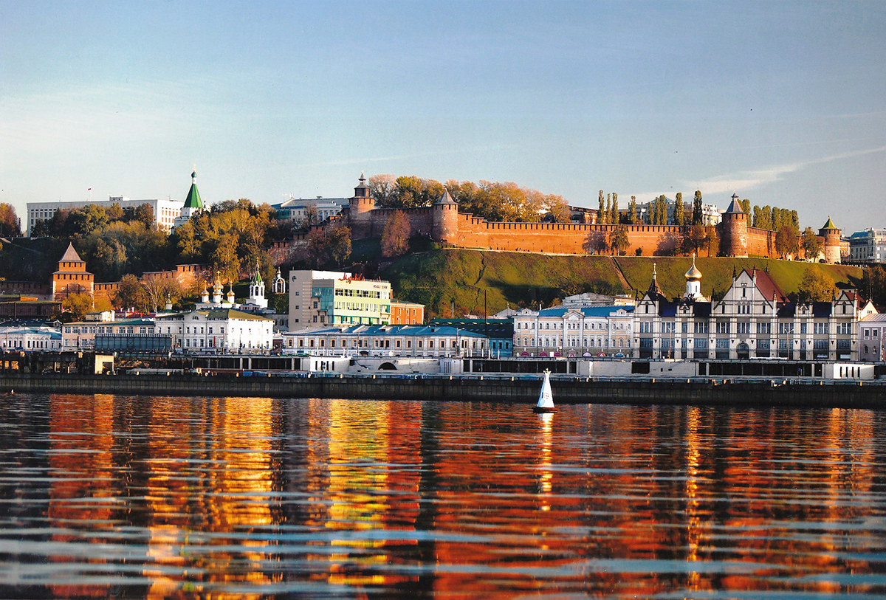

Slide 90
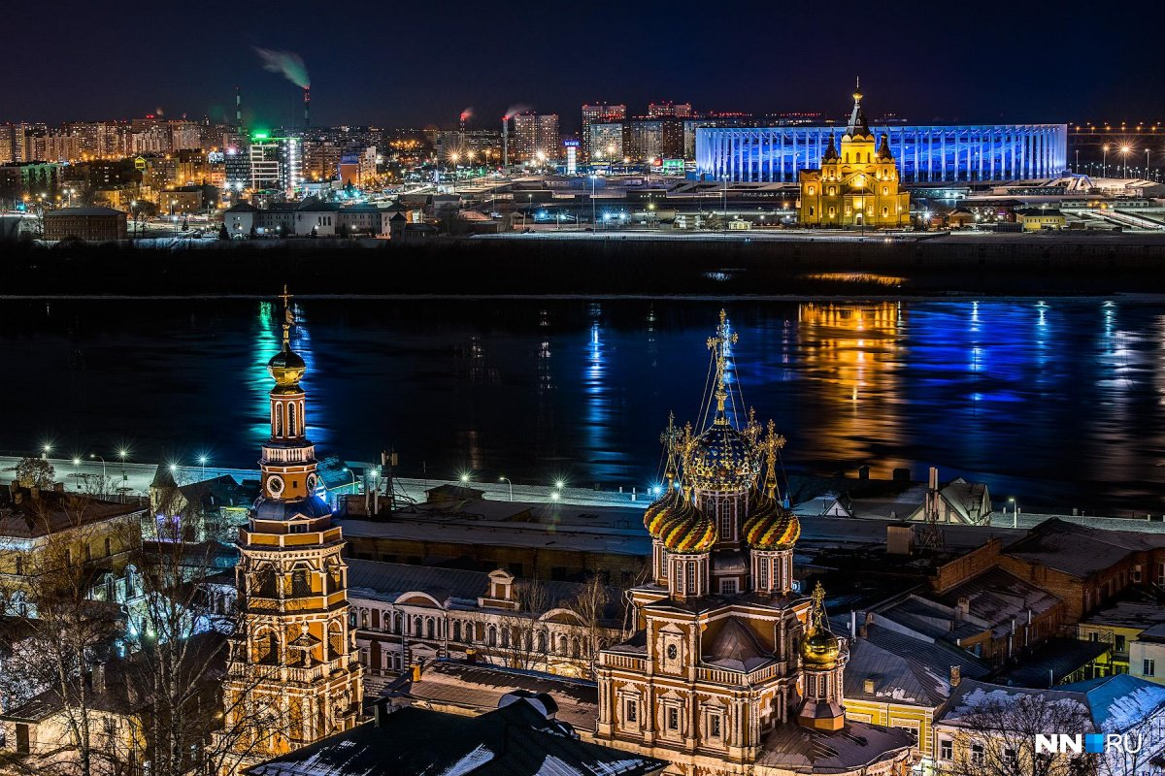

Slide 91
Thank you for your kind attention!

