Slide 1

LOW-SYMMETRY TRIBENZOPORPHYRAZINES:
A PROMISING PLATFORM FOR
THE CREATION OF THERANOSTIC AGENTS
XIV International conference
"Synthesis and application of porphyrins and their analogues"
S.D. Bondarenko, P.A Mikhina, A.A. Balakina, P.A. Tarakanov, D.V. Mishchenko

Slide 2
Purpose of work:
The study of photophysical and photochemical properties of compounds from the class of
1,4-diazepinoporphyrazines
as promising theranostic agents

Slide 3
Research objectives
To reveal the intensity of singlet oxygen generation by photosensitization with compounds of the tribenzo-1,4-diazepinoporphyrazine class;
To establish the effect of the studied compounds on the intensity of lipid peroxidation processes in the presence of laser irradiation;
To determine the cytotoxic effect of 1,4-diazepinoporphyrazines on tumor cells after photobleaching;
To study the effect of model media on the fluorescence of compounds in vitro;
To establish the possibility of accumulation and excretion of PS in vivo and in the organs of laboratory animals.

Slide 4
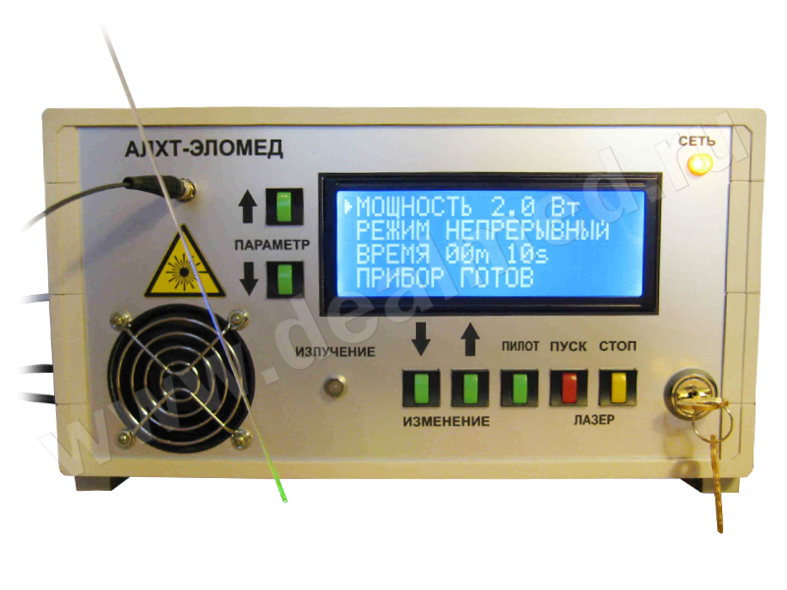
EQUIPMENT USED
Multifunctional Microplate Spectrophotometer TECAN SPARK 10M
VISQUE InVivo Smart-LF system for visualization and analysis of fluorescent, bioluminescent signals
Photosensitization was performed on a laser machine АЛХТ-ЭЛОМЕД
30 min
λ – 670 nm
P – 0,25 W

Slide 5
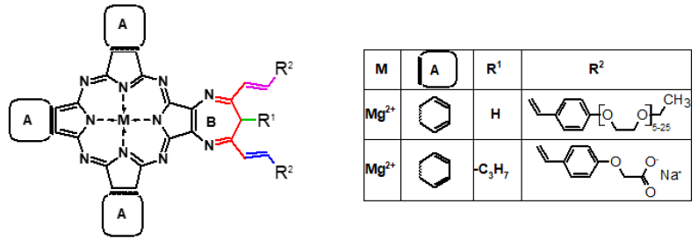
Исследуемые диазепинопорфиразины
Electronic absorption spectra in DMSO

Slide 6
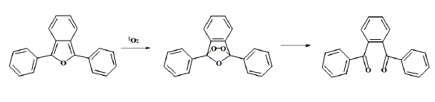
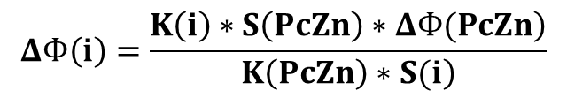
Irradiation: for 1 sec with λ – 670 nm
λ (DPBF) – 413 nm
PS | λ_{max}, нм Q-полоса | Выгорание ФС, % (30 сек) | ΔΦ(¹О₂), %
PcZn | 672 | 4,1 | 65,0
PEG | 666; 711 | 2,9 | 30,0 ± 2,0
S27_Na | 666; 709 | 1,4 | 7,4 ± 1,9
$$ΔФ\left(i\right)=\frac{\left.K\left(i\right)∗S\left(PcZn\right)∗ΔФ(PcZn\right)}{\left.K\left(PcZn\right)∗S(i\right)}$$
ΔФ PcZn(¹О₂) = 65 %

Slide 7
Determination of cytotoxicity of compounds by MTT test
7,000 cells/hole
24h 10µL PS
~0,08 µM – 10 µM PS
24h PBS
Irradiation 30 min, 0,25 W 670 nm
replacement of the culture medium
24h MTT-test

Slide 9
IC₅₀ M-HeLa & А431 with PS
_{Photosensitizer}\^{Irradiation} |  | W/O | W/
HeLa | PEG | >10 µM | 1,37 ± 0,17 µM
 | PcZn-PVP |  | 0,74 ± 0,10 µM
 | PEG-PVP |  | 1,67 ± 0,01 µM
 | S27-PVP |  | >10 µM
 | S27Na |  | 1,45 ± 0,10 µM
 | S27Na-PVP | >10 мкМ | 1,39 ± 0,10 µM
A431 | S27-PVP | >10 мкМ | >10 µM
 | S27Na | >10 мкМ | 2,19 ± 0,35 µM
 | S27Na-PVP | >10 мкМ | 1,80 ± 0,07 µM

Slide 10
Evaluation of the effectiveness of lipid peroxidation
Formation of malondialdehyde during lipid peroxidation of mouse brain homogenate;
λ_{ex} ― 670 nm; P = 0,25 W; τ = 30 min; С = 1∙10⁻⁵ М

Slide 11
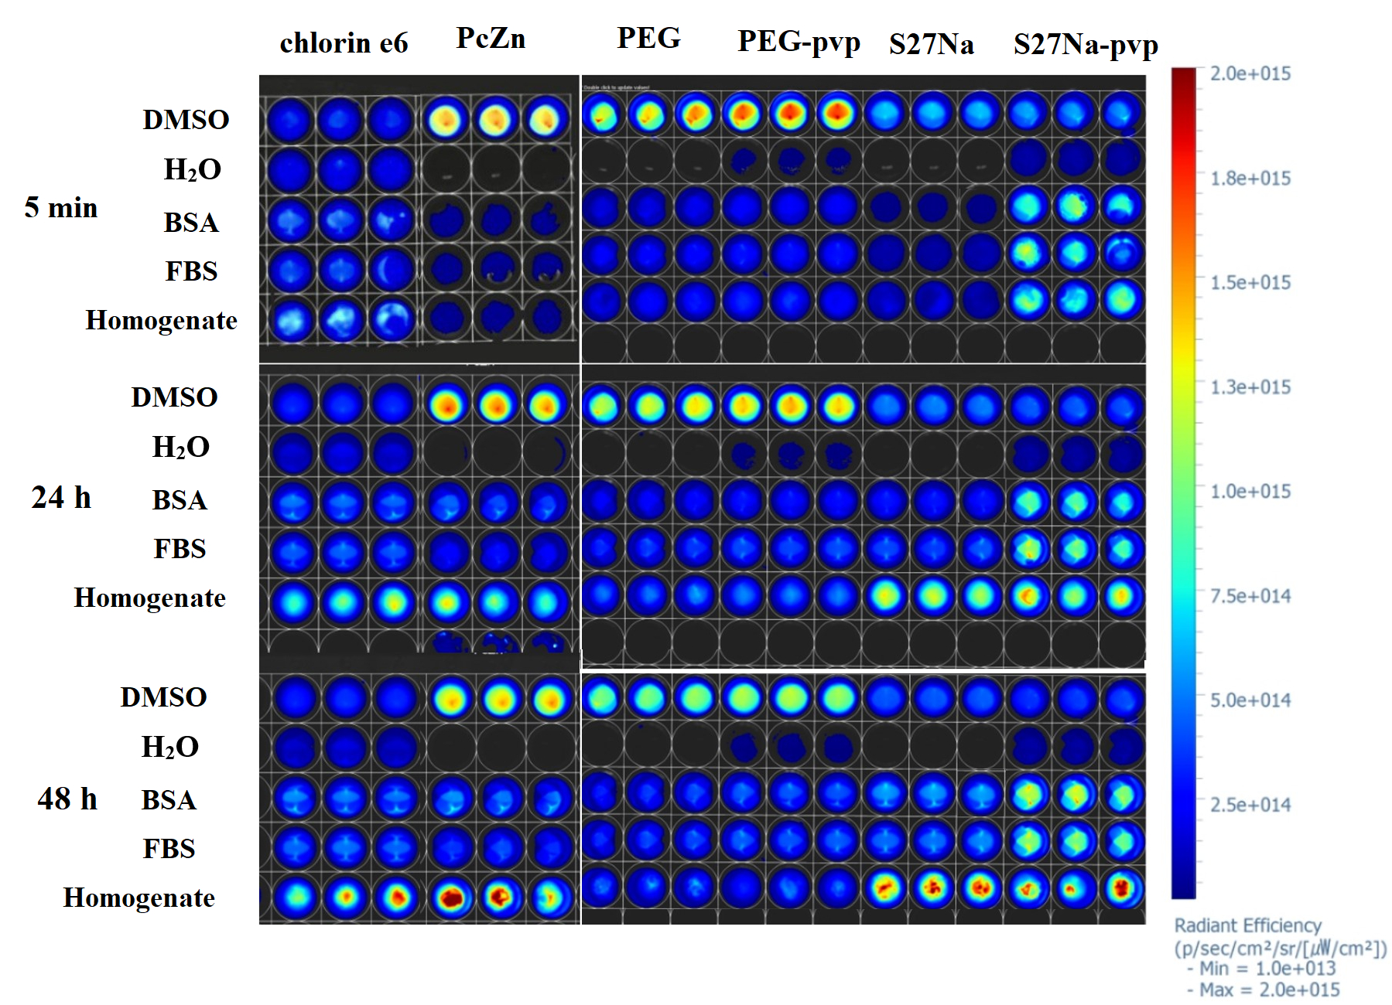
Fluorescence in vitro

Slide 12
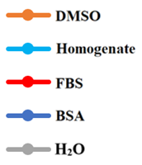

Slide 13
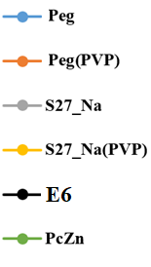

Slide 14
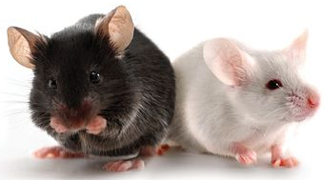
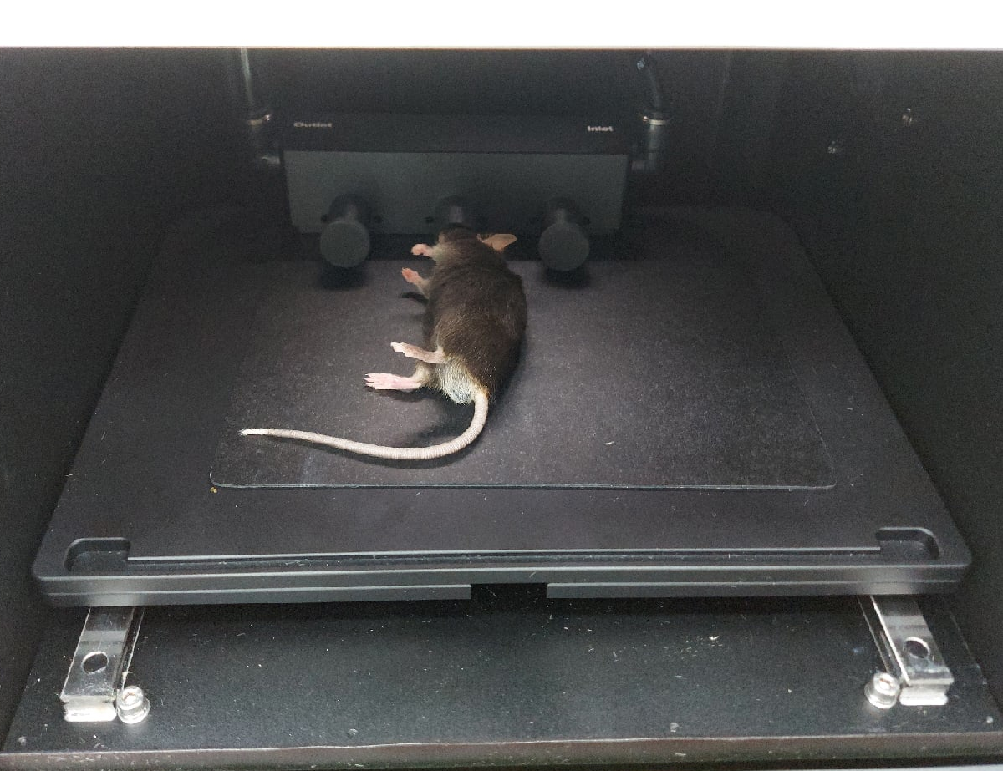
Experimental animals used
BDF1 – black mice with carcinoma Ca755
Anesthesia with isoflurane
2-chloro-2-(difluoromethoxy)-1,1,1-trifluoro-ethane
Shaved the wool
Steamed the tail in hot water
Injected drugs into the tail vein
(0.8 ~ 2 mg/kg)

Slide 15
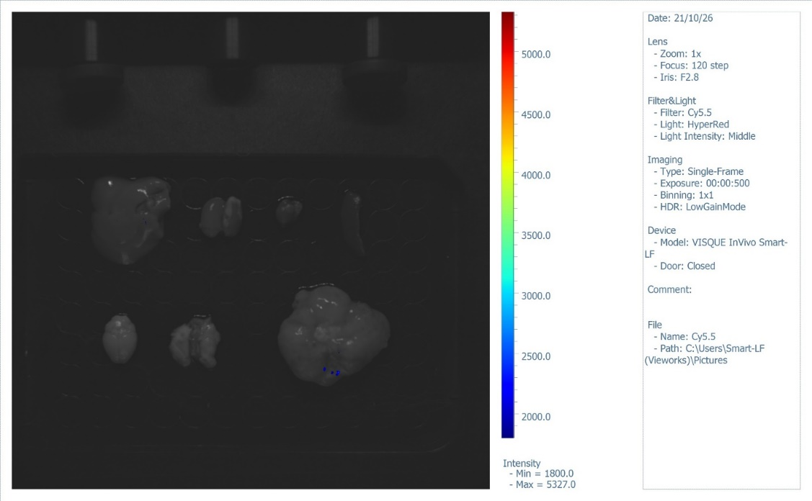
BDF1 Ca755 (back and belly)
Internal organs

Slide 16
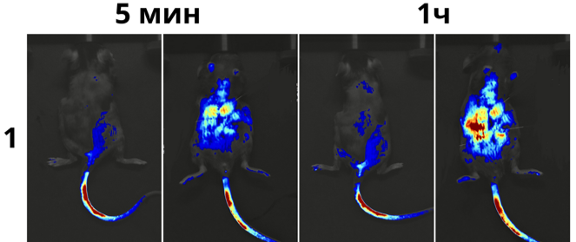
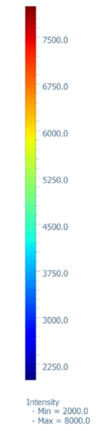
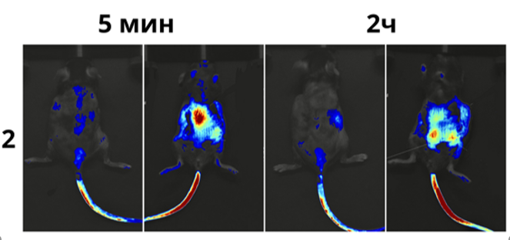
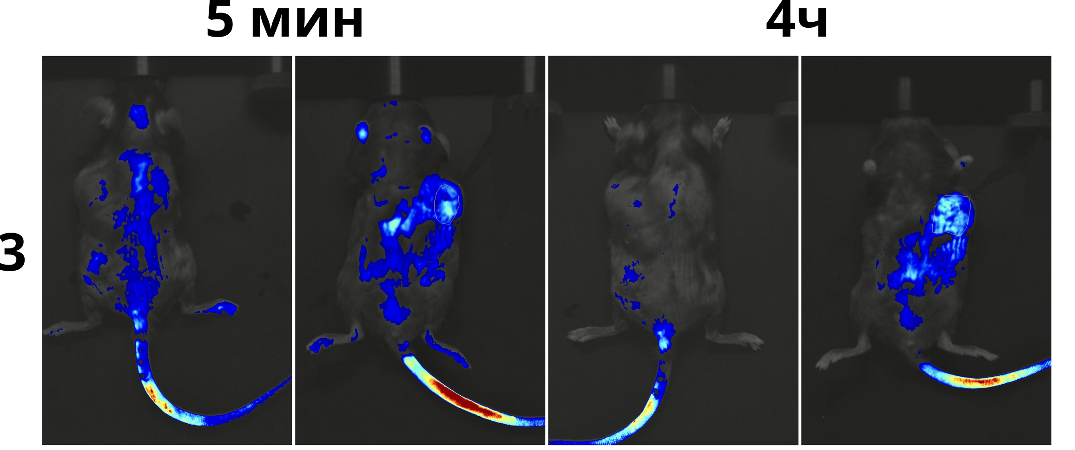
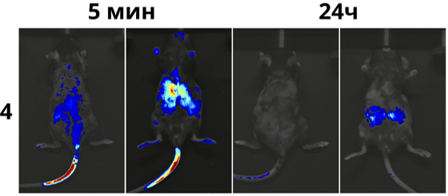
Fluorescence of chlorin e6 in vivo for 24 hours
2 mg/ kg
Left - back, right - belly

Slide 17
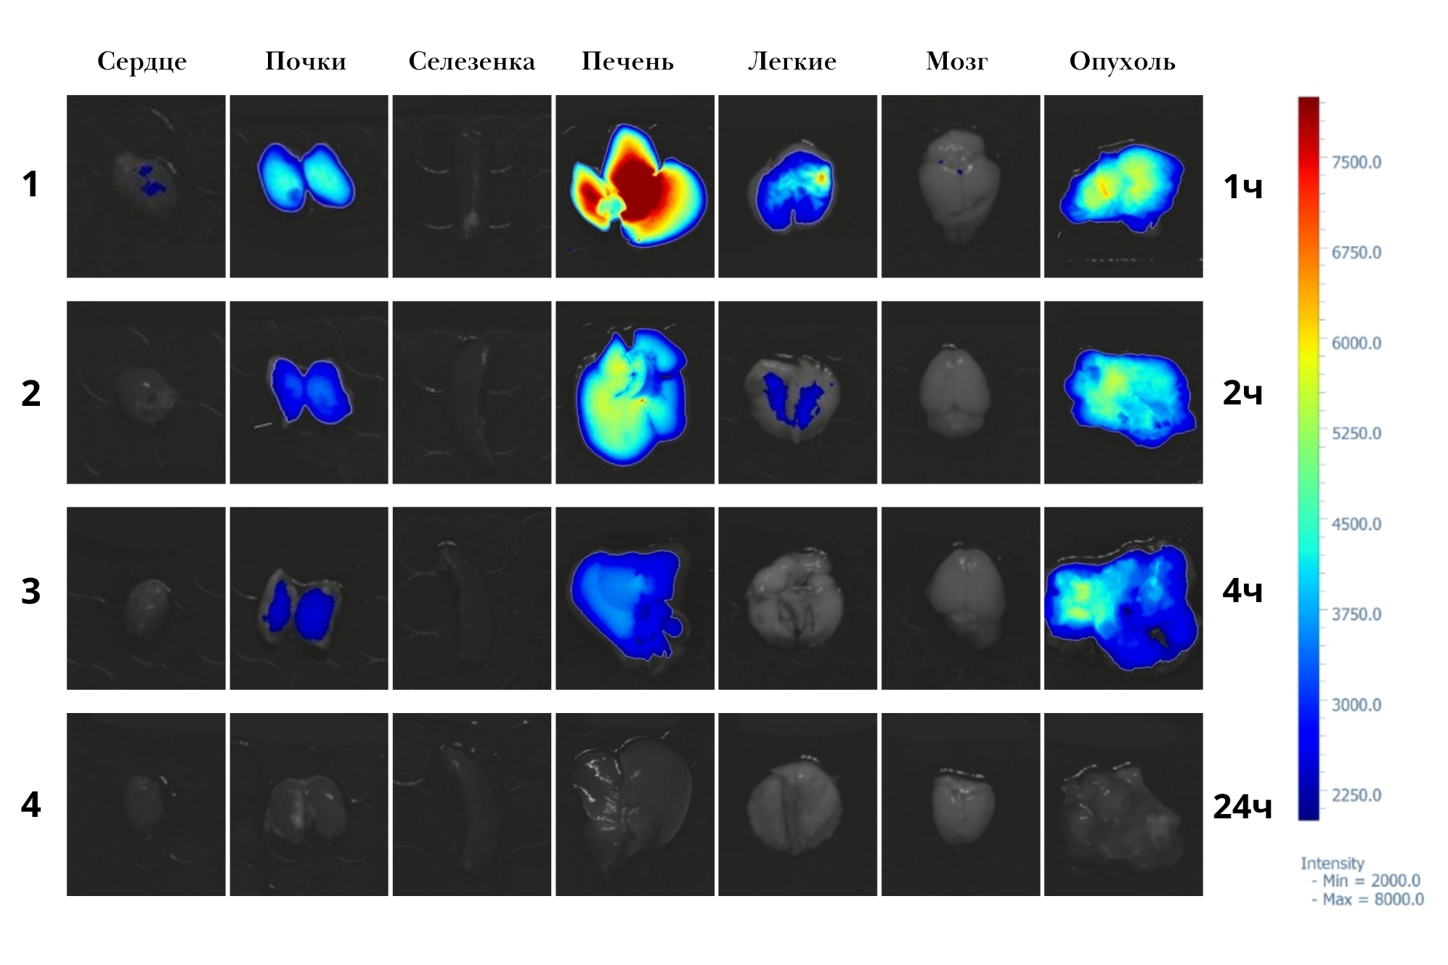
Organs after injection of chloride e6 (2 mg / kg) at different time intervals

Slide 18
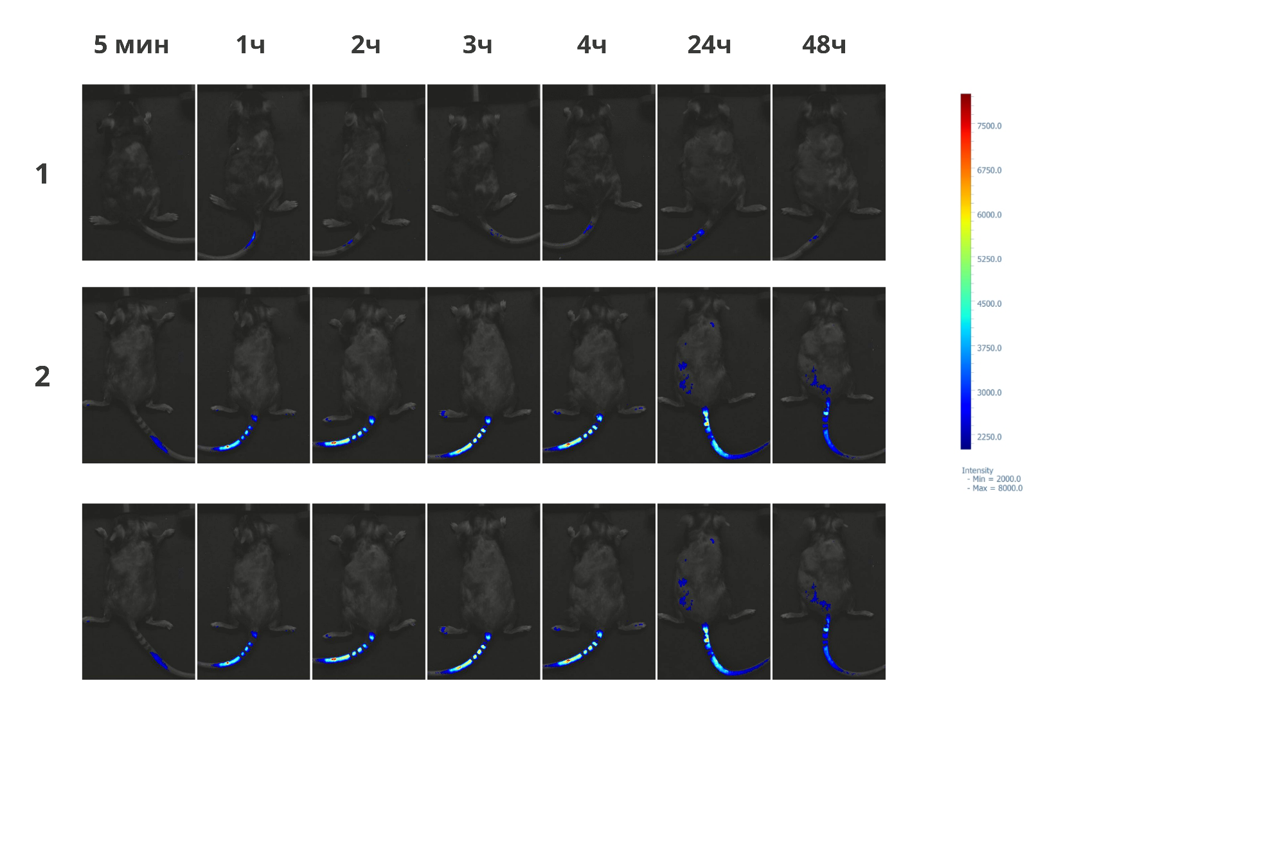
Fluorescence of S27_Na in vivo for 24h
0.8 mg/kg

Slide 19
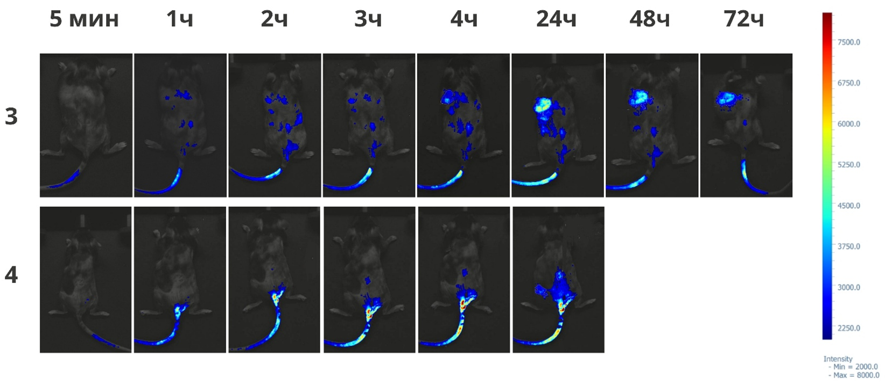
Fluorescence of S27_Na in the tumor in vivo
2 mg/kg
top – back, bottom - belly

Slide 20
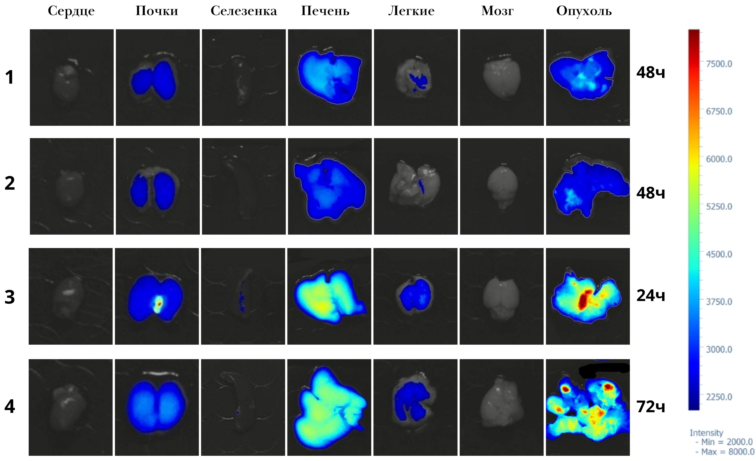
Organs after injection «S27_Na» (1,2 – 0.8 mg/kg, 3,4 – 2 mg/kg)

Slide 21
Conclusions
The quantum yields of singlet oxygen generation are calculated;
The effectiveness of tribenzo-1,4-diazepinoporphyrazines on the processes of LOP was studied by the example of the formation of MDA in PDT;
The dose-dependent nature of the cytotoxic effect of the studied compounds has been established. Without irradiation, the compounds showed no cytotoxic effect in the studied concentrations;
In in vitro experiments, as the model systems approach real biological conditions, an increase in the intensity of fluorescence of PS is observed. Compounds S27_Na, Pt_Peg do not interact with biological components from the first seconds, unlike chlorin e6. For modified PS with PVP, there is an acceleration of the interaction process;
Experiments were conducted with laboratory animals. The possibility of accumulation and retention of drugs in the tumor is shown (For chlorin e6 – excretion after 3 hours).

Slide 22

СПАСИБО ЗА ВНИМАНИЕ

