Slide 1

SPECTRAL PROPERTIES, AGGREGATION BEHAVIOR IN SOLUTIONS AND
NANOSTRUCTURED DELIVERY SYSTEMS OF
BORON(III)DIPYRROMETHENE LUMINOPHORS
Antina L.A., Kalinkina V.A., Kalyagin A.A., Berezin M.B., Antina E.V.
Conference cluster 2021
Antina L.A. et.al.

Slide 2
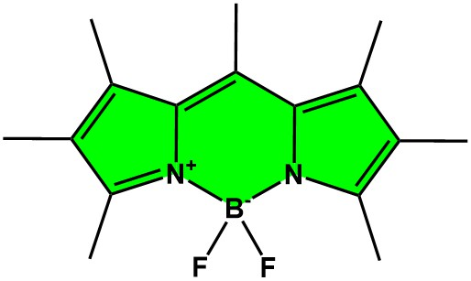


Excellent photophysical properties of BODIPYs:
strong absorption and fluorescence throughout the UV–vis region which could be tuned towards the near-IR region;
high molar extinction coefficient and fluorescence quantum yield;
BF₂-dipyrromethene complexes
high photochemical and thermal stability;
ease synthetic functionalization;
tunable electronic and photonic properties;
low cytotoxicity and good biocompatibility.
G.A. Krestov Institute of Solution Chemistry of the Russian Academy of Sciences, Russia

Slide 3
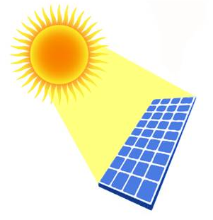
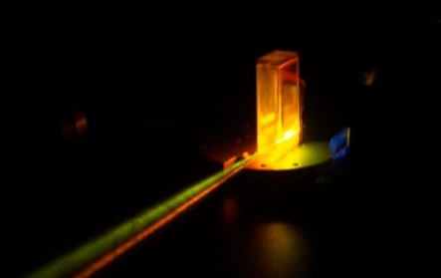
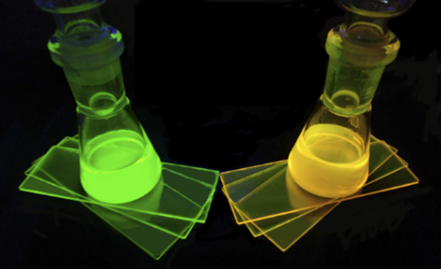
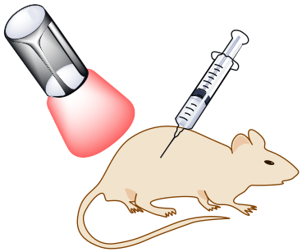
APPLICATION POSSIBILITIES OF BODIPYs:
OPTICAL DEVICES
BIOMEDICAL
laser dyes
photodynamic therapy
organic light-emitting diodes (OLEDs)
luminescence bioimaging
fluorescent sensors
biological labeling
electron-transporting materials (ETMs)
drug delivery agents
G.A. Krestov Institute of Solution Chemistry of the Russian Academy of Sciences, Russia

Slide 4
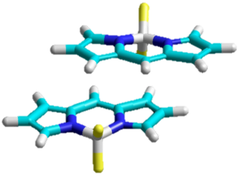
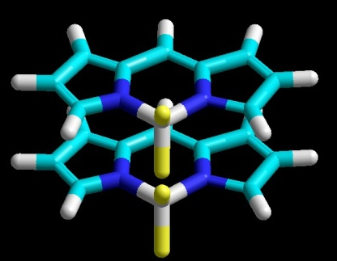

Practical use limitations of BODIPYs:
Aggregation caused emission quenching (ACQ) effect ;
weak fluorescence
of BODIPYs in the
solid-state
and water-organic
systems
Self-absorption induced by small Stokes shift;
High hydrophobicity.
H-aggregate
J-aggregate
Problems !!!
strong intermolecular interactions
(π-π stacking) induced by planar π-conjugated structures
G.A. Krestov Institute of Solution Chemistry of the Russian Academy of Sciences, Russia

Slide 5
BODIPY PROBLEM SOLVING STRATEGIES
Construction of efficient fluorescent BODIPYs aggregates
2
Use of nanoscale BODIPY carriers:
1
HOW DOING THIS???
WHAT KIND???
Metal-organic frameworks (MOFs);
BODIPY structure design
Metal-organic cages (MOCs);
Changе environmental conditions
Micelles;
Сarbon nanoparticles;
AIE-type molecules
Environment nature
Polymer capsules;
Water-soluble molecules
Temperature, pH…
G.A. Krestov Institute of Solution Chemistry of the Russian Academy of Sciences, Russia

Slide 6
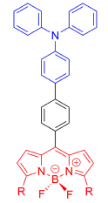
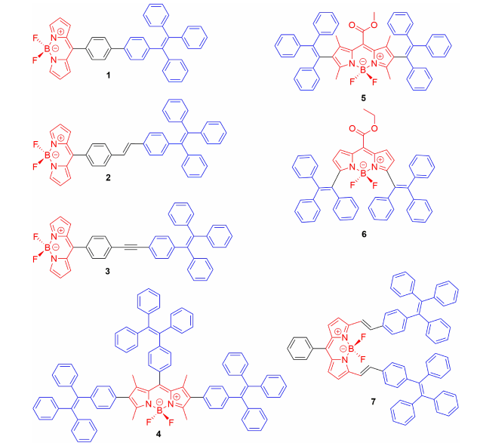
BODIPY structural modification
introduction of bulky aryl substituents
two main directions
into the ms-spacer and
α, β -positions of pyrrole nuclei
introduction of extended aliphatic alkyl substituents
meso position
β positions
β positions
1
8
7
R_{meso}
2
6
4
3
5
α position
α position
https://doi.org/10.3389/fchem.2019.00712
doi:10.1016/j.apsusc.2017.04.014
http://dx.doi.org/10.1007%2Fs00706-019-02521-4
G.A. Krestov Institute of Solution Chemistry of the Russian Academy of Sciences, Russia

Slide 7
Objects
"luminophore structure → conditions → properties of supramolecular structures"
meso; meso/α subtitution
BDP1
BDP2
BDP3
BDP4
β subtitution
BDP5
BDP6
BDP7
BDP8
Aggregation behavior of BODIPYs in water-organic mixtures / mono- and multilayer Langmuir-Schaefer (LS) films
G.A. Krestov Institute of Solution Chemistry of the Russian Academy of Sciences, Russia

Slide 8
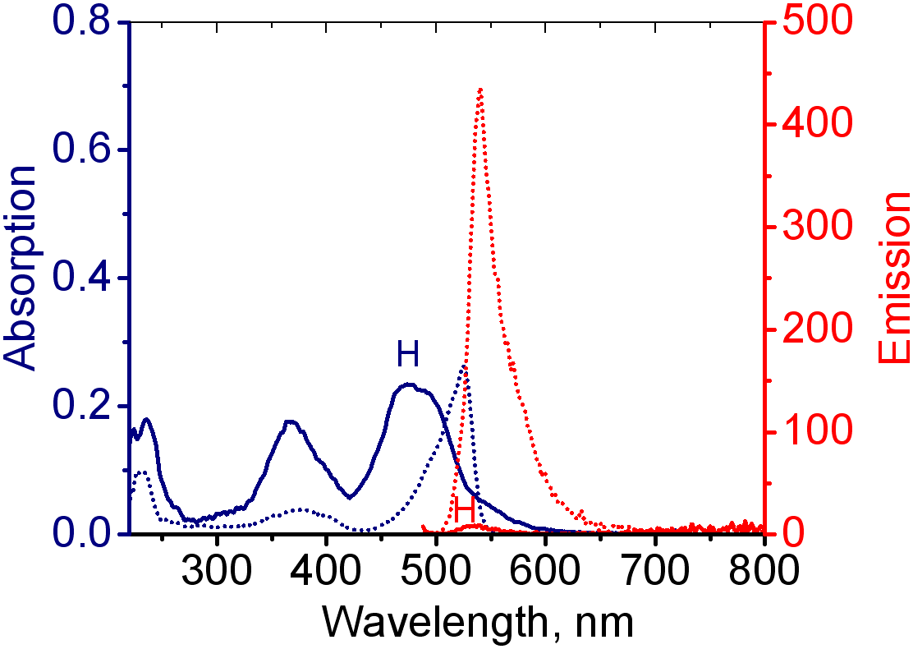
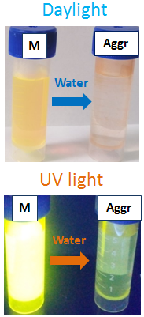
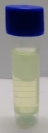
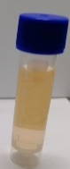
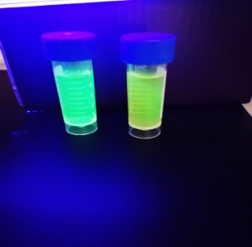
Aggregation behavior of BDP1 and BDP5 in water-organic mixtures
C_{BDP1}, μM
C_{BDP1}, μM
Daylight
H-aggregation
UV light
Absorption
monomer
aggregates
Emission
The absorption and emission spectra of BDP1 in TGF-water mixture (f_{w}=97,5%) at different concentrations of BDP1
The absorption and emission spectra of BDP5 in ACN-water mixtures
BDP1
BDP5
G.A. Krestov Institute of Solution Chemistry of the Russian Academy of Sciences, Russia

Slide 9
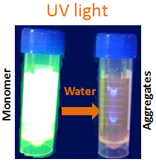
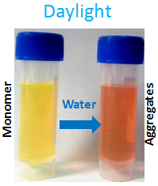
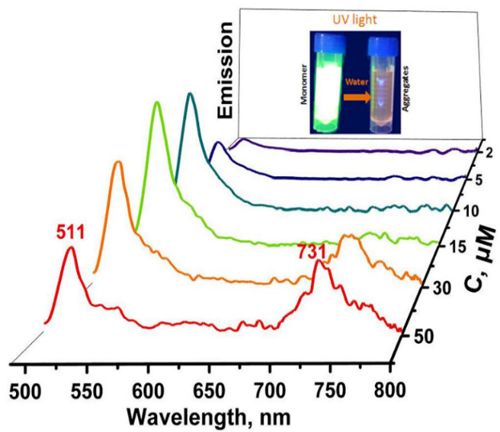
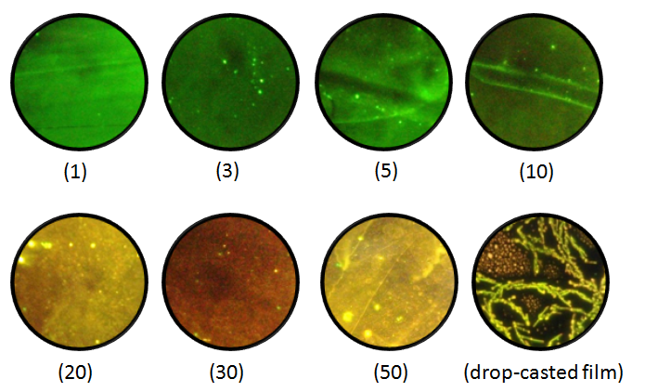
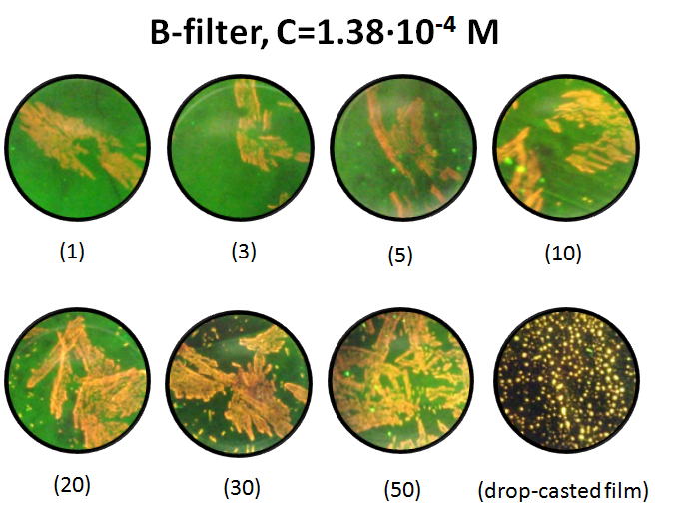
Aggregation behavior of BDP2 – BDP4 in water-organic mixters
C_{BDP2}, μM
J-aggregation
H- and J-aggregation
BDP2
The absorption BDP2 in ACN-water mixture (f_{w}=97,5%) at different concentrations BDP2.
The emission spectra of BDP2 in ACN-water mixture (f_{w}=97,5%) at different concentrations of BDP2.
The absorption and emission spectra of BDP4 in TGF-water mixtures (C_{BDP3}=6.5 μM) with varied volumetric fractions of water (f_{w})
BDP2
BDP3
BDP4
The fluorescent micrographs of LS- and drop-casted films of BDPs, filter with λ_{ex} = 410–490 nm (n is the touchdowns number)
The absorption spectra of BDP4 in TGF-water mixture (f_{w}=97,5%) at different concentrations of BDP3
G.A. Krestov Institute of Solution Chemistry of the Russian Academy of Sciences, Russia

Slide 10
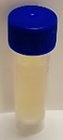
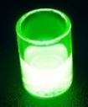
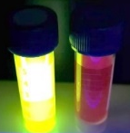
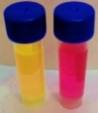
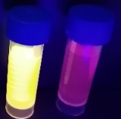
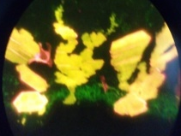
Aggregation behavior of BDP6-BDP8
H- and J-aggregation
50 mkM BDP6
50 mkM BDP6
UV light
Visible light, 98.5% H₂O
UV light
UV-light, ACN
Visible light
ACN
H₂O
ACN
H₂O
The absorption and emission spectra of BDP6 in ACN-water mixtures (C_{BDP6}=6.5 μM) with varied volumetric fractions of water (f_{w})
The absorption and emission spectra of BDP6 in ACN-water mixtures
(f_{w} = 97.5%) at different concentrations of BDP6
Drop-cast
f_{W}=0%
f_{W}=97.5%
The absorption and emission spectra of BDP7 in TGF-water mixtures (C_{BDP7}=6.5 μM) with varied volumetric fractions of water (f_{w})
The absorption spectra of BDP8 in ACN-water mixtures
(f_{w} = 97.5%) at different concentrations of BDP8
G.A. Krestov Institute of Solution Chemistry of the Russian Academy of Sciences, Russia

Slide 11
The influence of BODIPYs structure design on aggregation behavior of BODIPYs
meso subtitution
meso/α subtitution
J-aggregation
H- + J- aggregation
β subtitution
H-aggregation
H- + J- aggregation
G.A. Krestov Institute of Solution Chemistry of the Russian Academy of Sciences, Russia

Slide 12
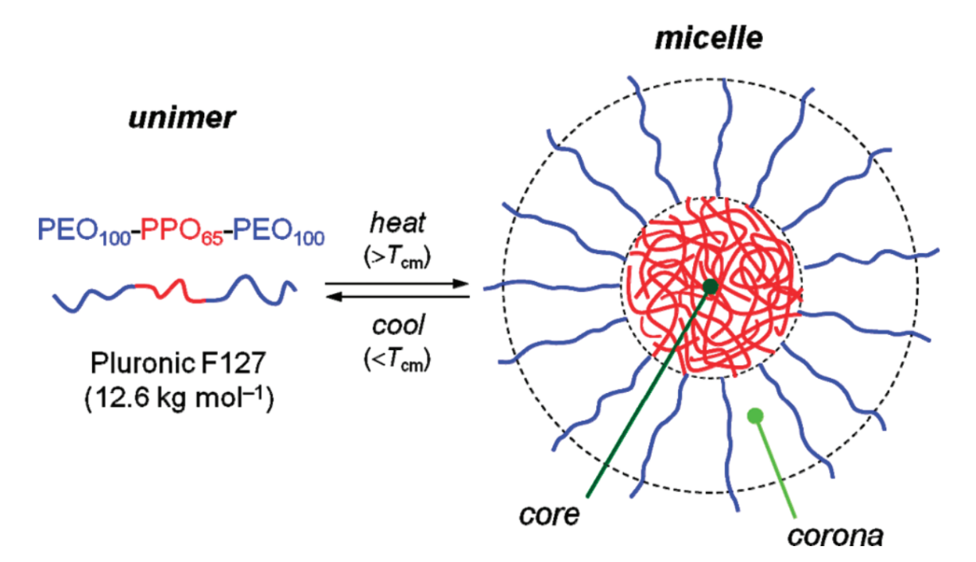
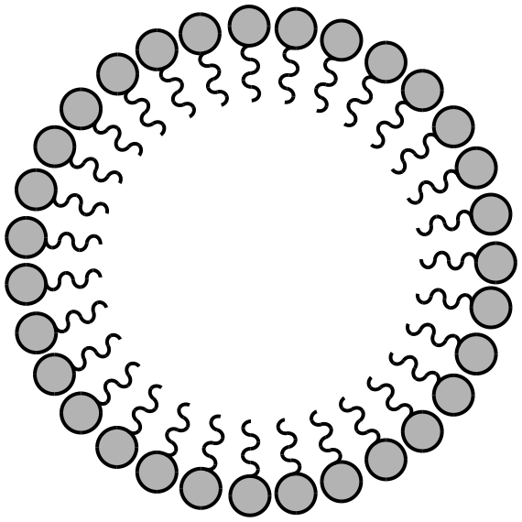
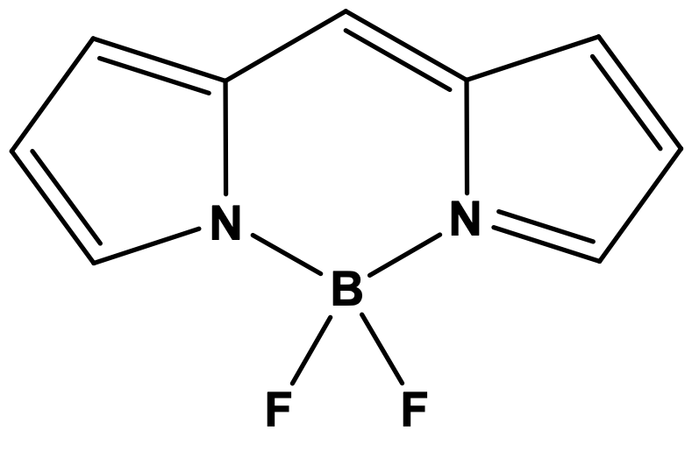
Pluronic micelles for BODIPYs solubilization
Hal-BDP
Bistyryl-BDP
Monostyryl-BDP
Bistyryl-ОН BDP
BDP conjugates with terpenoids
Pluronic block copolymer molecule
Micelle with a solubilized dye
G.A. Krestov Institute of Solution Chemistry of the Russian Academy of Sciences, Russia

Slide 13
Preparation of BDP4 - loaded Pluronic® F127 micelles
thin-film method
Bistyryl-BDP
Control of aggregation and increasing the solubility of distyryl-BDP in aqueous media
Nature of the initial organic solvent.
Solubilization efficiency. Increase in Pluronic® concentration at constant dye concentration
Solubilization capacity. Increasing BDP сoncentration at сonstant Pluronic® сoncentration
Ambient conditions: temperature, nature of the buffer solution, pH, etc.
G.A. Krestov Institute of Solution Chemistry of the Russian Academy of Sciences, Russia

Slide 14
Pluronic micelles for BODIPYs solubilization
Absorption and fluorescence spectra of distyryl-BDP (C_{BDP4} = 7·10⁻⁶ mol/L) in water at different Pluronic® concentrations (λ_{ex} = 600 nm, gap 5) and the dependences of the absorbance and fluorescence intensity of distyryl-BDP on the content of Pluronic® F127 in water.
τ_{BPD4–Pl} (Н₂О) = 2.07 ns;
τ_{BPD4–Pl} (PBS) = 2.15 ns;
τ_{BPD4-Pl} (THF) = 2.41 ns.
QY_{BPD4–Pl} (Н₂О) = 19%;
QY_{BPD4–Pl} (PBS) = 20%;
QY_{BPD4} (THF) = 22%
The dependence of the fluorescence quantum yield and the fluorescence lifetime of BDP4 vs. the organic solvent nature
G.A. Krestov Institute of Solution Chemistry of the Russian Academy of Sciences, Russia

Slide 15
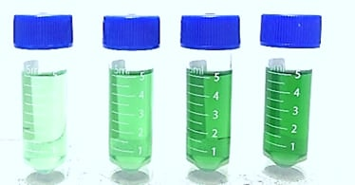
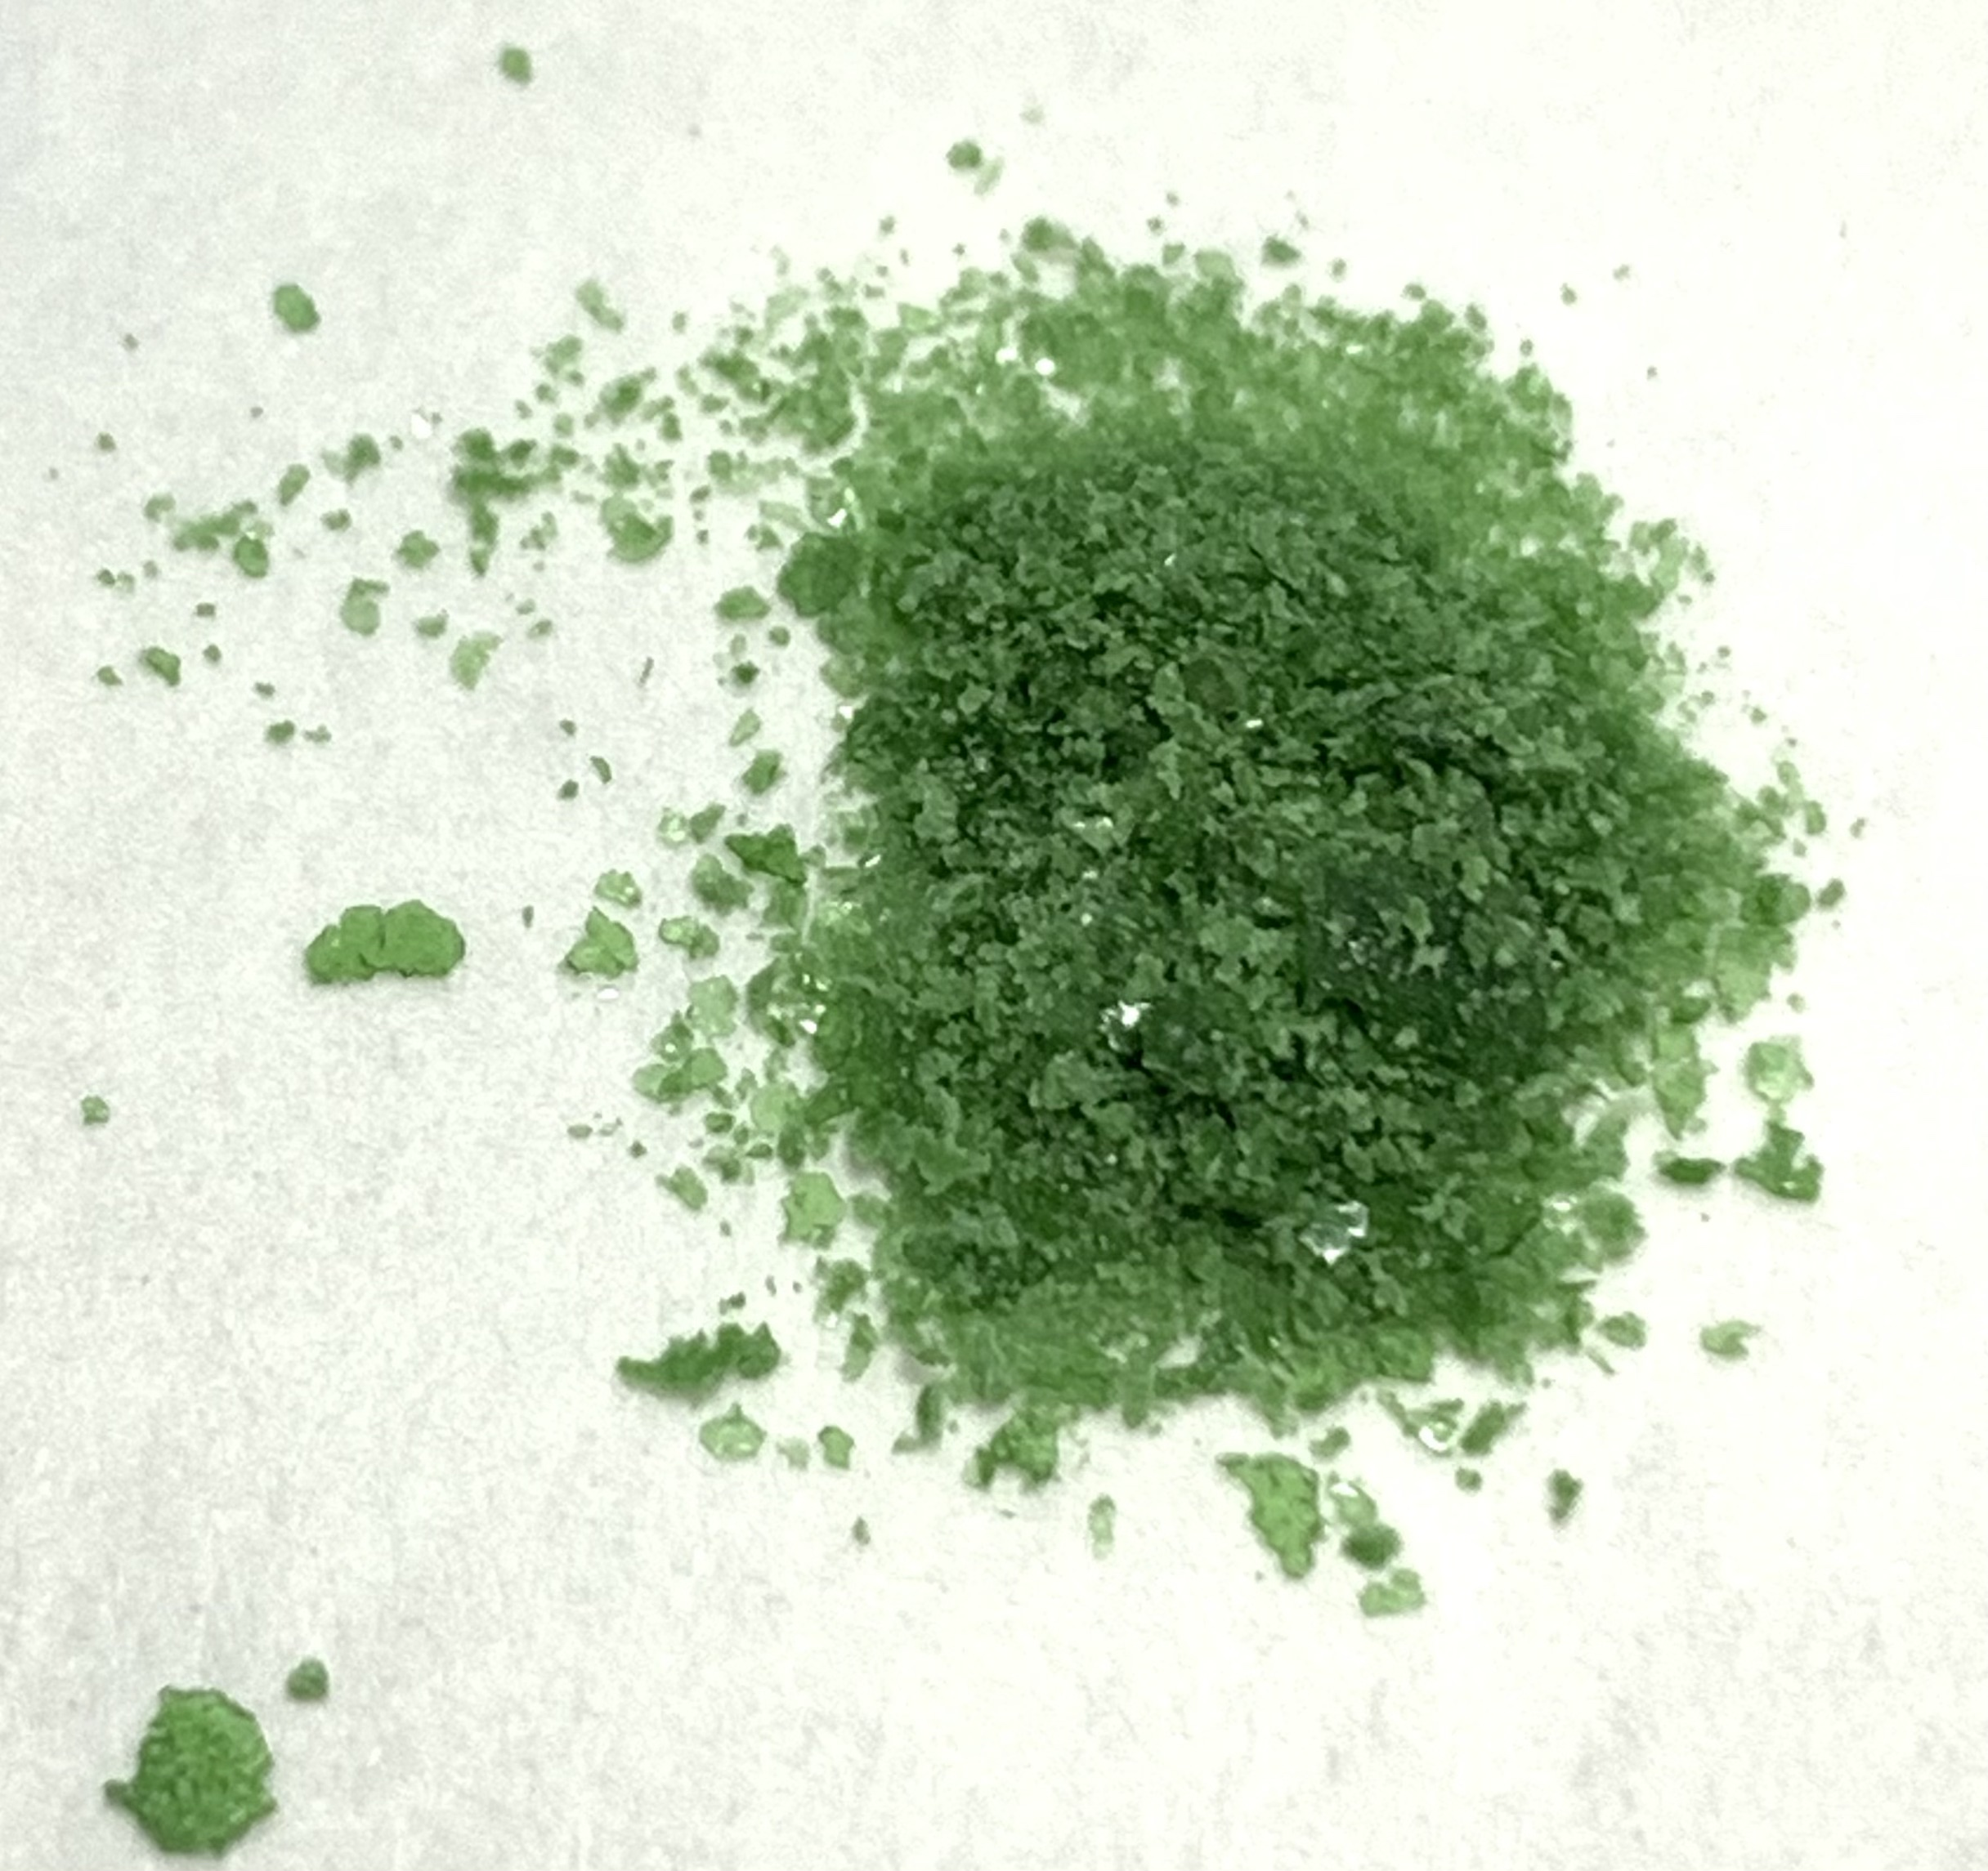
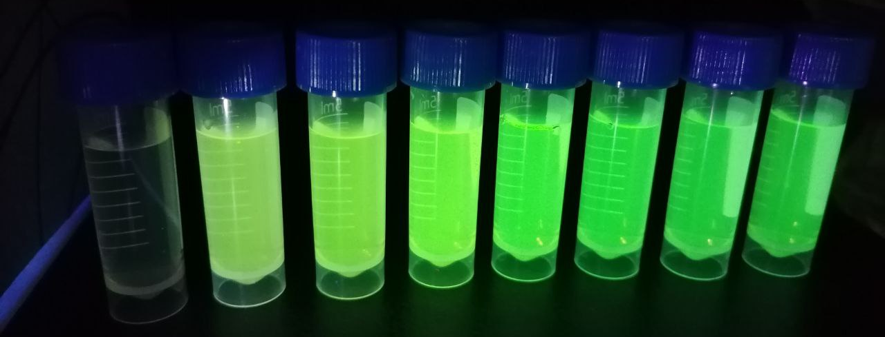
Pluronic micelles for BODIPYs solubilization
Absorption and fluorescence (λ_{ex} = 600 nm) spectra of BDP6 in water with different dye content (C_{distyryl-BDP} = 7·10⁻⁶ ÷ to 5.25·10⁻⁵ mol/L) and a constant concentration of Pluronic® (С_{Pl} = 3.5·10⁻⁴ mol/L), (λ_{ex} = 600 nm, gap 2)
The dependences of the average diameter of distyryl-BDP–Pl micelles on different concentrations of distyryl-BDP at constant Pluronic® (C_{Pl} = 3.5·10⁻⁴ mol/L) concentration in water.
Photo of solutions of BPD4-loaded Pl micelles in water at a constant content of Pluronic® (С_{Pl} = 3.5·10⁻⁴) and an increase in the content of the dye.
Photo of solutions of BDP conjugates with terpenoids loaded Pl micelles in water at a constant content of the dye and an increase in the content of Pluronic®
G.A. Krestov Institute of Solution Chemistry of the Russian Academy of Sciences, Russia

Slide 16
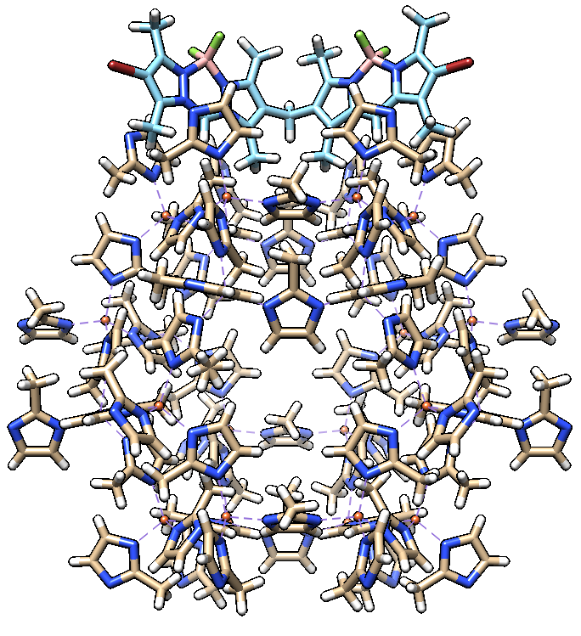
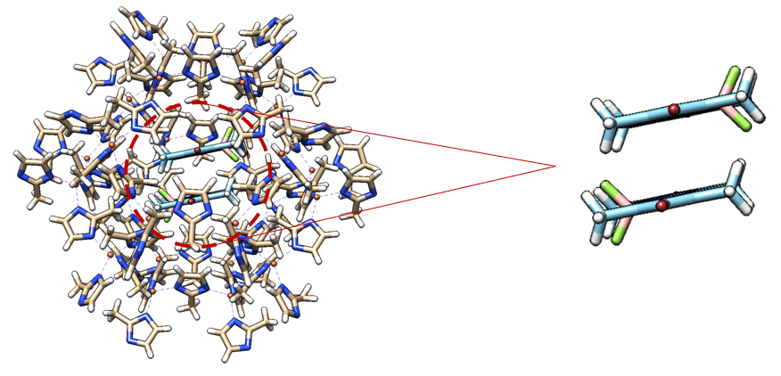
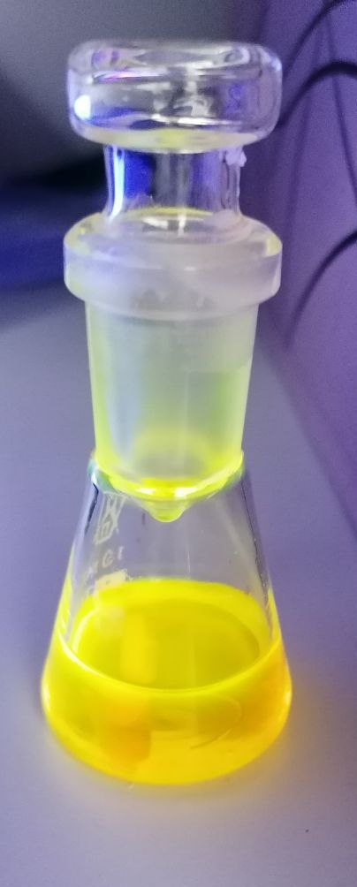
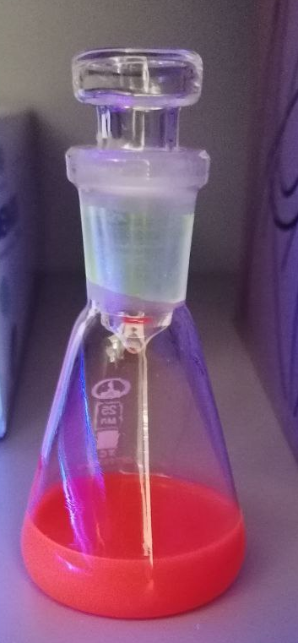
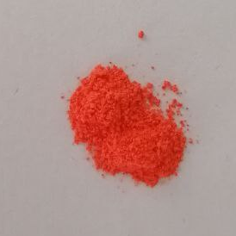
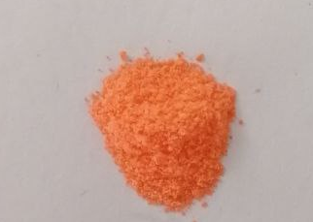
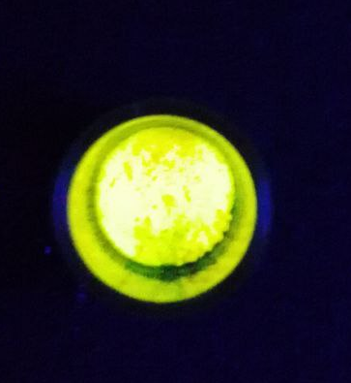
3D-architectures based on metal-organic frameworks (MOFs) for the point delivery of BODIPYs
Zif8 - BODIPY
Autodock 4.2
MOF – BODIPY
MOF – bis(BODIPY)
SEM image of BODIPY@Zif8 NPs
obtained under different synthesis conditions
One-Step synthesis of nanoscale zeolitic imidazolate frameworks with BODIPY loading
G.A. Krestov Institute of Solution Chemistry of the Russian Academy of Sciences, Russia

Slide 17
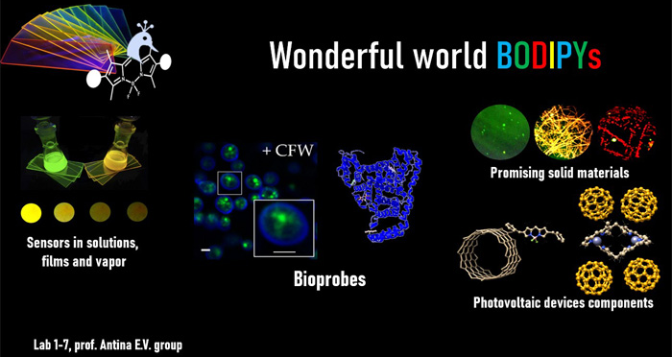

Спасибо за внимание

